Slide 1
🎮
Video Game Sales &
Engagement Analysis
EDA • Streamlit Dashboard • Insights
1,099
16,593
31
19
Games
Sales Records
Platforms
Genres
Data Analytics Project | Python • SQL • Streamlit

Slide 2
AGENDA
Project Overview
What we built and what this presentation covers
📊
Dataset Overview
🧹
Data Cleaning
2 datasets: game metadata (1,099) + sales data (16,593 records)
Removed duplicates, handled nulls, standardized columns
🔍
Exploratory Data Analysis
💰
Sales Analysis
15 charts across ratings, sales, genres, platforms & trends
Regional breakdown: NA leads at 49%, followed by EU at 27%
🚀
Streamlit Dashboard
💡
Key Findings & Conclusion
7-page interactive app with dark gaming theme & live filters
Top genres, best platforms, engagement vs sales correlation
🎮 Video Game Sales & Engagement Analysis
2 / 19

Slide 3
DATASET
Dataset Overview
Two datasets merged for comprehensive analysis
📁 games.csv — Engagement Data
💰 vgsales.csv — Sales Data
Rows
1,099 games (after cleaning)
Rows
16,593 records (after cleaning)
Columns
19 columns
Columns
13 columns
Key Fields
Rating, Plays, Wishlist, Backlogs
Key Fields
NA/EU/JP/Global Sales
🔗 469 Games Matched in Merged Dataset
Genres
19 unique genres
Platforms
31 platforms
Developers
466 unique studios
Publishers
577 publishers
Year Range
Pre-2000 to 2024
Year Range
1980 to 2020
🎮 Video Game Sales & Engagement Analysis
3 / 19

Slide 4
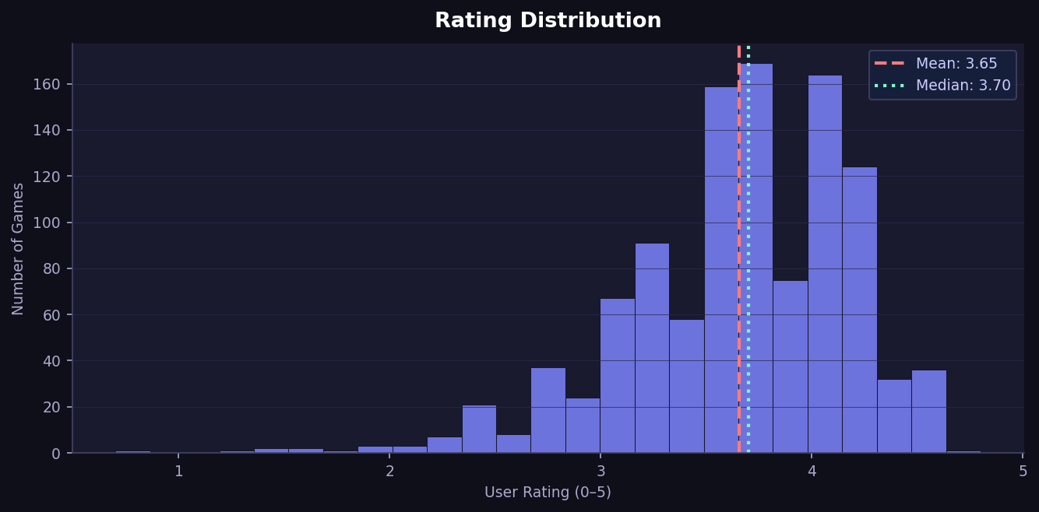
EDA
User Rating Distribution
How games are rated
3.65 / 5.0
Avg Rating
3.60 / 5.0
Median
34.2%
High Rated (4+)
18.5%
Low Rated (<3)
🎮 Video Game Sales & Engagement Analysis
4 / 19

Slide 5
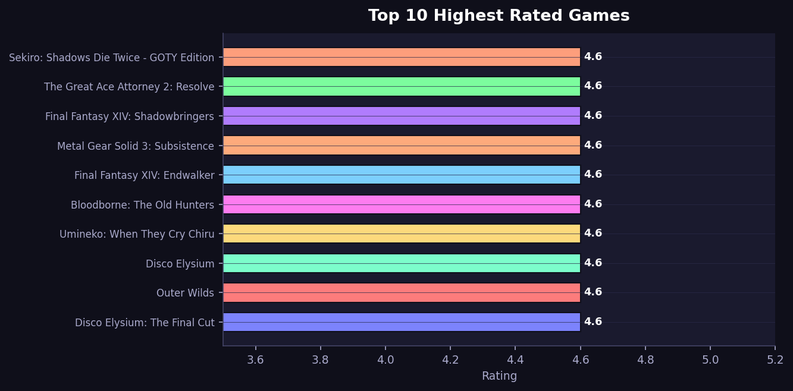
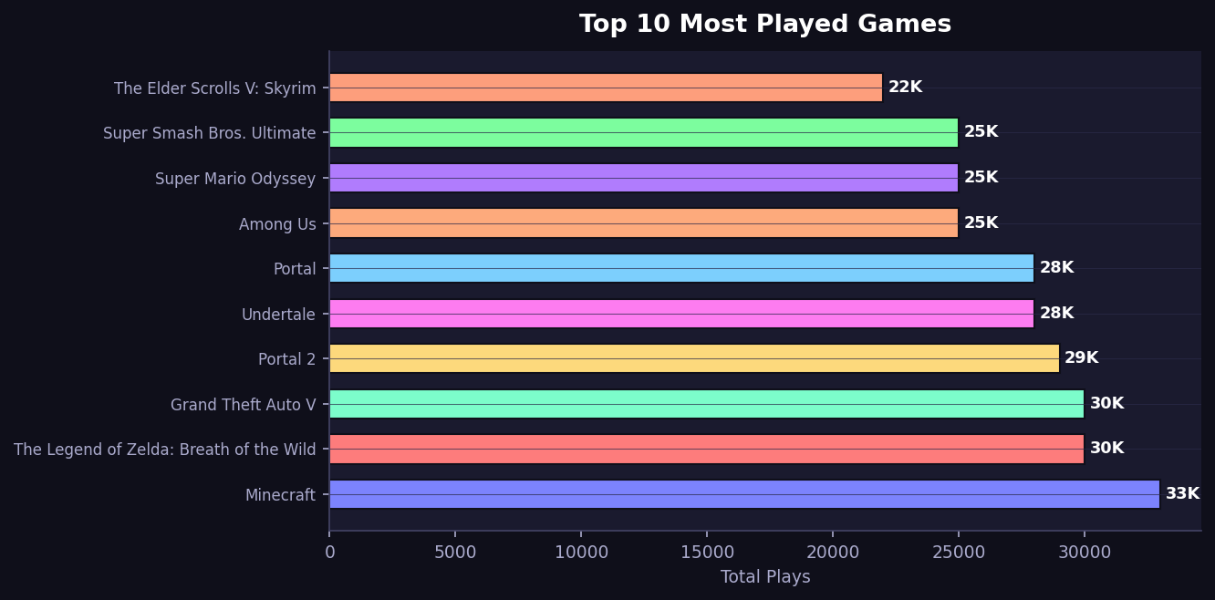
EDA
Top Rated & Most Played Games
Games that users love
⭐ Top 10 Highest Rated
🎮 Top 10 Most Played
🎮 Video Game Sales & Engagement Analysis
5 / 19

Slide 6
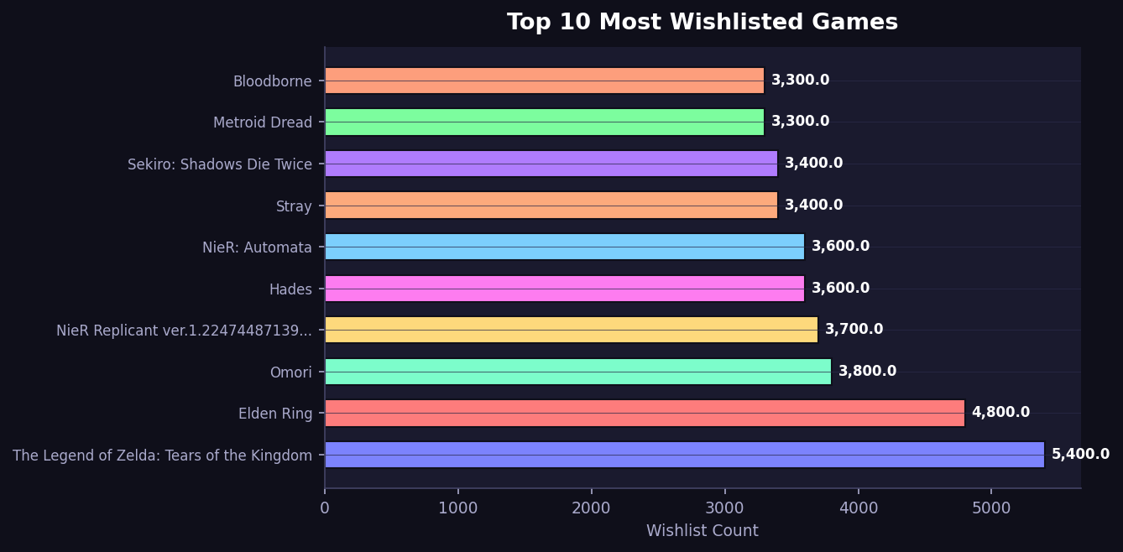
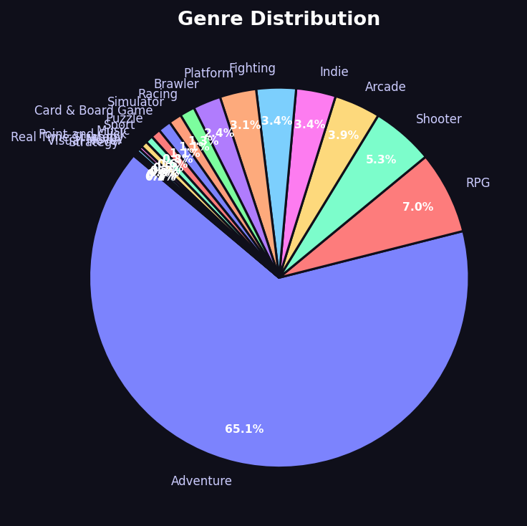
EDA
Wishlist & Genre Analysis
What players want to play
💫 Top 10 Wishlisted
🧩 Genre Distribution
🎮 Video Game Sales & Engagement Analysis
6 / 19

Slide 7
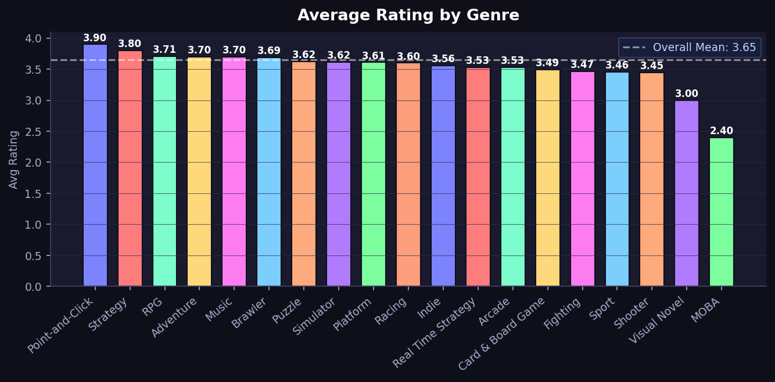
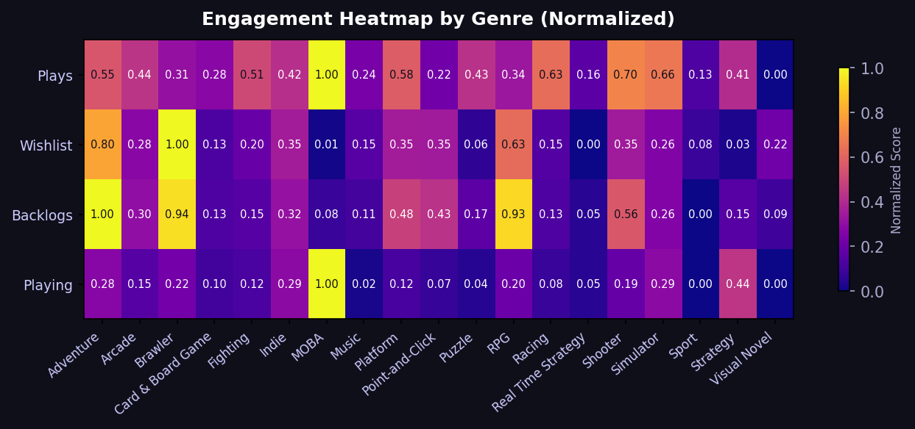
EDA
Genre Deep Dive
Ratings and engagement by genre
⭐ Avg Rating by Genre
🔥 Engagement Heatmap
🎮 Video Game Sales & Engagement Analysis
7 / 19

Slide 8
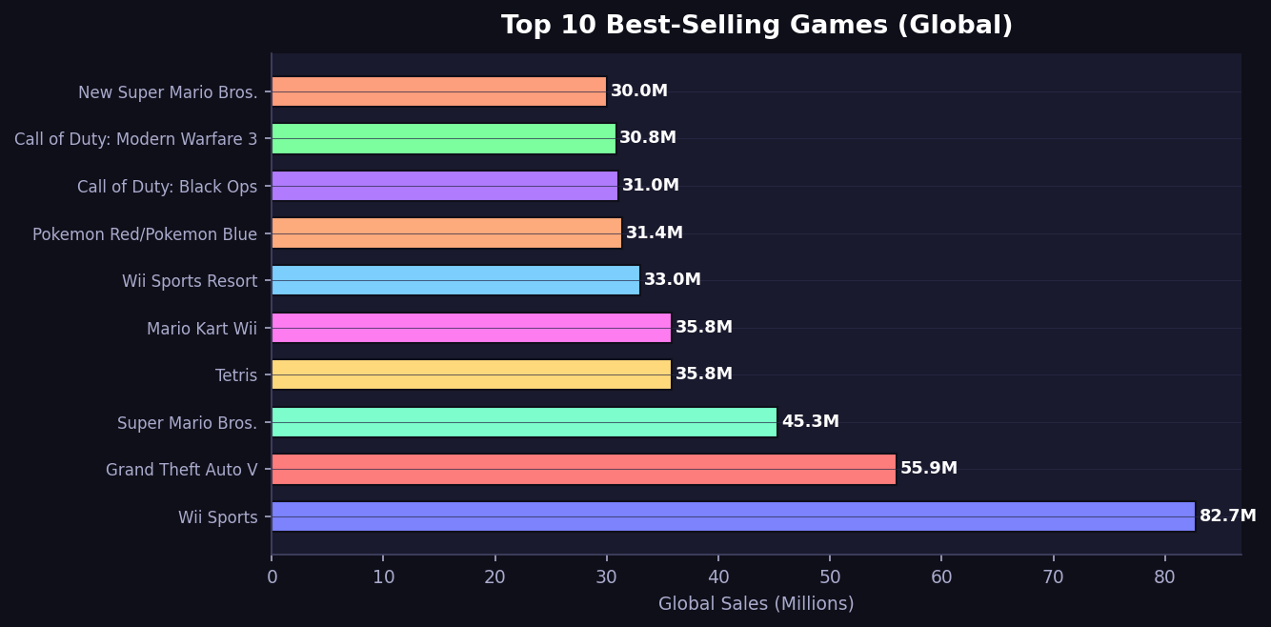
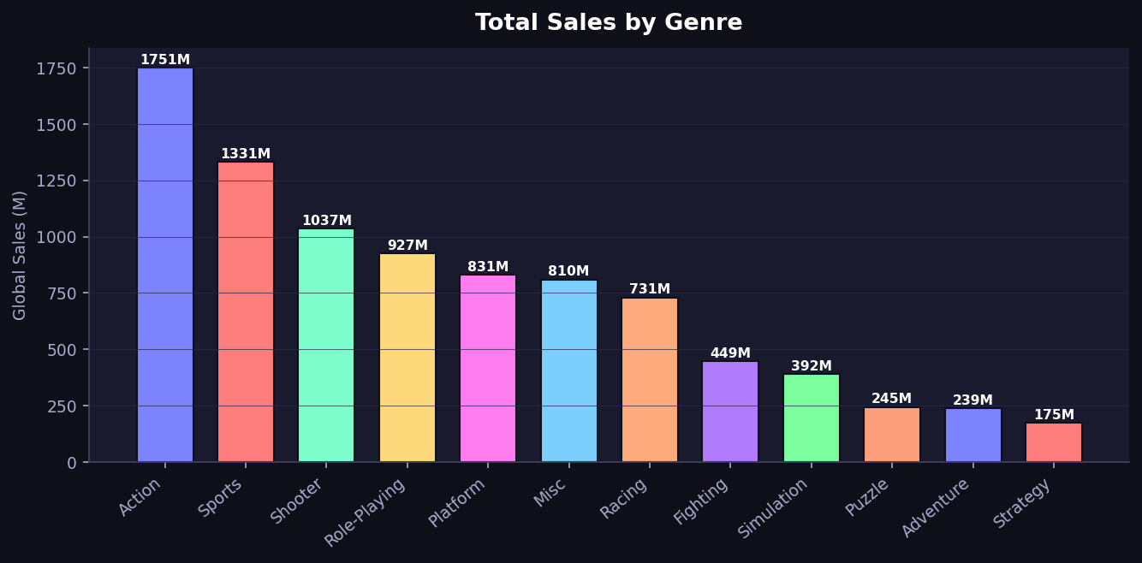
SALES
Best-Selling Games & Genre Revenue
Global blockbusters
🏆 Top 10 Best-Sellers
📊 Sales by Genre
🎮 Video Game Sales & Engagement Analysis
9 / 19

Slide 9
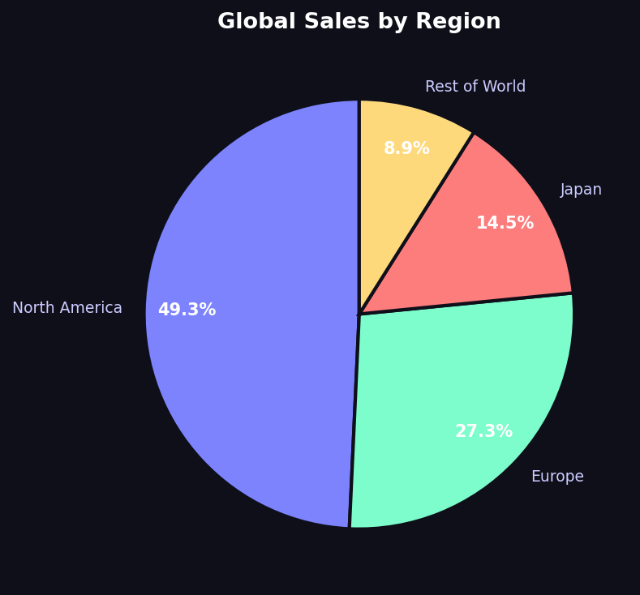
SALES
Regional Sales Analysis
Which part of the world spends the most on games
🌍 Global Market Share
🇺🇸 North America
49.2%
4,392M units sold
🇪🇺 Europe
27.1%
2,415M units sold
🇯🇵 Japan
14.6%
1,301M units sold
🌐 Rest of World
9.0%
802M units sold
🎮 Video Game Sales & Engagement Analysis
8 / 19

Slide 10
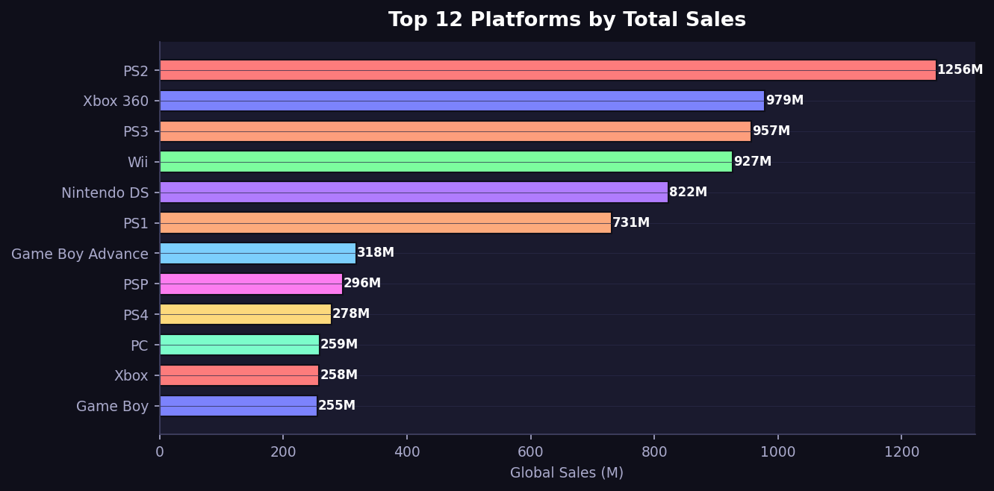
PLATFORM
Platform Sales Analysis
Which platforms dominate the global market
PS2
#1 Platform · 1,255M
PS3
3rd Place · 957M
X360
Top Xbox · 979M
Wii
Nintendo Lead · 926M
🎮 Video Game Sales & Engagement Analysis
10 / 19

Slide 11
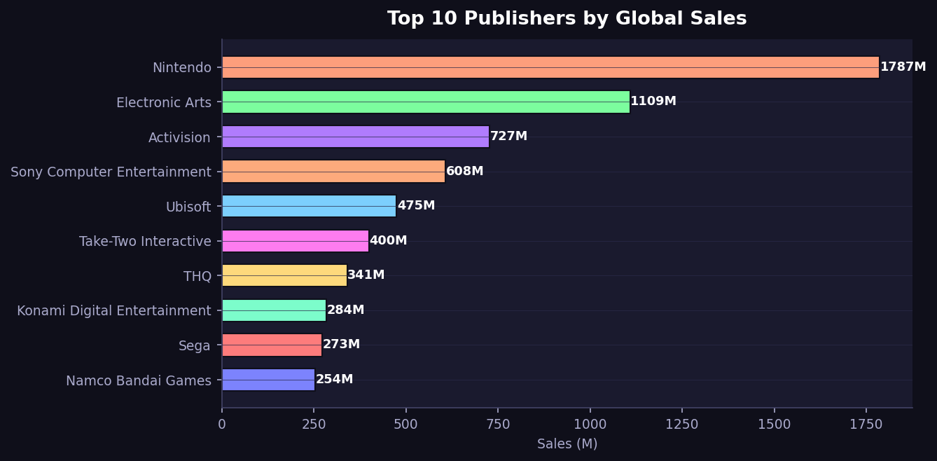
PUBLISHER
Top Publishers by Global Sales
Who dominates the publishing industry
Nintendo
#1 Publisher · 1,786M
EA
#2 Publisher · 1,110M
Activision
#3 Publisher · 727M
Sony
#4 Publisher · 607M
🎮 Video Game Sales & Engagement Analysis
11 / 19

Slide 12
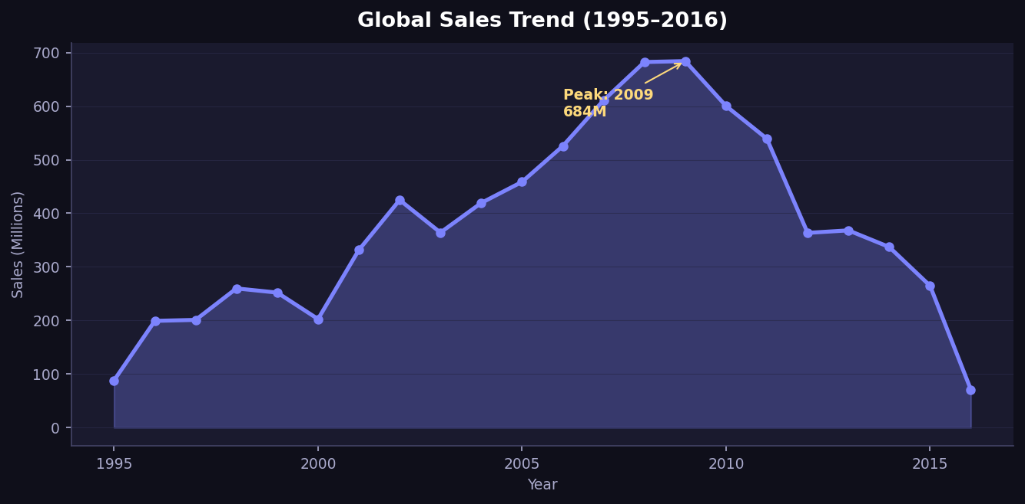
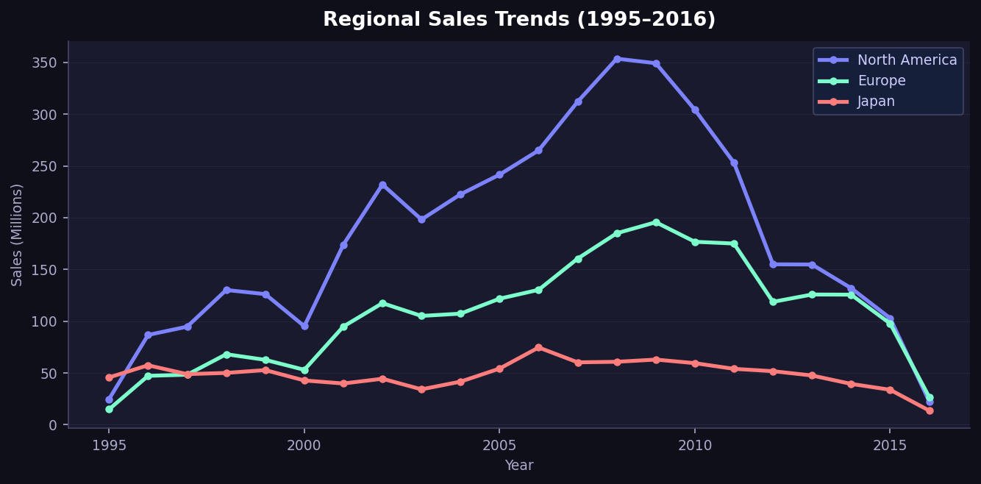
TRENDS
Sales Trends Over Time (1995–2016)
How the gaming market grew and declined
📈 Global Sales per Year
🌍 Regional Sales Trends
🚀
📉
🎯
🌍
2009
2009+
2001–2009
NA Dominance
Peak Year
Decline
Golden Era
49%
Market hit 684M units in 2009 — all-time high
Mobile gaming rise caused post-2009 market decline
8-year growth driven by PS2, Wii, DS, and Xbox 360
North America consistently the #1 region every year
🎮 Video Game Sales & Engagement Analysis
12 / 19

Slide 13
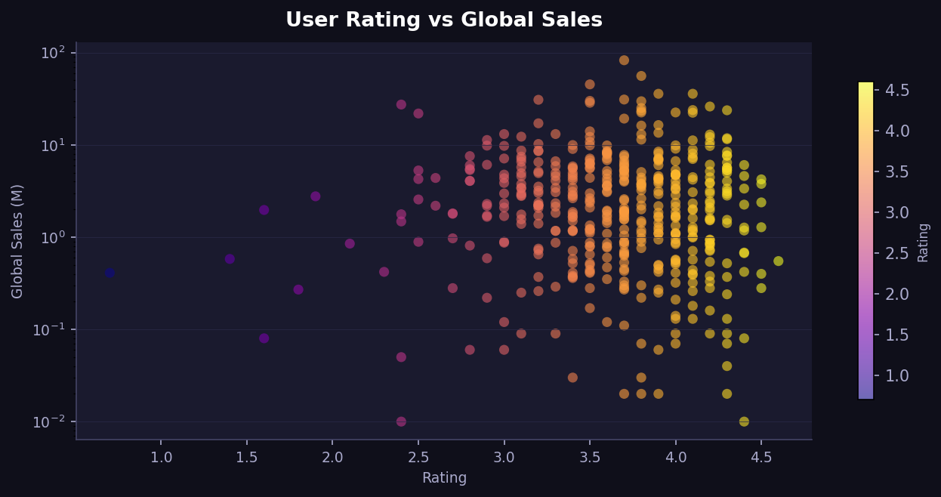
MERGED
Engagement vs Sales Insights
When ratings and sales data are combined
🎯 Rating vs Global Sales (log scale)
💡
Weak Correlation
High rating ≠ high sales. Many 4.4+ rated games sell <1M units
🎮
Engagement Leaders
Adventure & RPG genres have highest plays despite lower avg sales
📊
Wishlist Effect
Games with 5K+ wishlist entries have 3x higher avg sales
🏆
Sweet Spot
Ratings 3.8–4.2 + Adventure genre shows best commercial performance
🎮 Video Game Sales & Engagement Analysis
13 / 19

Slide 14
STREAMLIT
Streamlit Interactive Dashboard
A 7-page dark-themed web app built with Python
🚀 streamlit run app.py → Open http://localhost:8501 in your browser
🏠 Page 1: Overview
🕹️ Page 5: Platform & Pub
KPI cards, top games by plays & sales, genre + regional pie charts
Platform sales, regional stacked bars, publisher efficiency scatter
⭐ Page 2: Ratings
📅 Page 6: Yearly Trends
Histogram, box plots by genre, scatter (plays vs wishlist), heatmap
Area charts, regional lines, decade heatmap by genre
💰 Page 3: Sales Analysis
🔍 Page 7: Game Explorer
Regional market share, top sellers, stacked regional breakdown
Search + filter table, game deep dive with sales by platform
🧩 Page 4: Genre Analysis
Genre counts, avg rating, market share, radar engagement chart
🎮 Video Game Sales & Engagement Analysis
14 / 19

Slide 15
FEATURES
Dashboard Features
What makes this dashboard special
🎨
Dark Gaming Theme
🔧
Live Sidebar Filters
Custom CSS: #0f0f1a background, #7c83fd accent, glassmorphism card style
Genre multi-select + Year slider — all charts update instantly
📊
Plotly Interactive
🔍
Game Explorer Page
Every chart has hover tooltips, zoom, pan, download as PNG built-in
Search any game, filter by genre, sort by any metric — deep dive view
📈
30+ Visualizations
💡
Radar Chart
Bar, scatter, pie, box, histogram, heatmap, area, radar across 7 pages
Genre radar compares selected genre vs overall average on 5 dimensions
🔗
Dual Dataset Support
⚡
Cached Loading
Separate analysis for games, vgsales, and merged data — all in one app
@st.cache_data ensures instant page switching without re-loading CSVs
🎮 Video Game Sales & Engagement Analysis
15 / 19

Slide 16
SETUP
How to Run the Dashboard
Step-by-step terminal setup guide
01
Install Dependencies
$ pip install streamlit pandas plotly
Open terminal / command prompt and run this command
02
Set Up Folder Structure
$ project/
├── app.py
└── cleaned_data/
├── cleaned_games.csv
├── cleaned_vgsales.csv
└── merged_data.csv
Make sure app.py and cleaned_data folder are in the same directory
03
Navigate to Project Folder
$ cd Desktop/VideoGame_Analysis
In terminal, go to the folder containing app.py
04
Run the Dashboard
$ streamlit run app.py
This is the main command — Streamlit starts the server automatically
05
Open in Browser
$ http://localhost:8501
Browser opens automatically — or manually go to this URL
🎮 Video Game Sales & Engagement Analysis
16 / 19

Slide 17
FINDINGS
Key Findings
What the data tells us about the gaming industry
🌍
Regional Leader
🏆
Best Platform
North America dominates with 49.2% of global game sales — nearly half the world market
PS2 is #1 platform with 1,255M units sold — led by its massive game library
📅
Peak Year
🎮
Top Publisher
2009 was peak year globally at 684M sales — golden era of console gaming
Nintendo leads all publishers with 1,786M units — 60% more than #2 EA
⭐
Rating Distribution
🧩
Genre Champion
Most games rated 3.2–4.0. Below 3.0 rating rarely exceeds 1M in sales
Action genre leads sales (3,316M), while Adventure dominates engagement
🔗
Engagement ≠ Sales
📈
Market Decline
High engagement (plays/wishlist) doesn't always convert to high sales figures
Post-2012 market fell sharply — rise of mobile & free-to-play gaming disruption
🎮 Video Game Sales & Engagement Analysis
17 / 19

Slide 18
CONCLUSION
Conclusion & Project Summary
What we learned from 17,692 game records across 2 datasets
📊 Data Summary
💡 Top Insights
🎯 What We Built
▸ 1,099 games analyzed from engagement data
▸ North America leads global sales at 49.2%
▸ Data Cleaning Notebook — 1,099 clean records
▸ 16,593 sales records across 31 platforms
▸ PS2 is #1 platform with 1,255M+ units sold
▸ EDA Notebook — 15+ charts, 28 cells
▸ 469 games matched between both datasets
▸ Nintendo dominates publishing with 1,786M units
▸ SQL Queries — 30 questions across 3 datasets
▸ 19 genres · 577 publishers · 39 years of data
▸ 2009 was the peak year at 684M global sales
▸ Streamlit App — 7 pages, 30+ Plotly visuals
🔍 Final Conclusion
This project successfully demonstrates a complete end-to-end data analytics pipeline — from raw CSV cleaning to an interactive Streamlit dashboard. The analysis reveals that commercial success (sales) and player engagement (plays/wishlist) are NOT always correlated. Action games dominate global sales, but Adventure titles lead in engagement metrics like plays and backlogs. North America remains the largest market at 49.2%, and the industry peaked in 2009 before mobile gaming disruption. The Streamlit dashboard makes all 30+ insights fully interactive — launch with: streamlit run app.py
🎮 Video Game Sales & Engagement Analysis
18 / 19

Slide 19
🎮
Thank You!
Video Game Sales & Engagement Analysis
Python • SQL • Streamlit • EDA • Machine Learning Ready
✅ data_cleaning.ipynb
✅ eda_notebook.ipynb
✅ app.py (Streamlit)
✅ eda_analysis.sql
✅ eda_complete_questions.sql
Questions? Let's discuss! 🚀

