Slide 1
COVID-19
Data-Analysis & Visualization using Python
[CUTM 1018]
Group B6
Centurion University of Technology and Management, Bhubaneswar
Name of Students
Subhrajeet Nayak
170301140007
EE
Rudra Pratap Padhi
170301140014
EE
Notes:
Qwd’

Slide 2
Objectives:-
Visualize the Evolution of Confirmed cases over time in the world.
Visualize the Top 10 Affected countries’ Confirmed cases, Recovering cases, Death cases.
Visualize the different States’ Confirmed cases, Recovering cases, Death cases in India.
Visualize the COVID-19 Cases in Odisha.
Visualize the Different types of cases in US.
All Visualization data presentation by Dash
.

Slide 3
Evolution of Confirmed cases over time in the word
URL_DATASET = https://raw.githubusercontent.com/datasets/covid-19/master/data/countries-aggregated.csv

Slide 4
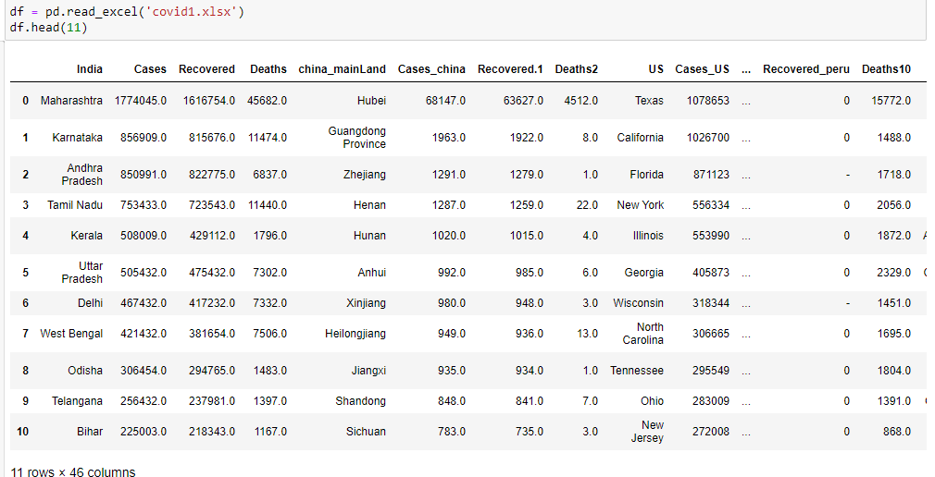

Slide 5
Top 10 worst hit countries - Confirmed cases

Slide 6
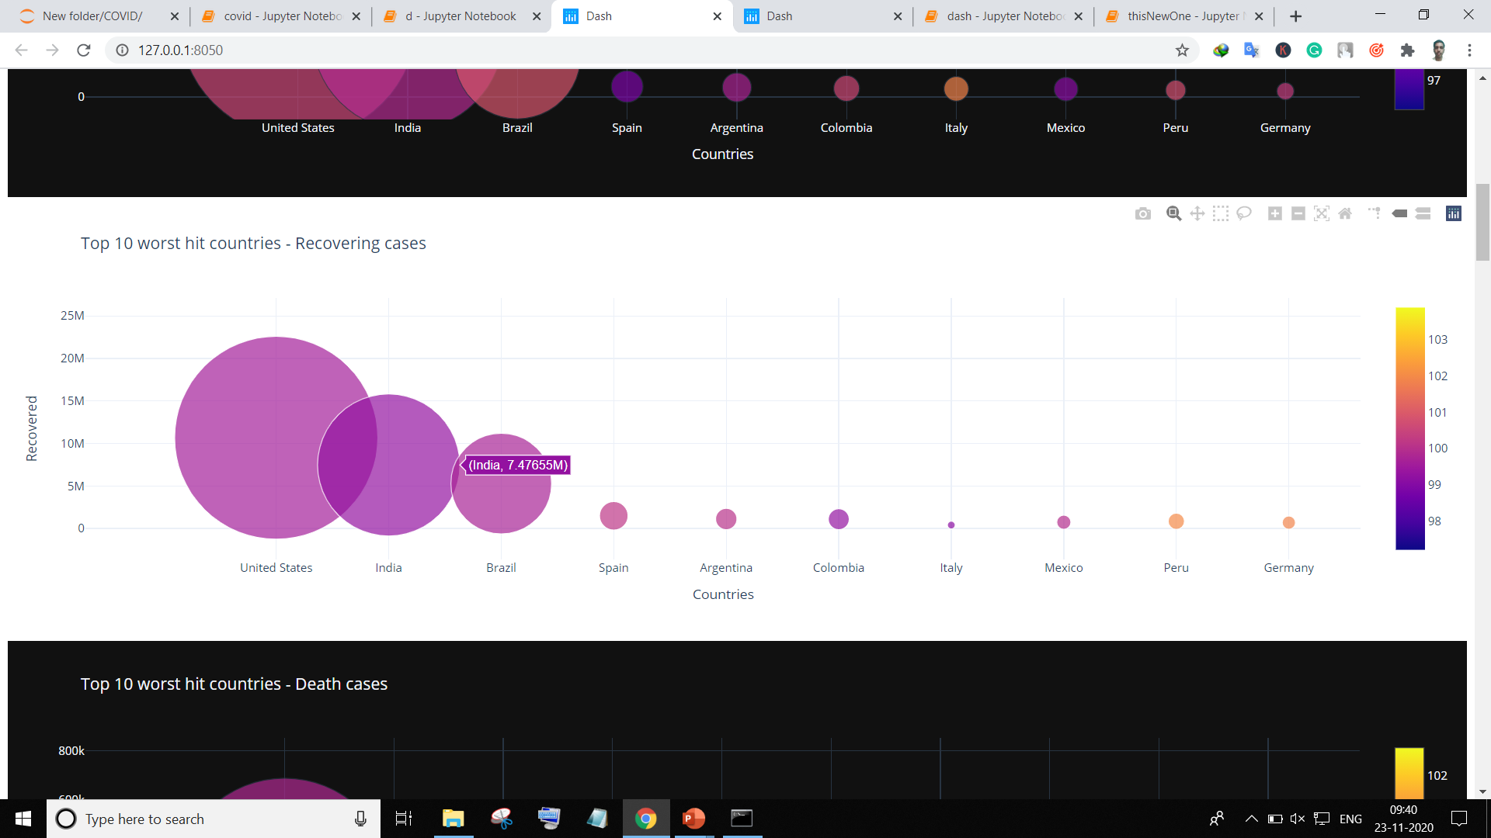
Top 10 worst hit countries - Recovering cases

Slide 7
Top 10 worst hit countries - Death cases

Slide 8
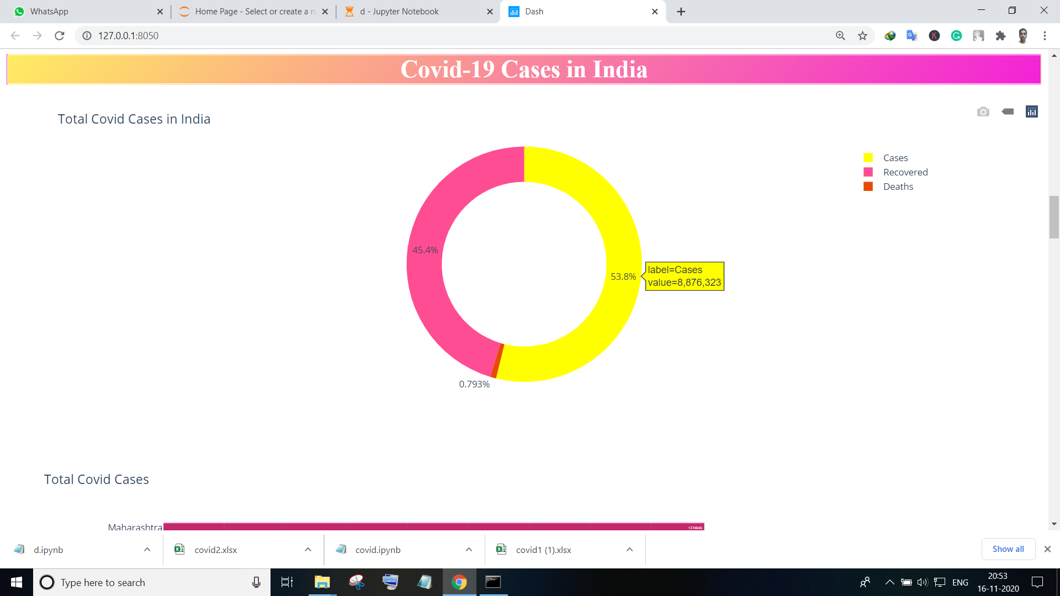
Total Cases in India

Slide 9
Total Number of Covid Cases

Slide 10
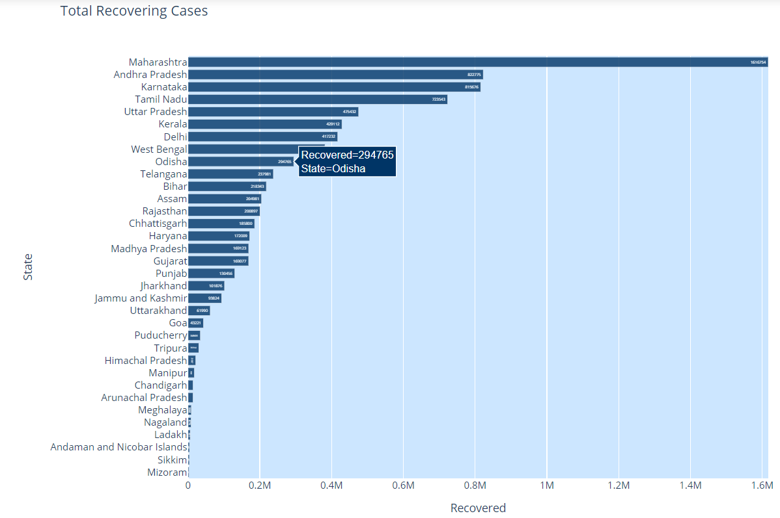
Total Recovering Cases

Slide 11
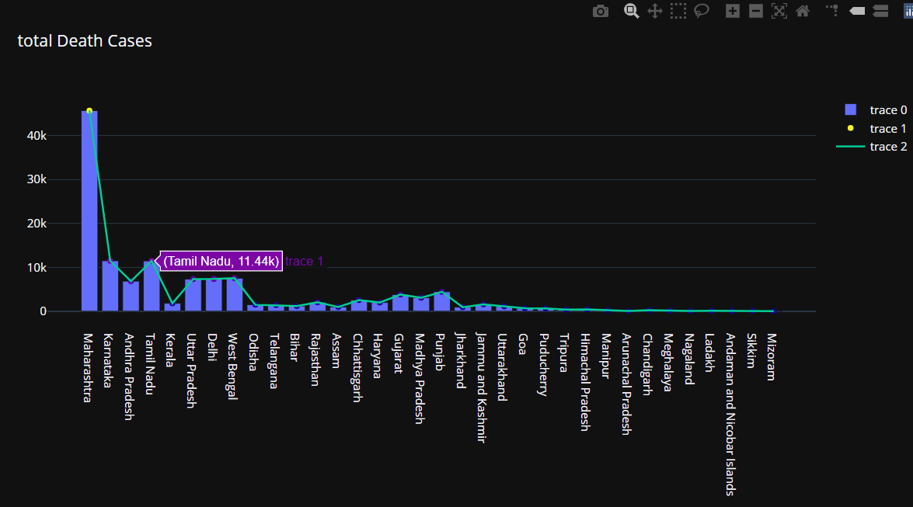
Total Death Cases

Slide 12
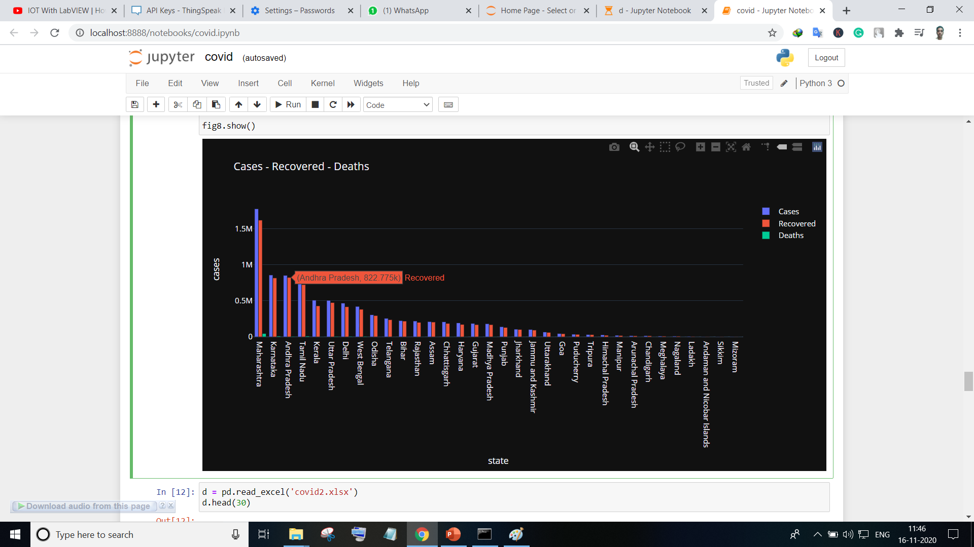
Cases - Recovered - Deaths

Slide 13
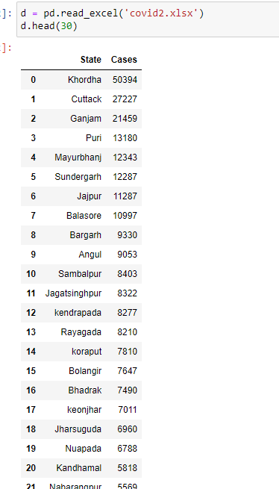

Slide 14
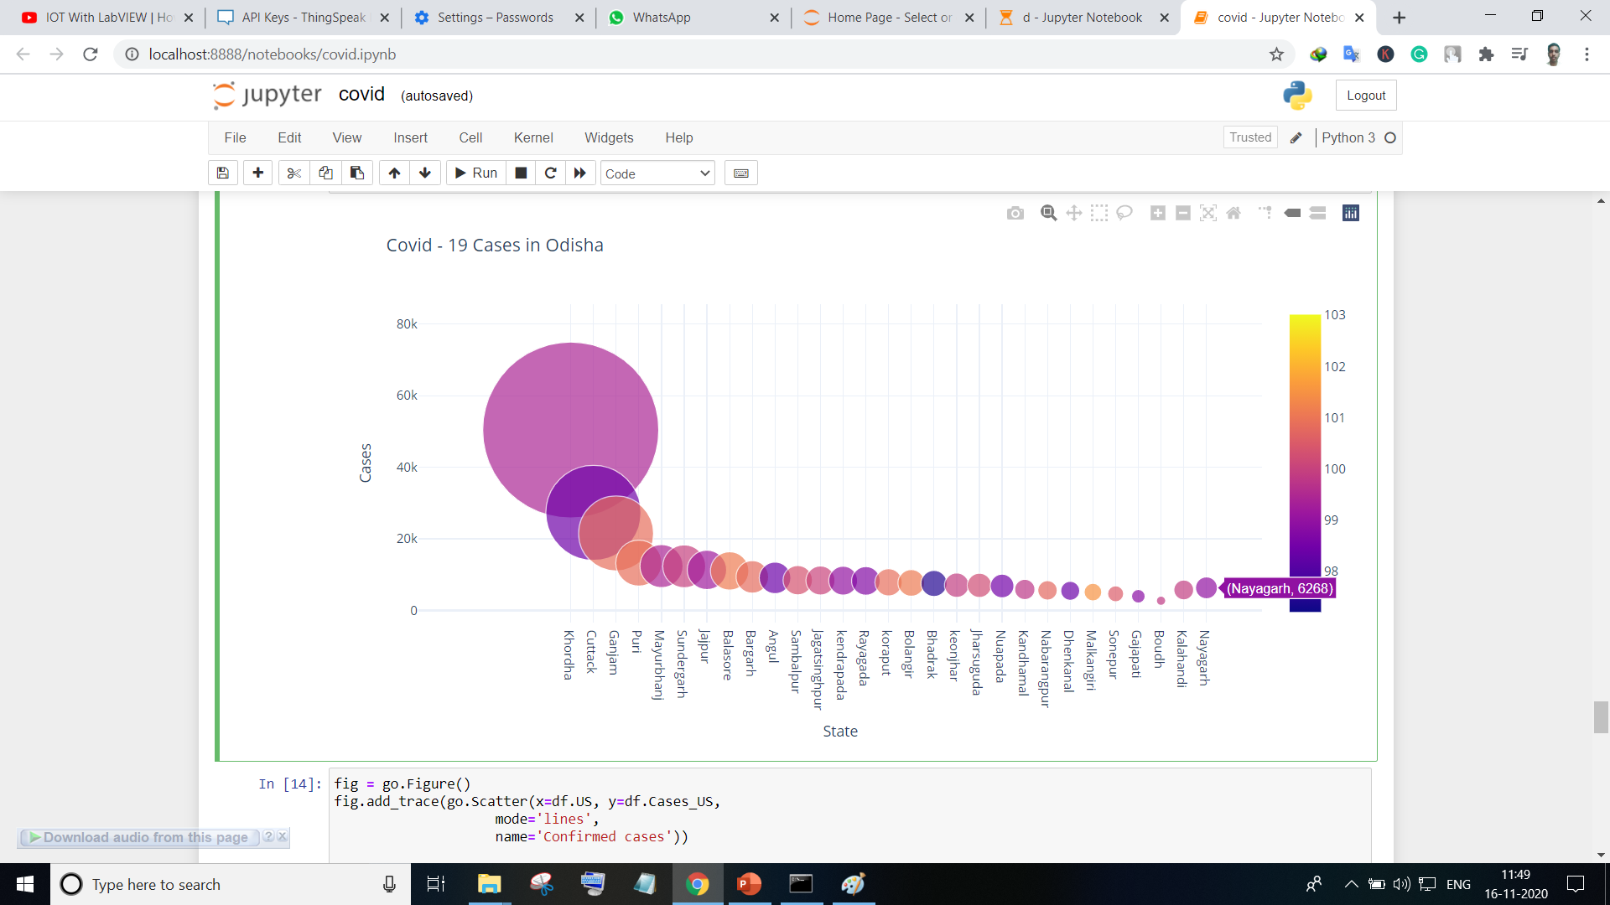
Covid - 19 Cases in Odisha

Slide 15
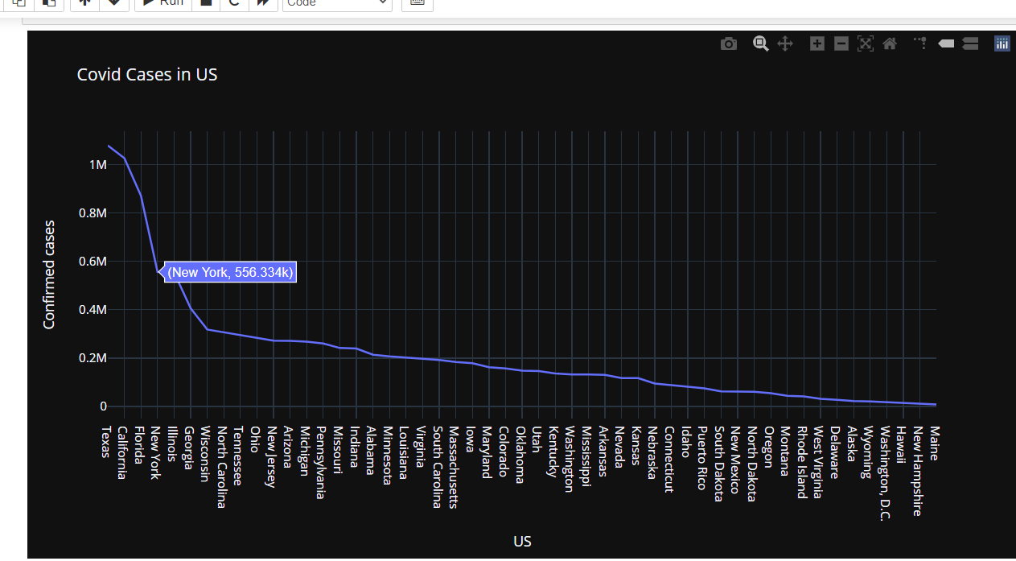
Confirmed cases in US

Slide 16
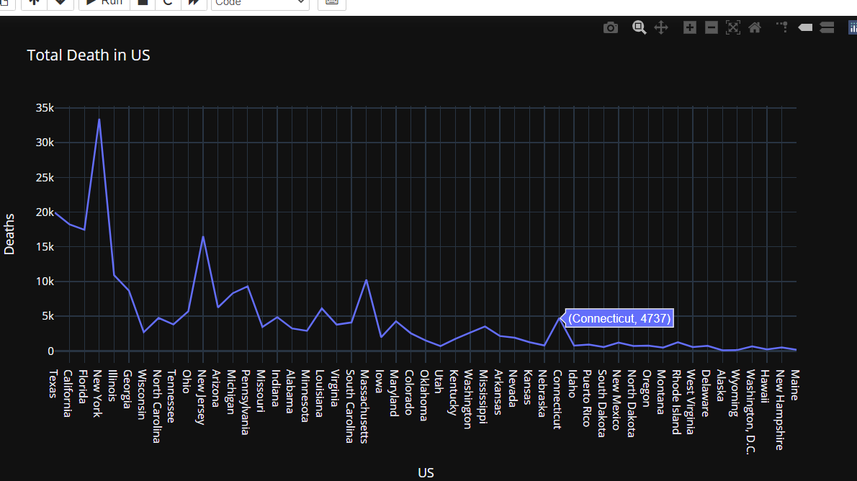
Total Death in US

Slide 17
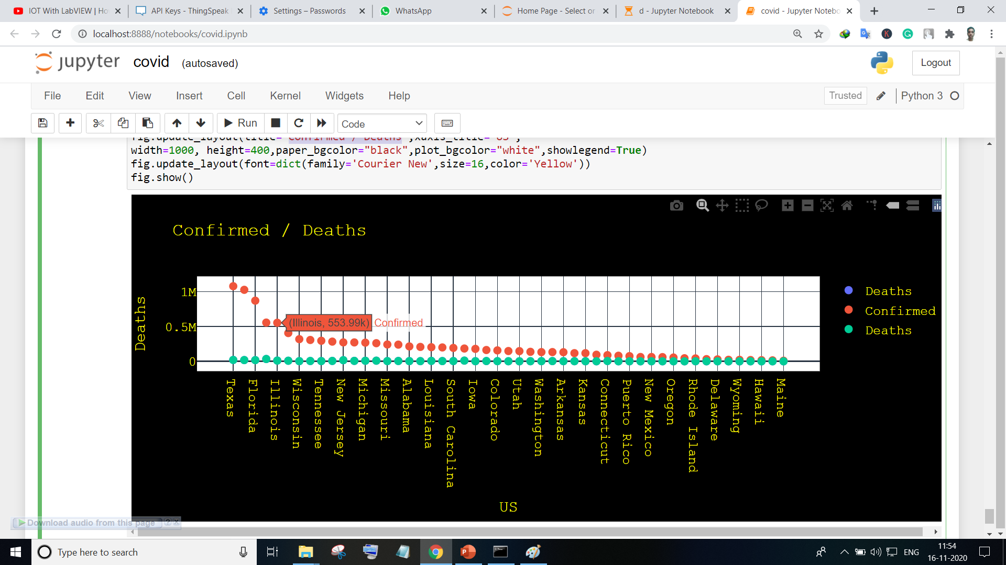
Confirmed / Deaths US

Slide 18
Findings:
Overall Death rate are less as compared to COVID-19 confirm cases.
According to the analysis In India the Maharashtra , Karnataka, Andhra Pradesh, Tamil Nadu states have most critical cases , so in these states the COVID restriction should be Strict.
Healthcare will become part of a country’s most precious asset.
Proper Vaccine supply must be needed as soon as possible.

Slide 19
Reference :
https://raw.githubusercontent.com/datasets/covid-19/master/data/countries-aggregated.csv
https://data.world/indoagri/covid-19-world-dataset
https://data.world/indoagri/covid-19-all-cases-in-odisha

Slide 20
Thank You

