Slide 1
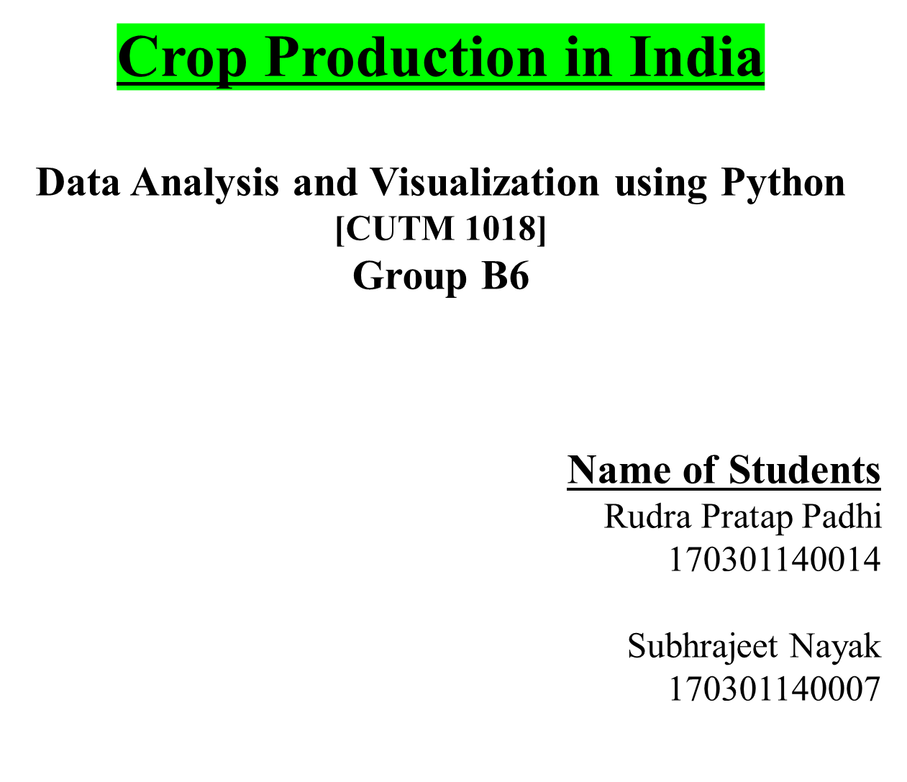
Notes:
Qwd’

Slide 2
Objective:
  Visualize the different varieties of Agricultural products.
  Visualize the year wise production of Agricultural Crops.
  Visualize the variations in crops costs and production.

Slide 3
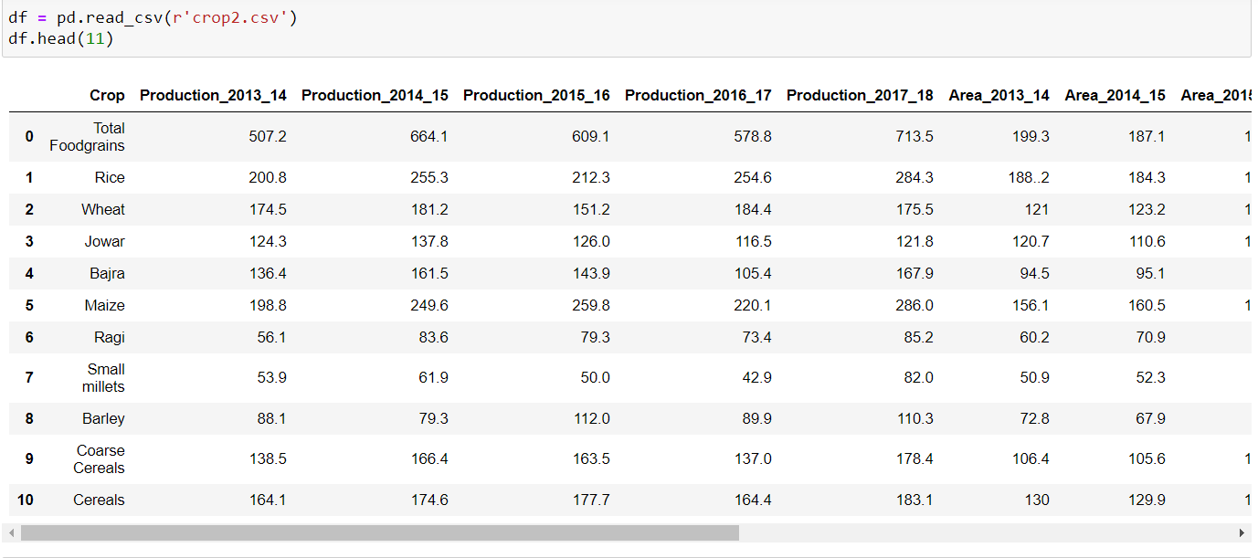
(1)-https://data.world/indoagri/indian-year-wise-crop-production

Slide 4
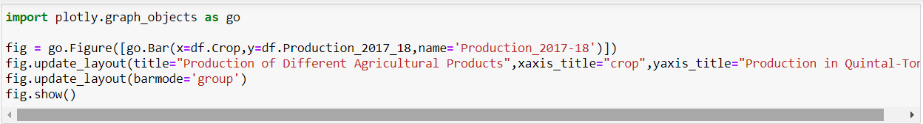
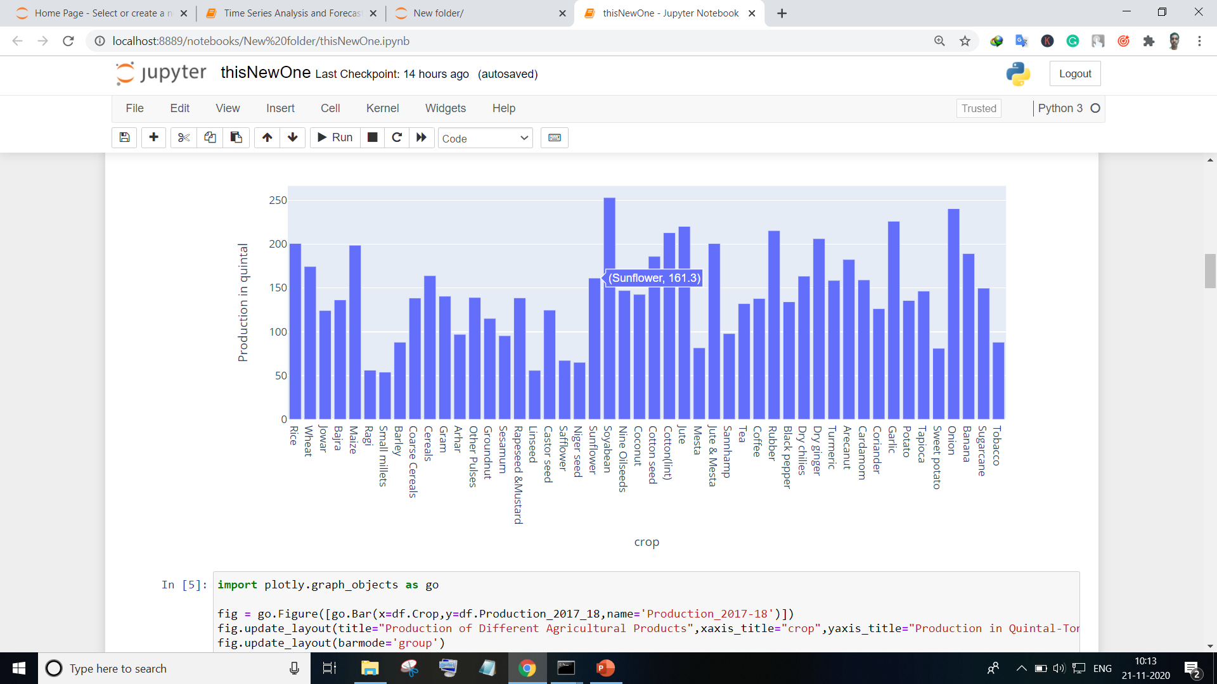

Slide 5
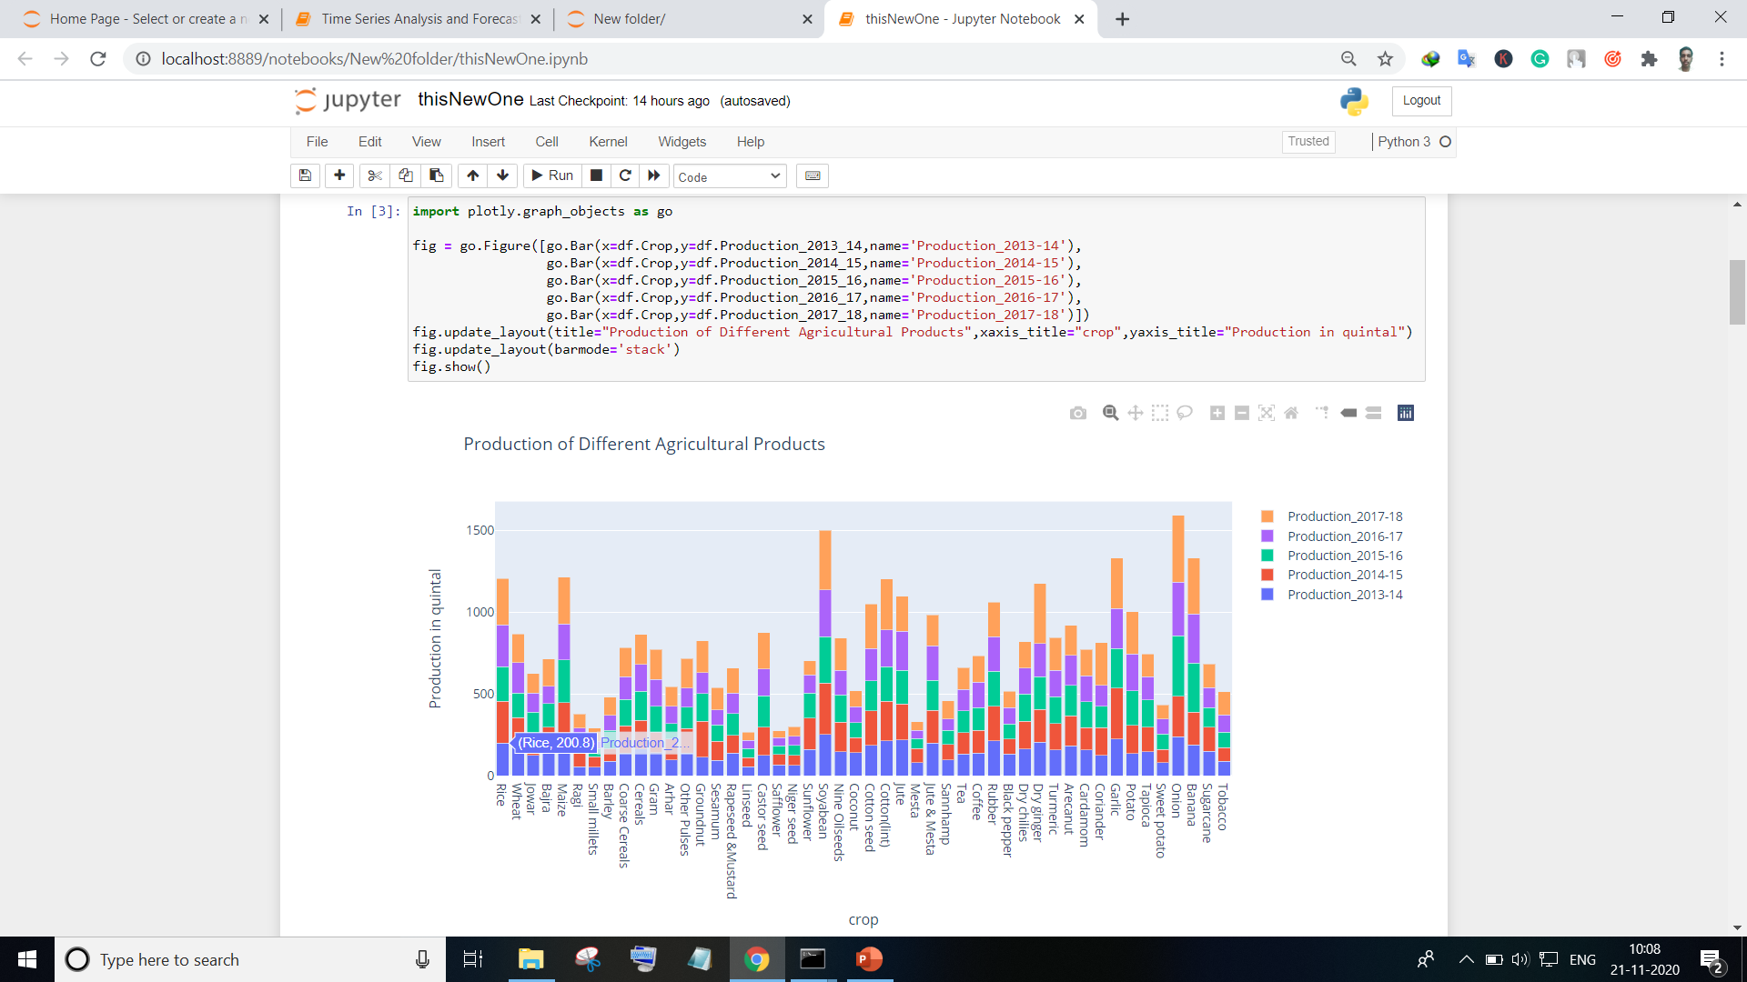
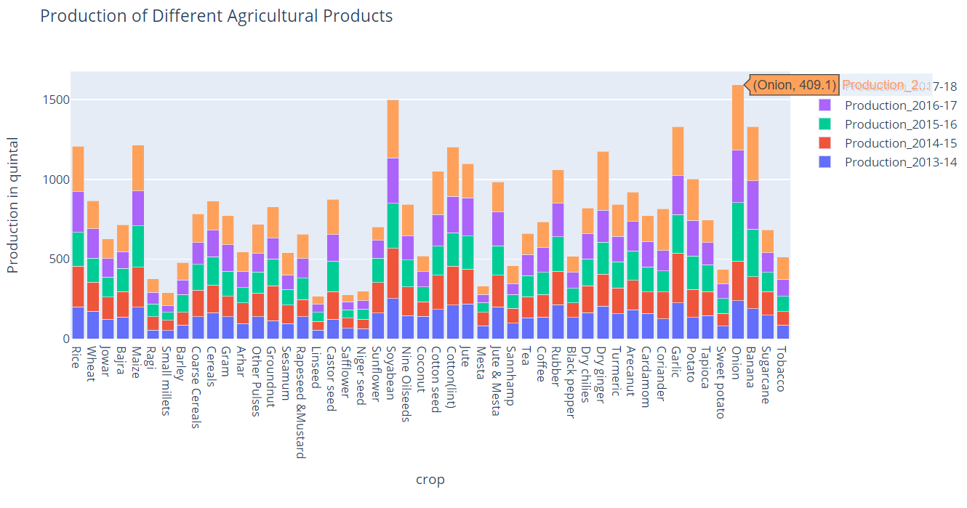

Slide 6
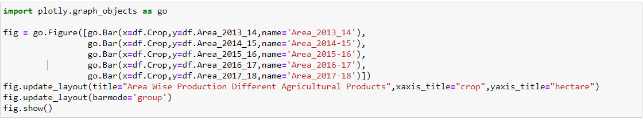
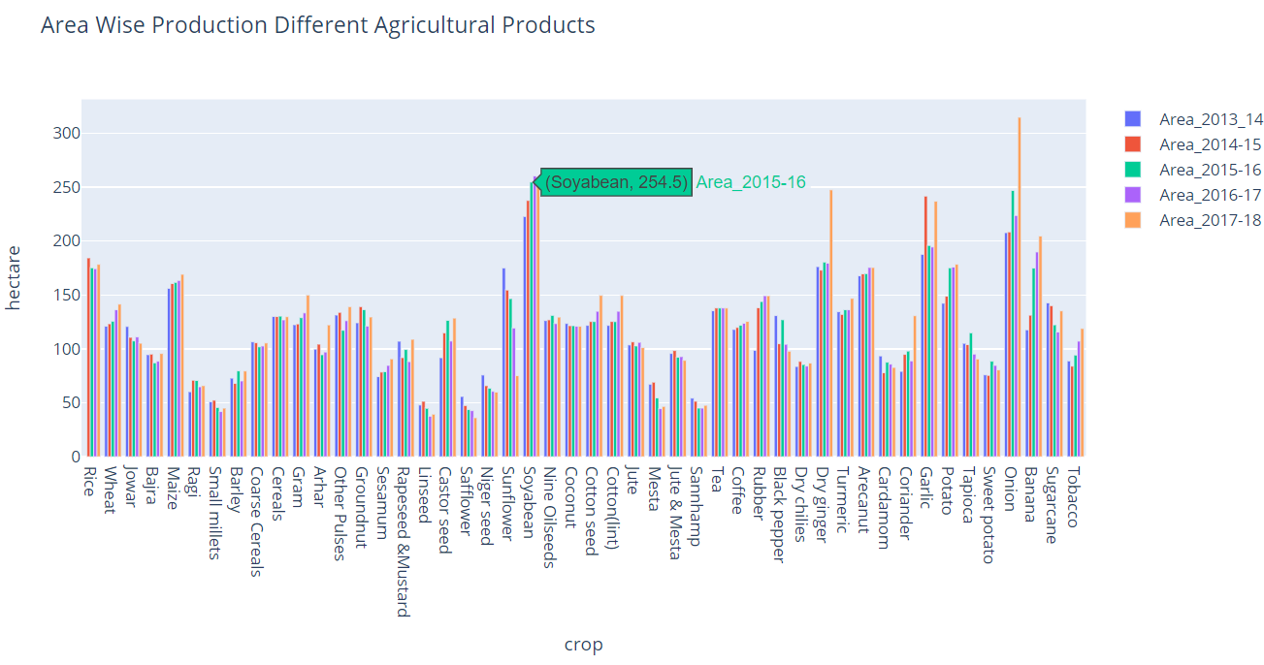

Slide 7
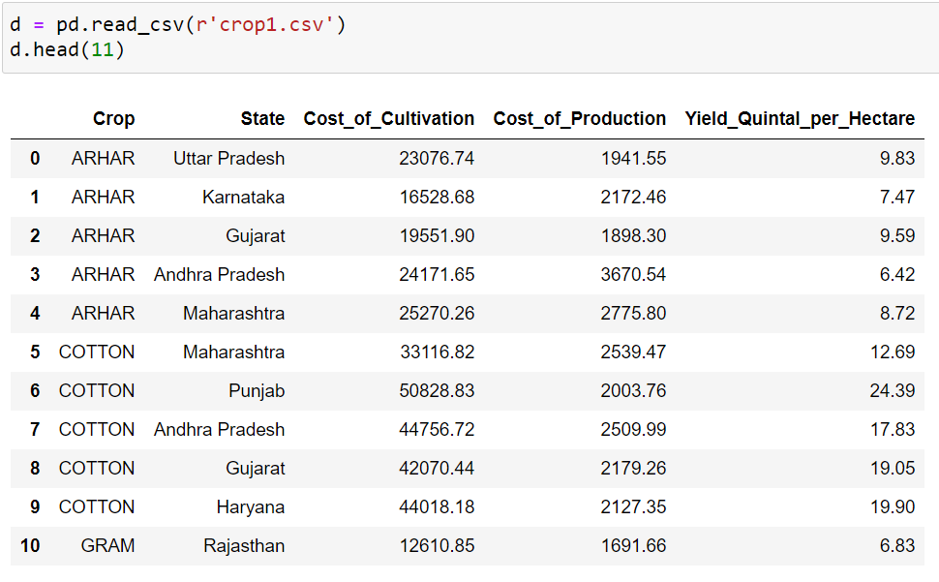
(2)-https://data.world/indoagri/indian-states-wise-crop-production

Slide 8
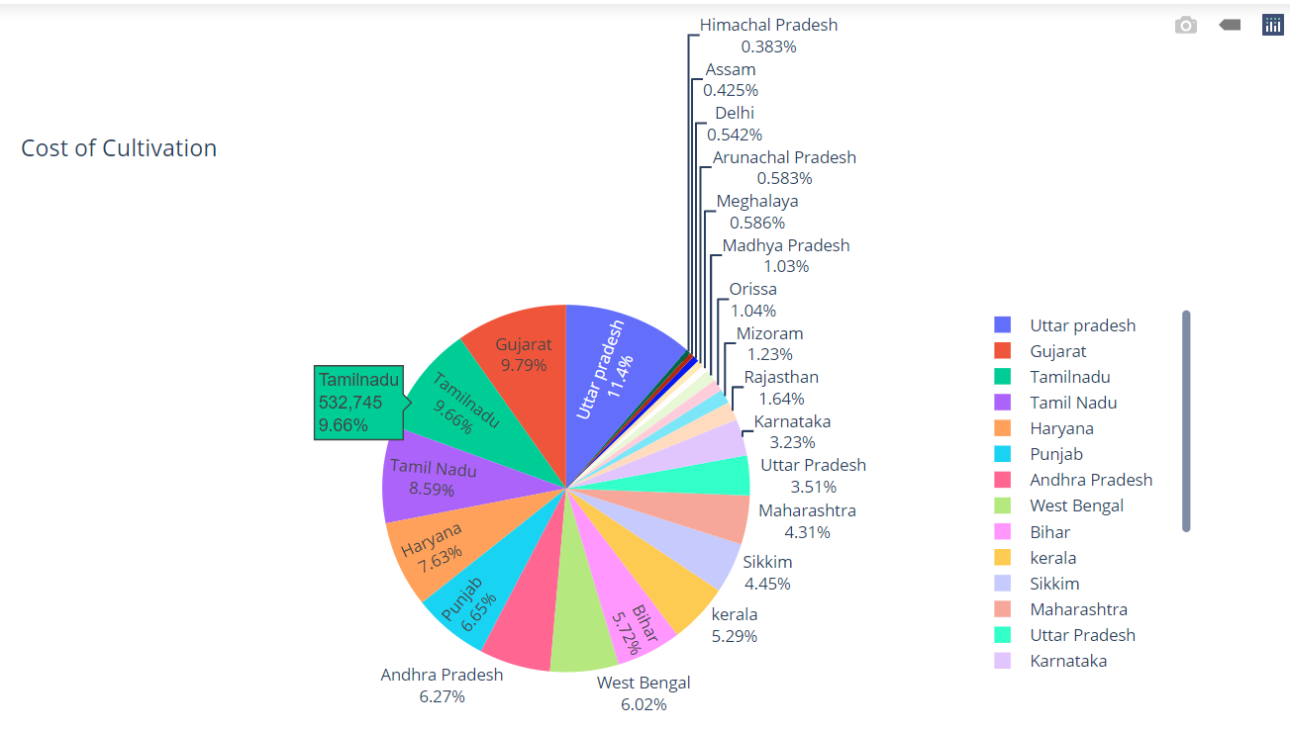

Slide 9
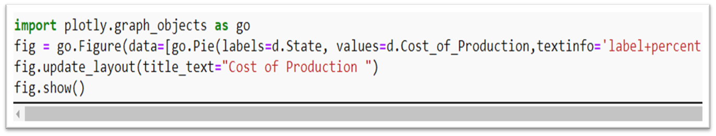
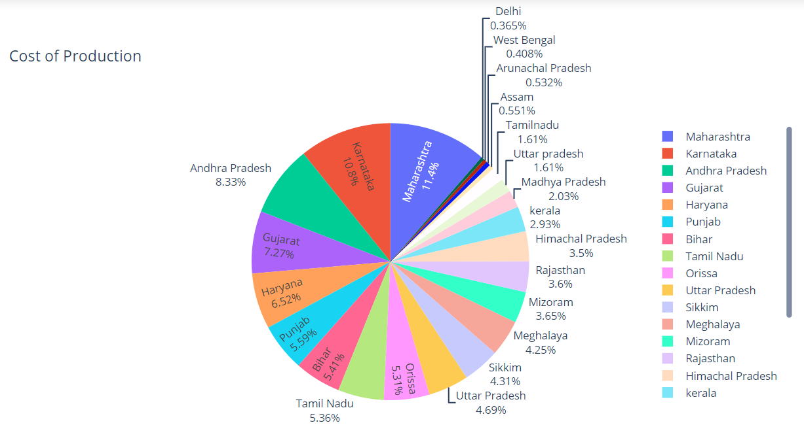

Slide 10
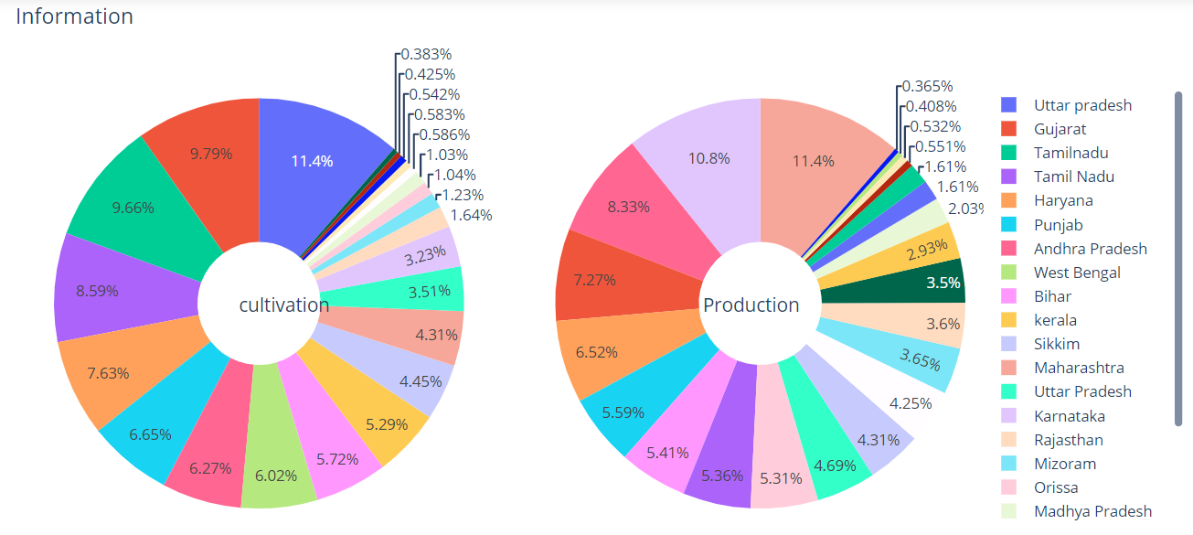

Slide 11
Findings:
  According to the dataset we were able to find out the details of production report, then we found there are some crop products which have always highest production and consumption like Onion, Soybean, Maize, Rice, Banana, Cotton.
  Niger Seeds, Safflower, Linseed, Small-millets crops having the lower production units. (Average 53 Tons)
  In Maharashtra , Karnataka, Andhra-Pradesh the cost of production is high.

Slide 12

Reference :
(1)-https://data.world/indoagri/indian-year-wise-crop-production
(2)-https://data.world/indoagri/indian-states-wise-crop-production

