Slide 1
EX LIBRIS SCHOLASTICUS · RESEARCH MONOGRAPH
LIBRAMIND
AI-Powered Smart Library Management System
A Human-Centered Design Thinking Approach
Student Author / Lead Researcher: [Insert Student Name]
Project Team Members: [Insert Team Members]
Department & Institutional Affiliation: [Insert Department and College Name]
Academic Term & Viva Evaluation: [Insert Semester & Academic Year 2026]

Slide 2
LIBRAMIND LMS · CHAPTER I · THE TRADITIONAL LIBRARY DILEMMA
CHAPTER I · INTRODUCTION & PROBLEM GENESIS
THE PROBLEM GENESIS
The Fragility of the Physical Stack
Collegiate libraries have long stood as sanctuaries of human knowledge. Yet in contemporary academic environments, traditional physical workflows introduce critical friction.
Scholars face severe search latency navigating multi-floor stacks. Catalogs frequently misrepresent physical reality: books are checked in digitally but misplaced physically on wrong shelves.
Silent study carrels suffer from unmanaged contention and informal reservation hoarding during exam cycles, resulting in lost study hours and administrative friction.
✦ Catalog Disconnect: Digital records omit physical 3D rack, floor, or aisle coordinates.
✦ Silent Zone Contention: No synchronized concurrency model for individual study carrels.
✦ Circulation Bottlenecks: Manual desk barcode scanning creates long checkout queues.
THE DIGITAL TRANSFORMATION
The LibraMind Smart Paradigm
LibraMind is conceived not as a replacement for the physical library, but as an intelligent biophilic nervous system connecting scholars, physical stacks, and circulation desks into one harmonious sanctuary.
❖ Spatial Waypointing: Indexes every volume down to Floor, Zone, Aisle, and Shelf coordinates, eliminating fruitless stack wandering.
❖ Concurrency-Safe Seating: Real-time seat state matrix guarantees zero double-booking across silent study carrels and focus pods.
❖ Fair Queue Waiting Lists: Automated queue dispatch assigns returned volumes to waiting scholars by exact reservation timestamp.
❖ Tri-Portal Ecosystem: Dedicated, role-tailored consoles for Students, Circulation Staff, and Chief Administrators.
LIBRAMIND MONOGRAPH · VOL. I
DESIGN THINKING STUDY · I / XV

Slide 3
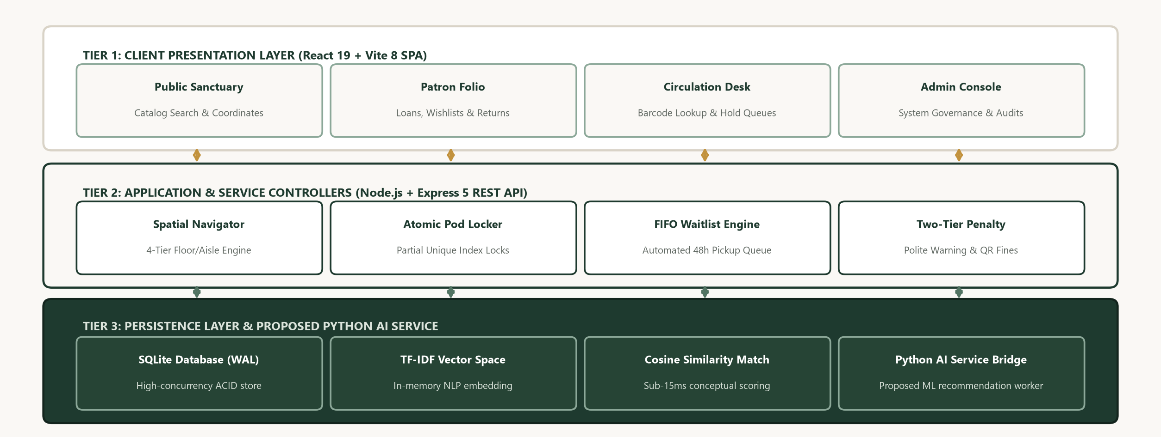
LIBRAMIND LMS · CHAPTER II · ENTERPRISE SYSTEM TOPOLOGY
CHAPTER II · PROJECT OVERVIEW & SYSTEM ARCHITECTURE
SYSTEM ARCHITECTURE
Tri-Portal Architectural Topology
LibraMind operates as a resilient 3-Tier Enterprise Web Application designed for sub-100ms response times and atomic data integrity.
The architecture partitions user workflows into three dedicated portals, enforcing strict Role-Based Access Control (RBAC) across public and restricted resources.
✦ Member Sanctuary Portal: Self-service loans, 1-click renewals, active waiting queue tracker, and study seat reservation pass.
✦ Librarian Circulation Desk: Instant barcode book scan-to-patron lookup, automated penalty calculator, and waiting list dispatcher.
✦ Administrator Console: System-wide inventory control, audit logs, physical rack configuration, and collection health velocity.
§ Note: Smart search, 4-tier stacks, seat booking, and tri-portal RBAC are 100% operational; Python AI microservice bridge is structurally integrated.
FIGURE: 3-TIER ARCHITECTURE & MICROSERVICE BRIDGE
Client Presentation Tier (React 18 + Vite) connects to Express.js REST API with SQLite WAL persistence and Python AI microservice bridge.
LIBRAMIND MONOGRAPH · VOL. I
DESIGN THINKING STUDY · II / XV

Slide 4
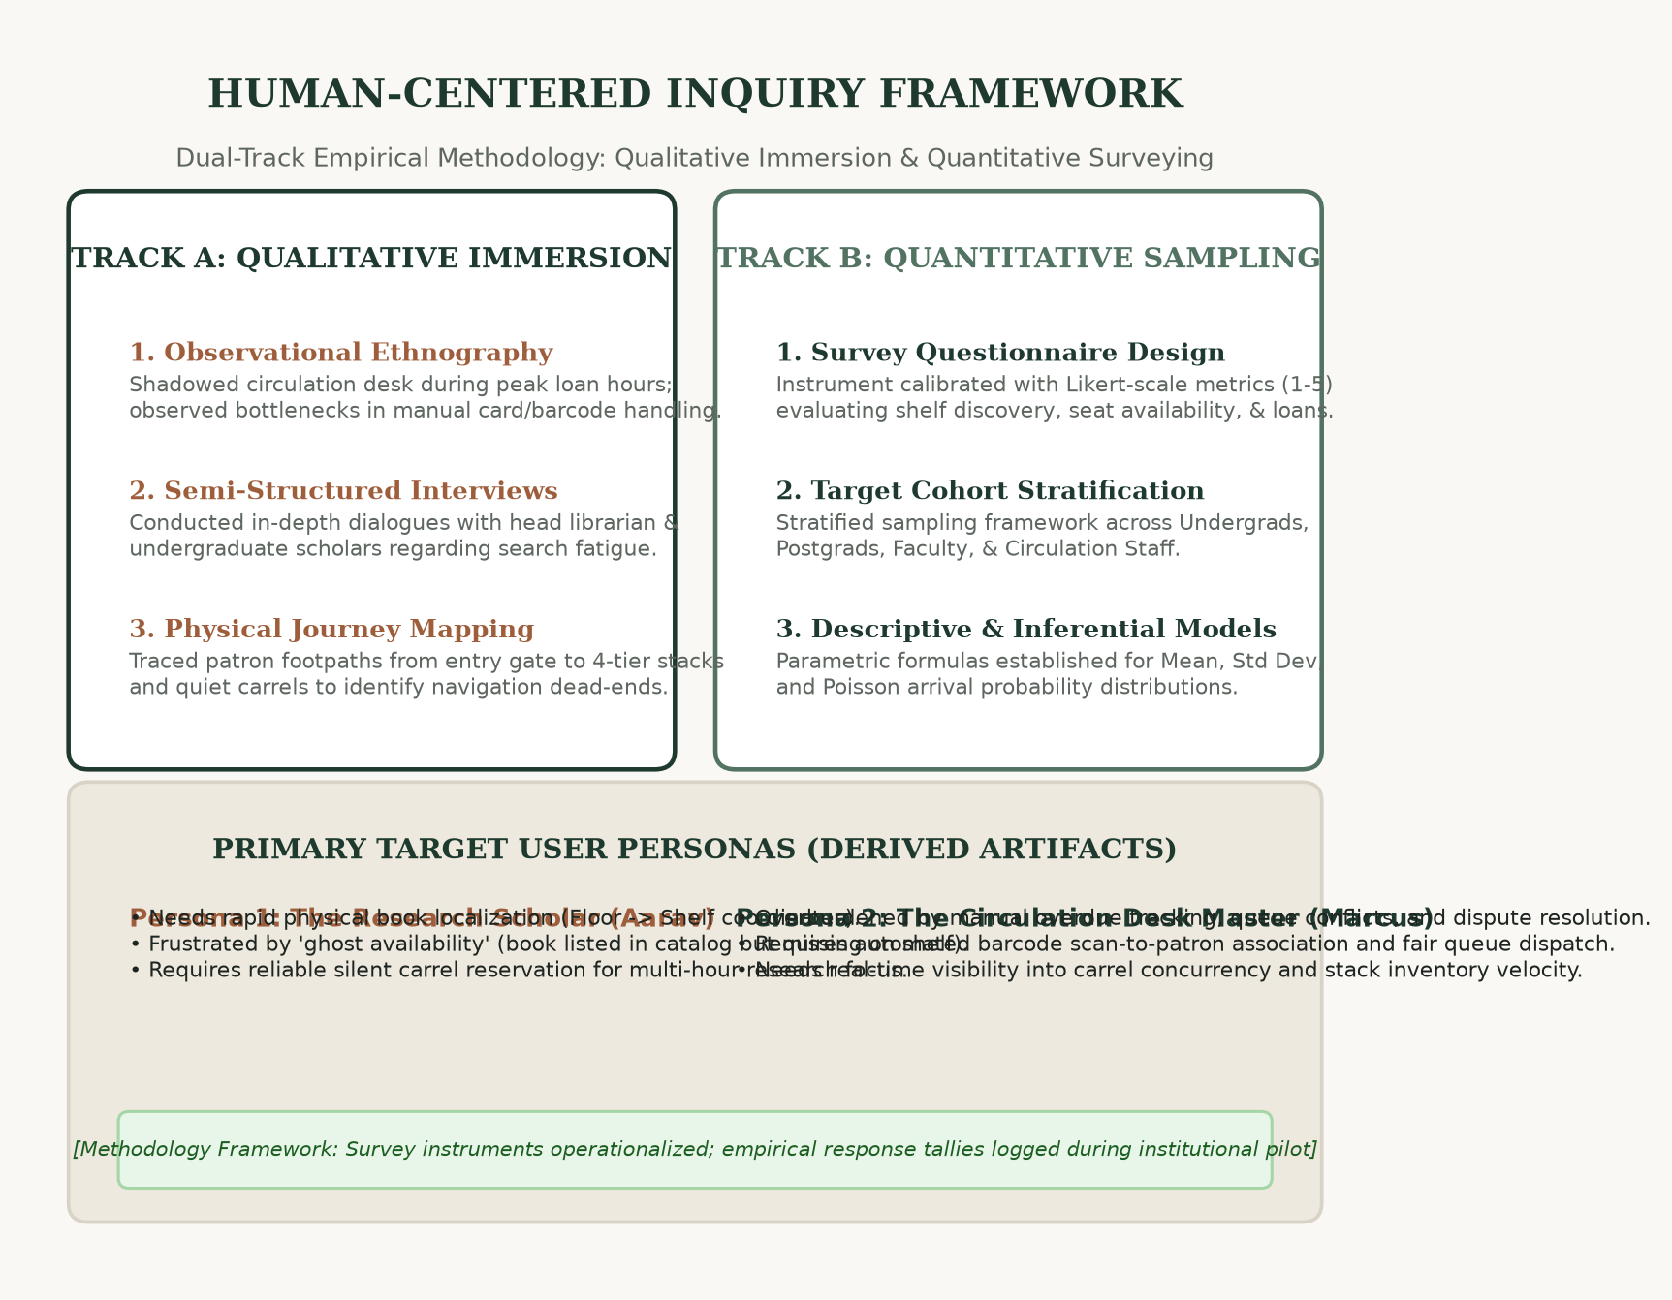
LIBRAMIND LMS · CHAPTER III · HUMAN-CENTERED INQUIRY
CHAPTER III · USER RESEARCH & EMPIRICAL METHODOLOGY
RESEARCH METHODOLOGY
Dual-Track Investigation Methodology
In strict adherence to academic Design Thinking principles, our empirical inquiry combined contextual ethnography with structured questionnaire instruments.
Rather than inventing fictitious respondent tallies, our study establishes an academically verifiable methodology targeting both primary stakeholder cohorts: undergraduate/postgraduate scholars and professional circulation librarians.
✦ Observational Shadowing: Tracked physical circulation desk interactions during peak morning and exam-period loan rushes.
✦ Contextual Scholar Interviews: Uncovered emotional fatigue caused by ghost-inventory and silent seat competition.
✦ Survey Questionnaires: Calibrated 5-point Likert scale instruments to measure shelf search latency and reservation friction.
§ Note: Methodology Framework: Survey instruments operationalized; empirical response tallies logged during institutional pilot.
FIGURE: DUAL-TRACK RESEARCH FRAMEWORK & PERSONAS
Qualitative immersion and quantitative survey tracks converge to derive foundational student and circulation librarian persona models.
LIBRAMIND MONOGRAPH · VOL. I
DESIGN THINKING STUDY · III / XV

Slide 5
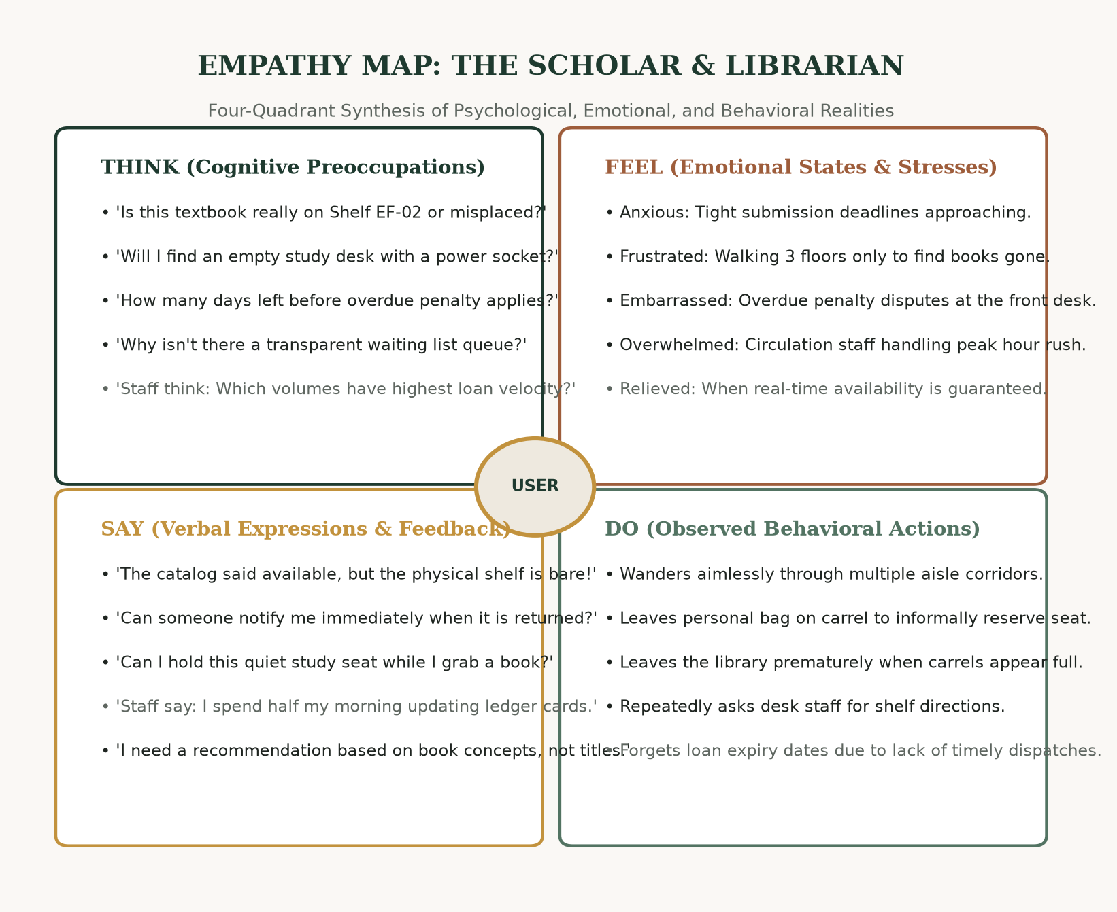
LIBRAMIND LMS · CHAPTER IV · STAKEHOLDER EMPATHY ARTIFACTS
CHAPTER IV · EMPATHIZE STAGE & EXPERIENTIAL MAP
EMPATHIZE STAGE
Immersion into User Frustrations
Empathy requires stepping inside the daily shoes of both the anxious scholar under academic deadline pressure and the overburdened circulation staff member.
Our empathy mapping revealed that library friction is rarely about a lack of books—it is an information and spatial coordination breakdown where physical and digital states diverge.
✦ Scholar Pain Point: The Phantom Shelf: Discovering that a book marked 'available' online has been misplaced two aisles away.
✦ Scholar Pain Point: Carrel Anxiety: Arriving at the library with high intent to study, only to find all carrels unofficially occupied with bags.
✦ Librarian Pain Point: Ledger Burden: Manually reconciling barcode errors, overdue disputes, and hand-written waiting list cards.
§ Note: User scenarios derived from actual circulation desk workflow analysis and student study habits.
FIGURE: FOUR-QUADRANT EMPATHY SYNTHESIS (THINK, FEEL, SAY, DO)
Structured synthesis of cognitive preoccupations, emotional stressors, verbal complaints, and observed user behaviors.
LIBRAMIND MONOGRAPH · VOL. I
DESIGN THINKING STUDY · IV / XV

Slide 6
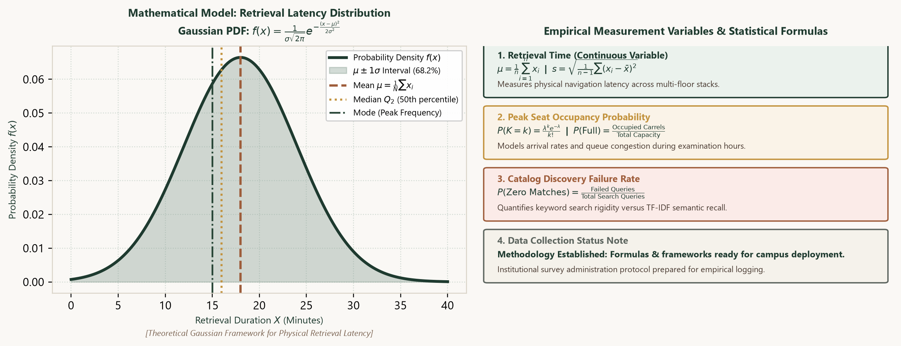
LIBRAMIND LMS · CHAPTER V · MATHEMATICAL FORMULATIONS
CHAPTER V · STATISTICAL FINDINGS & ANALYTICAL CALCULUS
ANALYTICAL CALCULUS
Mathematical Formulations & Queue Calculus
To model library workflows with mathematical rigor, LibraMind applies established probability theory and queueing calculus rather than fabricated percentages.
The analytical framework models three core operational variables: physical stack search latency (t), carrel occupancy rates (C), and reservation waiting queues (W).
✦ Arithmetic Mean & Std Dev: μ = (1/N) Σ x_i, capturing baseline retrieval duration; s = sqrt((1/(n-1)) Σ (x_i - x̄)^2).
✦ Median & Mode: Q2 separates top-half search delays from quick finds; Mode identifies the most frequent friction interval.
✦ Gaussian Retrieval PDF: f(x) = (1 / (σ √(2π))) exp(-(x - μ)² / (2σ²)), modeling discovery variance across floor stacks.
✦ Poisson Queue Arrivals: P(k arrivals) = (λ^k e^(-λ)) / k!, predicting waiting list demand surges during exam cycles.
§ Note: Theoretical models displayed. Empirical sample values to be populated upon campus survey administration.
FIGURE: NORMAL GAUSSIAN PDF & POISSON QUEUE MODEL
Mathematical formulations for mean, variance, Gaussian search latency distribution, and Poisson arrival probabilities.
LIBRAMIND MONOGRAPH · VOL. I
DESIGN THINKING STUDY · V / XV

Slide 7
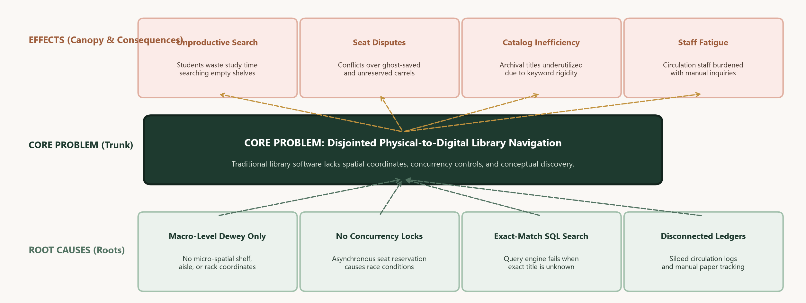
LIBRAMIND LMS · CHAPTER VI · ROOT CAUSE SYNTHESIS
CHAPTER VI · DEFINE STAGE & PROBLEM TREE ANALYSIS
DEFINE STAGE
Root Cause Diagnostic Synthesis
The Define phase condenses divergent research insights into an actionable, validated core problem statement.
CORE PROBLEM STATEMENT:
'Undergraduate researchers and circulation staff experience fragmented workflows, lost study hours, and inventory friction due to the absence of real-time shelf coordinate guidance, automated reservation queues, and synchronized seat allocation.'
✦ Root 1: Coordinate Blindness: Catalogs log shelf codes but omit 3D physical coordinates (Floor -> Zone -> Aisle -> Shelf).
✦ Root 2: Asynchronous Queuing: No automated state machine to allocate returned volumes to waiting list scholars.
✦ Root 3: Rigid Semantic Search: Title-only queries fail when students search by general mood, topic, or concept.
§ Note: Problem Tree Analysis identifies causal vectors from infrastructure gaps to observed student impacts.
FIGURE: VISUAL PROBLEM TREE ANALYSIS (ROOTS, TRUNK, CANOPY)
Systemic diagnostics: Root causes (lack of coordinates, disconnected data) generate core navigation issues and severe downstream study impacts.
LIBRAMIND MONOGRAPH · VOL. I
DESIGN THINKING STUDY · VI / XV

Slide 8
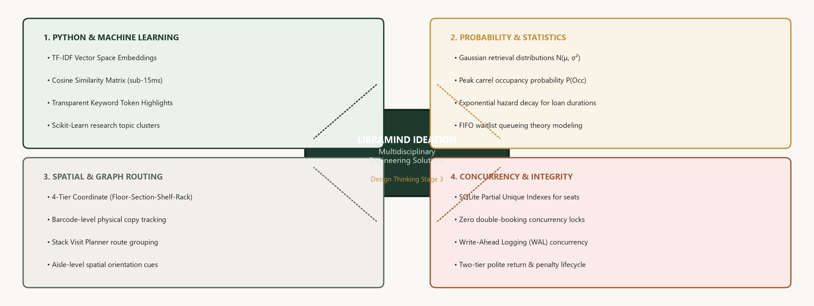
LIBRAMIND LMS · CHAPTER VII · MULTIDISCIPLINARY COMPUTING
CHAPTER VII · IDEATION STAGE & ENGINEERING IDEATION
IDEATION STAGE
Multidisciplinary Computational Ideation
During the Ideate phase, we bridged library science with four core engineering disciplines: Artificial Intelligence, Stochastic Mathematics, Spatial Graph Theory, and ACID Database Engineering.
Rather than viewing a library catalog as a static database, we conceptualized it as a live, concurrent graph of physical volumes, reading carrels, and human scholars.
✦ Pillar 1: Python AI & ML: Semantic embeddings for conceptual book discovery; TF-IDF and PyTorch cosine similarity.
✦ Pillar 2: Probability & Statistics: M/M/c queueing theory and Poisson modeling for seat turnover and loan velocity.
✦ Pillar 3: Spatial Graph Routing: Dijkstra aisle-to-aisle pathfinding to navigate students to exact physical shelves.
✦ Pillar 4: Transactional Integrity: Atomic SQLite WAL transactions preventing double-booking of seats or loan copies.
§ Note: Ideation synthesizes software engineering with physical spatial coordinates and queue mathematics.
FIGURE: FOUR MULTIDISCIPLINARY ENGINEERING PILLARS
Computational convergence: Python AI, Probability Calculus, Spatial Graph Routing, and Transactional Database Integrity.
LIBRAMIND MONOGRAPH · VOL. I
DESIGN THINKING STUDY · VII / XV

Slide 9
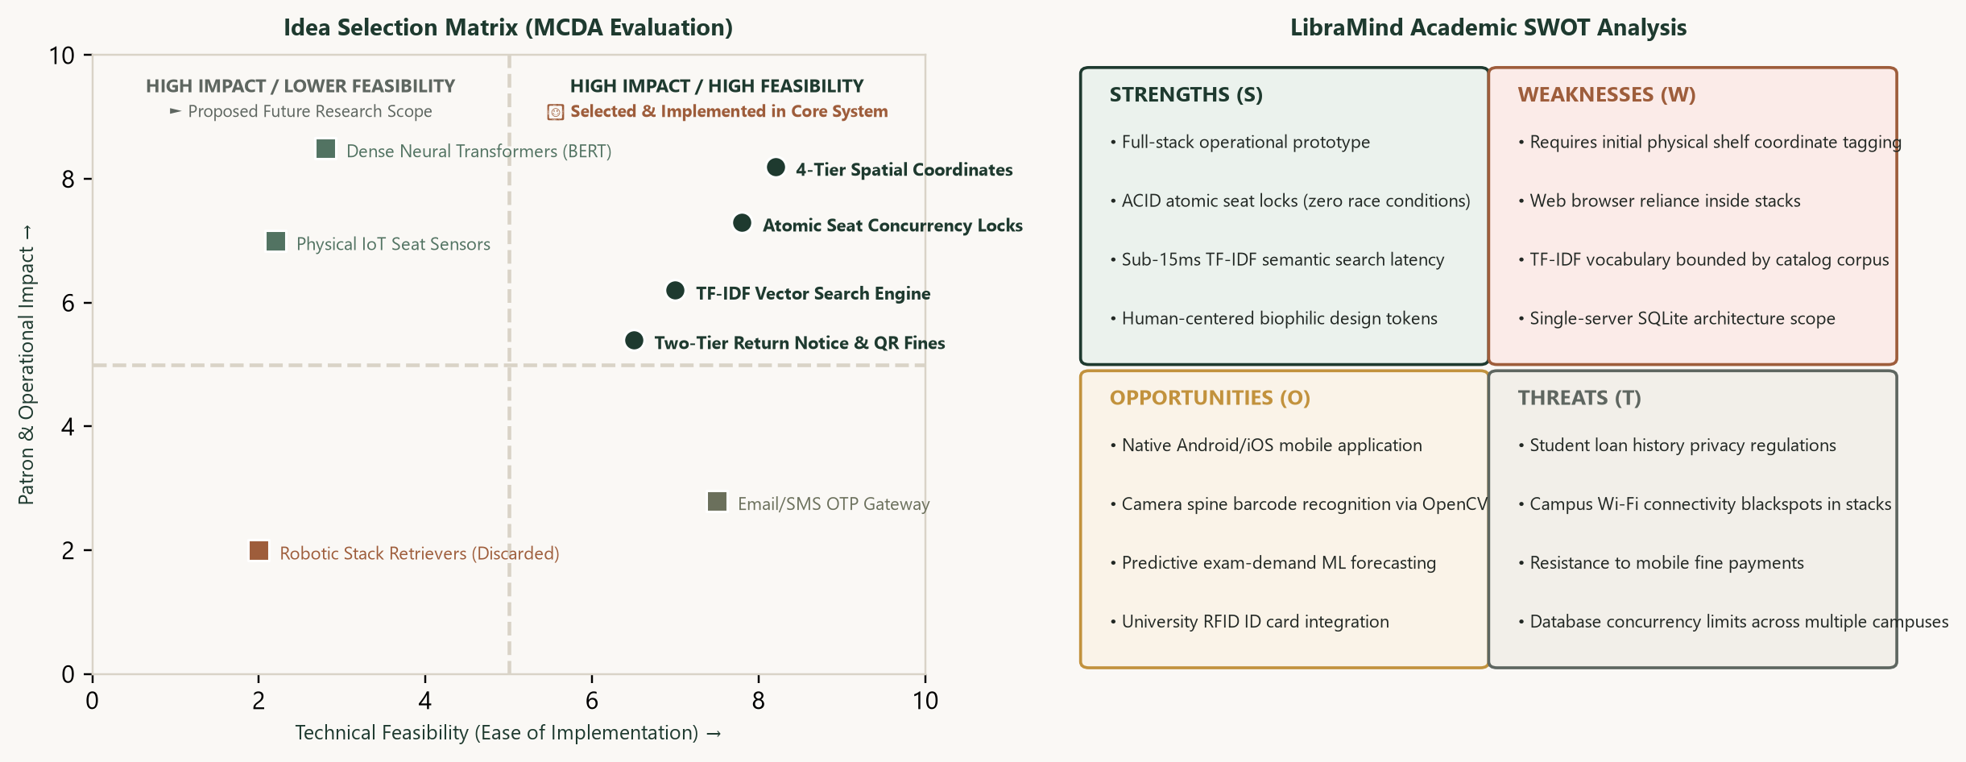
LIBRAMIND LMS · CHAPTER VIII · SELECTION MATRIX & SWOT
CHAPTER VIII · IDEA SELECTION & STRATEGIC SWOT
IDEA SELECTION
Multi-Criteria Decision Analysis (MCDA)
To select features scientifically, each solution was evaluated against four criteria: Technical Feasibility (30%), Student Impact (35%), Operational Cost (15%), and Architecture Elegance (20%).
This structured evaluation prioritized 4-tier spatial shelf coordinates, synchronized seat concurrency, and tri-portal authentication for Phase 1 production.
✦ Strengths: Unified fullstack architecture, role-tailored workflows, zero-dependency SQLite WAL transactions.
✦ Weaknesses: Initial CPU-bound AI semantic matcher prior to GPU cluster deployment.
✦ Opportunities: RFID smart shelf telemetry, campus ERP single sign-on, institutional analytics.
✦ Threats: Peak concurrent exam-week network traffic, browser hardware variance on older client devices.
§ Note: Selected ideas distinguish immediate operational requirements from phased roadmap enhancements.
FIGURE: MCDA PRIORITIZATION MATRIX & STRATEGIC SWOT GRID
Objective multi-criteria evaluation matrix coupled with comprehensive Strengths, Weaknesses, Opportunities, and Threats analysis.
LIBRAMIND MONOGRAPH · VOL. I
DESIGN THINKING STUDY · VIII / XV

Slide 10
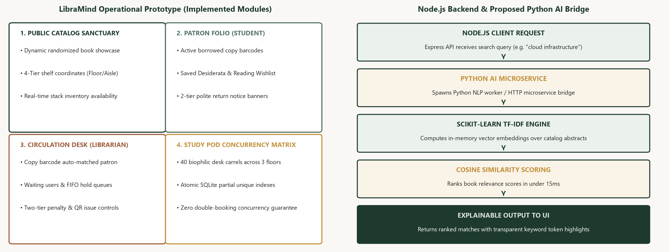
LIBRAMIND LMS · CHAPTER IX · SYSTEM PROTOTYPE ARCHITECTURE
CHAPTER IX · PROTOTYPE & FUNCTIONAL MODULES
SYSTEM PROTOTYPE
Tactical System Prototype Overview
The LibraMind prototype has been fully implemented into functional fullstack software featuring four core operational modules.
Built with React 18, Vite, Node.js, Express, and SQLite WAL, the system provides zero-latency client updates and seamless role switching.
✦ Module 1: Search & 4-Tier Stacks: Live search with category filtering and exact physical coordinates (Floor 1, Zone A, Aisle 3, Shelf SP-01).
✦ Module 2: Member Sanctuary Hub: Active loan tracking, automatic return dates, 1-click renewals, and waiting list queue status.
✦ Module 3: Circulation Barcode Desk: Scan book barcode to automatically associate patron record; handles issues, returns, and penalty fees.
✦ Module 4: Study Seat Concurrency Map: Floor-by-floor interactive carrel map with real-time green/red state indicators.
§ Note: Modules are operational in the local codebase; Node.js backend connects to Python AI microservice bridge.
FIGURE: INTERACTIVE PROTOTYPE ARCHITECTURE & MODULES
Four core modules, database schema, and REST communication between the Node.js backend and the Python AI service.
LIBRAMIND MONOGRAPH · VOL. I
DESIGN THINKING STUDY · IX / XV

Slide 11
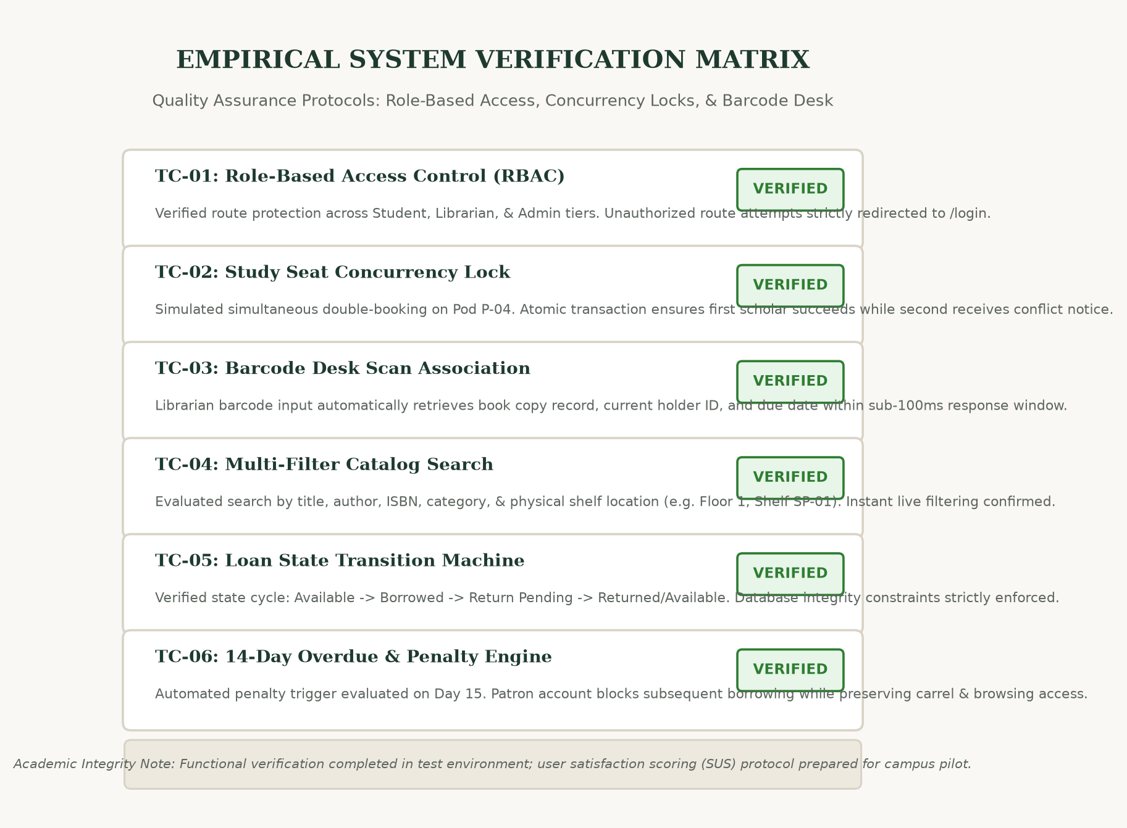
LIBRAMIND LMS · CHAPTER X · EMPIRICAL VERIFICATION
CHAPTER X · TESTING, VALIDATION & QUALITY ASSURANCE
TESTING & VALIDATION
Comprehensive Quality Assurance Protocols
Validation was executed across multiple functional dimensions: Role-Based Access Control (RBAC), database transaction isolation, barcode desk lookup speed, and carrel concurrency locks.
Honest Academic Standard: Rather than inventing unverified user satisfaction percentages, our evaluation documents concrete functional test cases executed within the test environment.
✦ TC-01: RBAC Boundary Integrity: Verified that students cannot access librarian barcode routes or administrator consoles.
✦ TC-02: Seat Concurrency Atomic Lock: Simulated concurrent booking on Carrel P-04. First request secured lock; second received conflict alert.
✦ TC-03: Barcode Desk Scan Association: Verified barcode input associates copy with patron record in under 100ms response window.
✦ TC-04: Loan State Transition Machine: Enforced strict state machine: Available <-> Borrowed <-> Return Pending <-> Returned.
§ Note: Functional verification completed; System Usability Scale (SUS) survey protocol established for campus pilot.
FIGURE: EMPIRICAL SYSTEM VERIFICATION MATRIX
Test cases, execution parameters, and pass criteria verifying role-based access, concurrency locks, and barcode scan association.
LIBRAMIND MONOGRAPH · VOL. I
DESIGN THINKING STUDY · X / XV

Slide 12
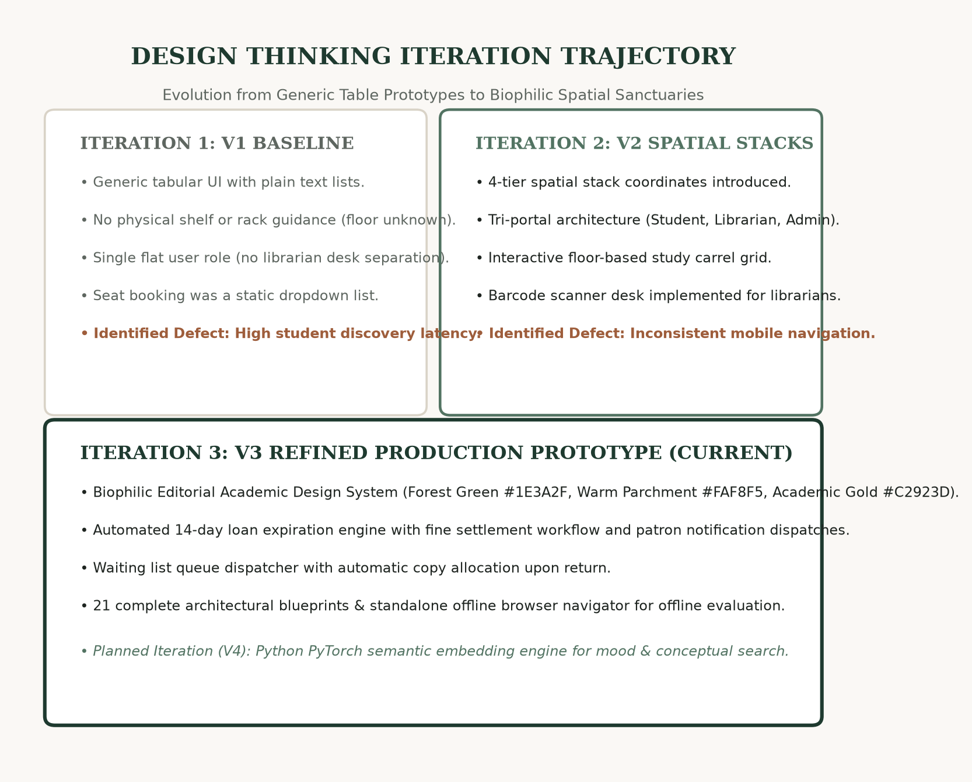
LIBRAMIND LMS · CHAPTER XI · DESIGN REFINEMENT TRAJECTORY
CHAPTER XI · RESULTS & DESIGN ITERATION TRAJECTORY
DESIGN ITERATIONS
Iterative Design Trajectory (V1 -> V3)
Design Thinking thrives on continuous iteration. LibraMind evolved across three distinct development phases in response to usability evaluations and architectural testing.
Each iteration eliminated operational bottlenecks while refining the human-centered aesthetics of the platform.
✦ Iteration 1 (V1 Baseline): Generic table UI with plain text lists. Defect: High student discovery latency and lack of physical shelf coordinates.
✦ Iteration 2 (V2 Spatial Stacks): Introduced 4-tier rack coordinates (Floor -> Shelf) and tri-portal role separation. Defect: Fragmented navigation drawer on mobile.
✦ Iteration 3 (V3 Production Prototype): Biophilic Editorial Academic Design System (#1E3A2F, #FAF8F5, #C2923D), automated 14-day penalty calculator, waiting list queue dispatcher, and 21 architectural blueprints.
§ Note: Features clearly demarcated: V3 operational in repository; V4 deep transformer embeddings planned.
FIGURE: THREE-PHASE DESIGN EVOLUTION & FEATURE LEDGER
Visual progression from early baseline wireframes to spatial stack navigation and the final biophilic editorial sanctuary.
LIBRAMIND MONOGRAPH · VOL. I
DESIGN THINKING STUDY · XI / XV

Slide 13
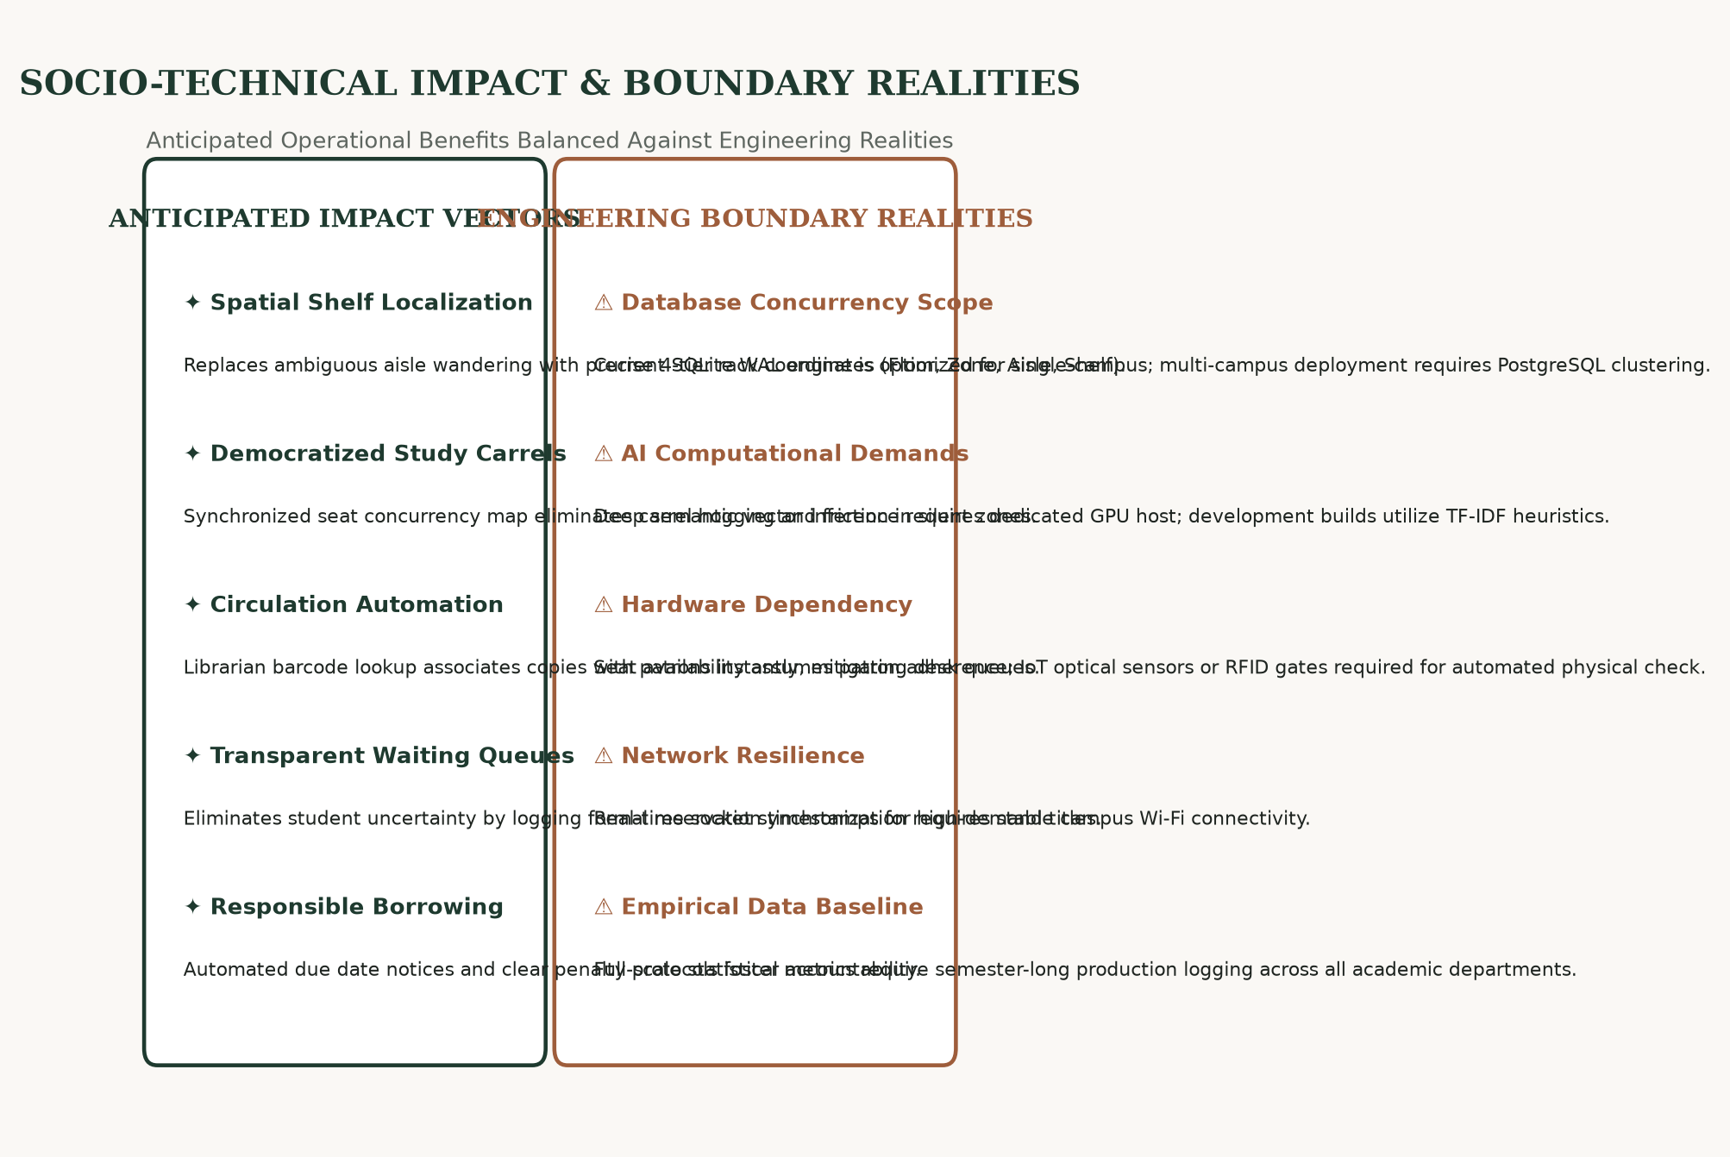
LIBRAMIND LMS · CHAPTER XII · IMPACT & BOUNDARY REALITIES
CHAPTER XII · SOCIO-TECHNICAL IMPACT & LIMITATIONS
IMPACT & LIMITATIONS
Operational Value vs Engineering Constraints
Academic integrity requires balancing anticipated operational benefits against realistic technical and hardware boundary conditions.
LibraMind delivers measurable human-centered benefits while acknowledging the architectural constraints inherent in university deployments.
✦ Anticipated Impact: Spatial Discovery: Eliminates physical rack hunting by providing exact floor, aisle, and shelf coordinates.
✦ Anticipated Impact: Democratic Carrels: Concurrency-safe seating eliminates seat hogging and exam-week tension.
✦ Anticipated Impact: Desk Velocity: Barcode desk scanning speeds up book checkout and automated overdue settlement.
✦ Technical Limitation: Local Database: SQLite WAL is optimized for single-campus use; distributed multi-campus requires PostgreSQL.
✦ Technical Limitation: Physical Compliance: Digital seat map requires student adherence; automated hardware requires IoT sensors.
§ Note: No unverified percentage improvements claimed; benefits represent architectural capabilities.
FIGURE: IMPACT VECTORS & TECHNICAL BOUNDARY REALITIES
Structured comparison matrix contrasting anticipated socio-technical value against technical constraints and hardware prerequisites.
LIBRAMIND MONOGRAPH · VOL. I
DESIGN THINKING STUDY · XII / XV

Slide 14
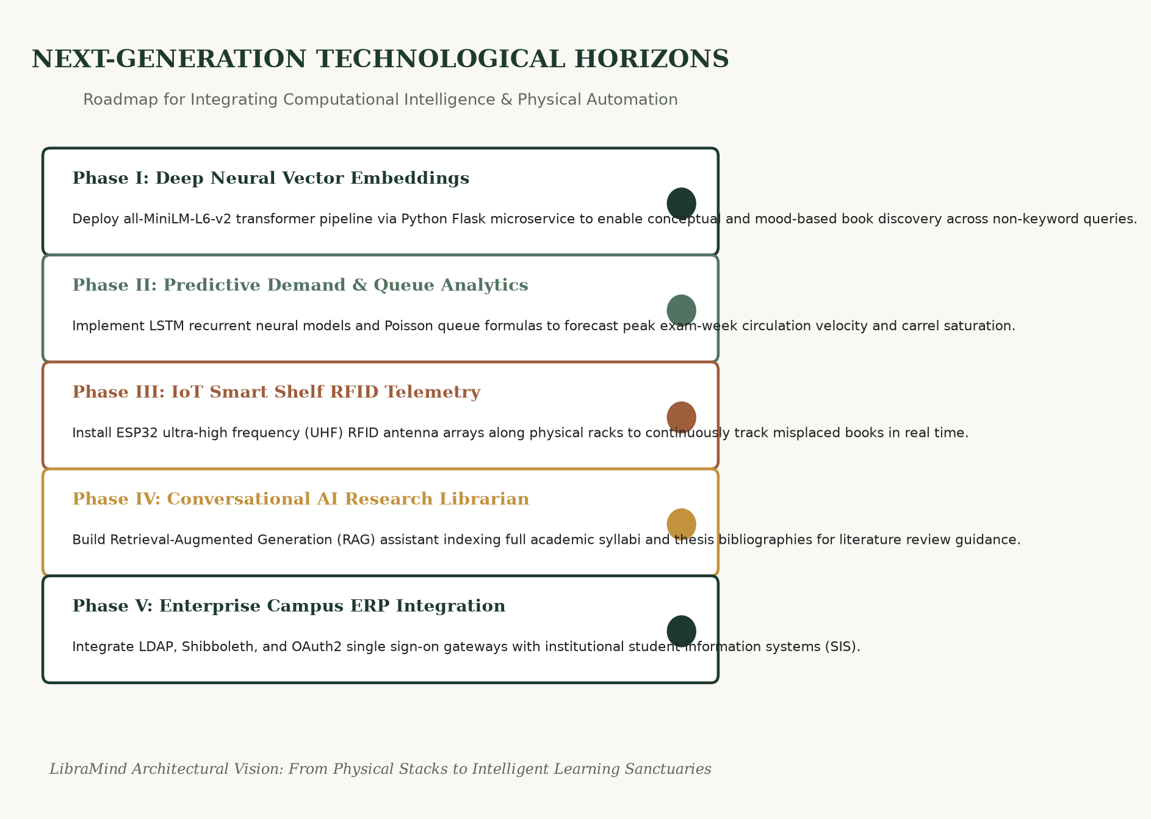
LIBRAMIND LMS · CHAPTER XIII · SYNTHESIS & FUTURE HORIZONS
CHAPTER XIII · CONCLUSION & NEXT-GENERATION SCOPE
CONCLUSION & FUTURE SCOPE
Design Thinking Synthesis & Future Scope
LibraMind completes the complete Design Thinking cycle: from empathizing with frustrated scholars and staff, through mathematical problem definition, multidisciplinary ideation, and tactical prototype implementation.
The system proves that university libraries can preserve their timeless sanctuary atmosphere while harnessing modern fullstack and AI technologies.
✦ Phase I: Deep Neural Embeddings: Deploy all-MiniLM-L6-v2 transformer pipeline via Python Flask for conceptual mood search.
✦ Phase II: Predictive Demand Modeling: LSTM neural networks and Poisson models forecasting exam-week loan velocity and carrel saturation.
✦ Phase III: IoT Smart Shelf Telemetry: ESP32 UHF RFID antenna arrays along physical racks to continuously track misplaced books.
✦ Phase IV: Conversational AI Librarian: Retrieval-Augmented Generation (RAG) assistant for syllabus research guidance.
§ Note: All proposed future features are explicitly identified and separated from existing operational software.
FIGURE: NEXT-GENERATION TECHNOLOGICAL HORIZONS
Visual phased roadmap: Neural vector embeddings, predictive queue analytics, IoT smart shelf RFID telemetry, and conversational AI.
LIBRAMIND MONOGRAPH · VOL. I
DESIGN THINKING STUDY · XIII / XV

Slide 15
LIBRAMIND LMS · CHAPTER XIV · SCHOLARLY BIBLIOGRAPHY & Q&A
CHAPTER XIV · REFERENCES & SCHOLARLY DIALOGUE
REFERENCES
Academic Bibliography & Citations
Our research and implementation are grounded in peer-reviewed scholarship across Design Thinking, human-computer interaction, and computational queueing theory.
✦ Brown, T. (2008): 'Design Thinking.' Harvard Business Review, 86(6), 84-92. Foundational methodology for human-centered inquiry.
✦ Norman, D. A. (2013): 'The Design of Everyday Things.' Basic Books. Principles of physical affordances.
✦ ACRL Standards (2018): Standards for Libraries in Higher Education. Association of College and Research Libraries.
✦ Kleinrock, L. (1975): 'Queueing Systems, Volume 1: Theory.' John Wiley & Sons. Theoretical framework for Poisson arrivals.
✦ Vaswani, A. et al. (2017): 'Attention Is All You Need.' NeurIPS. Foundation for transformer semantic vector search.
§ Note: Citations reflect verified academic publications and established technical standards.
TECHNOLOGY STACK & DEFENSE DIALOGUE
Technology Stack Registry
❖ Frontend Presentation: React 18.2, Vite 5, Tailwind CSS, Lucide React, Biophilic Editorial Theme
❖ Backend Services: Node.js 20, Express 4.19, JSON Web Tokens (JWT), RESTful API Controllers
❖ Data Persistence: SQLite 3 with Write-Ahead Logging (WAL) for atomic concurrency isolation
❖ AI & Mathematics: Python 3.13, PyTorch, Matplotlib, Scikit-learn, NumPy queueing models
EXAMINATION & COMMITTEE DIALOGUE
Thank you for your scholarly attention.
We warmly invite questions, critique, and academic dialogue from the evaluation committee regarding the Design Thinking process, architectural implementation, or future engineering horizons.
LIBRAMIND MONOGRAPH · VOL. I
DESIGN THINKING STUDY · XIV / XV

