Slide 1


Slide 2
ORW Seminar
on
IMPACT STUDY ON AURDINO BASED IRRIGATION SYSTEM IN HYDROPONICS
Presented by
Dalvi Komal Namdev Ek-2016/011
Kore Shubham Dilip Ek-2016/029
Patil Rushiksh Sanjevkumar Ek-2016/058
Kadam Tejas Suryakant Ek-2014/029
Patil Sourabh Sachin Ek-2014/053
Under the guidance of
Prof. D. A. Patil
Assistant Professor
Department of Irrigation and DrainageEngineering
Submitted to
Department of Irrigation and Drainage Engineering
Dr. D. Y. Patil College of Agricultural Engineering and
Technology, Talsande, Dist.-Kolhapur
2019

Slide 3
CONTENTS
Introduction
Importance
Objectives
Review of literature
Material and methods
Plan of experiment
Facilities required and their availabilities
Location and existing facilities
References

Slide 4
INTRODUCTION
In today's era, the traditional methods that are used for irrigation, such as over head sprinkler and flood type, is not that much efficient. They results in a lot of wastage of water and can also promote disease such as fungus formation due to over moisture of the soil.
Agriculture is the most important occupation for the most of the Indian families. It plays vital role in the development of agricultural country.
Irrigation is one method to supply water but in some cases, there will be lot of water wastage. Therefore, in this regard to save water and time we have proposed project titled Impact study on arduino based hydroponic system.
In this proposed system, we are using various sensors like temperature, humidity, soil moisture sensors that sense the various parameters of the soil.
In addition, based on soil moisture value land is automatically irrigated by ON/OFF of the motor. These sensed parameters and motor status will be displayed on LCD.

Slide 5
The proposed system has been designed to overcome the unnecessary water flow into the agricultural lands. Temperature, moisture and humidity readings are continuously monitored by using temperature, moisture and humidity sensor and send these values to the assigned IP address.
For effective growth of crop and for reducing excess water used in irrigation and also save the time of farmers which consume during irrigation process it necessary to design irrigation system which saves the time of irrigation and also saves the water.

Slide 6
OBJECTIVES
To develop arduino model for irrigation scheduling in hydroponic system.
To study parameters such as soil moisture, temperature and humidity by using sensor.

Slide 7
IMPORTANCE
It helps in water the crops as per their need.

Slide 8
REVIEW OF LITERATURE
Authors | Work Done | Results
1.Rajpal A.et.al. (2011) | They studied microcontroller based automatic irrigation system with moisture sensor | It can be seen that the combination of hardware and software provides a irrigation controller that can be implemented at relatively low cost and which is extremely user friendly
2.Nandurkar S. R. and Thool V. R. (2012) | They worked on smart irrigation system for automation which helped in utilization of water for irrigation as per requirement. | The proposed system enables irrigation of the field only when it is needed and thus serves to conserve water. Also, the proposed system eliminates the intervention of human being for irrigation purposes.

Slide 9
Authors | Work Done | Results
3. Kumar S. and Krishnaiah R. V. (2013) | They worked on advance technique for soil moisture content based automatic motor pumping for agriculture land purpose | Salient features of the system are: Closed loop automatic irrigation system, temperature and water usage monitoring. User can easily preset the levels of the Moisture and is regularly updated about current value of all Parameters on LCD display. In future, other important soil parameters namely soil pH, soil electrical conductivity will also be incorporated in the system.

Slide 10
MATERIALS AND METHODS
Arduino:
Arduino is an open-source electronics platform based on easy-to-use hardware and software.
There are many versions of Arduino boards introduced in the market like Arduino Uno, Arduino Due, Arduino Leonardo, Arduino Mega, however, most common versions are Arduino Uno and Arduino Mega.
Soil Moisture Sensor:
The sensor measures the dielectric constant of the soil in order to find its volumetric water content (VWS).
The sensor has a low power requirement and very high resolution.

Slide 11
C. Humidity Sensor:
Humidity sensor also called hygrometer.
The humidity sensor sense the relative humidity i.e. it measures both air temperature and moisture.
D. Hydroponics Set Up:

Slide 12
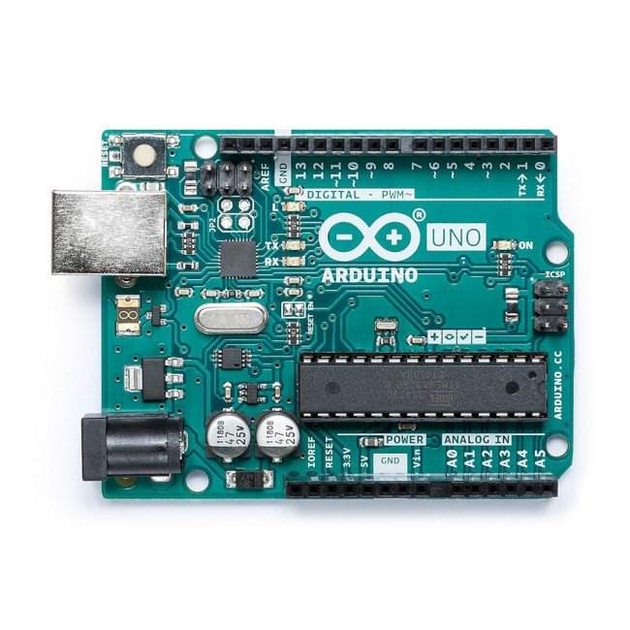
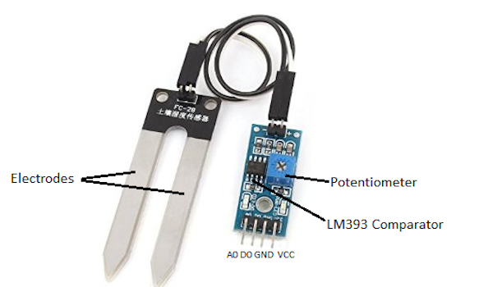
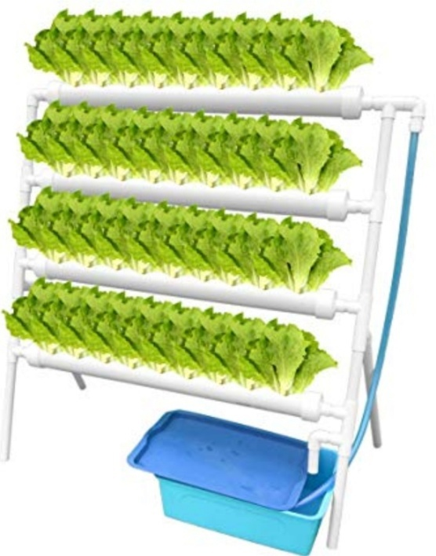
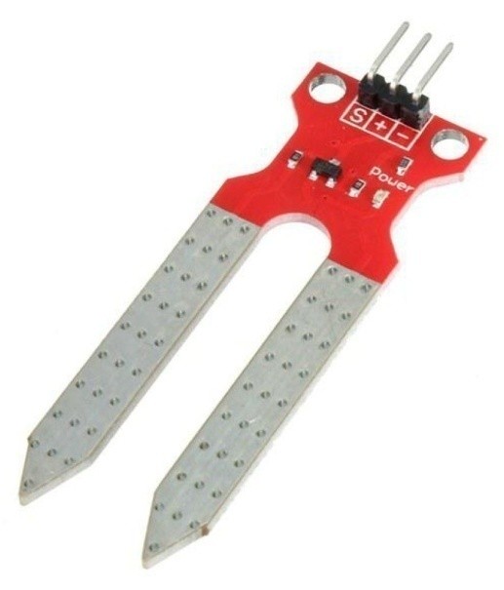
Fig. Arduino UNO
Fig. Soil Moisture Sensor
Fig. Humudity Sensor
Fig. Hydroponics Set Up

Slide 13
PLAN OF EXPERIMENT
Selection of project work
Collection of research paper
Selection of study area
Data collection
Selection of arduino and sensors
Selection of programs for arduino

Slide 14
Connection of arduino circuit
Implementation of arduino circuit in project area
Analysis of results

Slide 15
Facilities required and their availability
All the required facilities are available with the Department of Irrigation and Drainage Engineering, Dr. D.Y. Patil CAET, Talsande.
Sr. No. | Facilities required | Availability
1. | Hydroponics set up | Dnyanashanti farms, Dr. Y. Patil Agriculture campus
2. | Power supply | Dnyanashanti farms, Dr. Y. Patil Agriculture campus

Slide 16
Location and existing facilities
Research work will be conducted at Dnyanashanti farms and Laboratories of Department of Irrigation and Drainage Engineering, Dr. D.Y. Patil CAET, Talsande.

Slide 17
REFERENCES
Dukes 2003. Found that soil moisture based automatic irrigation system required weekly observations. Applied Engineering in Agriculture. Vol.1,889-101.
Nandurkar S. R. and Thool V. R. 2012. Design of Soil Moisture Sensing Unit for Small Irrigation Application, International Conference on Emerging Technology Trends on Advanced Engineering Research, Proceedings. Interntional Journal of Computer Applications, 1-5.
Kumar S. and Krishnaiah R. V. 2013. Advance technique for Soil Moisture Content Based Automatic Motar Pumping for Agriculture Land Purpose, International Journal of VLSI and Embedded System, Vol.4,99-603

Slide 18
Mediawan, M., Yusro, M., & Bintoro, J. (2018, November). Automatic Watering System in Plant House-Using Arduino. In IOP Conference Series: Materials Science and Engineering(Vol. 434, No. 1, p. 012220). IOP Publishing.
Naik, P., Kumbi, A., Katti, K., & Telkar, N. AUTOMATION OF IRRIGATION SYSTEM USING IoT.
Nikam M. et.al. 2016. Automated irrigation system by using microcontroller. Unpublished B. Tech. (Agri. Engg.) Thesis Submitted to Dr. D. Y. Patil CAET, Talsande

Slide 19
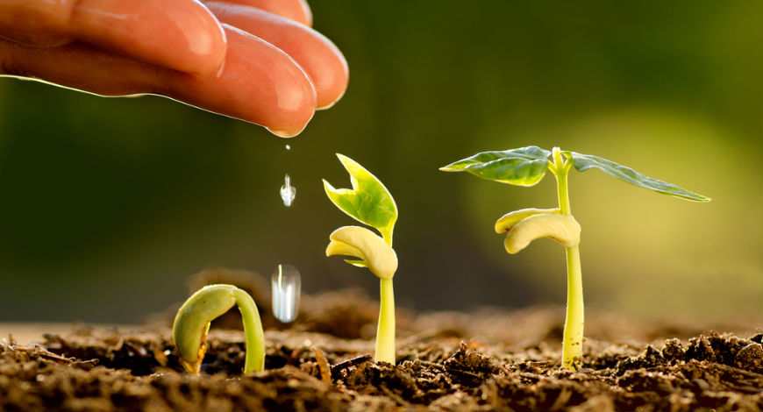
Thank you

