Slide 1

MEDEASY
1.Rudra Juyal(2401201205)
2.Priyanshu Mishra(2401201161)
3.Dharampal(2401201154)
SCHOOL OF ENGINEERING And TECHNOLOGY

Slide 2
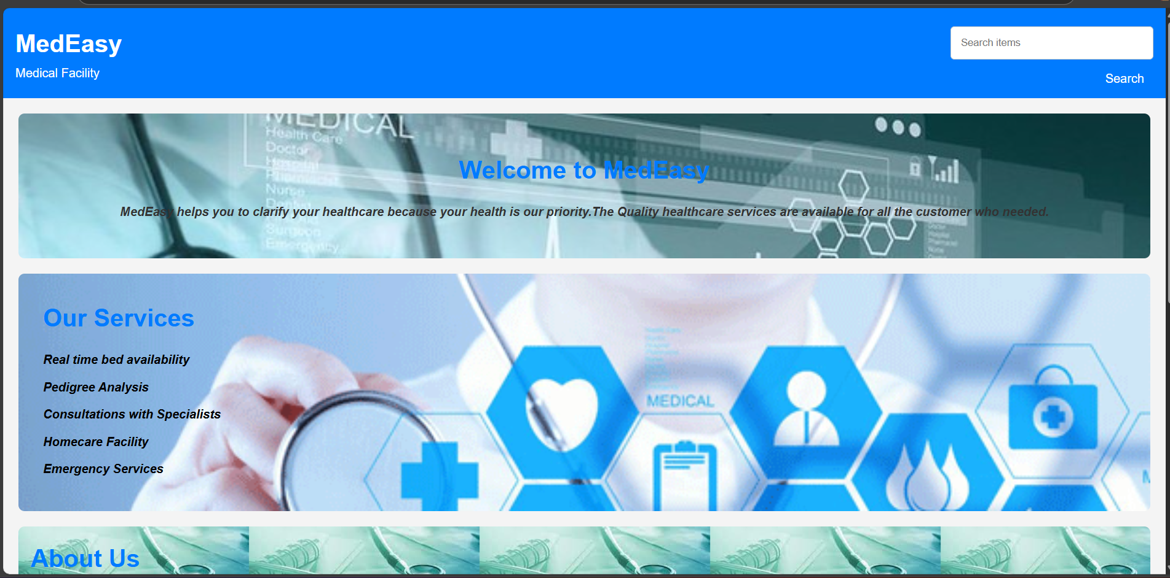
INTRODUCTION
We are presenting our MedEasy website that are used for the facility of pedigree analysis, real time bed availability check and health library, dosage alerts. It only contains facility of online consultation and information related to the doctors .

Slide 3

PROBLEM STATEMENTS
A web application for offering, homecare services, real –time bed availability, health library and secure medical information storage for further prediction of genetic disorder, enhancing patient care for better decision –making and timely healthcare delivery.
This Photo by Unknown Author is licensed under CC BY-SA

Slide 4
OBJECTIVES
The objective of creating a MedEasy is to provide easy access to healthcare information and services. It aims to streamline pedigree analysis ,real-time bed check , appointment bookings, patient communication, and offer detailed resources on treatments and services. Ultimately, it enhances patient experience and engagement.

Slide 5

TOOLS AND TECHNIQUES
HTML
CSS
JAVASCRIPT(INCLUDED IN HTML FORMAT)
PYTHON

Slide 6
KEY FEATURES
We use Real time bed availability system where we can allow users to see the real time bed available in different section of ward.
We have the consultation feature to the doctor for any diagnosis.

Slide 7
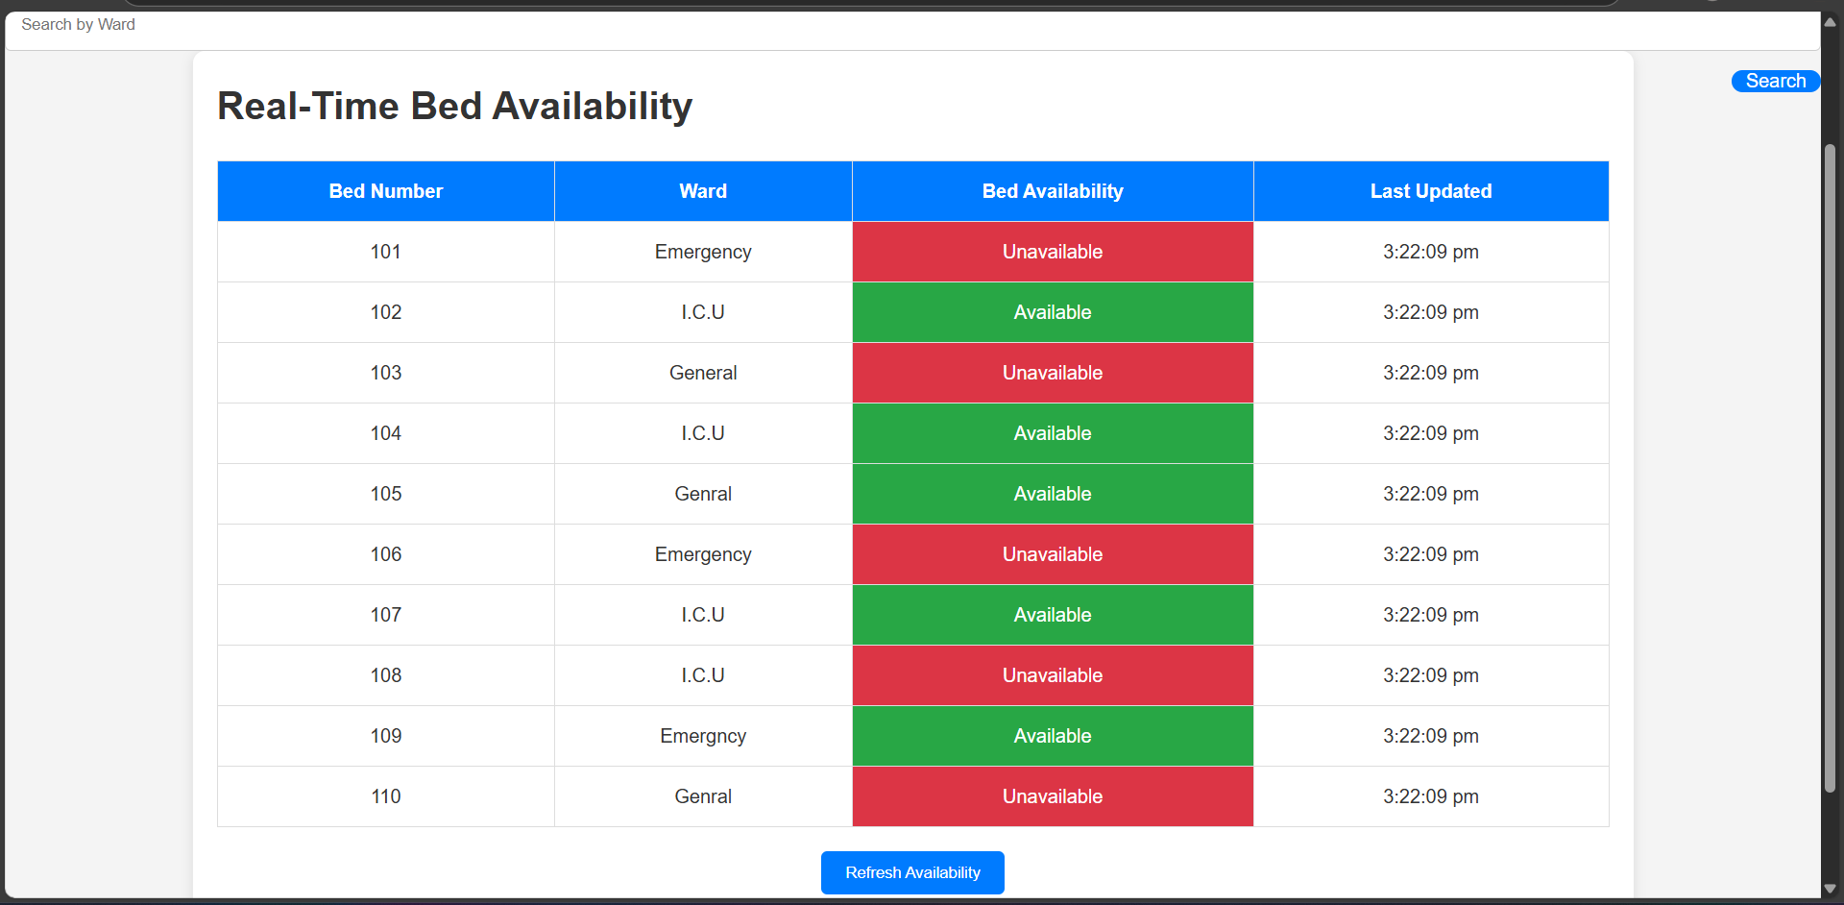

Slide 8
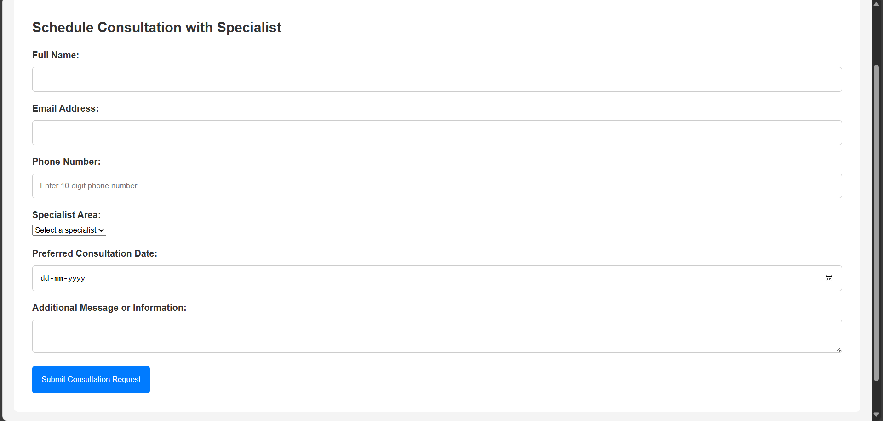

Slide 10
CONCLUSION & FUTURE WORKS
The MedEasy web application provides a user-friendly platform that streamlines access to essential healthcare services such as real-time bed availability, pedigree analysis, doctor consultations, and a health information library. Through this system, we aim to improve hospital resource management, enhance patient care, and support early diagnosis and consultation using a digital-first approach.
Future Works like Database Integration, API Integration, Cloud Hosting

Slide 11
THANK YOU

