Slide 1

Financement: The Ultimate Budgeting App for Students
Rudra Chobe
Nikhil Bhosale
Ritika Chougala

Slide 2
Introduction
Introduction to Financement
Generating Reports
Tips and Tricks to Financial
Extended Features
Security Measures
Customer Support
Conclusion

Slide 3
Introduction to Financement
Financement is a mobile app designed to help students manage their finances effectively. With the rising cost of tuition and living expenses, it can be challenging for students to keep track of their spending and budget accordingly. This app aims to simplify the process by providing an easy-to-use platform that allows students to monitor their expenses and income.
The first page of the app is dedicated to adding expenses. Users can input the amount spent, the category (such as food, transportation, or entertainment), and any notes they want to add. The app also allows users to set a budget for each category and receive notifications when they are close to reaching their limit.

Slide 4
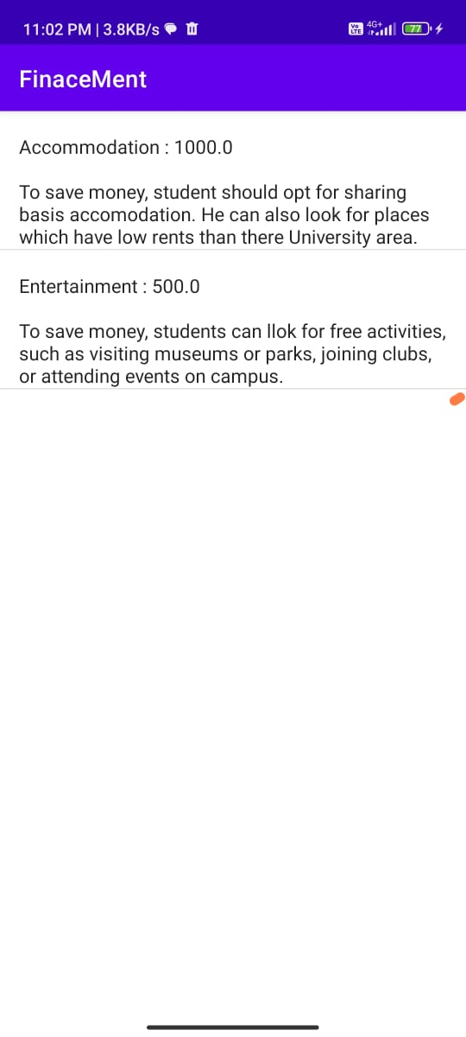

Slide 5
Generating Reports
One of the key features of Financement is its reporting capabilities. Users can access detailed reports that provide insights into their spending habits and patterns. The second page of the app is dedicated to generating these reports.
Users can view their spending by category, date range, or specific expense types. The app also provides graphs and charts to help users visualize their spending trends over time. These reports can be exported as PDFs or Excel files for further analysis.

Slide 6
Projected Expense
Accommodation: To save money, student should opt for sharing basis accomodation. He can also look for places which have low rents than their University area.
Transportation: Public transportation is usually the most affordable option. Students can consider investing in a monthly pass to save money in the long run.
Food and groceries: To save money, students can cook meals at home instead of eating out. They can also consider buying groceries in bulk and shopping at budget-friendly stores.
Textbooks and course materials: To save money, students can consider buying used textbooks or renting them. They can also look for free online resources or borrow materials from the library.
Travel expenses: To save money, students can plan their trips in advance, take advantage of student discounts, and consider cheaper modes of transportation.
Phone and internet bills: To save money, students can consider opting for a cheaper phone plan or internet package.

Slide 7
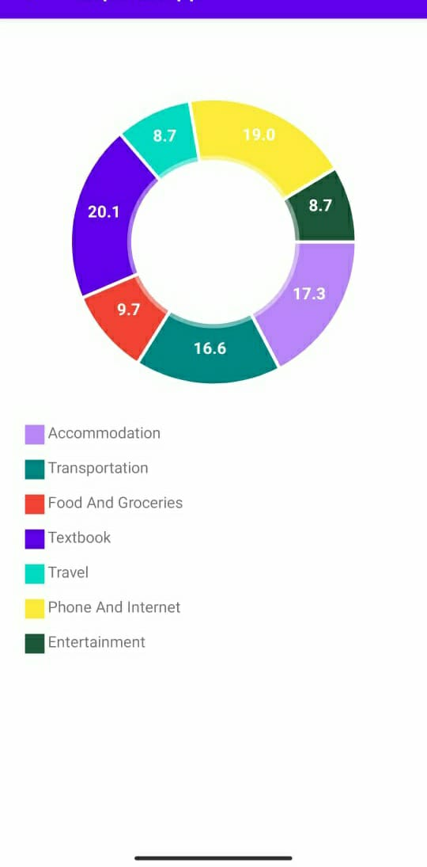

Slide 8
Tips and Tricks
In addition to its budgeting and reporting features, Financement also offers tips and tricks for financial management. The third page of the app is dedicated to providing users with advice on how to save money and make smart financial decisions.
These tips cover a wide range of topics, from reducing food waste to finding affordable housing options. Users can also submit their own tips and vote on the most helpful ones. This community-driven approach encourages users to share their knowledge and learn from one another.

Slide 9
Extended Features
Security Measures
Customer Support

Slide 10
Security Measures
With sensitive financial information at stake, security is a top priority for Financement. The app will use industry-standard encryption and authentication protocols to ensure that users' data is protected.
Users can also enable two-factor authentication for an extra layer of security. Additionally, the app does not store any credit card information, so users can rest assured that their financial information is safe and secure.

Slide 11
Customer Support
Financement understands that managing finances can be stressful, so the app provides robust customer support to help users navigate any issues or concerns they may have.
Users can access a comprehensive FAQ section within the app, as well as contact customer support directly through email or phone. The app also provides regular updates and bug fixes to ensure that users have the best possible experience.

Slide 12
Conclusion
In conclusion, Financement is a tool for any student looking to manage their finances effectively. With its user-friendly interface, powerful reporting capabilities, and community-driven approach to financial management, this app has everything you need to stay on top of your finances.Whether you're trying to save money, reduce debt, or simply gain a better understanding of your spending habits, Financement is the perfect app for you. Download it today and start taking control of your finances!

