Slide 1
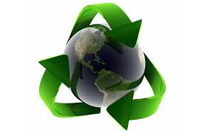
Technological Innovation and Design for Environment
Sub-topics on Eco-Design and Sustainable Practices
Made by Rudra Shivhare

Slide 2
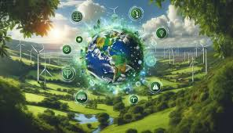
Introduction
Overview of Technological Innovation for Environment
Importance of Sustainable Design
Made by Rudra Shivhare

Slide 3
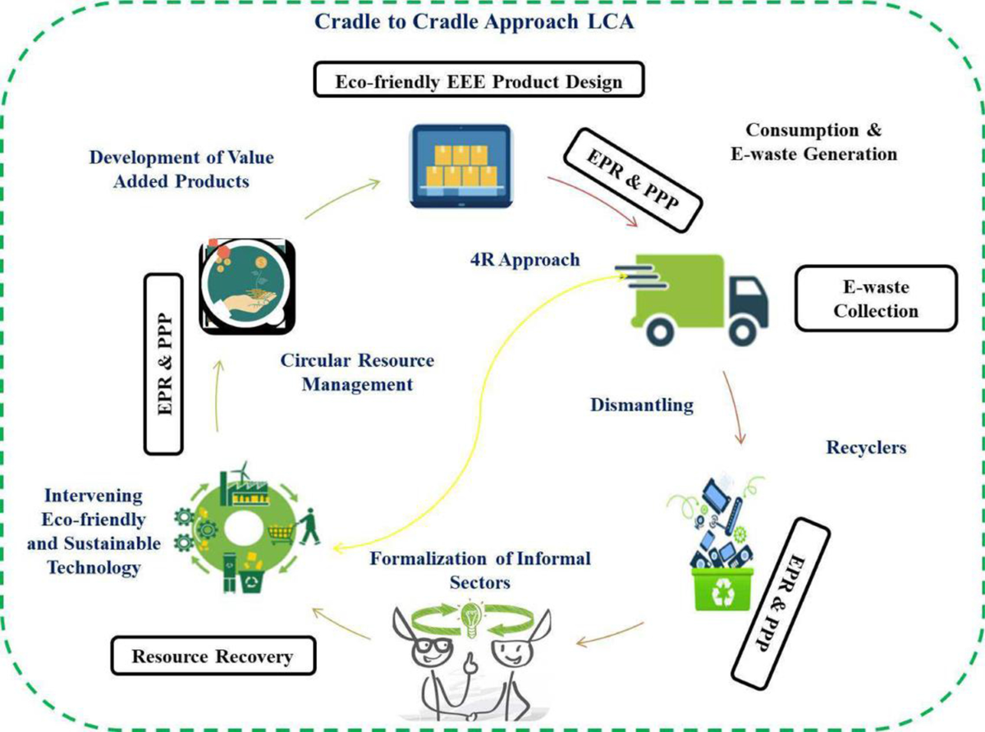
Eco-Design Principles
Made by Rudra Shivhare

Slide 4



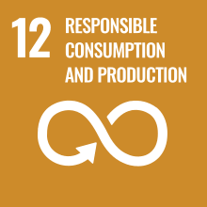
Sustainable Product Design Strategies
Minimizing Environmental Impact
Strategies:
- Material Selection
- Energy Efficiency
- Durability and Longevity
Made by Rudra Shivhare

Slide 5

Case Studies on Eco-Design
ABC Electronics is a global manufacturer of consumer electronics, known for their commitment to sustainability and environmental stewardship. In response to increasing concerns about e-waste, ABC Electronics decided to implement eco-design principles across their product development lifecycle.Example 2: Sustainable Packaging
Made by Rudra Shivhare

Slide 6
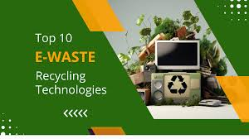
Innovative Technologies for E-Waste Recycling
blockchain technology can be used to track e-waste through its lifecycle, ensuring that it is properly recycled and reducing the chances of illegal dumping or improper handling.
This involves extracting valuable metals and minerals from e-waste through processes like acid dissolution, reducing the need for environmentally damaging mining operations.

Slide 7
Non-Toxic Extraction Methods
Mechanical Separation: Utilizing mechanical processes such as shredding, crushing, and sorting to separate different materials in e-waste. This method avoids the use of chemicals and minimizes the generation of hazardous by-products.
Green Chemistry Principles: Designing extraction processes following green chemistry principles such as minimizing waste, using safer solvents, and maximizing efficiency to reduce environmental impact.
Made by Rudra Shivhare

Slide 8
Conclusion
Made by Rudra Shivhare
E-waste poses significant environmental and health risks due to its toxic components and increasing volume. Effective management through reduction, reuse, recycling, and adoption of non-toxic extraction methods is crucial for mitigating these impacts and promoting sustainability.

Slide 9
Thank You
Made by Rudra Shivhare

