Slide 1

Technological Innovation and Design for Environment
Sub-topics on Eco-Design and Sustainable Practices
Made by Rudra Shivhare

Slide 2

Introduction
Overview of Technological Innovation for Environment
Importance of Sustainable Design
Made by Rudra Shivhare

Slide 3
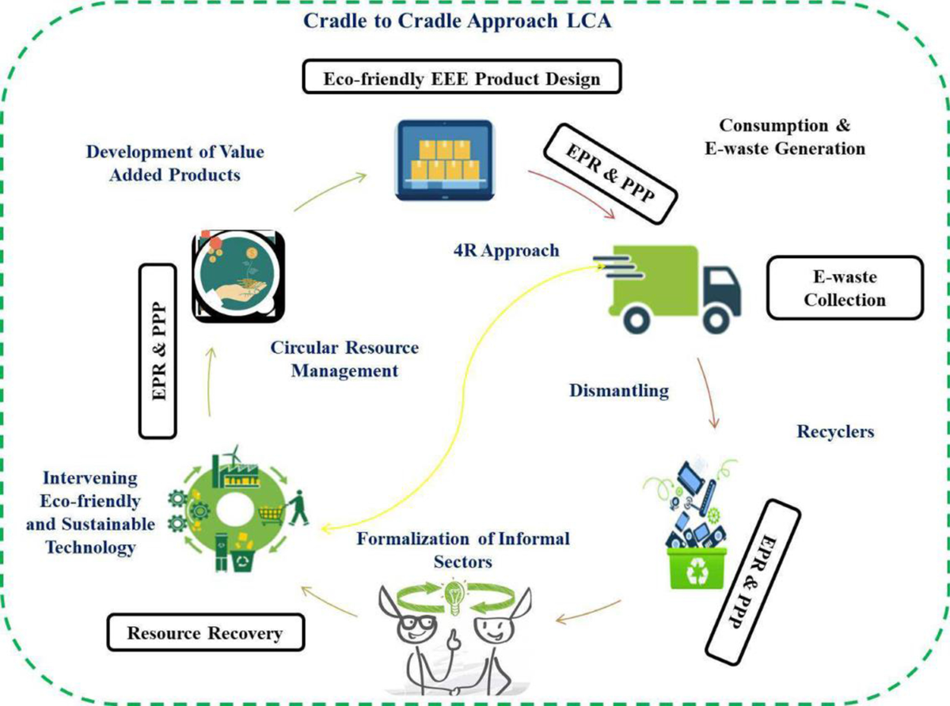
Eco-Design Principles
Made by Rudra Shivhare

Slide 4
Way of Recycling E-waste
Physical
Chemical
Made by Rudra Shivhare

Slide 5
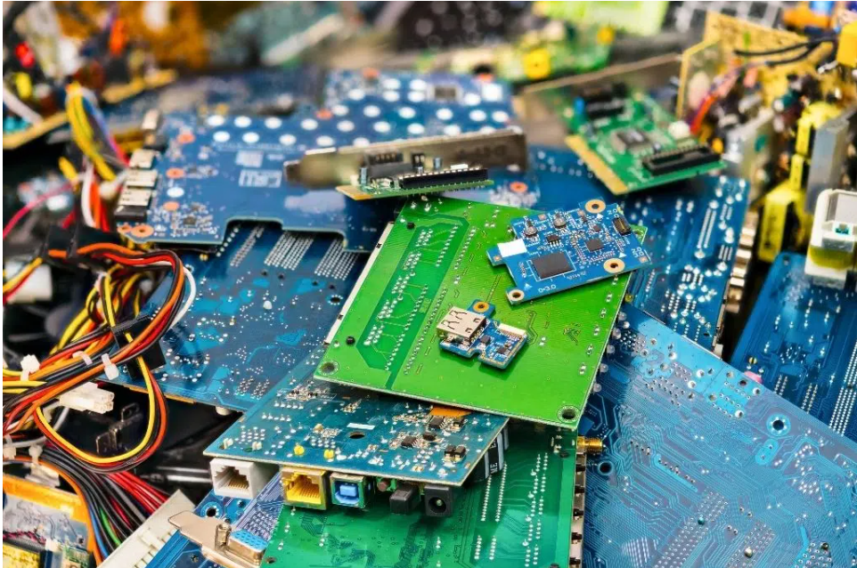
Physical Recycling
Also known as Magenetic or bioleaching Recycling. Physical recycling involves dismantling and shredding e-waste to separate components like metals and plastics. Techniques such as magnetic and optical sorting are used to recover valuable materials. This method ensures efficient material separation and recycling.
Made by Rudra Shivhare

Slide 6
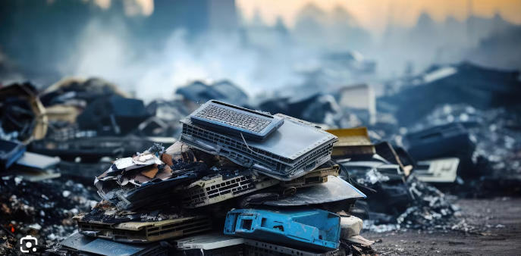
Chemical Recycling
Also known as Metallurgical recycling. Chemical recycling uses chemical processes to recover metals from e-waste. Methods like pyrometallurgical processing (high-temperature melting) and hydrometallurgical processing (chemical dissolution) extract valuable metals such as gold, silver, and copper. These techniques maximize material recovery while minimizing environmental impact.
Made by Rudra Shivhare

Slide 7



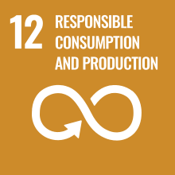
Sustainable Product Design Strategies
Minimizing Environmental Impact
Strategies:
- Material Selection
- Energy Efficiency
- Durability and Longevity
Made by Rudra Shivhare

Slide 8

Case Studies on Eco-Design
ABC Electronics is a global manufacturer of consumer electronics, known for their commitment to sustainability and environmental stewardship. In response to increasing concerns about e-waste, ABC Electronics decided to implement eco-design principles across their product development lifecycle.Example 2: Sustainable Packaging
Made by Rudra Shivhare

Slide 9
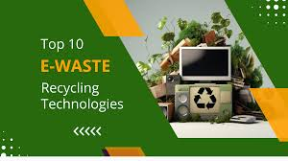
Innovative Technologies for E-Waste Recycling
blockchain technology can be used to track e-waste through its lifecycle, ensuring that it is properly recycled and reducing the chances of illegal dumping or improper handling.
This involves extracting valuable metals and minerals from e-waste through processes like acid dissolution, reducing the need for environmentally damaging mining operations.

Slide 10
Non-Toxic Extraction Methods
Mechanical Separation: Utilizing mechanical processes such as shredding, crushing, and sorting to separate different materials in e-waste. This method avoids the use of chemicals and minimizes the generation of hazardous by-products.
Green Chemistry Principles: Designing extraction processes following green chemistry principles such as minimizing waste, using safer solvents, and maximizing efficiency to reduce environmental impact.
Made by Rudra Shivhare

Slide 11
Conclusion
Made by Rudra Shivhare
E-waste poses significant environmental and health risks due to its toxic components and increasing volume. Effective management through reduction, reuse, recycling, and adoption of non-toxic extraction methods is crucial for mitigating these impacts and promoting sustainability.

Slide 12
Thank You
Made by Rudra Shivhare

