Slide 1
Targets are set on data that cannot be joined
Six official sources feed production. None of them is directly comparable with another.
NCS
grain: state
vintage: 2024-11-15
Udyam
grain: district
vintage: 2023-12-21
Census B-24
grain: district x occupation
vintage: 2011
LGD
grain: geography directory
vintage: monthly
PLFS
grain: national only
vintage: Apr 2025
MSDE AR
grain: state x scheme
vintage: 2024-03-31
Five vintages spanning fourteen years. Two occupation schemes. Three statistical natures.
No source carries a district x occupation vacancy count — which is exactly what the finest requirement needs.
Sources: NCS Parliament answers · Udyam MSME · Census 2011 B-24 · LGD · PLFS · MSDE Annual Report 2023-24
Notes:
Before a state sanctions seats, it needs to know which district-and-trade combinations are heading for shortage or oversupply. Today that judgement is last year's targets plus a bit.
The data exists - in five vintages across fourteen years, two occupation schemes, and three different statistical natures. Not one source carries a district-by-occupation vacancy count.

Slide 2
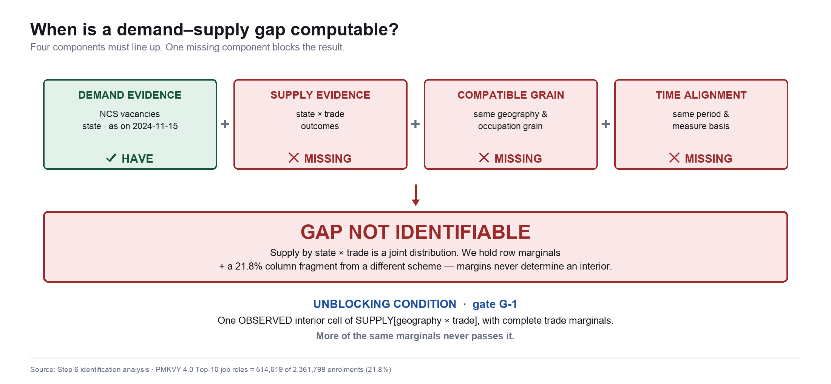
Why the problem is technically difficult
A gap is computable only when four components line up. One missing component blocks it.
Source: Step 6 identification analysis · PMKVY 4.0 Top-10 job roles = 514,619 of 2,361,798 enrolments (21.8%)
Notes:
Three failure modes recur in work on this problem. Scraping job portals - richest data, least defensible: postings are not vacancies, and it breaches terms of service. Treating a classification as a crosswalk - we proved NCS's 22 'sectors' are NIC-2008 industry sections, not occupations, so no sector-to-occupation mapping can exist as a function. And filling the gap with an assumption and calling it a model.
We have the demand side. We do not have supply at a compatible grain - and that single missing component is what blocks the result.

Slide 3
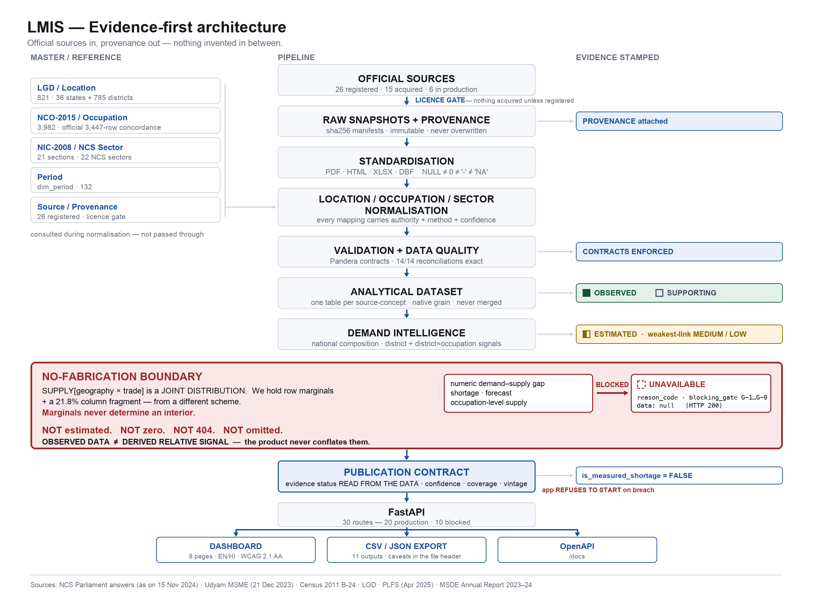
Evidence-first architecture
Official sources in, provenance out — nothing invented in between.
Notes:
Left to right is unremarkable. Two things are not.
The publication contract near the bottom: evidence status, confidence, coverage and prohibited interpretations are part of the response contract, and the application refuses to start if any output breaches it.
And the red boundary: where compatible supply evidence is missing, the pipeline BLOCKS rather than estimates. Do not read the boxes aloud - point at those two things.

Slide 4
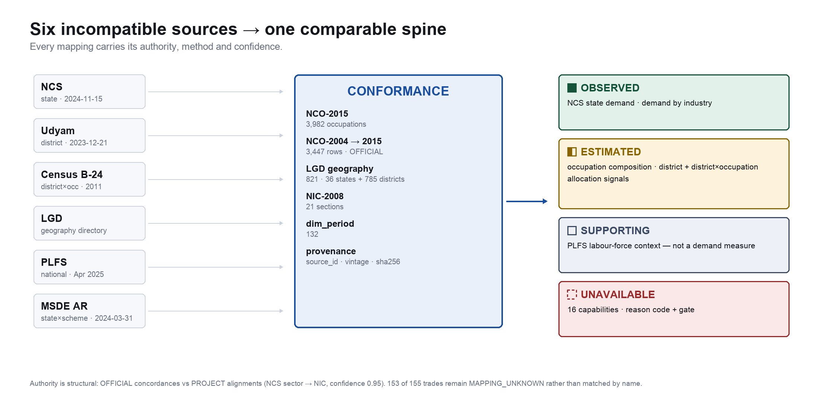
Official data → standardised intelligence
Every mapping carries its authority, method and confidence.
Sources: DGE NCO-2015 · official NCO-2004 concordance · LGD · NIC-2008 · DGT CTS curricula
Notes:
NCO-2015 is the occupation spine - 3,982 occupations. Census is coded in NCO-2004, so it is bridged through the OFFICIAL 3,447-row concordance, and division purity is measured rather than assumed.
Our one official trade-to-NCO link came from DGT's own CTS curriculum PDFs, which carry a Trade Code and an NCO-2015 field - that gave us two trades. The other 153 remain MAPPING_UNKNOWN. We could have matched all 155 by name resemblance in an afternoon. Fuzzy, semantic and LLM mapping are prohibited project-wide, because the result would be invented.

Slide 5
Current analytical outputs
Two observed products, three estimated signals, one context panel — each labelled on the face of the product.
OBSERVED
NCS state demand
state (37 + 1 residual)
OBSERVED
OBSERVED
NCS demand by industry
22 NCS sectors
OBSERVED
ESTIMATED
National occupation composition
NIC section x NCO division
157 MEDIUM / 18 LOW
ESTIMATED
District Relative Demand Allocation Signal
785 districts
MEDIUM
ESTIMATED
District x Occupation Relative Demand Allocation Signal
138 of 785 districts
LOW
SUPPORTING
Labour-force context (PLFS)
national only
not a demand measure
Unit of the signals: relative_signal_unitless — not a count. Occupation axis bridged via ILOSTAT/PLFS P(NCO division | NIC section).
Source: publication contract 7.3.1 · NCS Parliament answers as on 15 Nov 2024
Notes:
NCS has no occupation axis at all. We found the bridge in ILOSTAT's India series - whose own source is PLFS - giving an official probability of NCO division given NIC section. That makes the occupation composition estimated, and confidence varies by row, not one badge per table.
Note the product names: Allocation Signal. Never 'demand ranking'. A terminology lint fails the build if anyone writes that.

Slide 6
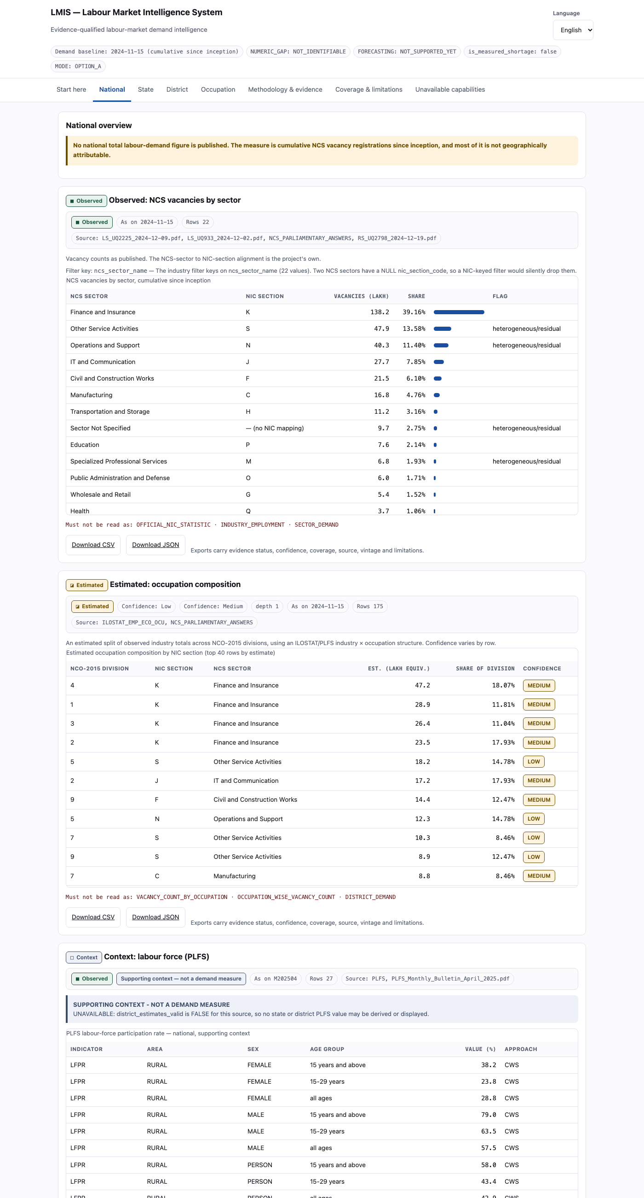
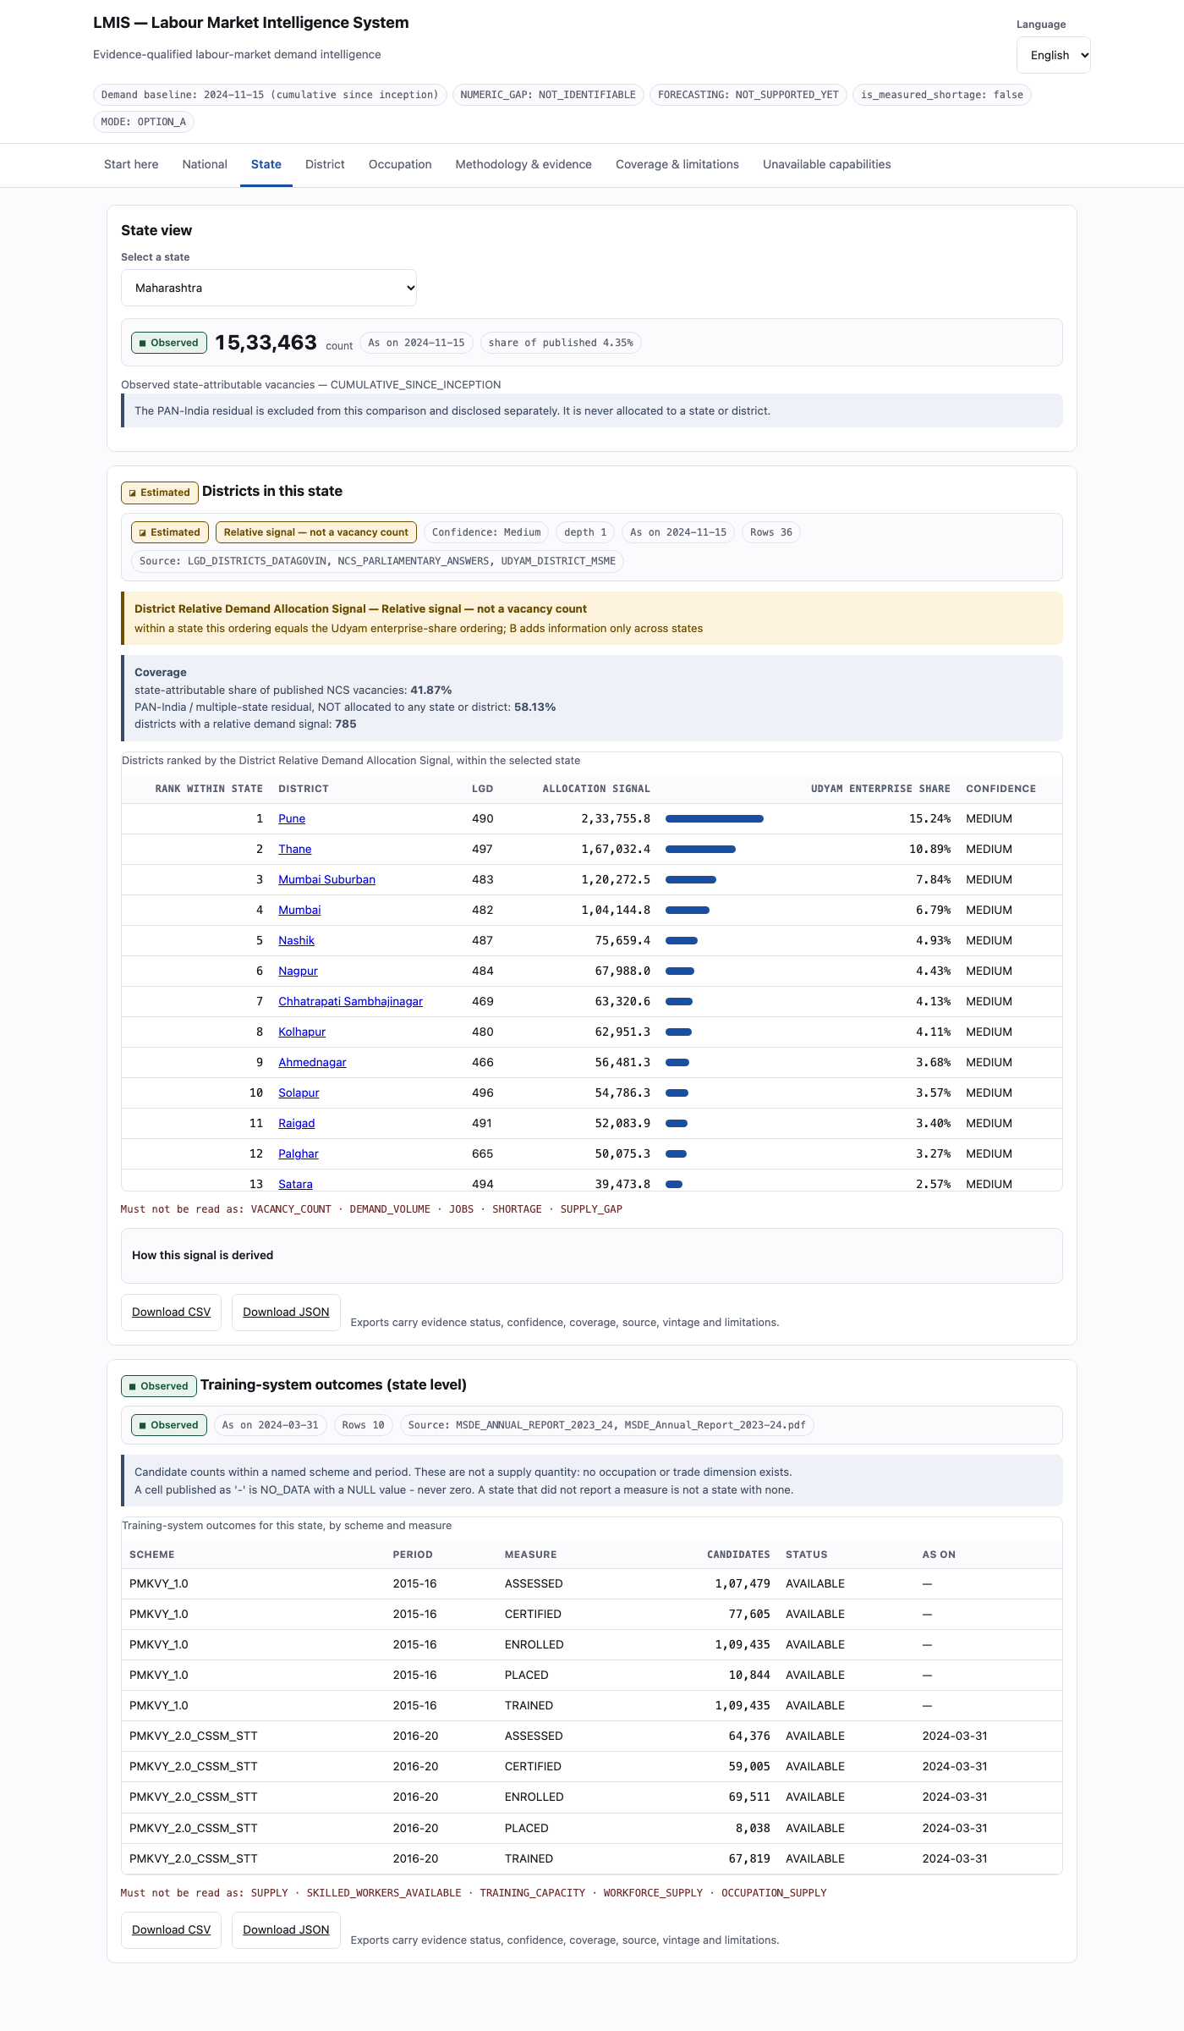
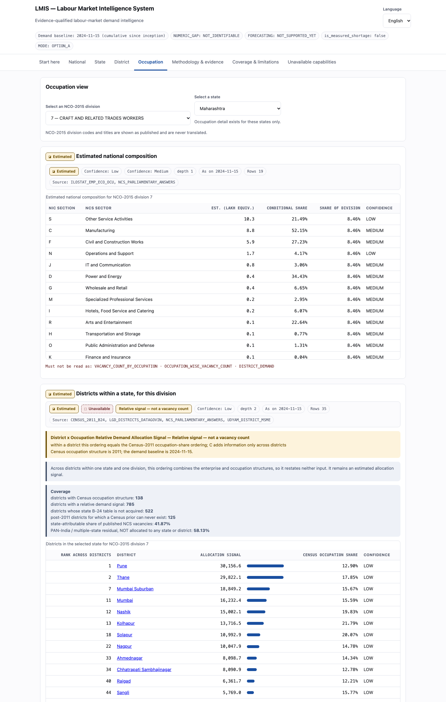
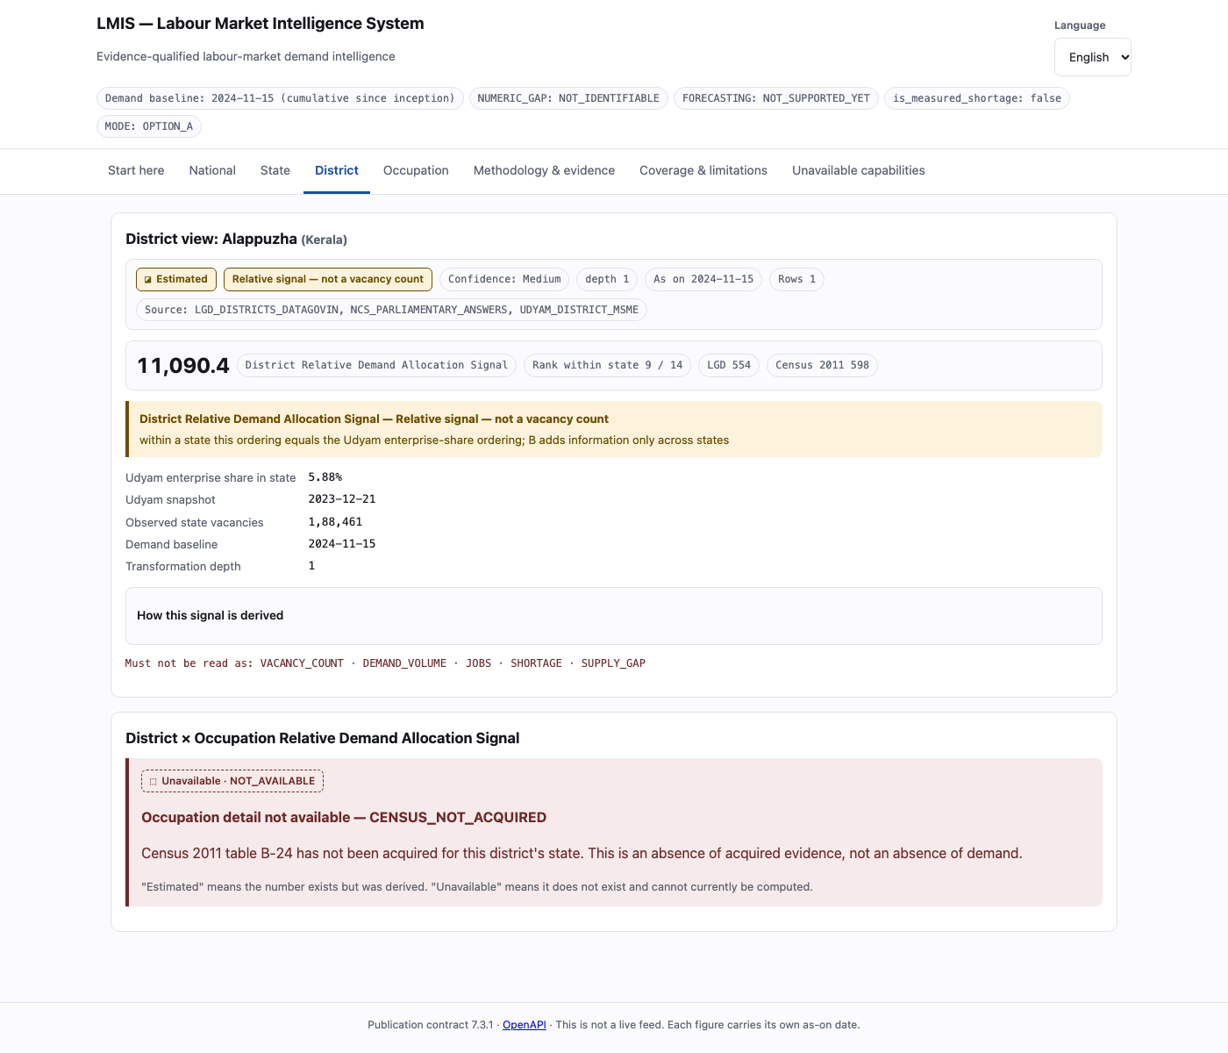
National → State → District → Occupation
The live product. Evidence weakens as you drill down, and the interface says so.
NATIONAL
STATE
DISTRICT
OCCUPATION
observed + estimated + context, kept apart
districts within state, with the caveat above the table
NOT_AVAILABLE with a reason — never a zero
districts within state x NCO division
Screenshots of the running application · publication contract 7.3.1
Notes:
Three minutes live: national evidence, a district drill-down with its caveat, and the page listing what we cannot compute.
Open with the header mode chips - NUMERIC_GAP: NOT_IDENTIFIABLE, is_measured_shortage: false - so the frame is set before any number appears. The app runs fully offline.

Slide 7
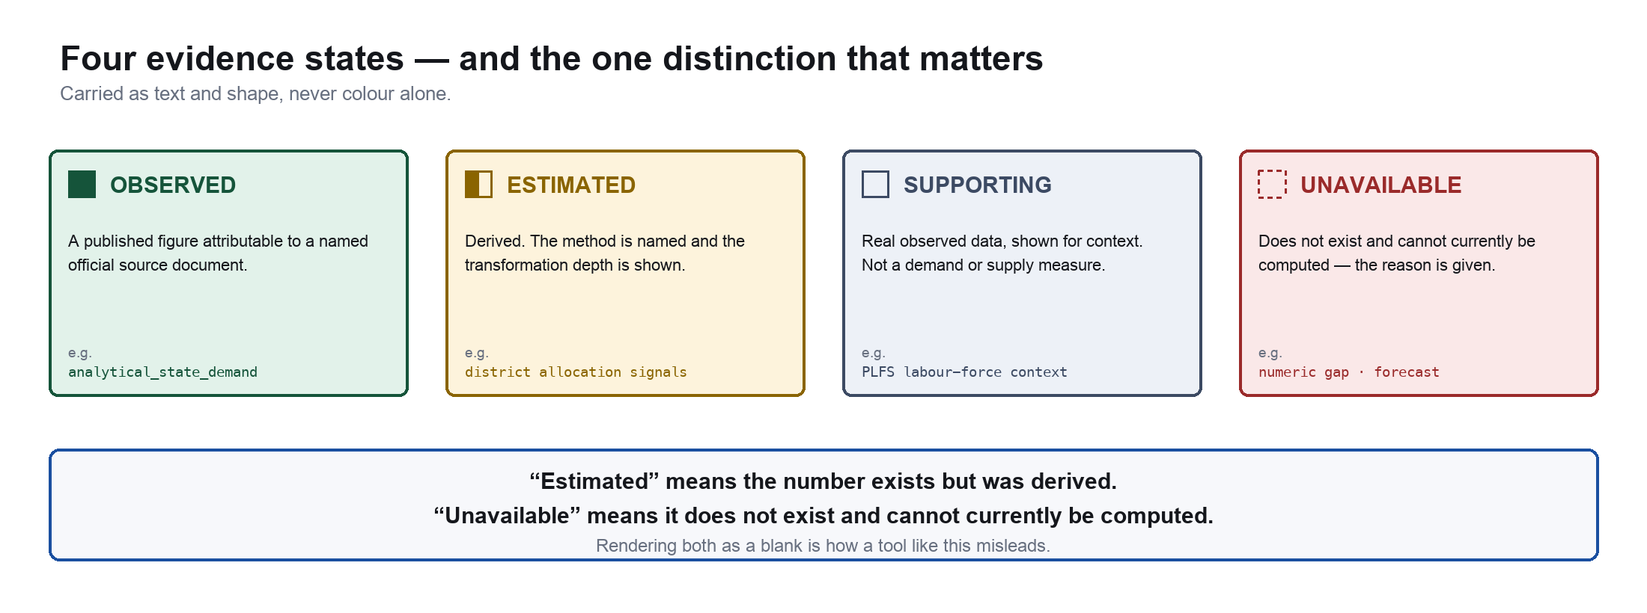
Provenance, coverage and confidence travel with every value
Transparency controls, not caveats bolted on at the end.
58.13%
PAN-India / multiple-state residual.
20,507,320 vacancies, attributable
to no state — NEVER allocated.
41.87%
state-attributable — 14,768,513.
This is the ENTIRE base of the
district allocation signal.
138 / 785
districts have Census occupation
structure. 522 not acquired;
125 can never have one.
All three figures are read live from the warehouse — a test fails the build if they appear as literals in the code.
Notes:
Most dashboards would quietly drop the residual. Twenty and a half million vacancies belong to no state. We never allocate them; allocating them is a PROHIBITED capability with its own blocked route.
And the distinction we work hardest to teach: 'estimated' means the number exists but was derived; 'unavailable' means it does not exist and cannot currently be computed. Rendering both as a blank is exactly how a tool like this misleads.

Slide 8
What cannot yet be measured — and why we say so
16 capabilities are published as explicitly unavailable, each with a reason and a gate.
Numeric demand–supply gap
NOT IDENTIFIABLE
gate G-1
Forecast
NOT SUPPORTED YET
gate G-4
District x trade supply
NOT ACQUIRED
gate G-2
State x occupation supply
NOT IDENTIFIABLE
gate G-3
Measured shortage
FALSE — always
gate permanent
PAN-India residual allocation
PROHIBITED
gate permanent
Blocked routes return HTTP 200 with data: null, a reason code and a gate.
A 404 would read as “none found”. The truth is “not computable”.
Source: publication contract 7.3.1 · /api/capabilities
Notes:
The grouping is the point. NOT_ACQUIRED means the source exists and we have not got it - the data.gov.in PMKVY district resource needs a registered API key. A paperwork problem.
NOT_IDENTIFIABLE is different. Supply by state and trade is a joint distribution. We hold the row totals plus 21.8% of the column totals, from a different scheme. Row and column totals never determine the interior. To close it you must assume every state trains the same trade mix - false, untestable, and it would erase the exact regional mismatch this PS exists to find.

Slide 9
Identification-aware analytics
Not the framework. These are the things we believe are genuinely uncommon.
1
We distinguish “missing” from “not identifiable”
NOT_ACQUIRED is a paperwork problem. NOT_IDENTIFIABLE is a mathematical result.
2
A publication contract enforced in code
Evidence, confidence, coverage and prohibited readings are part of the response contract. The app refuses to start on a breach.
3
Evidence status is read from the data, never declared
A derived output cannot be relabelled OBSERVED by editing config. A test forges a lying config and proves it.
4
Caveats stored as data — and self-criticism we published
Within a state our district ordering IS the Udyam ordering — 0 of 36 states differ. We print that above the table.
5
A terminology lint over the published surface
Reserved words and forbidden phrasings fail the build — translation files included.
There is no machine-learning model in production, and no ML library is installed. Every ML capability this PS implies is blocked by the same missing evidence — not by modelling.
Verified: no scikit-learn, LightGBM, XGBoost, PyTorch, TensorFlow or statsforecast; no model code in src/ or api/.
Notes:
The honest innovation is the discipline, and it is measurable. We found that our own district ranking was really an enterprise-density ranking, and instead of hiding that we printed it above the table and built a contract that will not let anyone remove it.
If asked where the AI is: be direct. There is no model in production. Forecasting needs two dated observations; we have one. A learned gap model needs a target variable; the target is not identifiable. An early-warning classifier needs labels; none exist.

Slide 10
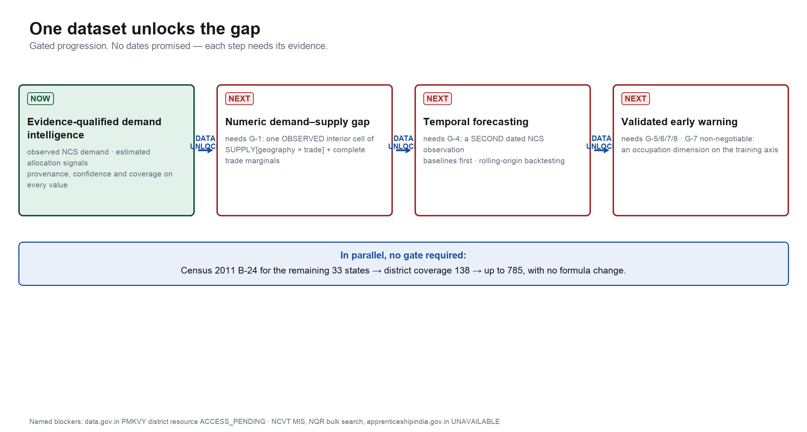
One dataset unlocks the gap
Gated progression. No dates promised — each step needs its evidence first.
Notes:
Nine objective gates, published inside the product itself. The decisive one is G-1 condition six: one observed interior cell of supply by geography and trade. The other five conditions are harmonisation problems that better data solves. Condition six is why this is an identification failure - more of the same marginals never passes it.
Note the parallel track: Census B-24 for thirty-three more states is pure acquisition. The architecture already handles the full grid - 138 to 785 districts with no formula change.

Slide 11
Impact
What a planner can do today — and what we are asking for.
Today
Inspect official demand evidence
with full provenance.
Compare districts within a state.
See exactly what is not covered.
For MSDE
A specific, costed data request:
state x trade training outcomes
with complete marginals.
Addressed to the data owner.
Not claimed
No deployment exists, so no
policy savings, no jobs created,
no efficiency percentages.
Any such figure would be invented.
We don’t manufacture a skill gap from incomplete data.
We build the evidence infrastructure that makes the gap computable when the right data becomes available.
40 tables · 82,358 rows · 30 routes · 11 exports with caveats in the file header · 16 capabilities blocked with reasons · 479 tests · is_measured_shortage = false, enforced at startup
Notes:
A fabricated gap would be worse than none: the error would be invisible, systematically wrong in one direction, and it informs seat sanctioning - real money.
So we did not manufacture the missing number. We built the infrastructure that tells decision-makers what the evidence supports, and exactly what evidence is required to go further.
Happy to take the hardest question you have.

