Slide 1
Placing Sound in Dynamic Procedurally Generated Videogame Levels
Semester Project Final Presentation
EPFL
Rodrigo Soares Granja
Supervised by Phil Lopes

Slide 2
PLAN
Motivation
Methodology
Sound Placement
Sound Selection
Simulations
Conclusion

Slide 3
MOTIVATION

Slide 4
Procedural Content Generation
Generation of game content algorithmically
Unique Game assets
Textures, 3D models
Levels
Interesting experience?

Slide 5
Goal
Enhance Player experience
With Sound
Use preexisting audio library
Placement
Selection
Evaluate the audio setup

Slide 6
Sound Classification
Tension [1]
Game progression to achieve climax
«Valence» model [2]
Audio perception is «positive» or «negative»
«Sonancia» sound library [1]
Files for classification

Slide 7
METHODOLOGY

Slide 8
Game
Horror game in Unity
Core components :
Procedural Level
Different and unknown at the runtime
First person view
Collectibles
Objective:
Find 4 collectibles in level

Slide 9
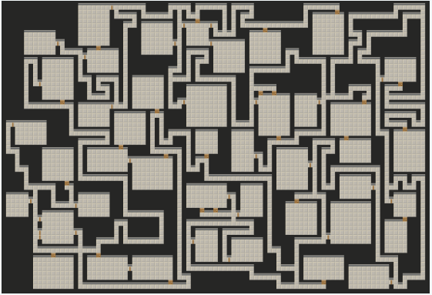
Level Generation
Bob Nystrom algorithm [1]
Generation of maze and rooms

Slide 10
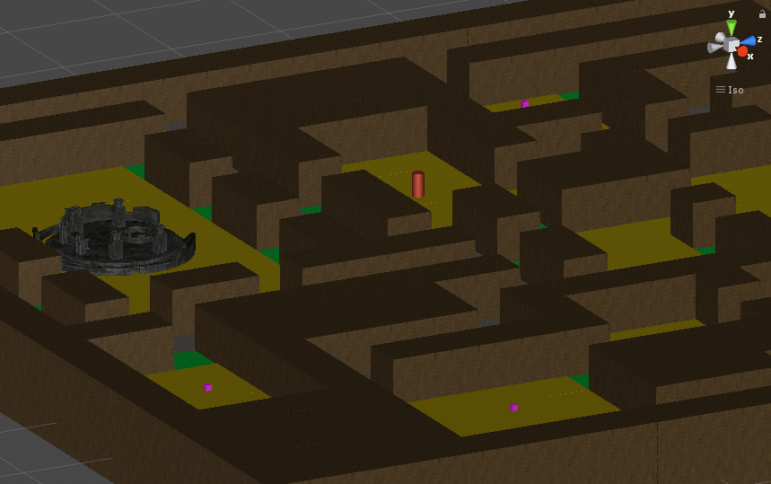
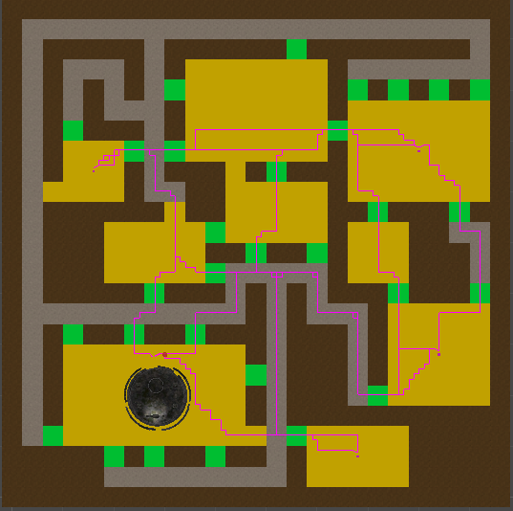
Level Generation
David Schwarz Unity implementation
2D using Unity Tilemap
Adapt to 3D

Slide 11
A Star Algorithm
Unity framework [1]
Well documented
Good performances
Multiple uses
Check level correctness
Important paths
Simulate playthroughs

Slide 12
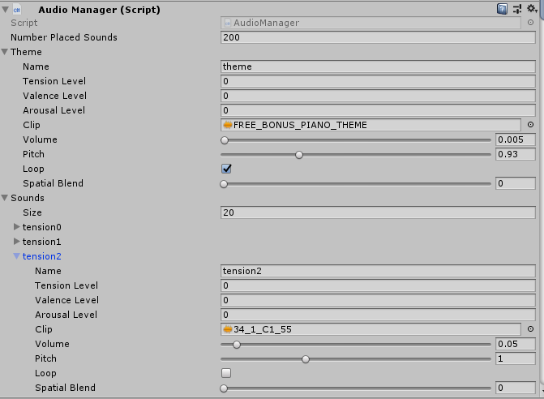
Sound Setup
Interface for audio library
Users must set library before running
Classification levels
Audio track
Sound options
Set max number of placed sound objects

Slide 13
Sound Evaluation
Game simulation
AI script
Automate player movement and sound activation

Slide 14
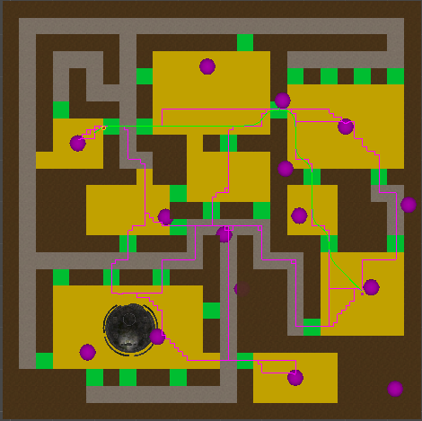

Slide 15
Sound Evaluation
Evaluation Function
Score system [0-1] after simulation
Criteria weights

Slide 16
Sound Evaluation
Objective Criteria
Repetition
Score each sound individually by repetition
0-1 time : + max score
2 times : + half score
3 times : + 1/4 score
more than 3 times : - half score
Count
Ratio placed/triggered

Slide 17
Sound Evaluation
Path Coverage
For all sounds check path % covered
If 50% of all paths are covered -> max score
Refinement function to avoid close positions
Room Coverage
Check rooms that contain sounds
If 2/3 of all rooms are covered -> max score

Slide 18
Sound Evaluation
Overlap
Max score if 0 overlaps
Linearly decrease score by number of overlaps
Progression Coherence
Tension – Progression coherence
Evaluate sound at time of play
Track Tension level = expect level tension -> max score
Track Tension level close to expected level tension -> half score
Otherwise 0

Slide 19
SOUND PLACEMENT

Slide 20
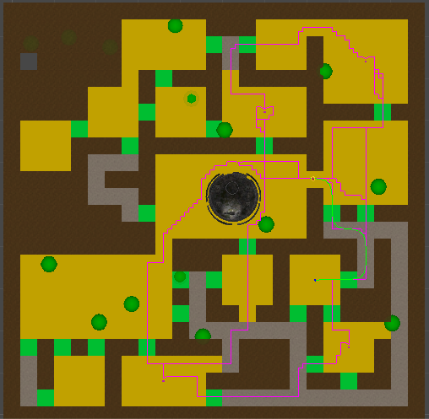
Baseline Algorithm
Random Placement
Random Selection
Use for comparison

Slide 21
Path Algorithm
Important paths
Player initial position to each collectible
Collectible to collectible

Slide 22
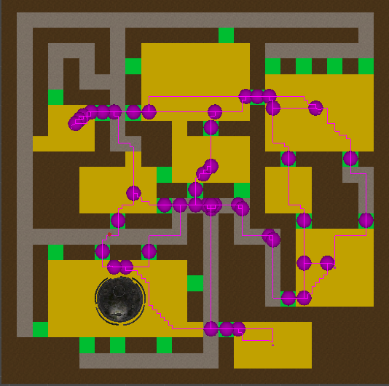
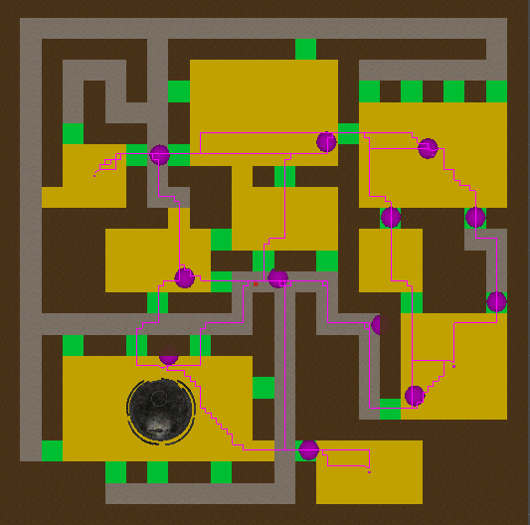
Path Algorithm
Compute intersections
Path-Path intersection
Path-Door intersection
Close positions
Non-smooth paths
Refinement function

Slide 23
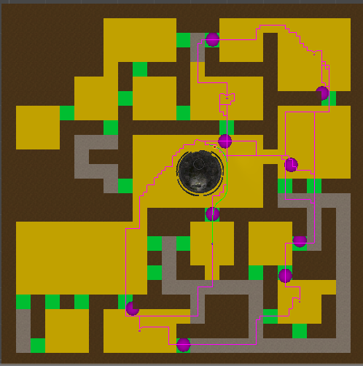

Slide 24
Distance Algorithm
Distance to Collectibles
Place sounds at collectibles
Create Different Circles
Intersect same radius’ circles
Place sounds
Cover more level area

Slide 25
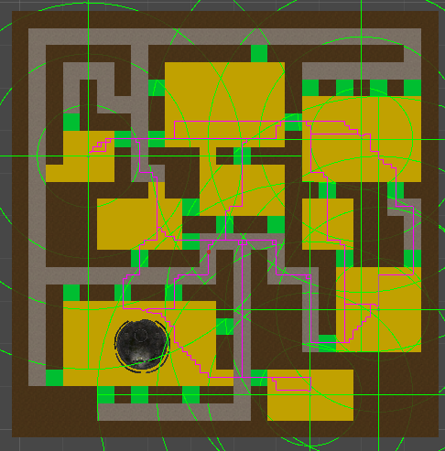
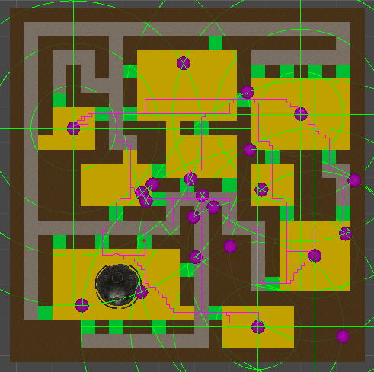
Distance Algorithm - Base

Slide 26
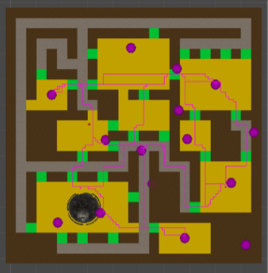
Distance Algorithm - Refinement

Slide 27
SOUND SELECTION

Slide 28
Tension/Progression Selection
Idea
Match Tension to Progression
Implementation
Predefined audio with Tension levels [1-4]
Track progression using collectibles (4)
Expected Tension level
Update all sounds after collection
Level evolves

Slide 29
Valence Selection
Idea
Collectibles are evil
Closeby sounds have low valence
Implementation
Distance to closest collectible
Valence Level
Audio guides player
Environment feels alive

Slide 30
SIMULATIONS

Slide 31
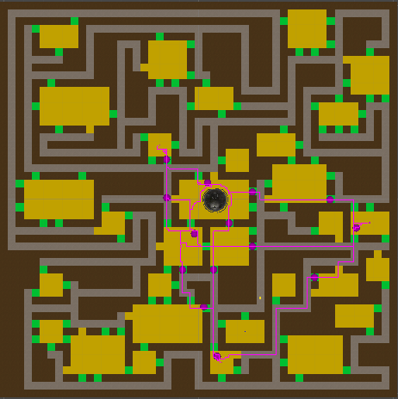
Small vs Big

Slide 32
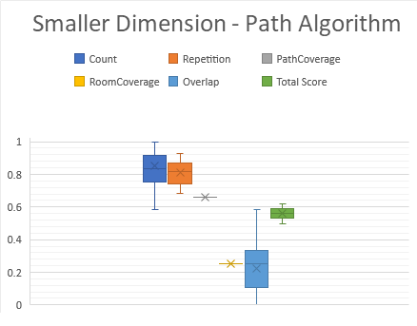
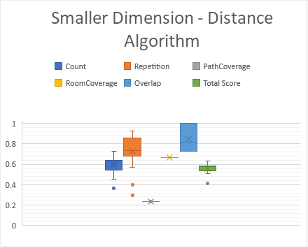
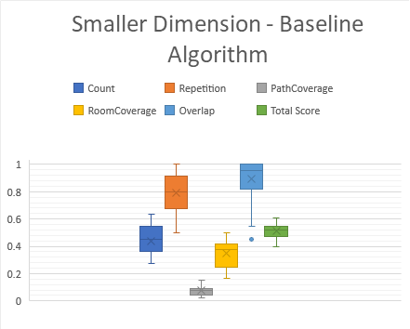
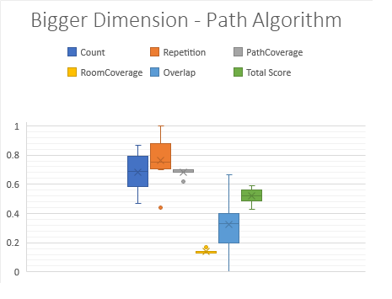
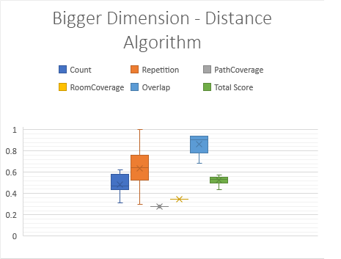
20 simulations for small level
10 simulations for big level
Equal number of placed sounds

Slide 33
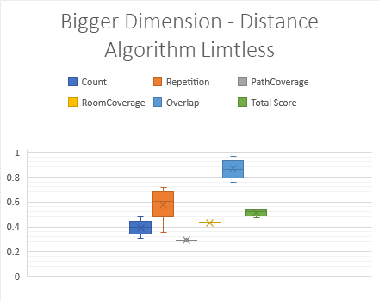

Slide 34
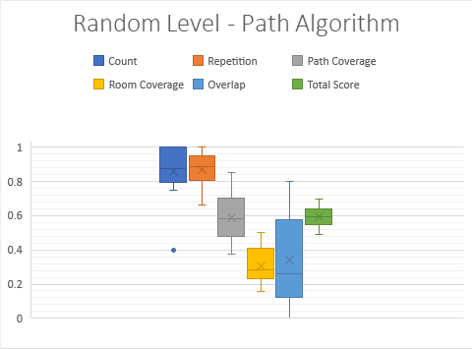
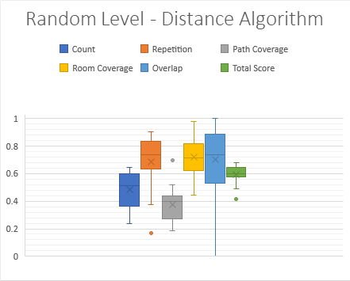
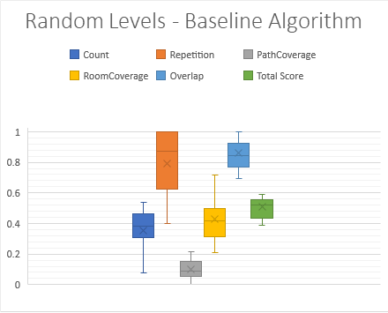
20 simulations on different levels with medium Size.

Slide 35
CONCLUSION

Slide 36
Conclusion
2 Different Approaches
Better than Baseline
Path Algorithm
Privileges audio accuracy
Level audio adapts to game progression
Good scaling

Slide 37
Conclusion
2 Different Approaches
Distance Algorithm
Privileges level coverage
Audio can guide player.
Environment feels alive
Average scaling

Slide 38
Conclusion
Evaluation Function
Evaluates objective physical criteria
Better suited for audio placement evaluation
Hard to evaluate subjective aspects of audio

Slide 39
Possible Extensions
Join algorithms
Placement using both
Selection using both
Optimization
Genetic algorithms
Extend evaluation function
Subjective evaluation
Sound characteristics

Slide 40
Thank you for your time!

