Slide 1
Fitness Buddy
CAPSTONE PROJECT
Presented By
Student name: Rudra Prashant Bhagat
College Name: Deogiri Institute of Engineering and Management Studies
Department : CSE(AIML)

Slide 2
OUTLINE
Problem Statement
Technology used
Wow factor
End users
Result
Conclusion
Git-hub Link
Future scope
IBM Certifications

Slide 3
Problem Statement
The challenge - In today’s fast-paced world, many individuals struggle to maintain a healthy lifestyle due to lack of personalized guidance, time constraints, and inconsistent motivation. Traditional fitness solutions often require expensive subscriptions, in-person consultations, or rigid schedules that don't adapt to personal preferences or daily routines.
There is a growing need for an accessible, friendly, and intelligent virtual assistant that can provide on demand fitness advice, healthy lifestyle suggestions, and basic nutrition guidance—all tailored to individual needs and available at any time.
Fitness Buddy aims to solve this problem by offering a conversational, AI-powered health and fitness coach that can:
Recommend home workouts and routines based on user input.
Provide motivational tips and daily fitness inspiration.
Suggest simple, nutritious meal ideas.
Encourage habit-building and consistency.

Slide 4
Technology used
IBM cloud lite services
Natural Language Processing (NLP)
Retrieval Augmented Generation (RAG)
IBM Granite model

Slide 5
IBM cloud services used
IBM Cloud Watsonx AI Studio
IBM Cloud Watsonx AI runtime
IBM Cloud Agent Lab
IBM Granite foundation model

Slide 6
Wow factors
Fitness Buddy is a virtual AI-powered fitness assistant designed to empower individuals to stay active and healthy—whether at home or in the gym. It promotes a consistent lifestyle by offering personalized exercise routines, nutrition suggestions, and motivational support tailored to individual needs and goals.
Unique features:
Personalized workout plans for both home and gym users
Smart adaptation to user fitness goals (weight loss, muscle gain, endurance, etc.)
Instant healthy meal suggestions based on dietary preferences and goals
Habit tracking and daily reminders to encourage consistency
Daily motivational tips and fitness challenges to keep users inspired
Built on IBM Watson and IBM Cloud Lite for intelligent NLP and scalability
Inclusive and accessible design for all ages and fitness levels

Slide 7
End users
Beginners Starting Their Fitness Journey
Home Workout Enthusiasts
Gym-goers and Fitness Enthusiasts
Busy Professionals and Students
Older Adults and Seniors
People with Physical Limitations or Recovery Needs
Anyone Seeking a Healthy Lifestyle

Slide 8
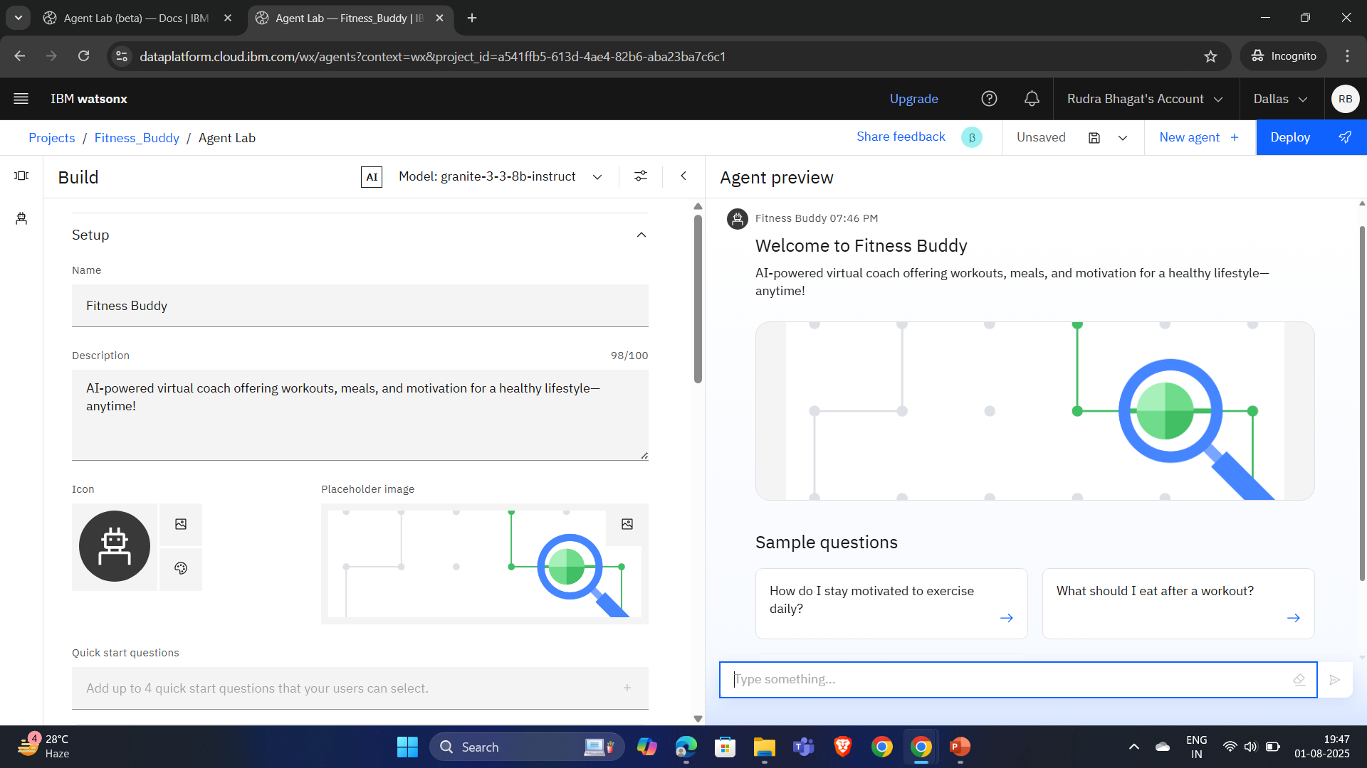
Results

Slide 9
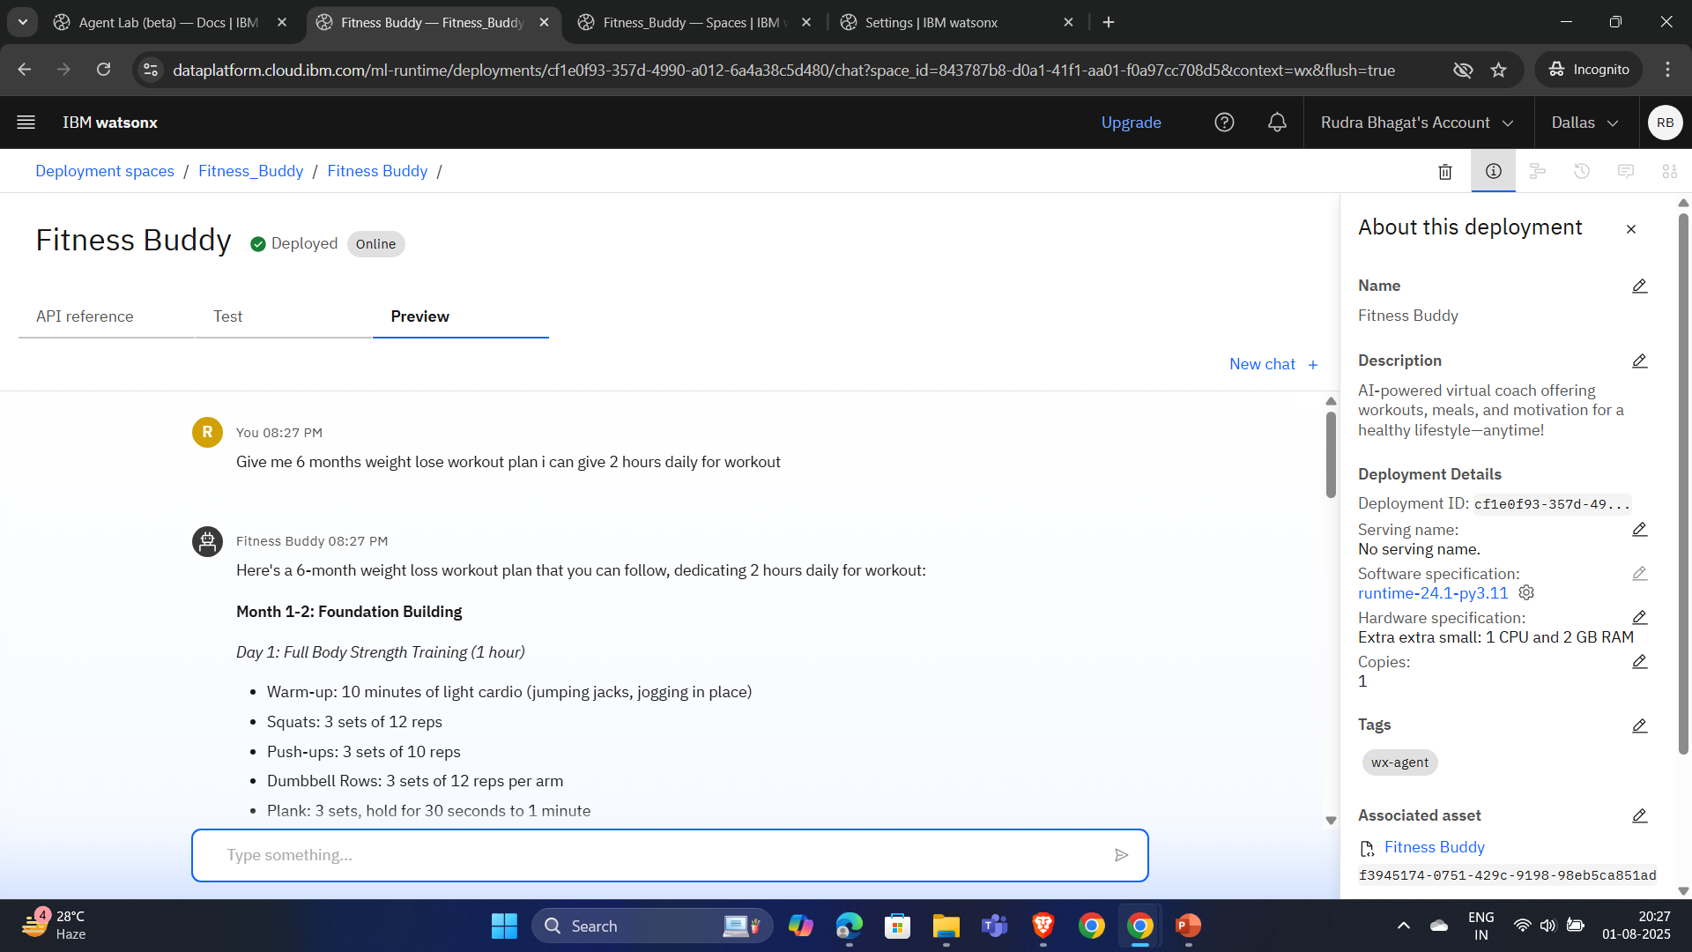
Results

Slide 10
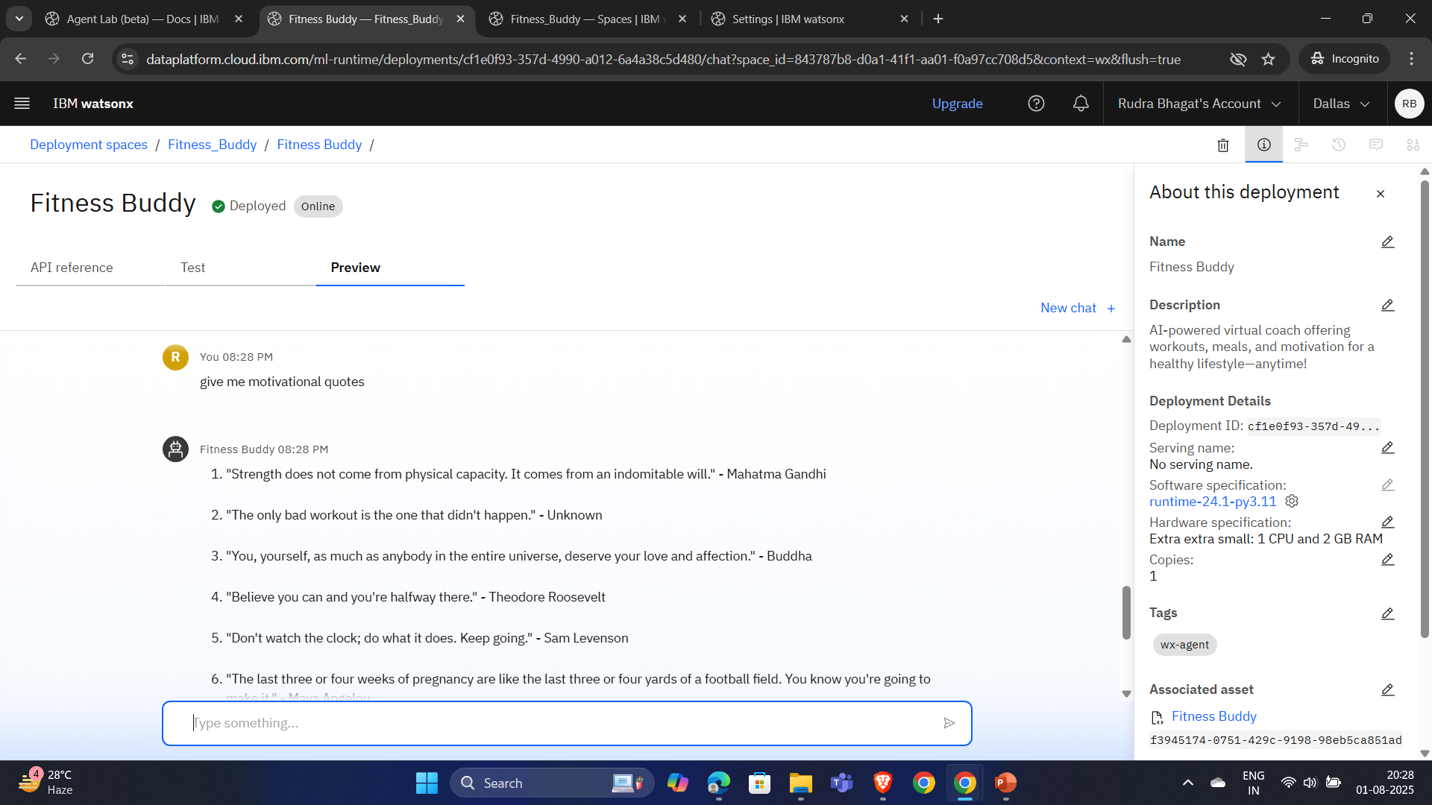
Results

Slide 11
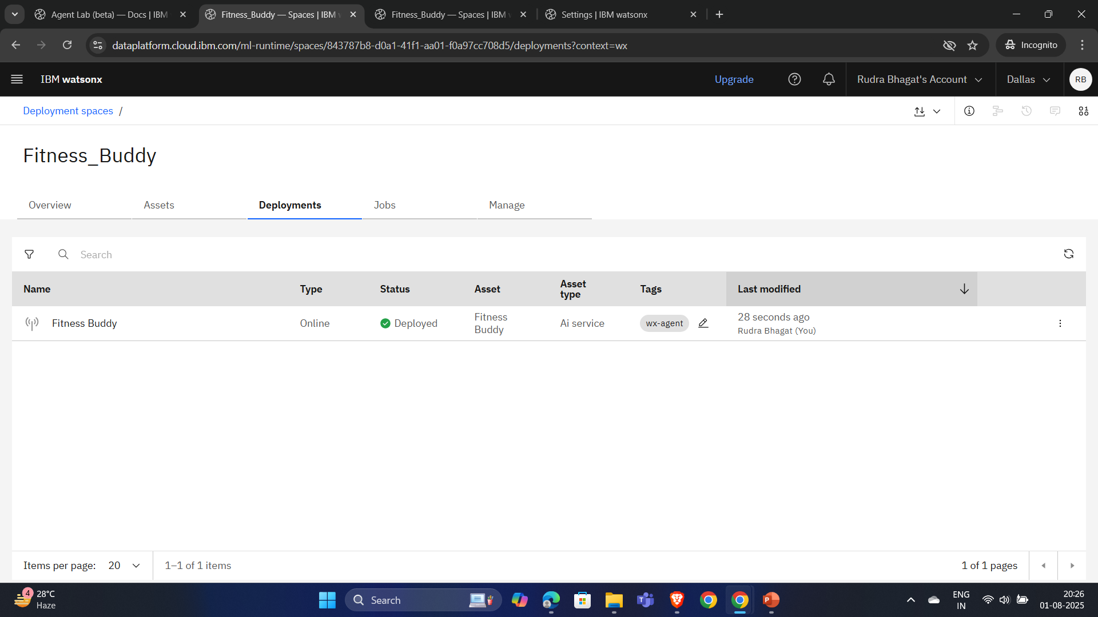
Results

Slide 12
Conclusion
Fitness Buddy is a smart AI-powered fitness companion that supports users in both home and gym workouts.
It personalizes workout and nutrition plans based on user goals, fitness level, and preferences.
The agent keeps users motivated with real-time guidance, progress tracking, and reminders.
Fitness Buddy promotes a healthy lifestyle by making fitness accessible, engaging, and tailored for everyone.

Slide 13
GitHub Link
https://github.com/RudraBhagat/Fitness_Buddy.git

Slide 14
Future scope
Expand accessibility by supporting multiple regional and international languages.
Enable users to interact hands-free during workouts via voice commands.
Adapt workouts and nutrition plans based on real-time mood and stress analysis.
Sync with fitness bands, smartwatches, and health trackers for real-time data analysis.
Offer proactive health suggestions and risk alerts using user behavior and fitness history.

Slide 15
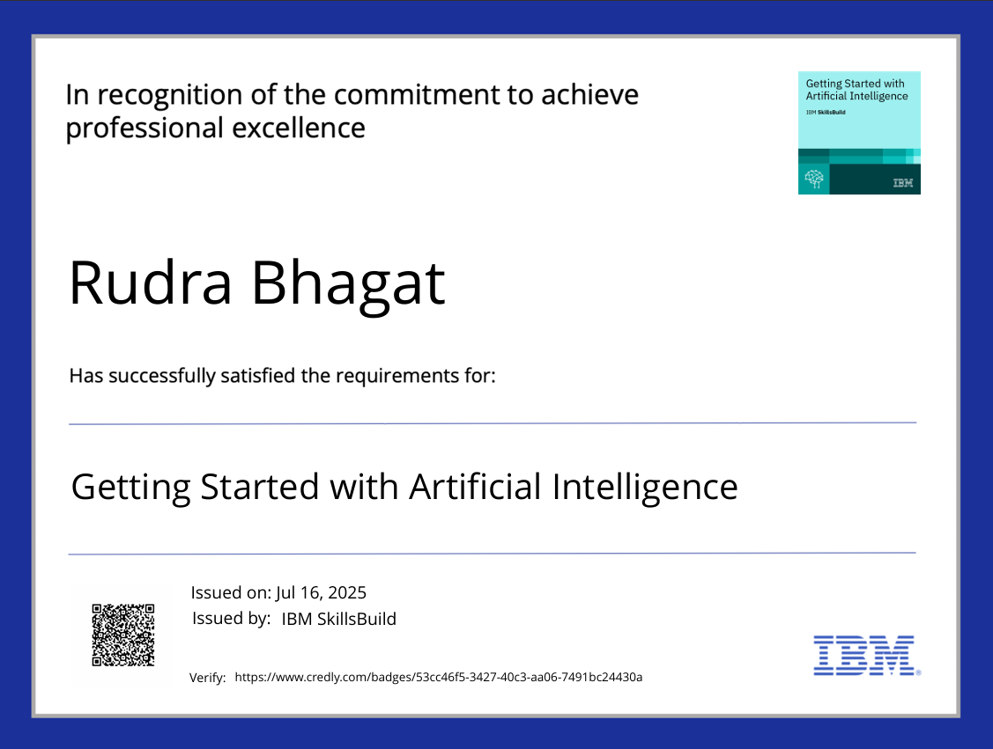
IBM Certifications

Slide 16

IBM Certifications

Slide 17
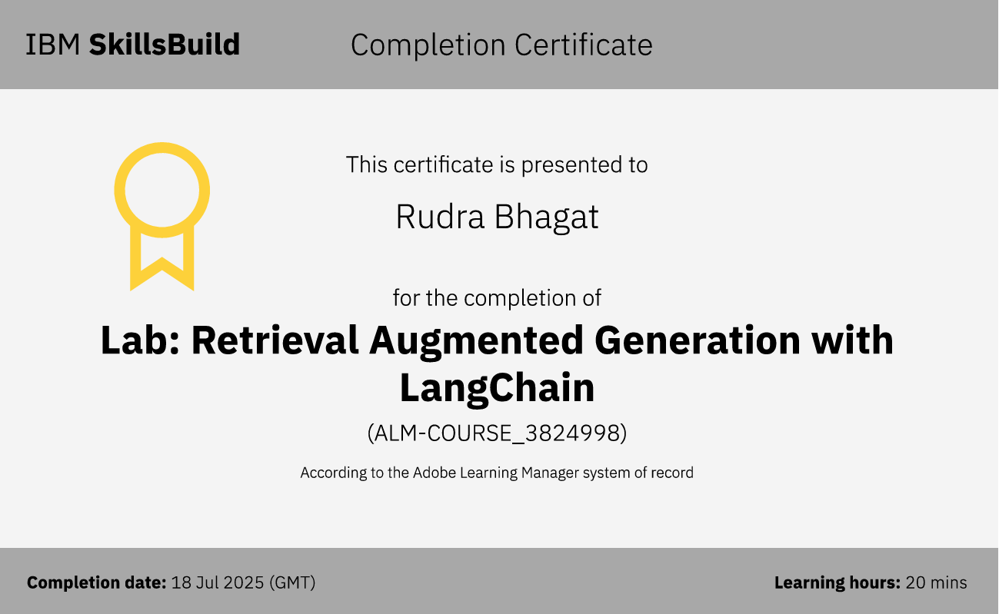
IBM Certifications

Slide 18
THANK YOU

