Slide 1
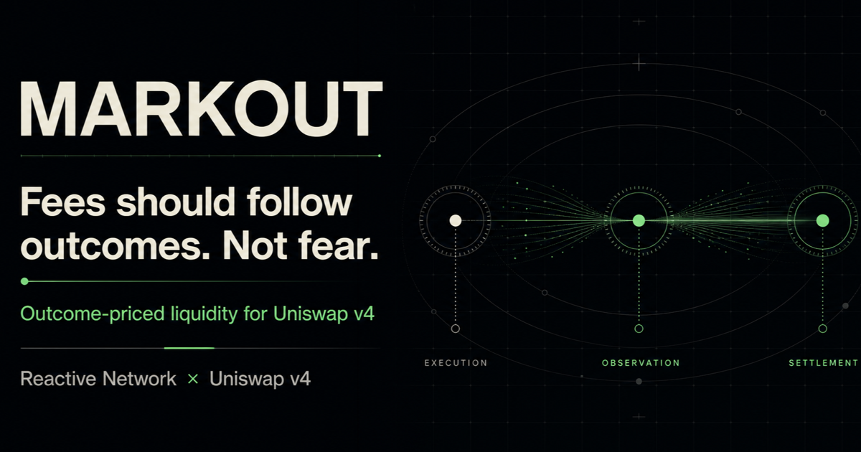
Notes:
Open with the research question: can an AMM wait for the outcome before deciding how much protection to retain?
Frame Reactive Network as the primary event-to-action layer. Unichain retains custody, validation, and final accounting.
[Sources]
- README.md
- docs/HYBRID_SETTLEMENT.md
- deployments/reactive-legacy-2026-08-26.json
[/Sources]

Slide 2
THE GAP
Volatility sees risk. It does not see who caused it.
VOLATILITY FEE
MARKOUT
fee = f(market state)
fee = f(realized outcome)
≠
Benign, informed, and inventory-improving flow can all pay more together.
The final allocation follows directional post-trade evidence—not wallet identity.
Classify the outcome, then settle the protection.
MARKOUT · UHI10 2 / 9
Notes:
Explain that volatility is useful but cannot attribute information content to an individual realized trade.
MARKOUT does not predict intent or blacklist a trader; it observes a directional price outcome.
[Sources]
- docs/MECHANISM.md
- experiments/README.md
[/Sources]

Slide 3
MECHANISM
MARKOUT prices flow after it reveals itself.
A bounded provisional surcharge becomes either trader rebate or LP protection.
1
2
3
4
5
EXECUTE
WAIT
OBSERVE
SETTLE
ALLOCATE
v4 swap collects
a bounded surcharge
five-minute
maturity window
Pyth-verified
price observation
bounded markout
retention curve
rebate + reserve
conserve escrow
No valid observation by expiry → full provisional surcharge rebate
MARKOUT · UHI10 3 / 9
Notes:
Walk left to right: the publisher verifies Pyth, and the hook still applies the frozen curve after authenticated delivery.
Emphasize conservation and the fail-open expiry path.
[Sources]
- docs/MECHANISM.md
- docs/ACCOUNTING.md
- docs/HYBRID_SETTLEMENT.md
[/Sources]

Slide 4
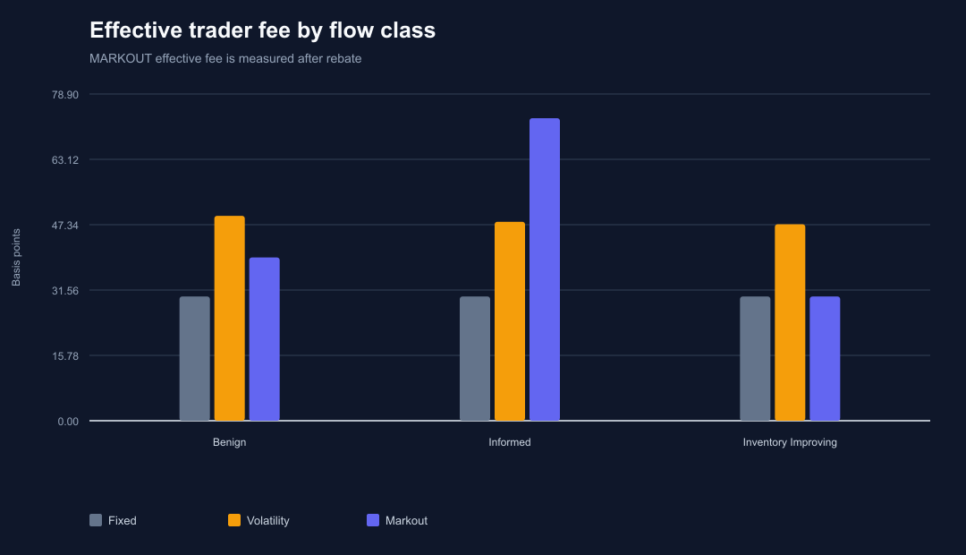
DISCRIMINATION
MARKOUT charges information—not the whole market.
73.06 bps informed · 39.43 bps benign · 30.00 bps inventory-improving
MARKOUT · UHI10 4 / 9
Notes:
Use the informed bar first: MARKOUT retains the most only where the markout is adverse.
Then compare benign and inventory-improving flow against the volatility baseline.
[Sources]
- experiments/charts/effective_fee_by_flow.svg
- experiments/results/flow_summary.csv
[/Sources]

Slide 5
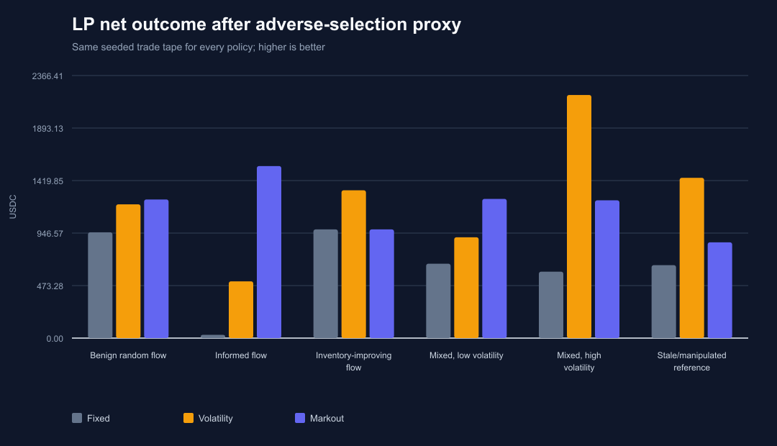
EVIDENCE
The experiment supports a tradeoff, not a miracle.
+$3,249.79
LP net after proxy
versus fixed fee
−$454.75
versus volatility fee;
good flow pays less
MARKOUT · UHI10 5 / 9
Notes:
Every policy receives the same seeded 768-trade tape, so the comparison isolates fee allocation.
State the regression clearly: the volatility baseline earns more overall because it charges benign and inventory-improving flow more.
The proxy is not exact LVR or individual LP PnL.
[Sources]
- experiments/charts/lp_net_after_proxy.svg
- experiments/results/report.md
- https://arxiv.org/abs/2208.06046
[/Sources]

Slide 6
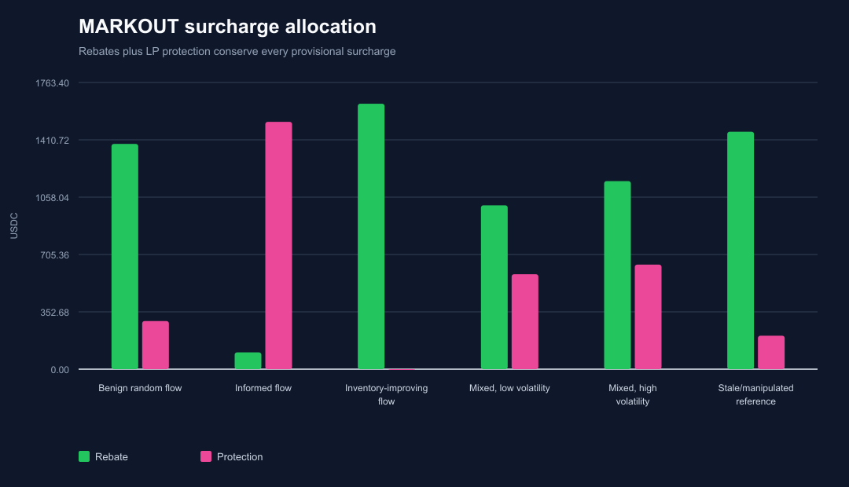
ACCOUNTING
Every provisional dollar ends in a named bucket.
$6,746.61
returned to traders
$3,249.79
credited to LP protection
63
invalid references expire
with full surcharge rebate
MARKOUT · UHI10 6 / 9
Notes:
Connect the chart to the hook invariant: pending, claimable, and reserve balances always reconcile with held assets.
The 63 invalid observations are not forced into LP protection; they fail open to a full rebate.
[Sources]
- experiments/charts/markout_rebate_and_protection.svg
- experiments/results/report.md
- docs/ACCOUNTING.md
[/Sources]

Slide 7
AUTONOMY
Reactive turns delayed evidence into an authenticated action.
Reactive is primary. Unichain owns custody, validation, and final accounting.
UNISWAP v4
REACTIVE NETWORK
COORDINATOR
Escrow surcharge
Create pending trade
Emit MarkoutRequested
Exact event subscription
ReactVM validates payload
Authenticated Unichain callback
Authenticate sources
First valid delivery wins
Hook settles or expires
At-least-once delivery. Exactly-once economics.
MARKOUT · UHI10 7 / 9
Notes:
Pyth publishes one canonical delayed observation on Ethereum Sepolia.
The deployed Legacy Reactive pulse subscribes to the exact publisher, event signature, and market topic.
ReactVM validates and encodes the authenticated callback to the immutable Unichain receiver.
Reactive initiates the cross-chain action but cannot create a price, choose a fee, redirect a rebate, or touch escrow.
The hook revalidates every economic input and finalizes exactly once; permissionless expiry returns the full provisional amount if delivery is unavailable.
[Sources]
- docs/HYBRID_SETTLEMENT.md
- docs/THREAT_MODEL.md
- deployments/reactive-legacy-2026-08-26.json
- https://sepolia.etherscan.io/tx/0x99c7110784fc9e39ff0db078be74e3995855172a4f9a8c565169373e1daa7c85
- https://sepolia.uniscan.xyz/tx/0x5d933d5ff078c500c61fc32fef1ae526049085dad8e15ff4ef2673a971114459
[/Sources]

Slide 8
PROOF
The prototype is hardened where it matters most.
186
12
0
768
deterministic
Solidity tests
stateful
invariants
medium / high
Slither findings
trades on one
seeded tape
Security review ≠ independent audit · synthetic evidence ≠ forecast
MARKOUT · UHI10 8 / 9
Notes:
The cumulative gate includes adversarial authorization, reentrancy, expiry, oracle failure, replay, transport races, and insolvency cases.
Keep the boundary explicit: this is production-shaped and internally hardened, not independently audited.
[Sources]
- docs/PHASE_7_VERIFICATION.md
- docs/PHASE_11_VERIFICATION.md
- docs/PHASE_12_VERIFICATION.md
- docs/PHASE_13_VERIFICATION.md
- docs/STATIC_ANALYSIS.md
- experiments/results/report.md
[/Sources]

Slide 9
CLOSE
PRICE THE OUTCOME.
MARKOUT turns LP protection from a prediction into a settlement.
Negative markout settled in 38s → 100% rebated.
Positive markout settled in 67s → 100% retained.
Reactive callback reached Unichain in 11s.
100% REBATED 100% RETAINED
MARKOUT · UHI10 9 / 9
Notes:
Resolve the opening: MARKOUT does not predict identity before execution; it settles what the post-trade outcome supports.
Historical economic proof demonstrates both allocation extremes: full provisional rebate after negative markout and full LP retention after positive markout.
Reactive proof: a canonical Ethereum Sepolia publisher event executed in ReactVM and completed an authenticated Unichain callback in 11 seconds.
That callback reached an already-terminal trade and was handled as a safe no-op, so it proves Reactive transport and replay safety rather than a pending-first economic allocation.
[Sources]
- deployments/hybrid-2026-08-21.json
- deployments/reactive-legacy-2026-08-26.json
- https://sepolia.etherscan.io/tx/0x99c7110784fc9e39ff0db078be74e3995855172a4f9a8c565169373e1daa7c85
- https://sepolia.uniscan.xyz/tx/0x5d933d5ff078c500c61fc32fef1ae526049085dad8e15ff4ef2673a971114459
[/Sources]

