Slide 1


SMART INDIA HACKATHON 2025
TITLE PAGE
Problem Statement ID – SIH25045
Problem Statement Title- Blockchain-Based Supply Chain Transparency for Agricultural Produce
Theme- Agriculture, FoodTech and Rural Development
PS Category- Software
Team ID- 91642
Team Name (Registered on portal) : Tech Coders_SVIT

Slide 2
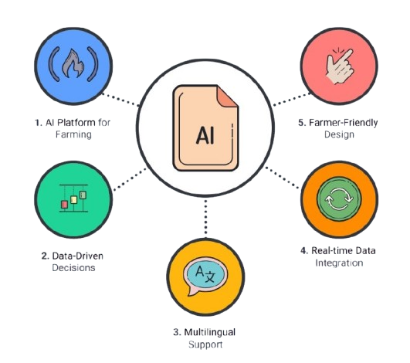
IDEA TITLE
Tech
Coders
Proposed Solution
Idea / Solution / Prototype
💻 Web-based AI platform for crop yield prediction & farming optimization
📊 Integrates historical yield data + real-time weather APIs + soil health metrics
🌱 Provides actionable recommendations (irrigation, fertilization, pest control)
🗣️ Multilanguage UI (Hindi + English + …) for accessibility
How It Addresses the Problem
📈 Helps farmers predict yield in advance & plan better
🌦️ Reduces crop losses from unpredictable weather & poor input management
🧮 Ensures data-driven decisions instead of guesswork
🌾 Delivers region & crop-specific insights
Innovation & Uniqueness
🌐 Multilingual support (starting with Hindi) → wider adoption
🛰️ Combines real-time weather + satellite/soil data → accurate forecasts
🤖 AI/ML-driven personalized advisories vs. generic tips
🚀 Scalable solution → works for all crops across India
💡 Farmer-friendly design → simple dashboard, icons & alerts

Slide 3
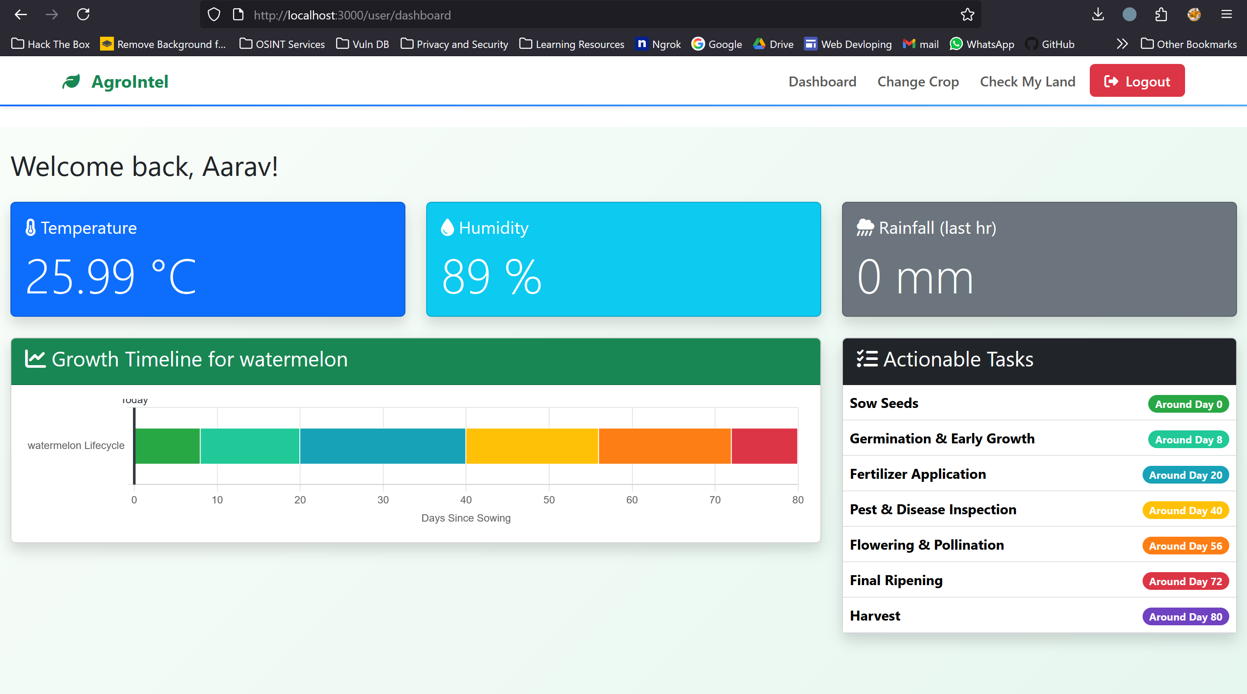
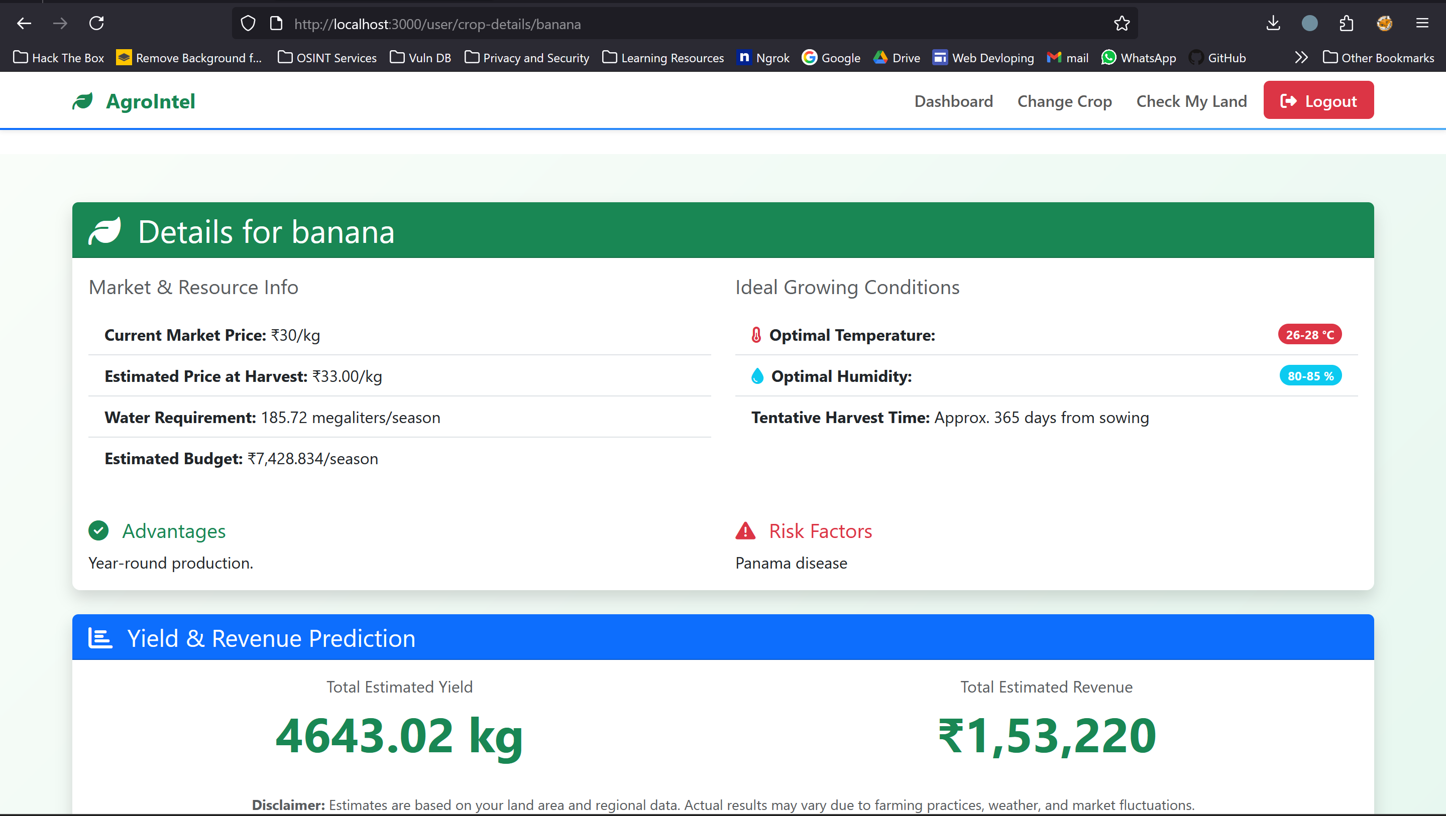










TECHNICAL APPROACH
Tech
Coders
Technology Stack
Just Scan Crop to check crop status, pest attacks and growth of crop
Languages: Python, JavaScript
Libraries/Frameworks: TensorFlow, PyTorch, Scikit-learn, Pandas, NumPy, Flask, Django, React.js, Bootstrap/Tailwind
Databases: MYSQL, Cloud Storage (GCP)
APIs/Data: OpenWeatherMap, AgroMonitoring, Google Earth Engine, Govt Data (Data.gov.in, ICAR), Kaggle, Google Vision
Cloud/Deployment: GCP
Tools: GitHub, TensorBoard, Power BI.

Slide 4
FEASIBILITY AND VIABILITY
Tech
Coders
2. Business Potential
👨‍🌾 Target Users – Farmers, FPOs, NGOs, Govt agencies.
💼 Revenue Models – Freemium (basic free, premium paid), B2B/B2G,
agri-input tie-ups.
📈 Market Size – India’s AgriTech sector projected at $24B by 2025.
🌍 Scalability – Expandable to more crops, Indian languages & global markets.
1. Feasibility Analysis
📡 Technical – AI/ML models + real-time weather/soil/satellite APIs, web-first(mobile & PC).
💰 Economic – Uses open/free datasets & cloud → low-cost, scalable, affordable via freemium/govt support.
⚙️ Operational – 875M+ smartphone users, bilingual UI (Hindi/English), easy rollout (pilot → nationwide).
4.Strategies to Overcome Challenges
🛰️ Data Gaps → Use govt + satellite NDVI/soil moisture + crowdsourced inputs.
📲 Connectivity → Offline-first + SMS/IVR-based advisories.
🗣️ Adoption → Bilingual UI, voice guidance, simple icons.
🔄 Sustainability → Value-add features (market price alerts, pest warnings).
3. Challenges & Risks
📊 Data Gaps – Limited soil/crop datasets.
📶 Connectivity – Poor rural internet coverage.
📱 Farmer Adoption – Low digital literacy, trust gap.
🌾 Regional Variability – Different soils & climate zones.

Slide 5
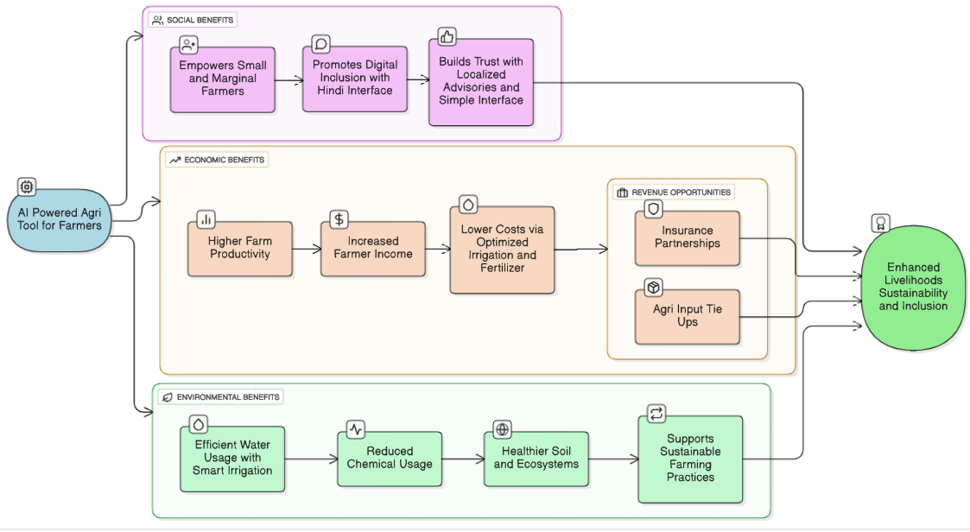
IMPACT AND BENEFITS
Tech
Coders
1. Potential Impact on Target Audience
Potential Impact on Target Audience
👩‍🌾 Farmers – +10% yield, less input wastage, weather risk readiness
🤝 FPOs/Cooperatives – Better collective planning, stronger market power
🏛️ Government – Reliable data for policy & subsidies, boosts food security
2. Benefits of the Solution
🌍 Social – Empowers small farmers, digital inclusion (Hindi), localized & simple advisories
💰 Economic – Higher yields & income, reduced input costs, new revenue opportunities (insurance, agri-inputs)
3. Environmental Benefits
💧 Smart irrigation → efficient water use
🌱 Reduced chemicals → healthier soil & ecosystems
🌍 Promotes sustainable farming practices

Slide 6
RESEARCH AND REFERENCES
Tech
Coders
Comparison With Existing Platform :
1. Datasets & APIs
Government Data: Crop yield statistics
ICAR Agricultural datasets & reports
Weather Data API: OpenWeatherMap
Open Datasets: India crop yield dataset (1997–2020)
2. Research Papers & Articles
Crop Yield Prediction using Machine Learning Algorithms
AI for Agriculture in India
3. Related Solutions & Case Studies
AI4AI (Saagu Baagu Project, Telangana): 21% increase in yields.
AgriTech Market Reports: $24B by 2025.
3. Screenshots of Project
Google Drive link
Feature | Kisan Suvidha | Plantix | Farmonaut | Proposed AI Platform
Bilingual / Hindi Support 🌐 | ✔ (Hindi only) | ✖ | ✖ | ✔ (All Indian Major Languages)
Uses Historical Crop Data 📊 | ✖ | ✖ | ✖ | ✔
Real-time Weather Data 🌦️ | ✔ | ✖ | ✔ | ✔
Soil/Satellite Data (NDVI, pH) 🛰️ | ✖ | ✖ | ✔ | ✔
AI/ML Yield Prediction 📈 | ✖ | ✖ | ✖ | ✔ (crop & region-specific)
Personalized Recommendations 🌱 | ✖ (generic tips) | ✔ (disease only) | ✔ (NDVI only) | ✔ (irrigation, fertilization, pest, disease)
Offline / SMS Support 📶 | ✖ | ✖ | ✖ | ✔
Scalability (All Crops/Regions) 🚀 | ✖ (limited) | ✖ | ✖ | ✔ (nationwide & global potential)
Expected Yield Impact 💰🌍 | Low (awareness only) | Moderate (disease reduction) | Moderate (crop health monitoring) | High (≥10% yield increase)

