Slide 1
SINGLE OBJECTIVE ANT COLONY OPTIMIZATION

Slide 2
Introduction
Ant Colony Optimization (ACO) is a relatively new and successful technique in the
field of swarm intelligence. This technique was first introduced by Dorigo and his colleagues [1,2].
This technique is used for many applications especially problems that belong to the combinatorial
optimization. ACO algorithm models represent the behaviour of real ant colonies in establishing the
shortest path between food sources and nests. The ants release pheromone on the ground while
walking from their nest to food and then go back to the nest. The ants move according to
the richer amount of pheromones on their path and other ants would be followed and will tend to
choose a shorter path which would have a higher amount of pheromone. Artificial ants imitate the
behaviour of real ants, but can solve much more complicated problem than real ants can.

Slide 3
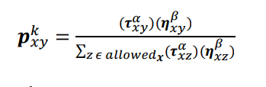
Mathematical model of Ant Colony Optimization
Edge selection -
To apply an ant colony algorithm, the optimization problem needs to be converted into the
problem of finding the shortest path on a weighted graph. In the first step of each iteration,
each ant stochastically constructs a solution.
Initially, each ant is placed on some randomly chosen city. An ant k currently at city
x choose to move to city y by applying the following probabilistic transition rule:
where n_{xy} is the heuristic visibility of edge (x, y) generally it is a value of 1/d_{xy.}
where d_{xy} is the distance between city x and city y.
For ant k , the probability Pxy of moving from state x to state y depends on the
combination of two values, the attractiveness ηxy of the move and the trail level Txy of the move.

Slide 4

PHEROMON UPDATE
Trails are usually updated when all ants have completed their solution, increasing or decreasing
the level of trails corresponding to moves that were part of "good" or "bad" solutions, respectively.
An example of a global pheromone updating rule is
where τxy is the amount of pheromone deposited for a state transition ,
ρ is the pheromone evaporation coefficient and ∆𝝉𝑥𝑦 𝑘 is the amount of pheromone deposited
by kth ant, typically given for a TSP problem (with moves corresponding to arcs of the graph) by

Slide 5
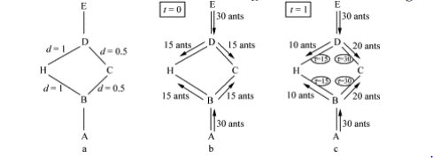
EXAMPLE ILLUSTRATION
Suppose that at time t = 0 there are 30 ants at point B (and 30 at point D). And at this moment
there is no pheromone trail on any segments. So the ants randomly choose their path with equal
probability. Therefore, on the average 15 ants from each node will go toward H and 15 toward C
(Fig.1(b)). At t = 1 the 30 new ants that come to B from A find a trail of intensity, 15 on the path
that leads to H, laid by the 15 ants that went that way from B, and a trail of intensity 30 on the
path to C, obtained as the sum of the trail laid by the 15 ants that went that way from B and by
the 15 ants that reached B coming from D via C (Fig.1(c)). The probability of choosing a path is
therefore biased, so that the expected number of ants going toward C will be double of those
going toward H: 20 versus 10, respectively. The same is true for the new 30 ants in D which come
from E. This process continues until all of the ants will eventually choose the shortest path.

Slide 6

Iteration 1
A simple TSP example
[A]
[B]
1
A
2
B
[C]
3
C
[D]
[E]
D
5
4
E

Slide 7
How to build next sub-solution?
[A]
1
A
B
[A]
1
[A]
C
1
[A,D]
[A]
1
1
D
E

Slide 8
Iteration 2
[E,A]
[C,B]
5
A
3
B
[B,C]
2
C
[A,D]
[D,E]
1
D
4
E

Slide 9
Iteration 3
[D,E,A]
[E,A,B]
4
5
A
B
[A,D,C]
1
C
[B,C,D]
[C,B,E]
2
D
3
E

Slide 10
Iteration 4
[B,C,D,A]
[D,E,A,B]
2
A
4
B
[E,A,B,C]
5
C
[C,B,E,D]
[A,DCE]
D
3
1
E

Slide 11
Iteration 5
[C,B,E,D,A]
[A,D,C,E,B]
3
1
A
B
[D,E,A,B,C]
4
C
[E,A,B,C,D]
[B,C,D,A,E]
D
5
E
2

Slide 12
Path and Pheromone Evaluation
[A,D,C,E,B]
L₁ =300
1
[B,C,D,A,E]
L₂ =450
2
[C,B,E,D,A]
L₃ =260
3
[D,E,A,B,C]
L₄ =280
4
[E,A,B,C,D]
L₅ =420
5

Slide 13
Ant Systems Algorithm for TSP
Initialize
Place each ant in a randomly chosen city
For Each Ant
Choose NextCity(For Each Ant)
yes
more cities
to visit
No
Return to the initial cities
Update pheromone level using the tour cost for each ant
No
Stopping
criteria
yes
Print Best tour

Slide 14
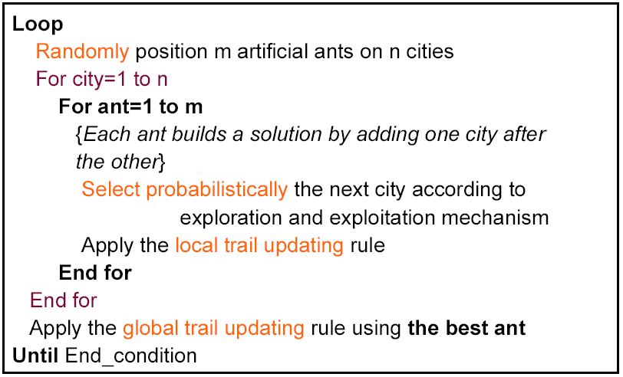
ACS : Ant Colony System for TSP

Slide 15
Conclusion
It is shown in the iteration number 5 that all the ants converge to the best path which
gives minimum distance. The pheromone distribution for iteration and the next city selection
based on maximum probability is determined in the iteration. It is evident from the analysis that
the rich pheromone edge is converges the best path for the travelling salesmen problems.

