Slide 1

SANGYAN 2026 · TRACK A + TRACK E
Nirikshak निरीक्षक
Check before you trust.
An investor-protection auditor for forwarded WhatsApp tips, finfluencer videos and the creators behind them, checked against SEBI's registers, in Hindi and English.
Live demo https://13-233-152-160.sslip.io
Code https://github.com/RudraPandit0504/nirikshak

Slide 2
THE PROBLEM
Market access has outrun trustworthy guidance
16+ crore
70%+
9 in 10
demat accounts in India
of new retail accounts from Tier-2/3 cities
individual F&O traders lose money (SEBI study)
• Tips arrive as WhatsApp/Telegram forwards and YouTube videos: "guaranteed" returns, buy/sell calls, VIP groups, fake KYC alerts.
• Scammers use fake SEBI numbers, cloned broker sites and remote-access apps; victims realise only when money is gone.
• Many first-time investors are more comfortable in Hindi, have no one to ask, and can't tell education from promotion.

Slide 3
WHO WE SOLVE FOR
Sunita, 34, Kanpur: first-time investor, Hindi-first
• Opened a demat account last year; learns from YouTube and family WhatsApp groups
• Receives "tips" and "KYC alerts" daily and can't verify who is behind them
• Reads Hindi comfortably, English with effort; uses a mid-range Android phone
• Needs a quick, trustworthy answer at the moment of doubt: before she pays, clicks or invests
Also built for
Senior citizens targeted by impersonation (fake SEBI / broker calls)
Families checking a tip forwarded to a parent
Anyone who just received a suspicious message
What she needs
Is this a scam? Which exact part is dangerous?
Is this person SEBI-registered?
What should I do now, in my language?

Slide 4
THE SOLUTION
One product, four ways to check before you trust
Check a message
Audit a video
Profile a creator
Ask in your words
Paste a forwarded WhatsApp/Telegram/SMS tip or drop a screenshot. Flags OTP requests, fake KYC, payment demands, suspicious links, impersonation.
Paste a YouTube link. Every guaranteed-return promise, buy/sell call, hype and hidden promotion, quoted with its timestamp.
Audits a channel's recent uploads: how often they give tips, promise returns or push paid groups.
Chat (typed or spoken, Hindi/English) about any audit. Answers cite the evidence; never gives investment advice.
Track A
Track E
Track E
Tracks C/E
Every name, website and registration number is checked against 6,645 entities from 5 SEBI registers. Every result comes with a plain-language summary, concrete next steps, a PDF report and a natural voice, in English or हिन्दी.

Slide 5
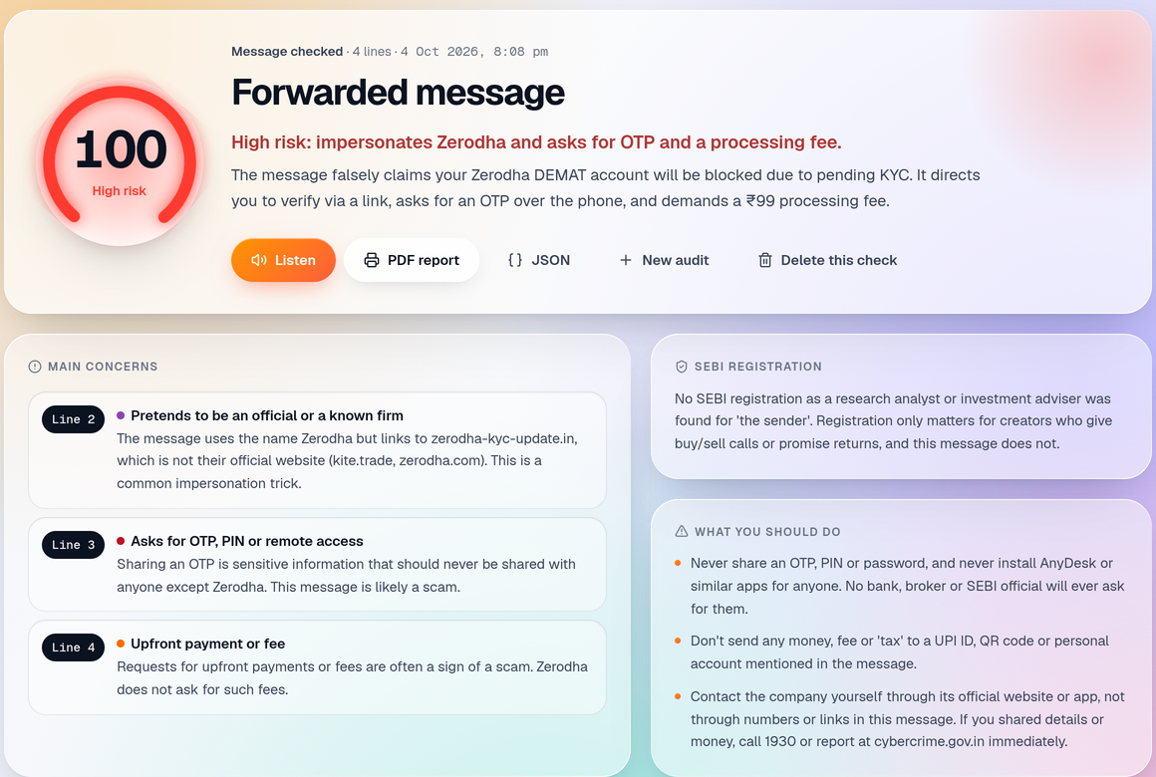
JOURNEY 1 · TRACK A
A fake Zerodha KYC alert, caught in seconds
• Risk 100/100: every warning sign is tied to the exact line
• Domain check: uses Zerodha's name but links to zerodha-kyc-update.in, not their official site
• Spots the OTP request and the ₹99 fee to a UPI handle; ignores a genuine bank OTP SMS
• Gives concrete steps: don't share, don't pay, use the official app, call 1930
• Works from a screenshot too (vision OCR keeps Hindi in Devanagari)

Slide 6
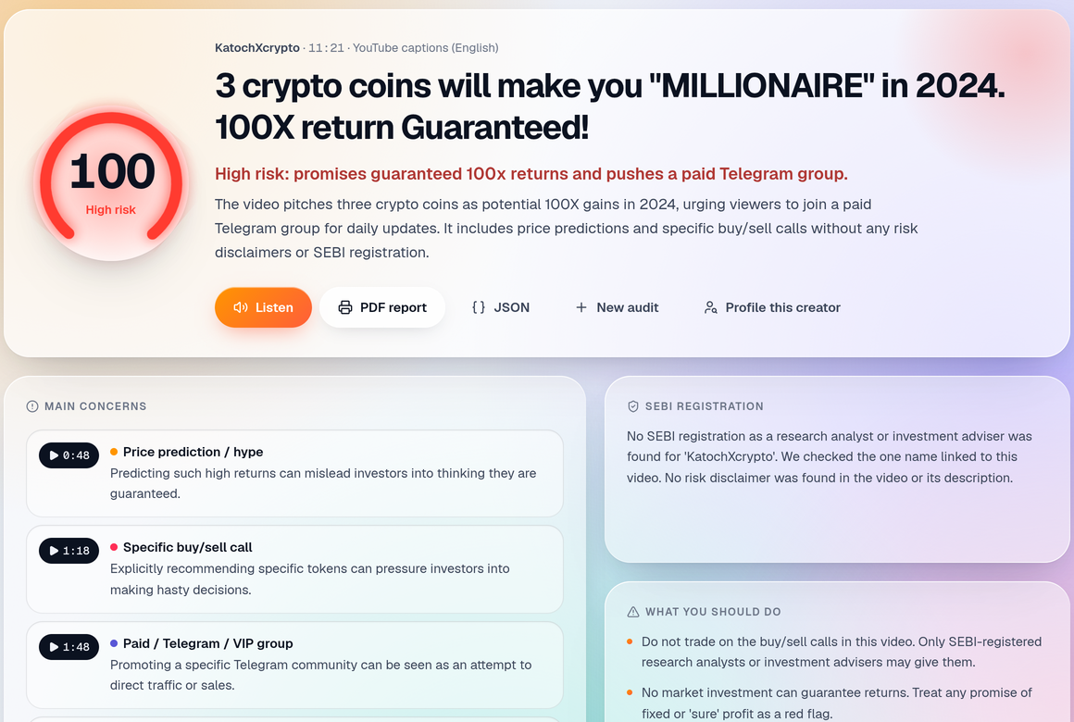
JOURNEY 2 · TRACK E
A "100X guaranteed" crypto video, audited line by line
• Full transcript (YouTube captions or local Whisper, Hindi/English/Hinglish)
• Findings quote the creator verbatim with a timestamp you can click
• Each finding shows severity, confidence and whether AI or keywords found it: uncertainty is visible, never a bare true/false
• Separates promotion (paid groups, referral links) from education

Slide 7
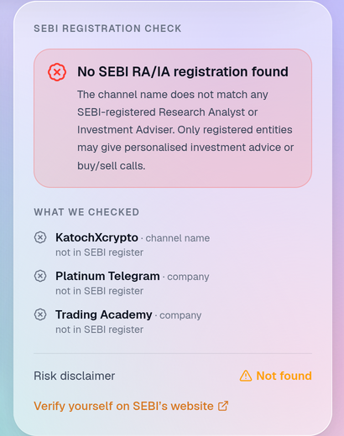
WHO IS GIVING THE ADVICE?
Real checks against SEBI's public registers
• Local mirror of 5 SEBI registers: research analysts, investment advisers, portfolio managers, brokers, mutual funds (6,645 entities)
• Checks every registration number (typos too), the channel name, presenters and guest experts found by AI, and the creator's own website
• Clear verdicts: registered adviser · registered only as a broker (not allowed to give tips) · guest expert registered · not registered
• Shows exactly what was checked, so "not found" is evidence, not a failure

Slide 8
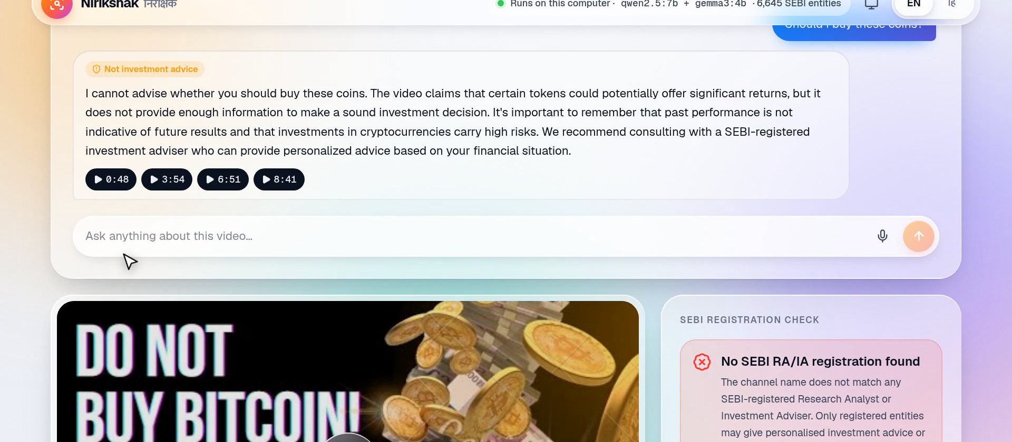
ASK THE VIDEO
Grounded answers, and a firm line on advice
• Questions in English or Hindi, typed or spoken (local Whisper)
• Answers cite real transcript lines; made-up citations are dropped
• "Should I buy?" / "Will it double?" are refused and redirected to the facts and registration status
• Concept questions ("what is a stop-loss?") get labelled general explanations

Slide 9
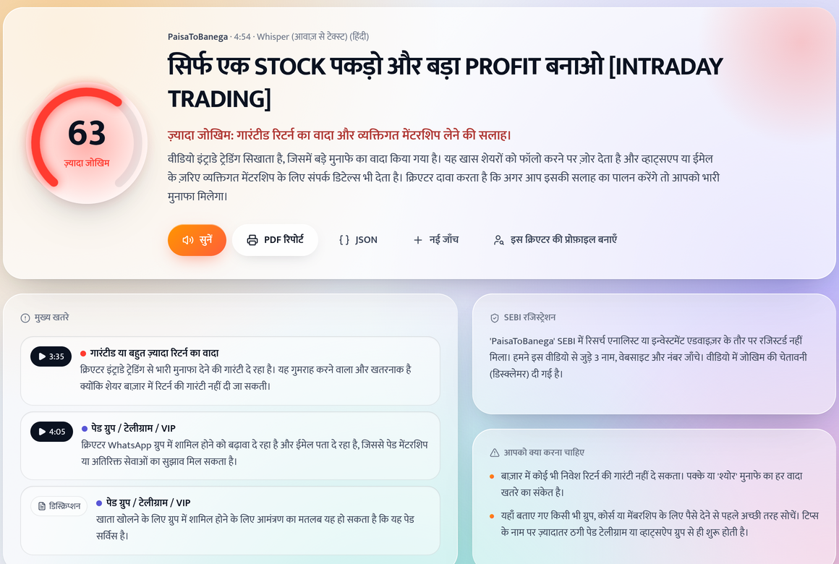
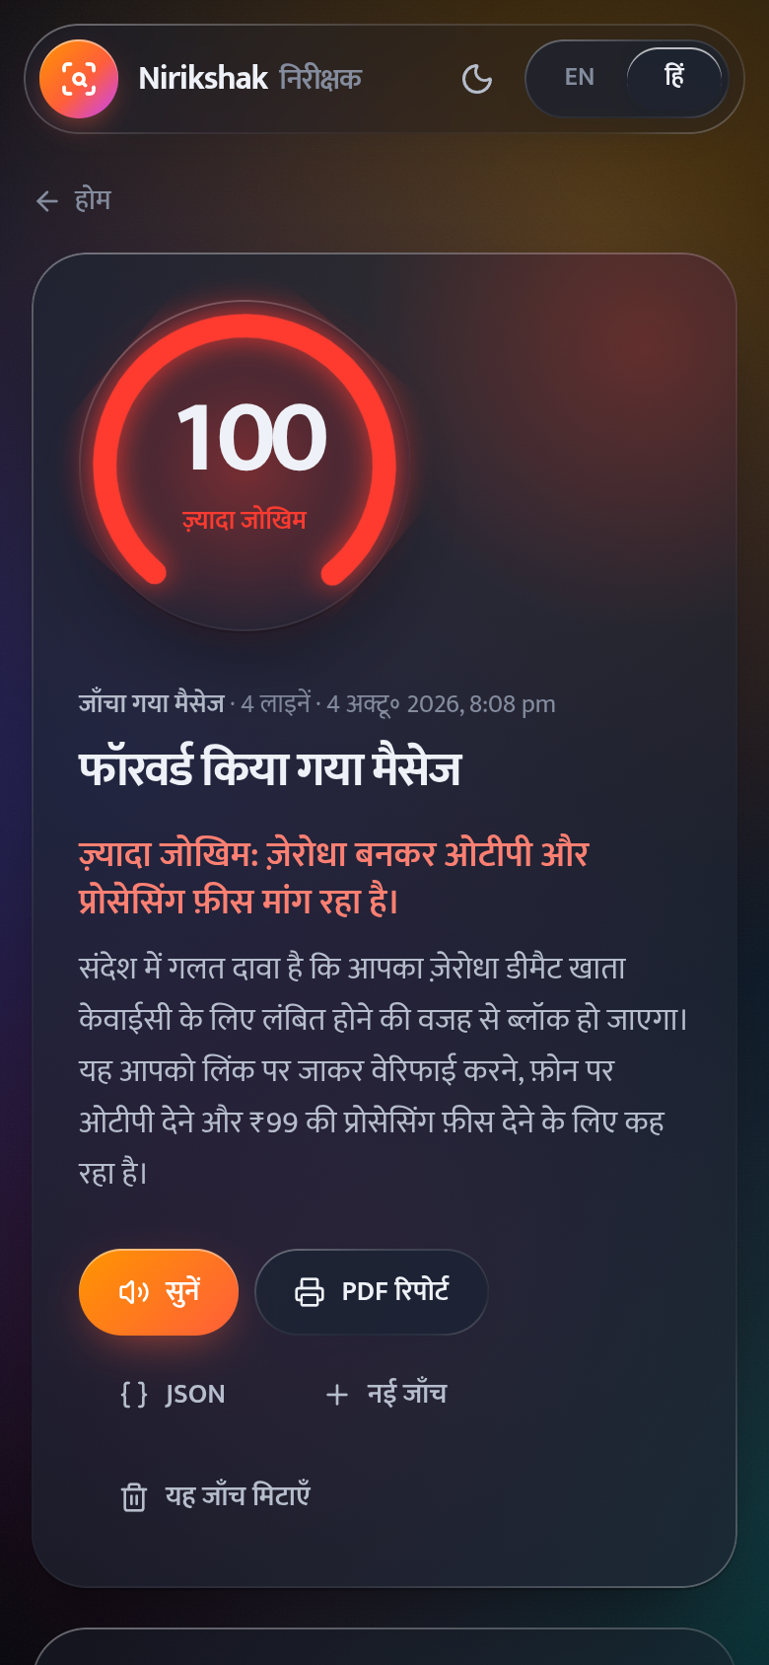
BHARAT-FIRST · 25% OF THE EVALUATION
Built for Hindi speakers and low-end phones
• Full Hindi UI, explanations, summaries and PDF, written in everyday Hindi (style guide + glossary)
• Natural voice reads the summary aloud (Kokoro TTS, 4.1/5 naturalness in Hindi vs 1.4 for the browser voice)
• Works on any phone browser: responsive layout, light effects; the AI runs on a server

Slide 10
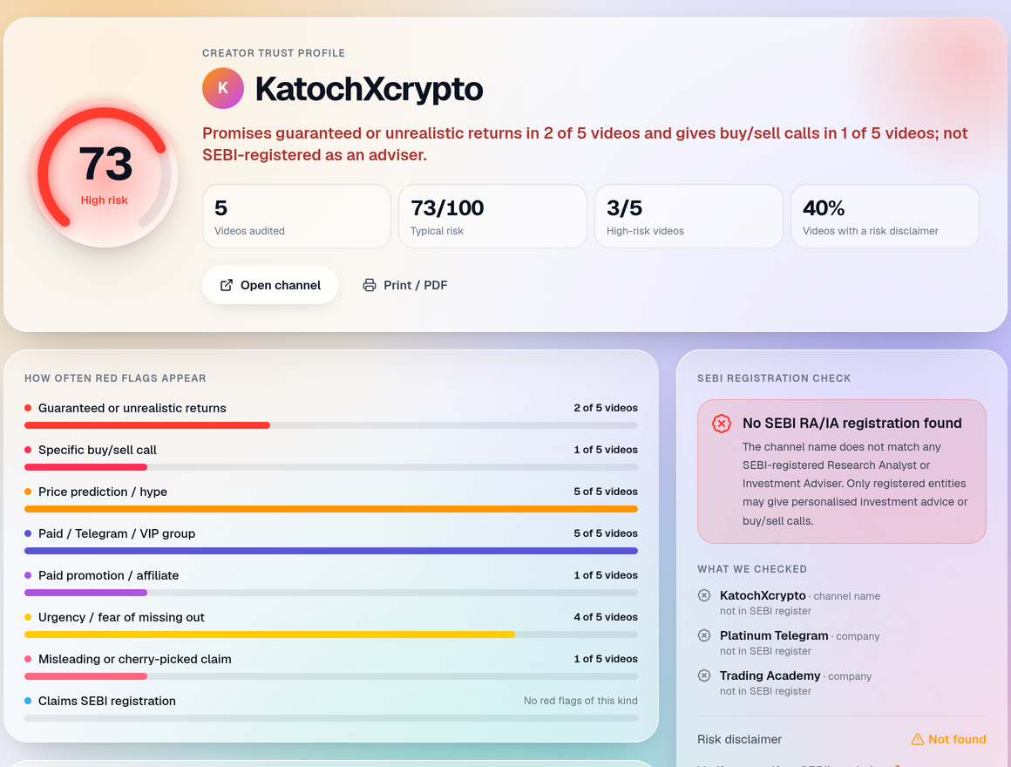
CREATOR TRUST PROFILE
One video can be an outlier; the pattern is the warning
• Audits a channel's latest uploads (re-using earlier audits)
• Example: high risk overall; all 5 recent videos push a paid Telegram group, 2 promise guaranteed returns; not registered
• Contrast: a SEBI-registered research analyst is verified and scores low (0/100) across recent videos
• Helps users decide whom to follow, not what to buy

Slide 11
TECHNOLOGY
AI used where it matters, guarded by checks
Input
Scan
Understand
Ground
Verify
Explain
YouTube captions · Whisper
(local) · screenshot OCR
Multilingual rules
EN · Hinglish · हिन्दी
LLM, JSON-schema output
12 harm categories
Quote must match the text,
else discarded
SEBI registers · official
broker domains
Brief · Hindi · voice ·
PDF · Q&A
• Runs fully local on a 6 GB laptop GPU: Qwen 2.5 7B (analysis) + Gemma 3 4B (Hindi, vision) via Ollama, faster-whisper, Kokoro TTS. No data leaves the device.
• Hosted demo on AWS (EC2, Mumbai): same code, AI via Amazon Bedrock with Groq/Gemini fallback, server-side keys, per-visitor limits.
• Stack: Python · FastAPI · SQLite · React + TypeScript + Tailwind · Docker. 31 unit tests; labelled eval sets.

Slide 12
TRUST, GUARDRAILS & MEASURED ACCURACY
Non-commercial, private, honest about uncertainty
Guardrails
Privacy
Uncertainty
No tips, predictions or buy/sell/hold views
Advice questions refused
No brokers promoted, no monetisation
Full version runs on the user's device
No SMS/OTP harvesting; nothing stored remotely
Messages can be checked without saving
Confidence on every finding
Verbatim quotes to self-check
"Possible match: verify the number"
Held-out test sets (never used for tuning): video claims F1 0.89 vs 0.56 for keyword rules alone, 0 false alarms on clean videos; forwarded-message scams F1 0.96, 0 false alarms on clean messages (bank OTP SMS, news, family chats).
Calibrated scoring: registered analysts and educational videos score low (0-14); scams and guaranteed-return pitches score high. Test sets are published with the code.

Slide 13
FEASIBILITY & SCALE
Infrastructure any institution can run
• Open source; runs on one consumer GPU with zero per-check cost, or on a hosted model API
• An exchange, depository, investor-education fund or NGO can host it for millions; users only need a phone browser
• Rules, registers and languages are data: add new scam patterns or regional languages without retraining
Next steps
Share-to-Nirikshak from WhatsApp and a Telegram bot
Tamil, Telugu, Bengali, Marathi via Bhashini / IndicTrans2
IVR / missed-call verification of a registration number
Brokers' and AMFI distributor registers; nightly SEBI sync
Larger labelled dataset with investor-protection volunteers

Slide 14
Check before you trust.
Live demo https://13-233-152-160.sslip.io
Code https://github.com/RudraPandit0504/nirikshak
Awareness tool only. Not investment advice.

