Slide 1

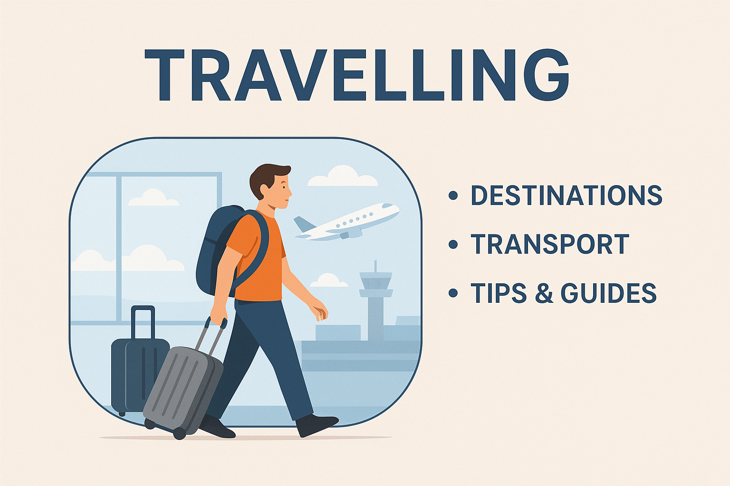
Title: Exploratory Data Analysis of Travel Traingle Website

Slide 2
About Us:
TRIPURAM RUDRA REDDY
B.Tech graduate passionate about Data Analytics and Visualization.
Exploring data-driven insights through real-world datasets.
Interested in web data extraction and business trend analysis.
LINKEDIN: https://www.linkedin.com/in/rudra-reddy/
GITHUB: https://github.com/RudraReddy12
BODE JAGADISH KUMAR
B.Tech graduate passionate about Data Analytics and Visualization.
Exploring data-driven insights through real-world datasets.
Interested in web data extraction and business trend analysis.
LINKEDIN: https://www.linkedin.com/in/jagadishkumarbode
GITHUB: https://github.com/jagadish789

Slide 3
Introduction:
TravelTriangle is an online travel marketplace offering customized holiday packages.
The platform connects travelers with multiple verified travel agents.
Users can compare prices, itineraries, and reviews before booking.
Web scarping helps in collecting real-time travelling data directly from travel traingles.
In this project, Python libraries Requests and BeautifulSoup were used to extract package details.
Analyzing this data helps understand customer behavior and travel trends.
The scraped data was cleaned, processed, and converted into a structured dataset using Pandas.
Insights from EDA can support better business decisions and improve customer experience.

Slide 4
Business Problem:
TravelTriangle hosts thousands of travel packages, agents, and customer interactions online.
However, valuable insights are not directly visible without structured analysis.
Identifying travel trends and popular locations can support business planning.
Understanding user preferences can help improve package offerings and pricing.
A cleaned and organized dataset is required to support clear comparison and insight-driven decision making.

Slide 5
Objectives:
To scrape real-time travel package data from the TravelTriangle website.
To clean, organize and convert the raw scraped data into a structured dataset.
To perform Exploratory Data Analysis (EDA) to understand travel trends and patterns
To identify popular destinations, pricing variations, and seasonal behaviors.
To analyze customer preferences such as trip duration, budget range, and package type.
To visualize findings using meaningful charts and graphs for better interpretation.

Slide 6
Web Scraping:
Web scraping was performed to collect travel package details from the TravelTriangle website.
Python libraries Requests and BeautifulSoup were used for HTML parsing.
Key information collected included destination, price, duration, package description, and agent details.
Extracted data was stored in a structured tabular format for analysis
Extracted values were stored in lists and converted to a dataframe
Data cleaning steps were applied to remove duplicates, missing values, and formatting issues. .

Slide 7






Tools Used:

Slide 8
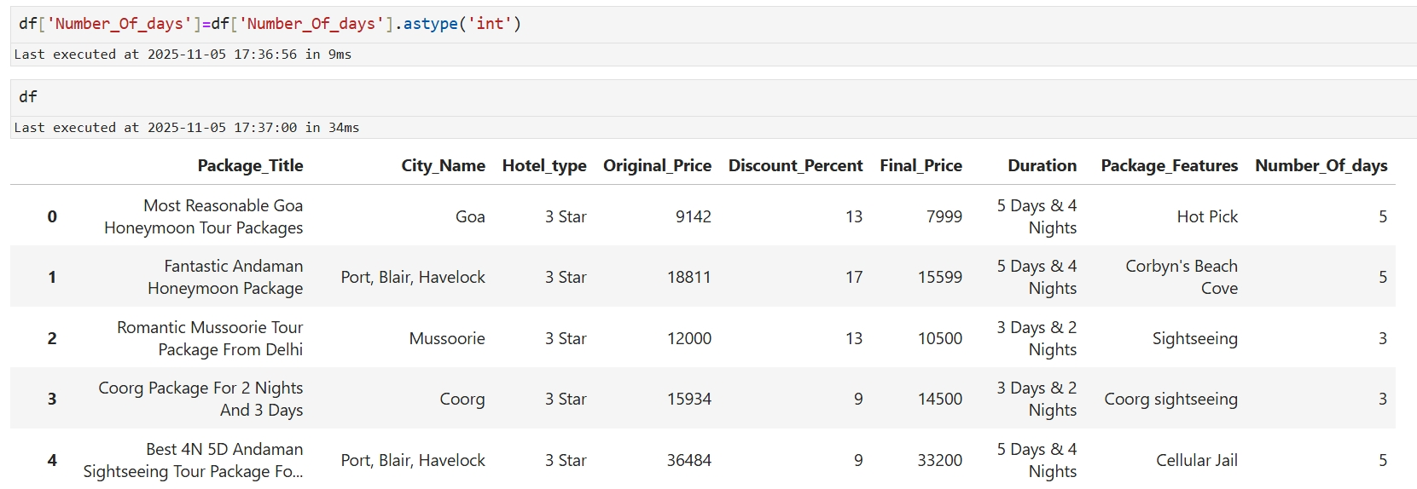
Data Cleaning Steps:
Identified and handled missing values (imputation or removal)
Removed duplicate records
Corrected inconsistent or incorrect data entries
Standardized formats (dates, text, numbers)
Detected and treated outliers
Handled irrelevant or redundant columns
Converted data types to appropriate formats

Slide 9
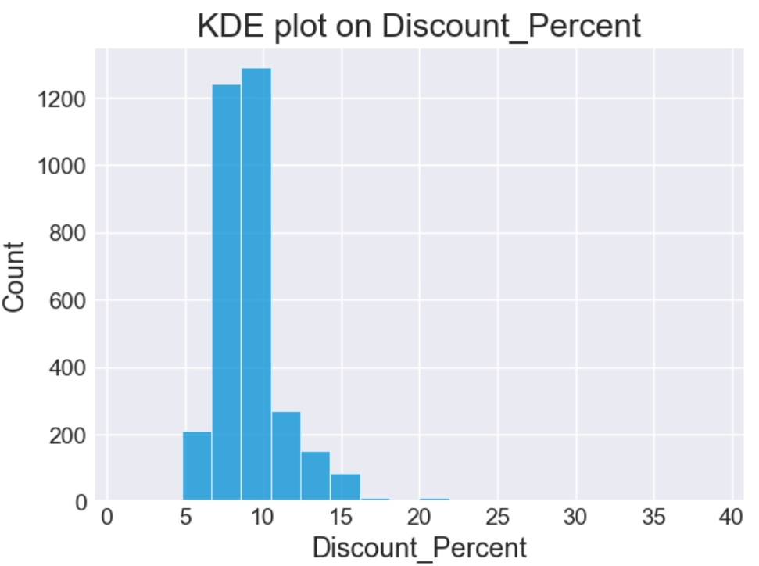
Data Visualization:
The distribution is highly concentrated between 7% and 12%, indicating most tour packages fall in this discount range.
Peak frequency occurs around 9–10%, showing it is the most common discount offered.
Very few packages offer discounts beyond 15%, suggesting higher discounts are rare.
The distribution shows a slight right skew, meaning a small number of high-discount packages pull the tail to the right.
This insights helps businesses understand pricing competitiveness and benchmark against competitors

Slide 10
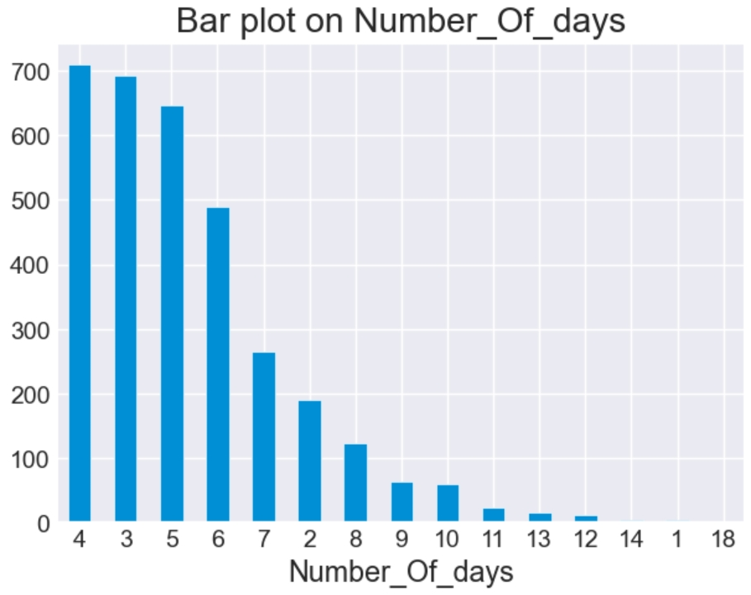
Data Visualization:
Majority of travel packages are between 3 to 6 days, indicating that short trips are most popular among customers.
4-day trips have the highest count, followed closely by 3-day and 5-day options.
Very few packages extend beyond 10 days, showing low demand for long vacations.
The pattern suggests that most customers prefer long weekend or short-week travel itineraries.
Shorter trips are likely favored due to cost, work schedules, and quick getaway preferences.

Slide 11
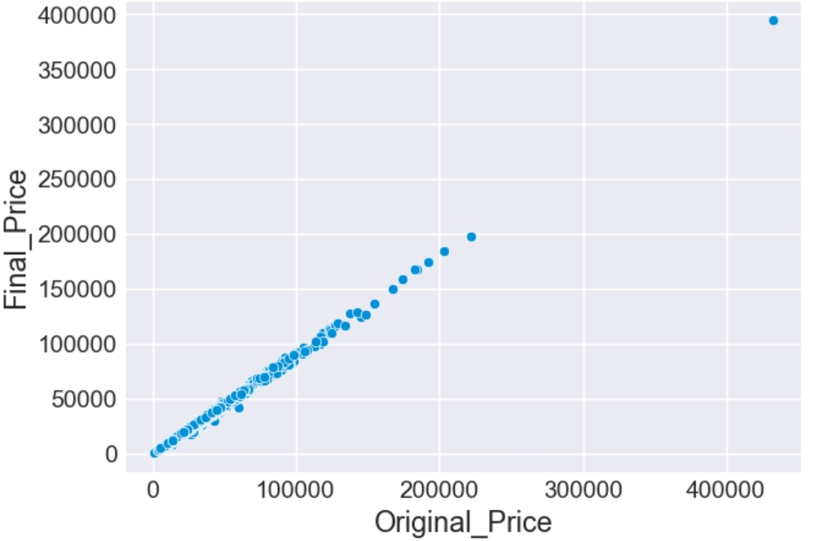
Data Visualization:
The plot shows a strong positive linear relationship between the original package price and the final discounted price.
As the original price increases, the final price also increases proportionally, indicating consistent discount application across packages.
Most data points lie close to a straight line, suggesting limited variability in discount percentages.
A few high-ticket packages appear as outliers, but they still follow the same linear trend.

Slide 12
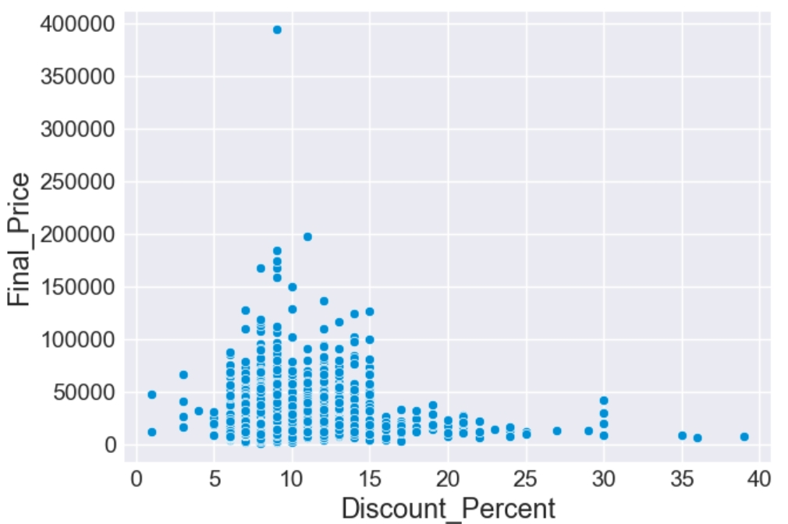
Data Visualization:
Most Travel Packages fall in the 5%–15% discount range, suggesting this is the typical discount band.
Higher-priced packages (above ₹150,000) are concentrated mostly around 10% discounts, indicating premium items rarely receive high discounts.
Products with higher discounts (20–40%) generally correspond to low final price items, suggesting clearance or low-value products.

Slide 13
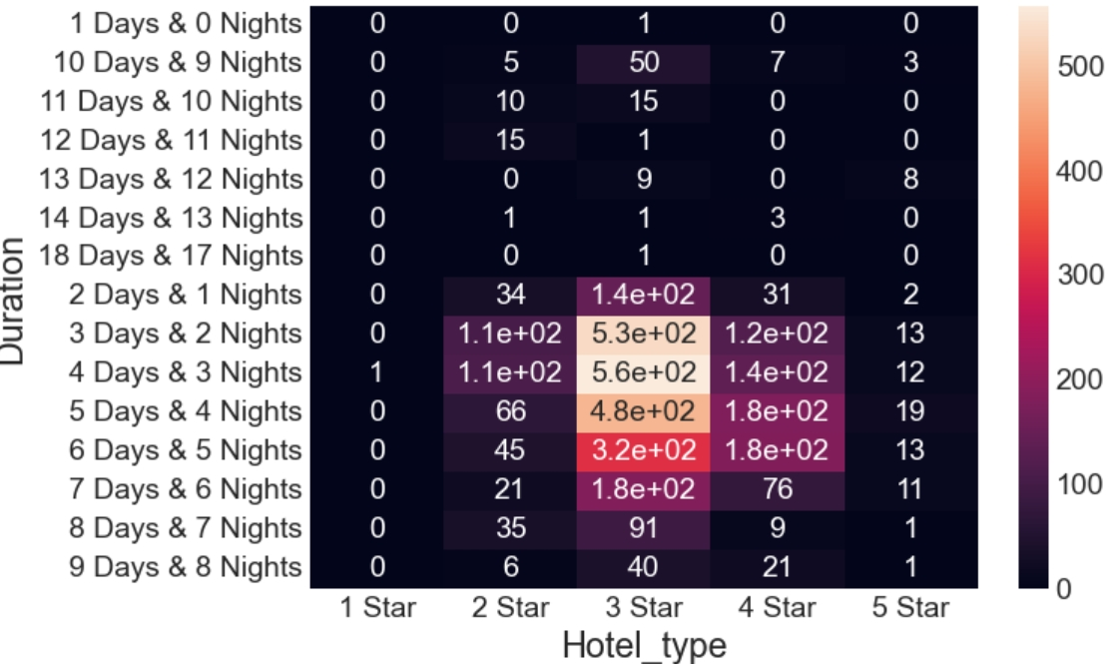
Data Visualization:
A heatmap comparing hotel types with number of days in the travel package.
Majority of short trips are associated with mid-range hotel categories.
Premium hotel categories are chosen more for longer stays.
Indicates travel preference behavior and spending capability of customers.

Slide 14
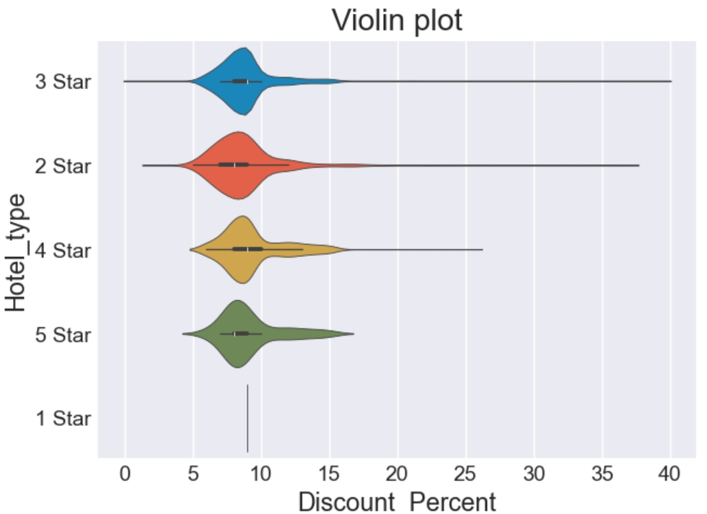
Data Visualization:
Violin plot visualizing spread, density, and distribution of discounts for different hotel classes.
Some hotel types consistently offer larger discounts.
Wider plot areas represent heavy concentration of similar discount values.
Discount behavior can be used as a pricing strategy insight.

Slide 15
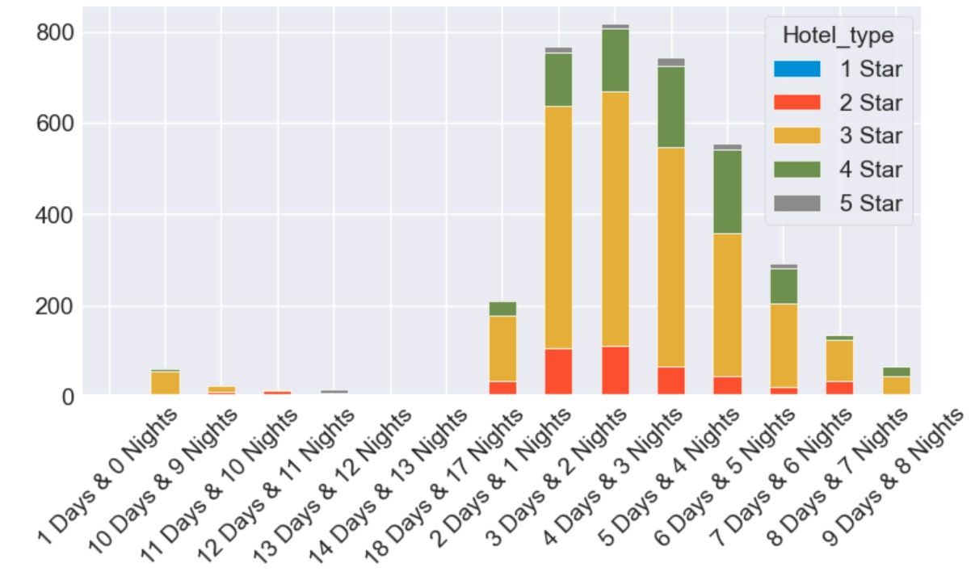
Data Visualization:
A stacked bar chart comparing different hotel types (1–5 star) across various trip durations.
Bar segments show how many packages are available in each hotel category for that duration.
Most travel packages fall within 3–6 day durations, showing the most popular trip length among customers.
3-Star hotel packages dominate the majority of the offerings, followed by 4-Star options.
Longer trips (7+ days) show fewer total packages overall, indicating lower customer preference for longer holidays.

Slide 16
Conclusion:
Discount Percent vs Final Price scatter plot reveals no strong linear correlation, implying discounting is not uniform across price tiers.
Higher discounts (20–40%) were mostly associated with low-priced items, likely clearance or stock-clearance products.
Demand patterns indicate that mid-priced products with moderate discounts (5–15%) form the majority of the dataset.
Product ratings remain largely consistent across discount ranges, suggesting discounts do not heavily influence ratings.
Category analysis shows uneven distribution—few categories dominate both count and revenue, indicating skewed inventory strategy.
Overall, the dataset reflects a pricing strategy centered on moderate discounts, stable packages, and a clear separation between premium and budget segments.

Slide 17
Q&A

Slide 18
Experience– Web Scraping & Data Analysis:
Scraped Package Features from travel triangle data using Python (BeautifulSoup, pandas).
Cleaned and standardized data (Price ,Duration ,Discount).
Created visualizations showing price trends based on duration and hotel type.
Learned end-to-end data workflow: scraping → cleaning → analysis → visualization.

Slide 19
Challenges – Web Scraping & Data Analysis:
Inconsistent webpage structures across Packages.
Missing or mismatched match details.
Handling duplicate and unclean data.
Overcoming request blocks and slow scraping.
Choosing the most meaningful visuals for insights.

Slide 20
