Slide 1
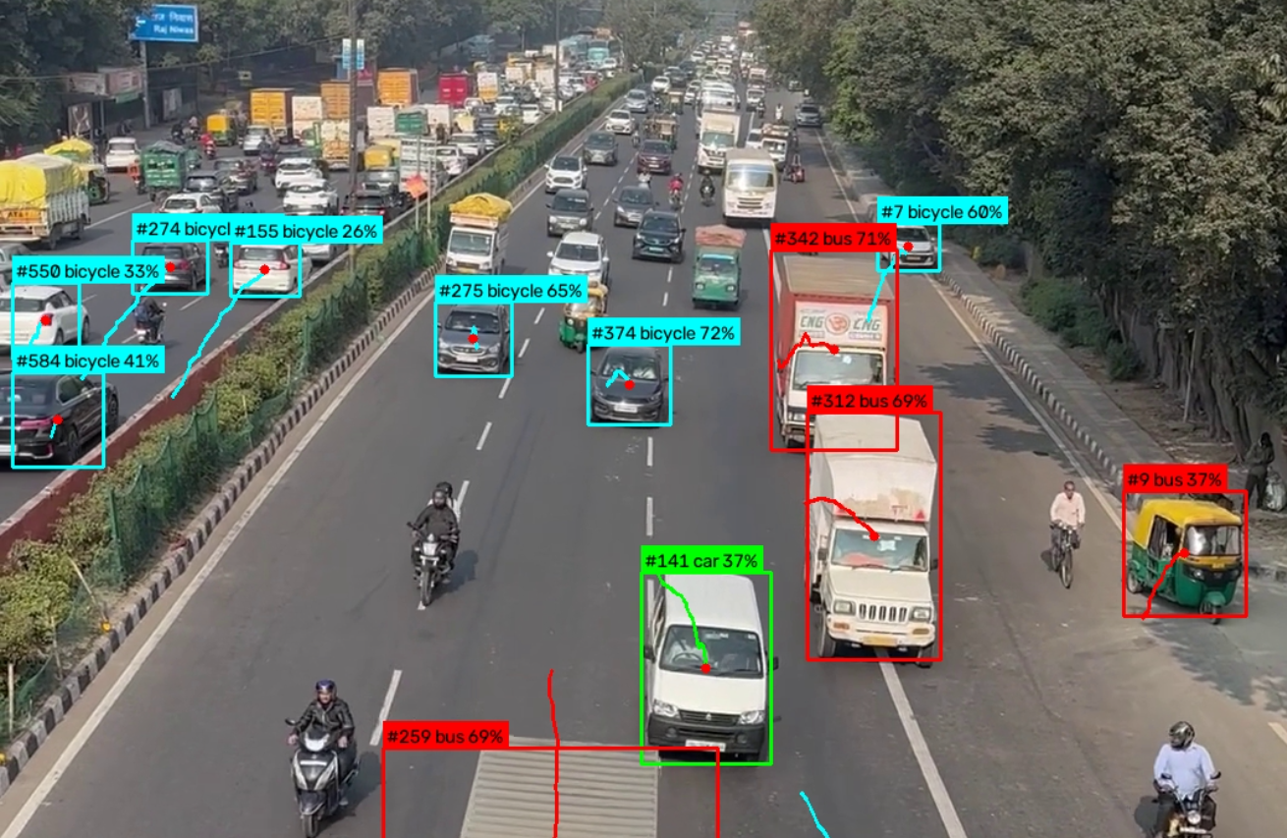

Smart Traffic Monitoring and Vehicle Classification System
Subham Sharma (26MAI007)
Rudradatt Purohit (26MAI015)
Notes:
Good morning. Our project is a Smart Traffic Monitoring system. It looks at road images and videos, finds the vehicles, tells what type each one is, tracks it, and counts it. The picture on the right is a frame from our own test video.

Slide 2
Aim and objectives
1
Classify 7 vehicle types, including auto rickshaw and scooter
AIM
Build a system that looks at road images and videos, recognises the type of each vehicle, tracks it, and counts the vehicles that cross a line. Then traffic does not have to be studied by watching footage by hand.
2
Train our own CNN and compare it with ResNet-18 and MobileNetV3-Small
3
Detect, track and count vehicles crossing a line, with direction
4
Estimate congestion as Low, Medium or High
5
Save results in a database and show them in a web dashboard
Notes:
The aim is simple: from a road video, know what vehicles pass and how crowded the road is. We chose seven classes on purpose, because Indian roads have auto rickshaws and scooters that many standard datasets do not cover. We also wanted to build our own CNN and see how it compares with two ready-made models.

Slide 3
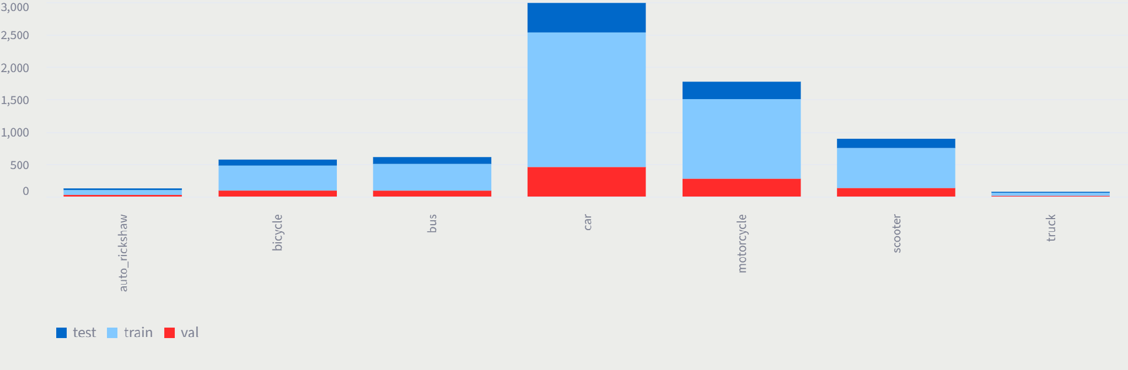
Dataset
7,035
images in 7 classes
70 : 15 : 15
train 4,852, validation 1,081, test 1,102
Car is the biggest class (about 3,000 images), then motorcycle (1,800) and scooter (900)
Class weights in the loss, so mistakes on small classes count more
Augmentation: random flips, small rotations, colour changes
24 and 15
auto rickshaw and truck images in the test set
Notes:
We have 7,035 images, split about 70, 15, 15 into train, validation and test. The chart shows the data is not balanced. Cars are by far the biggest class, while auto rickshaw and truck have only 24 and 15 images in the test set. We used class weights and augmentation to reduce the effect. Keep this imbalance in mind, it comes back in the results.

Slide 4
How the system works
1
Frames
2
Detect
3
Track
4
Classify
5
Count
A road image or video is read frame by frame
YOLO finds every vehicle in the frame
ByteTrack gives each vehicle a fixed ID
Our CNN labels the crop; majority vote over frames
Centre point crosses the line: counted once, with direction
Why our own classifier?
Congestion level
YOLO uses COCO labels, which have no auto rickshaw or scooter. So we pass each crop to our seven-class CNN for the final label.
Low, Medium or High, from the number of vehicles and the share of the road covered by their boxes. Speed in km/h was not reported, as the camera was not calibrated.
Everything is saved in SQLite and shown in a 9-page Streamlit dashboard. 26 pytest tests check the code.
Notes:
This is the whole pipeline. YOLO finds vehicles, ByteTrack keeps an ID for each one, and our own CNN decides the type, because the standard COCO labels do not have auto rickshaw or scooter. The type is decided by a vote over many frames so it does not flicker. A vehicle is counted when its centre point crosses a virtual line, and each ID is counted only once. We did not report speed because the camera was not calibrated.

Slide 5



Three models compared
Custom CNN
ResNet-18
MobileNetV3-Small
98,823 parameters
11.18 million parameters
1.53 million parameters
Four convolution blocks. Convolution, batch norm, pooling and backpropagation are written by hand in NumPy.
Ready-made and pretrained. Last layer replaced to give seven outputs.
Small pretrained model. Last layer replaced to give seven outputs.
Same recipe for all three: AdamW optimizer, cosine learning-rate schedule, class weights, early stopping after 5 epochs without improvement, best checkpoint kept. All were tested on the same 1,102 images.
Notes:
We trained three models. The first is our own CNN, with the main operations written by hand in NumPy. The other two are ResNet-18 and MobileNetV3-Small, which are pretrained, with the last layer changed for seven classes. All three used the same training settings and the same test set, so the comparison is fair.

Slide 6
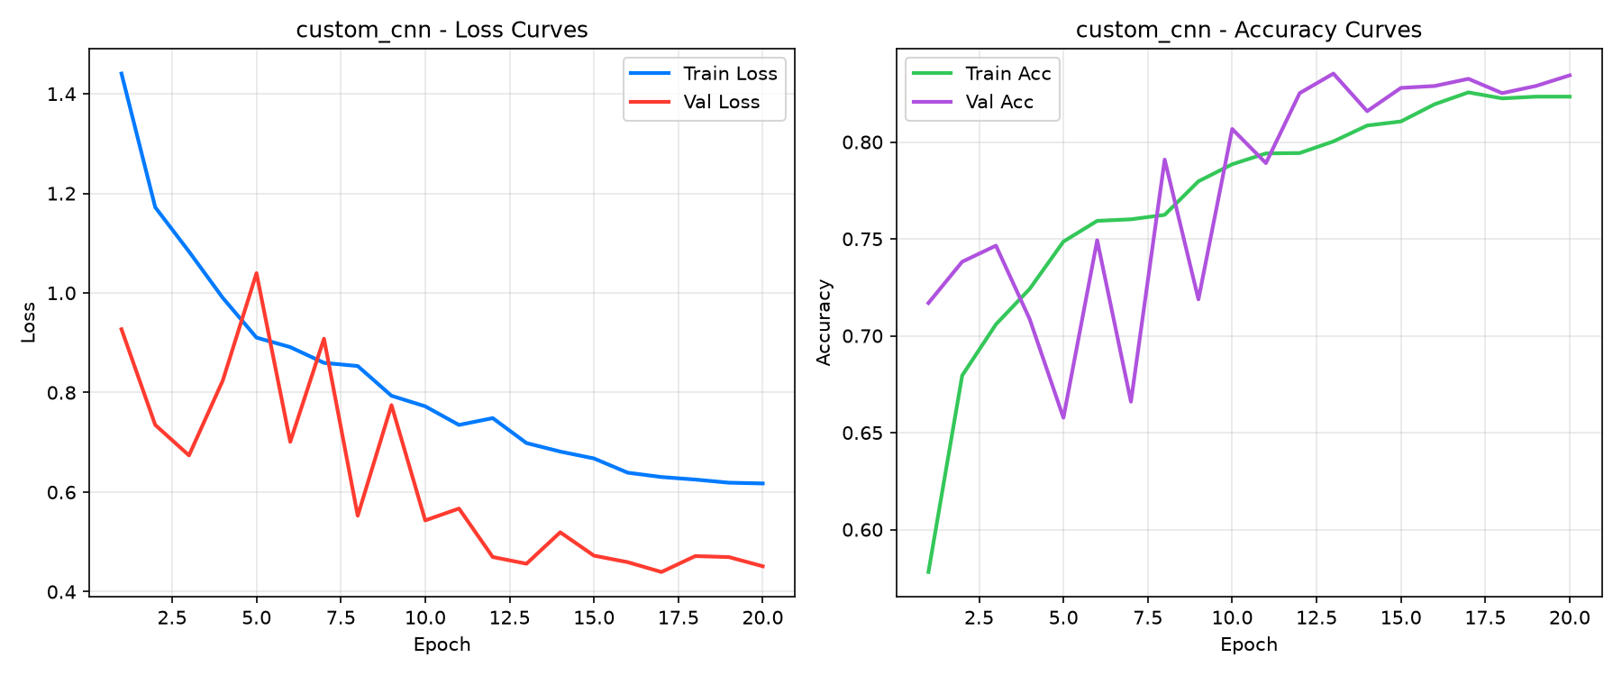
Training of the custom CNN
20
epochs of training
83%
validation accuracy, close to training (82%)
Validation curves jump around until about epoch 12, then settle. Validation loss is below training loss, probably because augmentation and dropout work only during training.
1.44 → 0.62
training loss, first to last epoch
Notes:
Training ran for 20 epochs. Training loss came down steadily from 1.44 to 0.62. Validation accuracy ended near 83 percent and training near 82, so the two are close and we see no sign of overfitting. The validation curve is noisy in the first ten epochs and then becomes stable.

Slide 7
Model comparison
Model | Params | ms/img | FPS
Custom CNN | 0.10 M | 241 | 4
ResNet-18 | 11.18 M | 10.1 | 99
MobileNetV3-Small | 1.53 M | 11.5 | 87
Custom CNN is the most accurate, but the slowest: it runs in NumPy on the CPU.
ResNet-18 runs at about 99 FPS, so it suits real-time video.
MobileNetV3-Small was the weakest here.
Notes:
Here is the comparison on the same 1,102 test images. Our custom CNN got the best accuracy, 84.2 percent, and the best macro F1, 76.9, even though it has under a tenth of a million parameters. But it is slow, 241 milliseconds per image, because it runs in NumPy on the CPU. ResNet-18 is about 99 frames per second, so for live video it is the practical choice. Macro F1 is lower than accuracy because every class counts equally, and the small classes are harder.

Slide 8
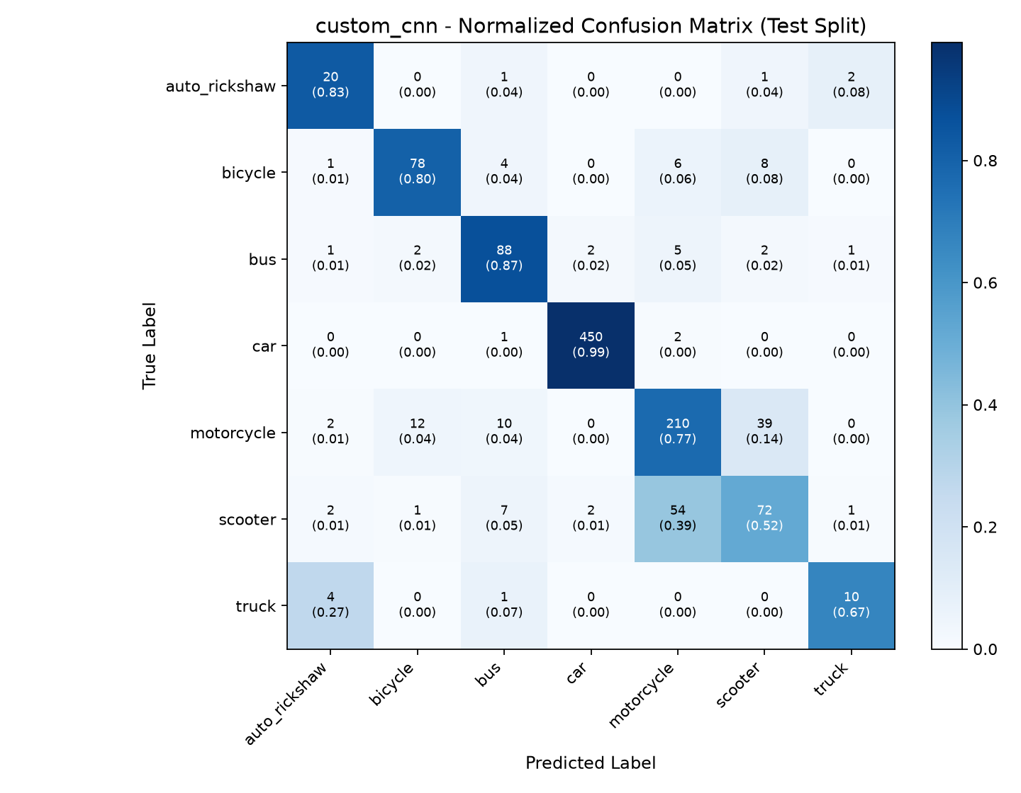
Where the custom CNN goes wrong
99%
52%
car, 450 of 453
scooter, the weakest class
928 of 1,102 test images correct
54 of 139 scooters were called motorcycle, and 39 of 273 motorcycles were called scooter
4 of 15 trucks were called auto rickshaw
Truck and auto rickshaw have very few test images, so treat their numbers as rough
Notes:
This confusion matrix is for the custom CNN. Cars are almost perfect. The biggest problem is scooter versus motorcycle: more than a third of scooters were predicted as motorcycle. They look alike from many angles. Truck and auto rickshaw have only 15 and 24 test images, so one image changes their percentage by 4 to 7 points. Please read those numbers as rough.

Slide 9
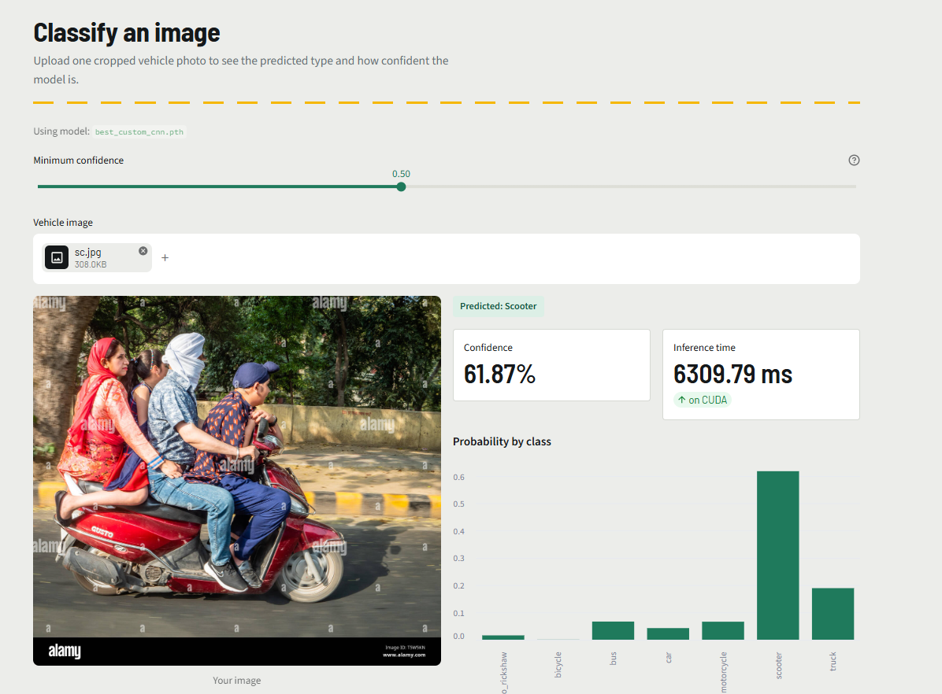
Dashboard and video test
Classify page: Scooter at 61.87%. Truck came second (about 19%), so the model was not very sure.
Video frame: IDs and trails hold up, but some cars are labelled bicycle, and the trucks and an auto rickshaw bus. Likely cause: small, distant vehicles look unlike the training images.
Notes:
On the left is the Classify page of our dashboard. A scooter with three people was predicted as Scooter at about 62 percent, but truck came second, so the model was unsure. On the right is a frame from the video. The tracker keeps stable IDs, which counting needs, but the labels are often wrong: some cars are called bicycle, and the trucks and the auto rickshaw are called bus. On clean test crops the model got 20 of 24 auto rickshaws and 10 of 15 trucks right, so we think the problem is small, distant vehicles seen from a bridge. We have not tested that separately. The dashboard also showed about 6.3 seconds for this one image, much more than the benchmark, and we have not looked into why.

Slide 10
Conclusion
What we built
Limits
Next steps
A working pipeline from video to count to dashboard
Custom CNN: best accuracy (84.2%) and smallest model
ResNet-18: fastest, about 99 FPS at 78.1%
Unbalanced data: only 15 truck and 24 auto rickshaw test images
Scooter recall is 52%; video labels are often wrong
No hand-counted check of totals, and no speed (camera not calibrated)
More scooter, auto rickshaw and truck images
Train YOLO directly on the 7 classes
Run the CNN on GPU, calibrate the camera, test more roads and weather
Notes:
To finish: we built a pipeline that works end to end. The custom CNN gave the best accuracy and ResNet-18 the best speed. The main limits are the unbalanced data and the wrong labels in video, mostly on scooters, auto rickshaws and trucks. Next we would collect more images of those classes, train YOLO directly on the seven classes, and calibrate the camera to measure speed. Thank you. We are happy to take questions.

