Slide 1
SUPPLY CHAIN
ANALYTICS
Delivery Performance & Late Delivery Prediction
Employee meeting presentation
180,518
57.3%
42.7%
Decision Tree
ORDERS ANALYZED
DELAY RATE
ON-TIME RATE
BEST MODEL
DataCo Supply Chain dataset

Slide 2
What this analysis is designed to answer
A business view of delivery performance and risk
01
02
03
Current position
Pattern
Action
How often are orders delayed, and how large is the schedule deviation?
Which shipping, regional, customer, department, and time dimensions show higher delay rates?
Where should management focus operational review, and can late-delivery risk be predicted?
02

Slide 3
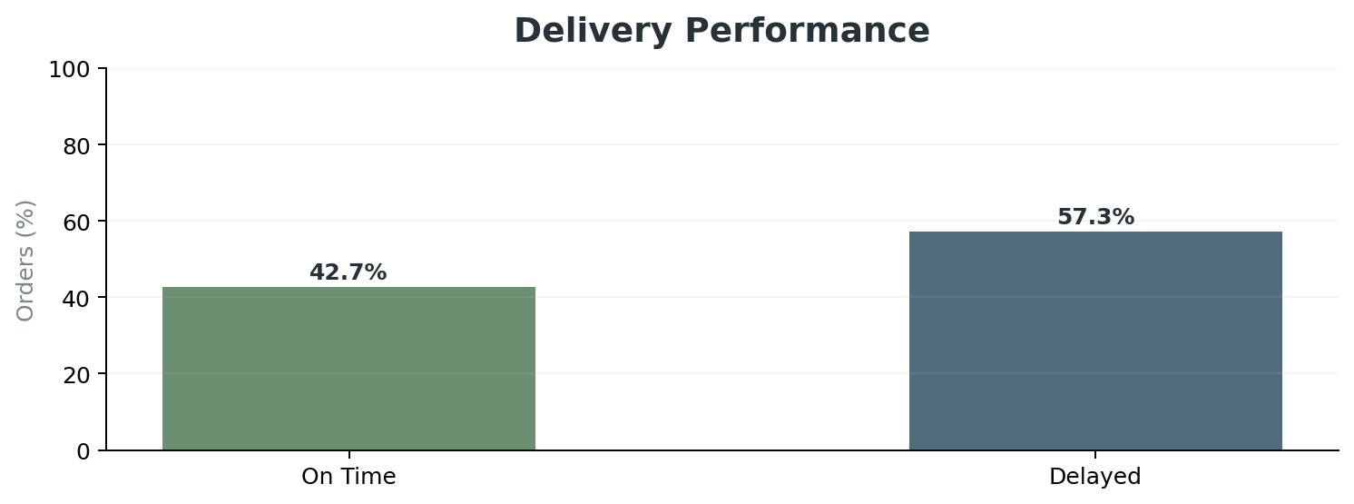
Delivery performance at a glance
The main issue is frequency of delay
180,518
103,399
57.3%
1 day
TOTAL ORDERS
DELAYED ORDERS
DELAY RATE
MEDIAN DEVIATION
INSIGHT
Delay is not an isolated event
57.3% of analyzed orders exceeded scheduled shipping time. The median deviation is 1 day, while the 90th percentile is 2 days.
More than half of the order base is affected.
The distribution supports a process-level review rather than only individual exceptions.
03

Slide 4
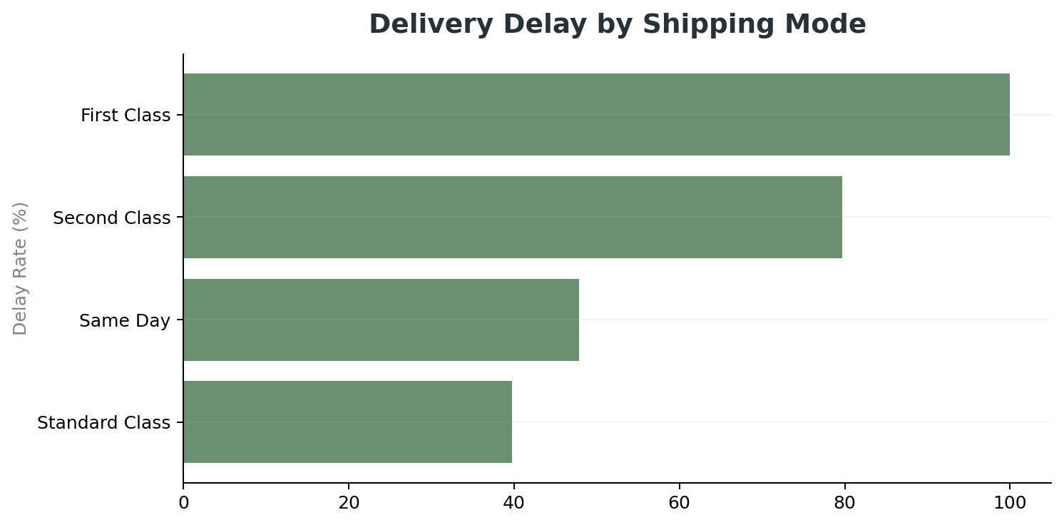
Shipping mode is the strongest visible pattern
Premium service levels do not automatically translate into better observed delivery performance
INSIGHT
What the chart suggests
First Class has the highest observed delay rate at 100.0%. Second Class is also high at 79.7%. Standard Class is lower at 39.8%.
Review carrier assignment and route design.
Compare promised service levels with actual performance.
Check whether premium orders are concentrated in harder-to-serve lanes.
04

Slide 5
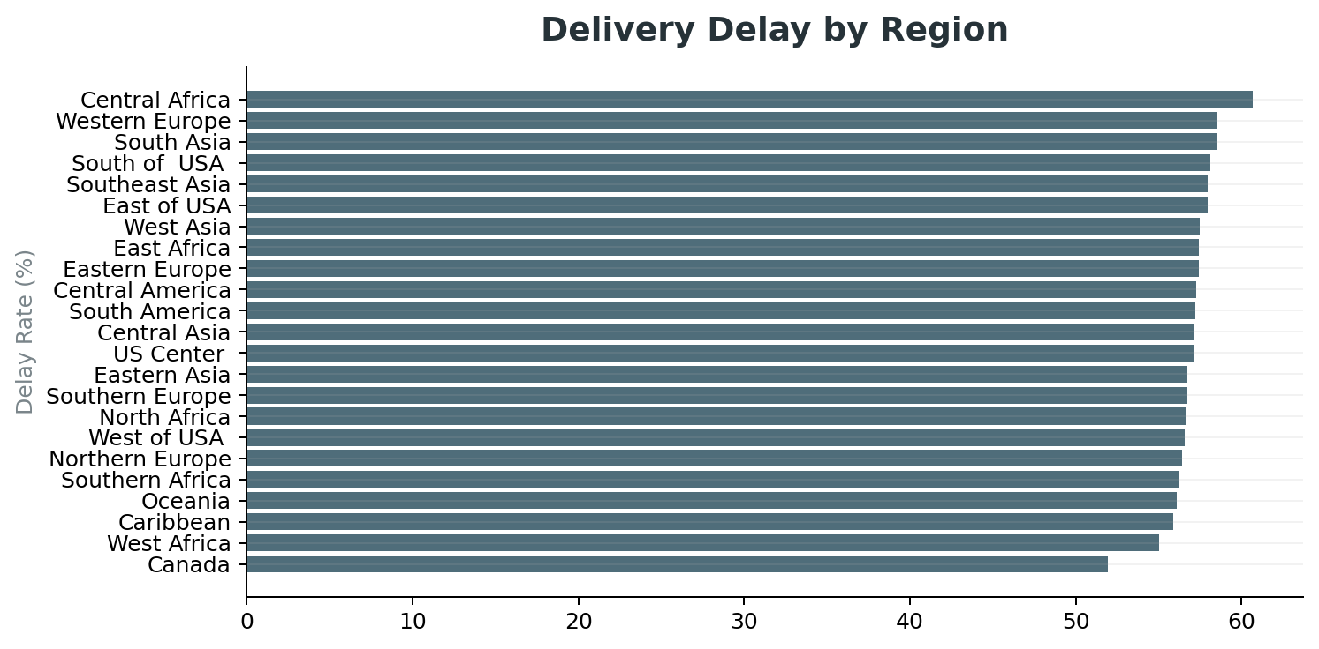
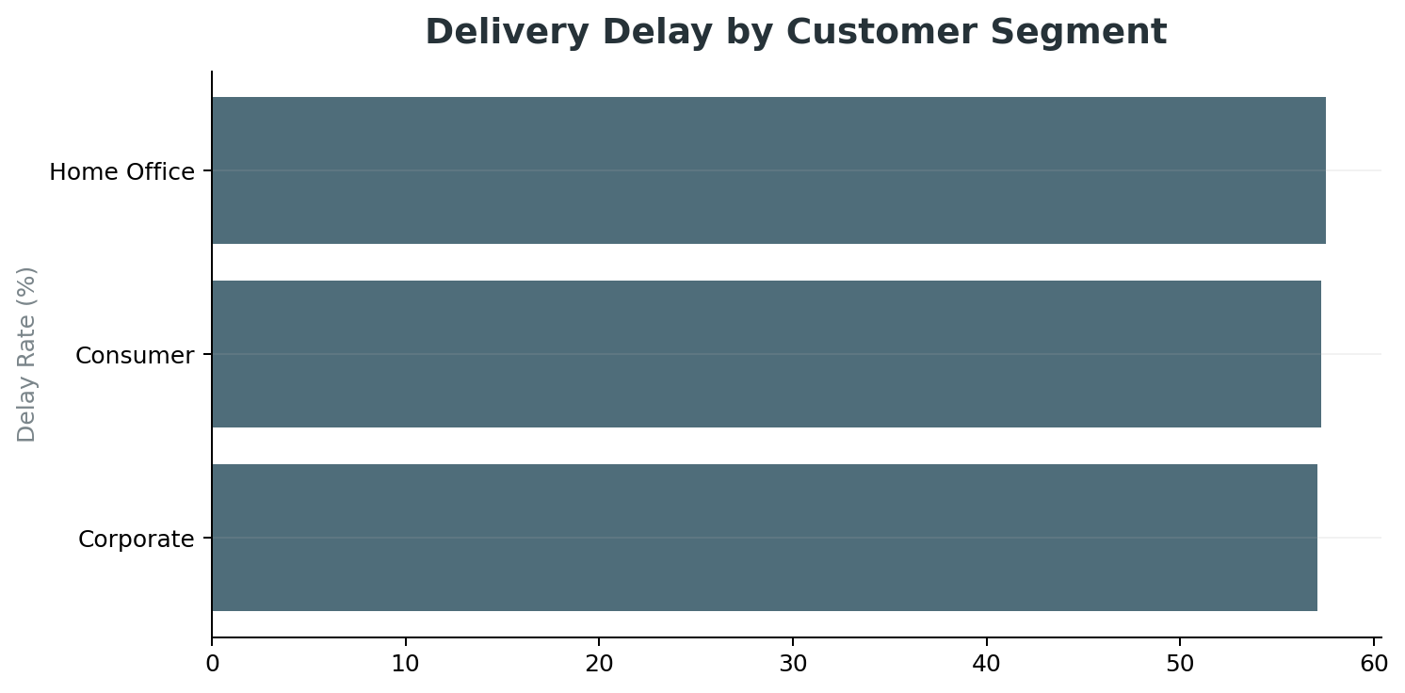
Regional and customer patterns are more moderate
Useful for prioritization, but not the primary signal
INSIGHT
INSIGHT
Regional insight
Customer insight
Central Africa has the highest regional delay rate at 60.7%. Regional variation is visible but less pronounced than the shipping-mode difference.
Home Office has the highest segment rate at 57.5%. The overall segment spread is relatively small.
05

Slide 6
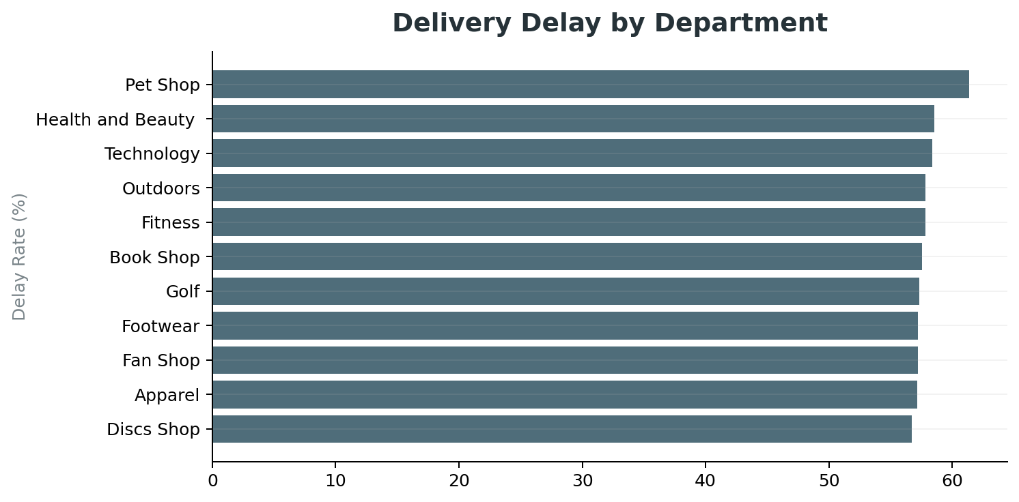
Department differences point to targeted review
The highest-delay departments can be examined for fulfillment constraints
INSIGHT
Highest observed department
Pet Shop has the highest delay rate at 61.4%.
Health and Beauty : 58.6%
Technology: 58.4%
Review inventory availability, fulfillment time, and carrier assignment.
Treat these results as associations, not proven root causes.
06

Slide 7
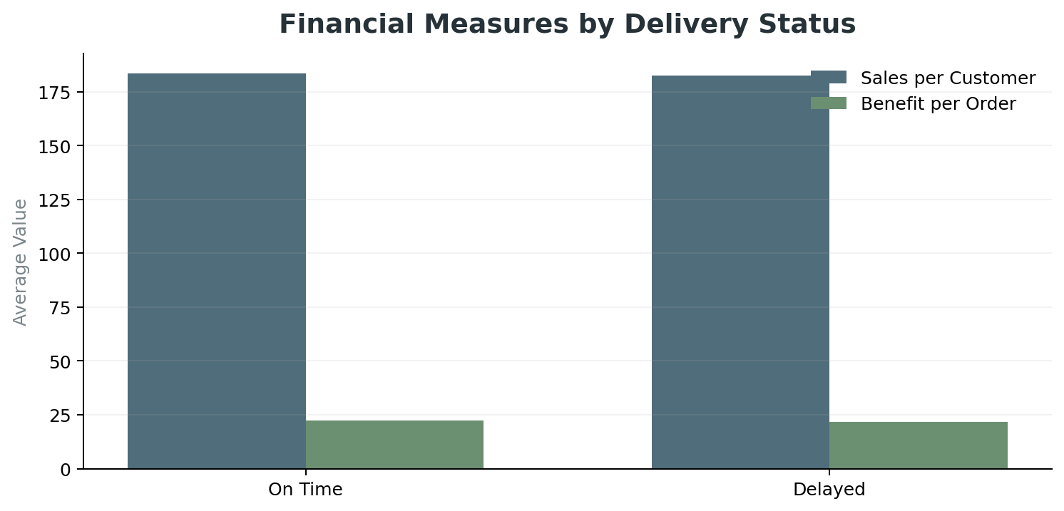
Financial view
Delivery status shows modest differences in selected average measures
INSIGHT
What the chart suggests
Average benefit per order is $21.58 for delayed orders versus $22.50 for on-time orders. Sales per customer also differs between the groups.
• The current analysis does not prove that delay causes financial loss.
• A stronger business case would add revenue, profit, discount, shipping cost, and customer-impact measures.
07

Slide 8
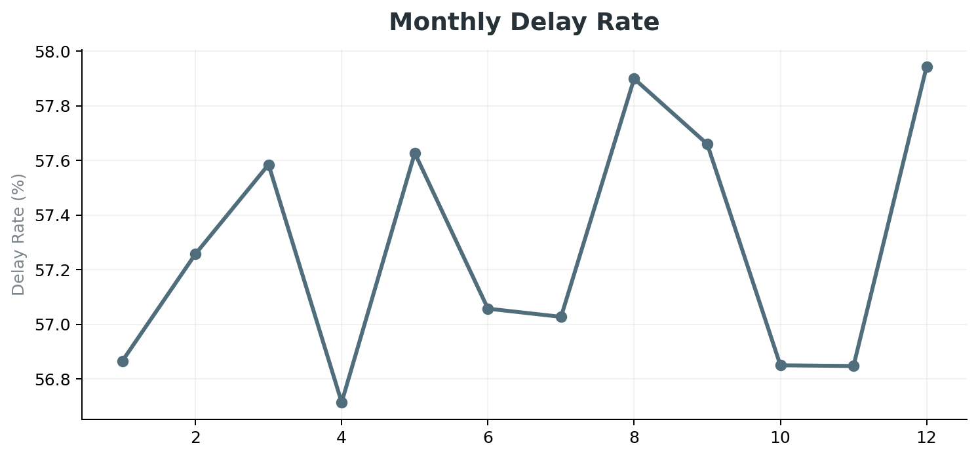
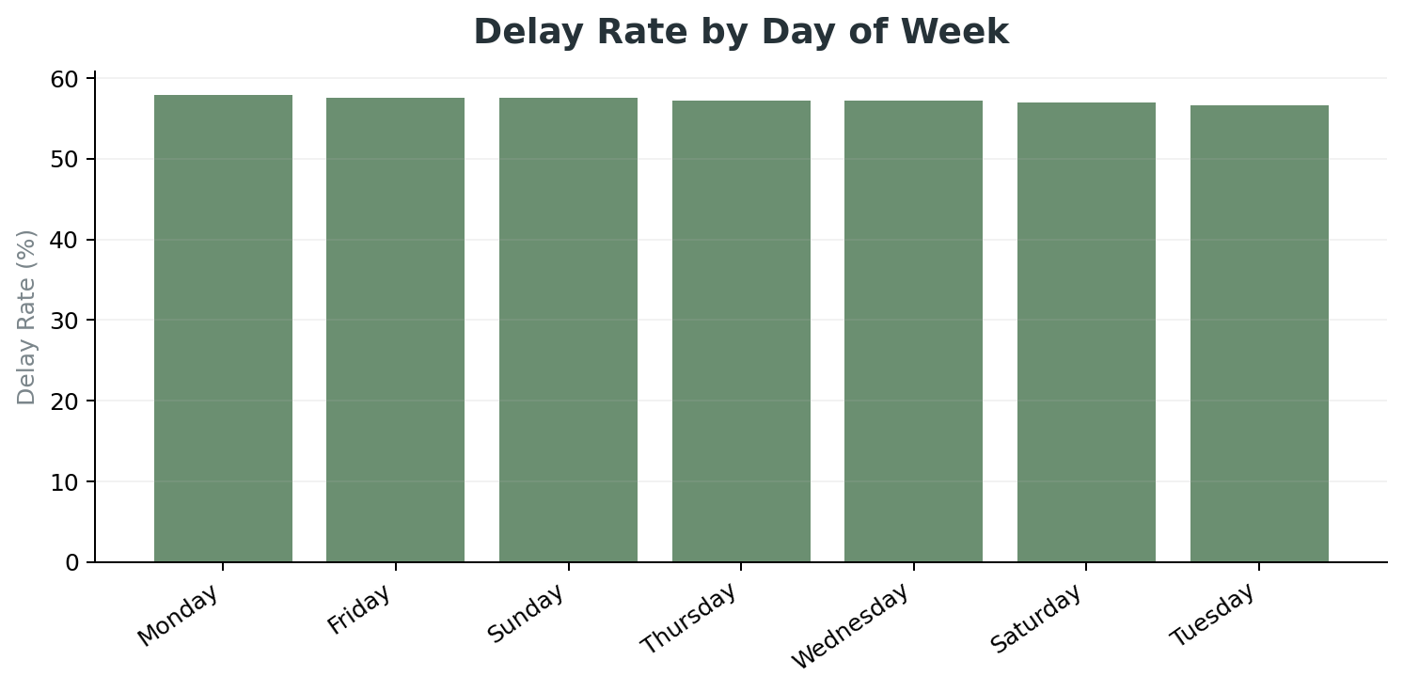
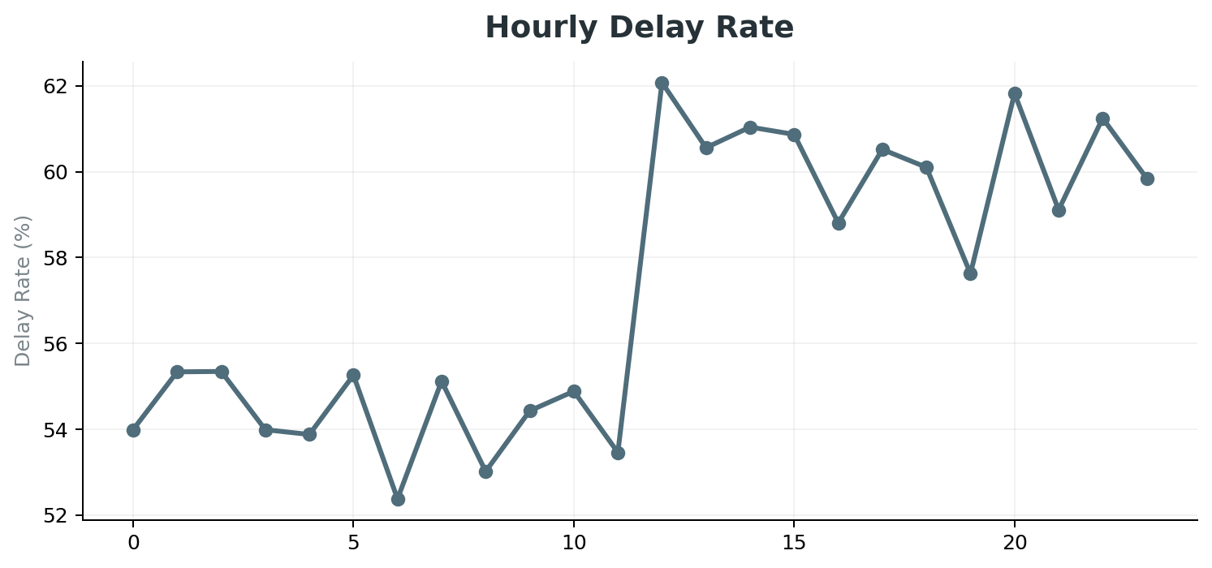
When are delays more common?
Time patterns can support capacity and cutoff planning
INSIGHT
Interpretation
Month 12 has the highest monthly rate at 57.9%. The highest observed hourly periods are 12:00, 20:00, 22:00.
08

Slide 9
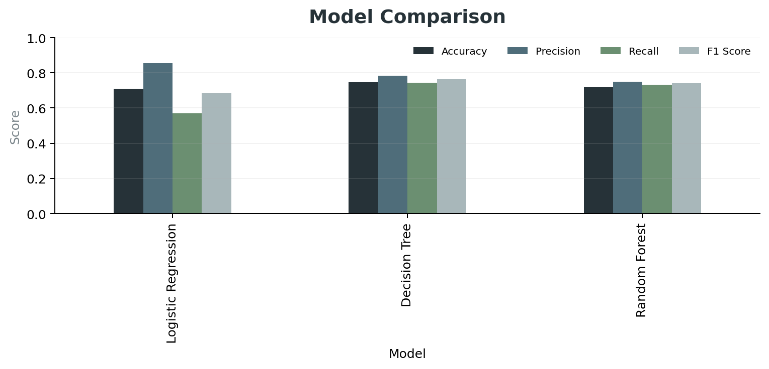
Predictive model results
Three baseline classifiers were compared using F1 as the primary selection measure
0.763
BEST F1 SCORE
0.746
BEST ACCURACY
INSIGHT
Selected baseline
Decision Tree produced the highest F1 score among the three tested models.
The model supports prioritization of higher-risk orders.
It should be validated and improved before operational deployment.
09

Slide 10
From analysis to action
Five areas for management and operations to review
01
Shipping mode
Review carrier, routing and service-level performance.
02
High-delay regions
Investigate coverage, transit time and regional constraints.
03
High-delay departments
Review inventory, fulfillment time and carrier assignment.
04
Capacity planning
Use monthly and hourly patterns to review workload and cutoffs.
05
Risk prioritization
Use the predictive model as a supporting decision tool.
10

Slide 11
Management takeaway
The analysis points to focused operational review rather than broad intervention
57.3%
100.0%
61.4%
0.763
DELAY RATE
FIRST CLASS DELAY
HIGHEST DEPT DELAY
BEST MODEL F1
INSIGHT
INSIGHT
Core message
Decision support
Delivery performance is a recurring operational issue. Shipping mode is the strongest visible pattern, while regional and department analysis helps identify where deeper review should begin.
The predictive model adds an order-level risk perspective. It is best used alongside operational knowledge and further validation.
The next step is to connect these patterns with carrier, fulfillment, inventory, and cost data.
11

Slide 12
Thank you
Questions & discussion
Supply Chain Analytics | Delivery Performance & Late Delivery Prediction

