Slide 1
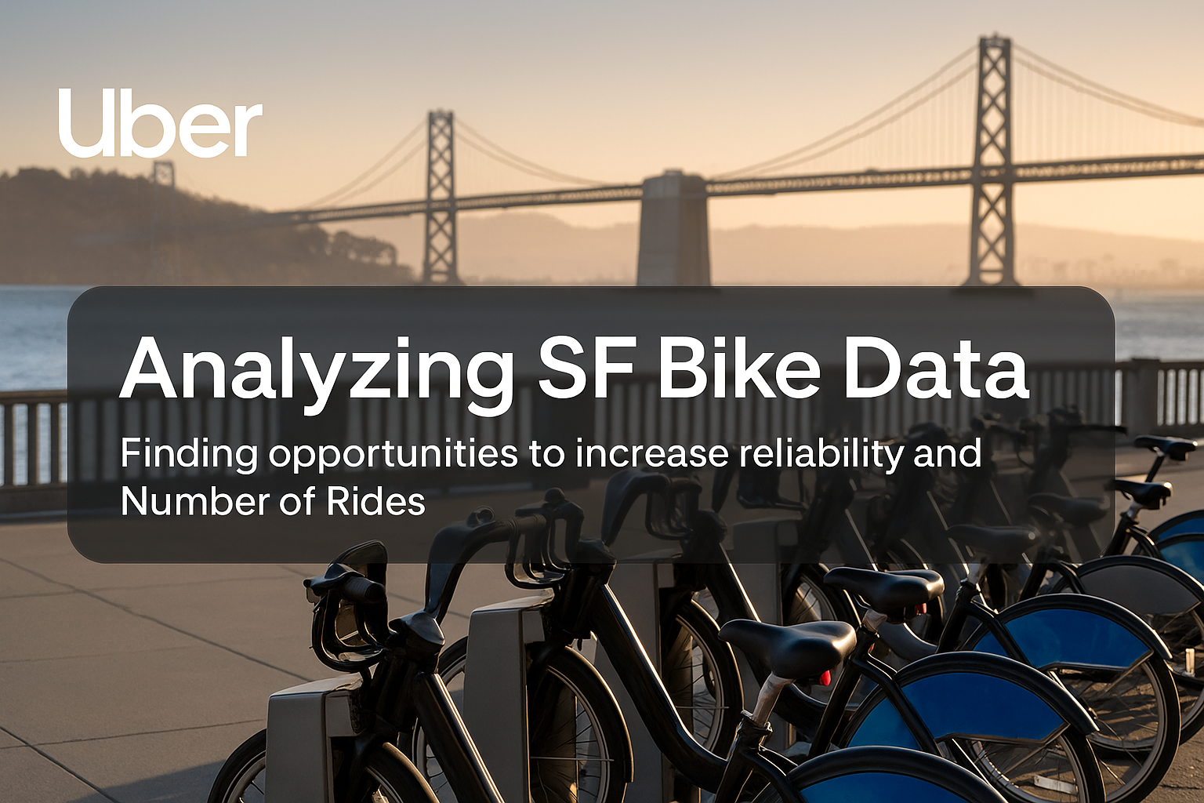

Slide 2

Methodology & Tools
Data Preparation: Python for data cleaning , EDA and validation.
Feature Engineering : created new metrics (Trip duration in min , SF vs non-SF Stations).
Cleaned Data set : Reduced the data set from 90k rows to around 70k rows to focus on SF-region 22% size reduction , makes it better for handling .
Descriptive Stats: mean , median , percentages, KPI’s
Visualization: Charts in Tableau

Slide 3

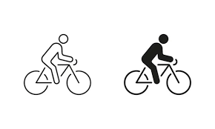
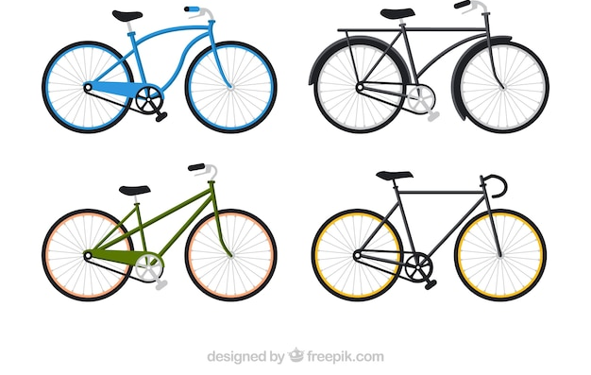
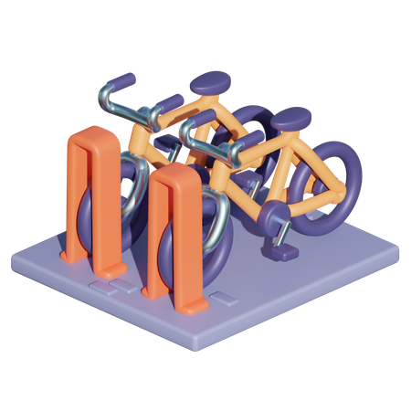


Key Performance Indicators
70,897
Total Trips Completed
410
Unique Bikes
2020
Zip codes
33
Unique Stations
20,466
Hours
9 min.
Typical length of a ride

Slide 4

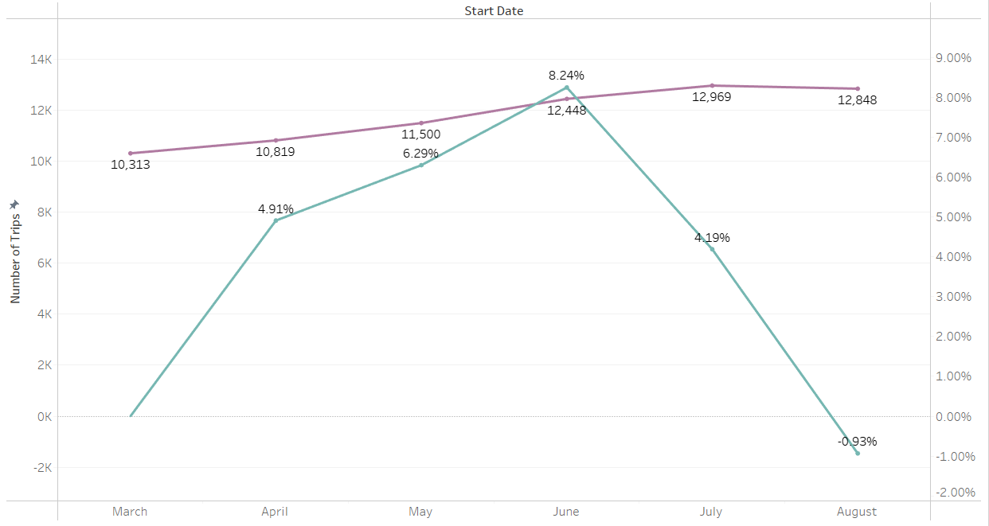
Trips grew steadily Mar to Jun (+20%).
Peak in June (+8.2%), slowed in July (+4.2%).
August dip (-0.9%) .
Time Trends

Slide 5
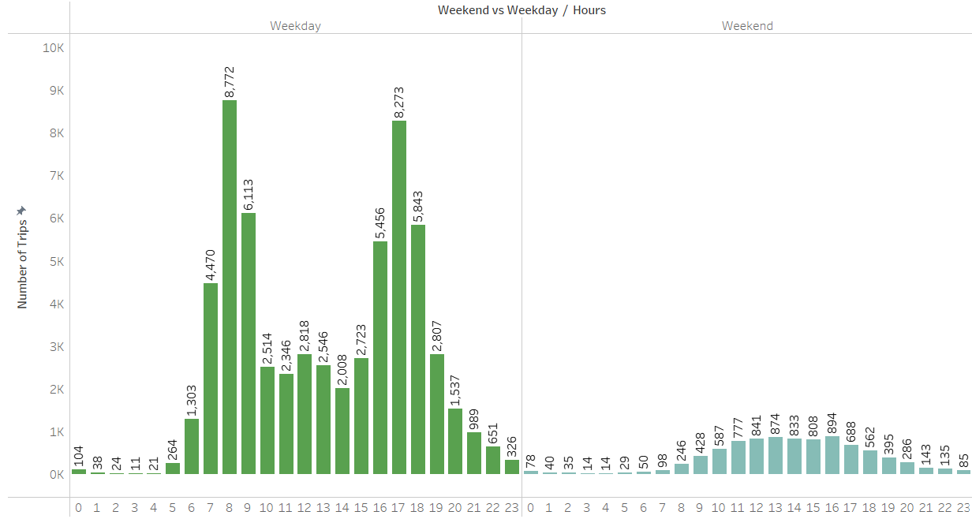
Weekday vs Weekend Trends
87% of rides are weekday commutes; weekends are underutilized (13%). Weekday rides are short (typically 8–9 min ) with sharp peaks at 8am/5pm; Weekend rides are longer (leisure, appx. 20+ min) and spread across midday.

Slide 6
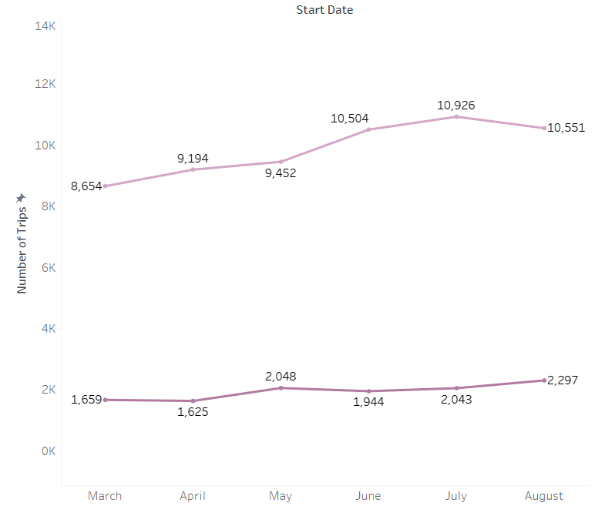
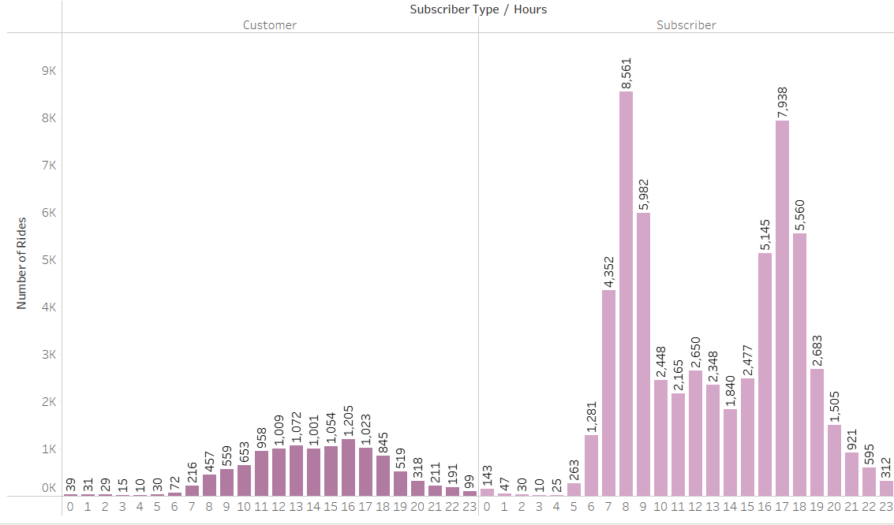

User pattern
Subscribers = 84% of rides , strong, stable base revenue.
Customers = 16% of rides, share has stayed flat , limited growth from casual riders.
Subscriber behavior: rides concentrated between 8am–5pm - commute-focused usage.
Customer behavior: longer rides, more frequent at midday - leisure-driven.
Subscriber base ensures predictable revenue, but growth depends on expanding casual riders and converting them into subscribers (especially through midday and weekend opportunities).

Slide 7
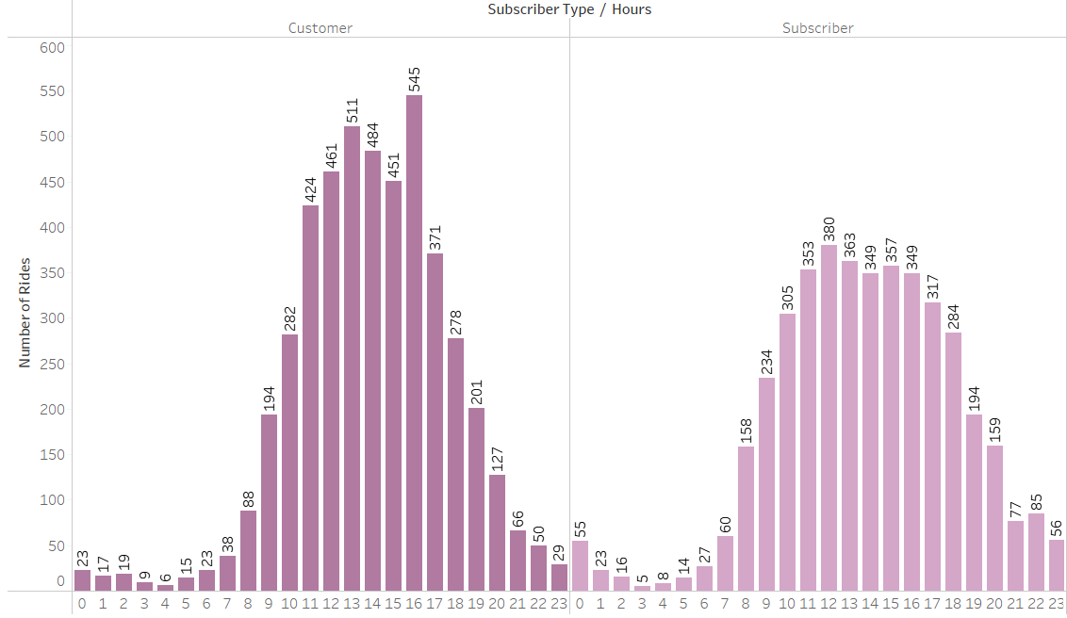
User Pattern (Weekend)
Weekends see fewer subscribers but more customer activity with longer midday rides. This shift suggests growth potential through weekend promotions.

Slide 8
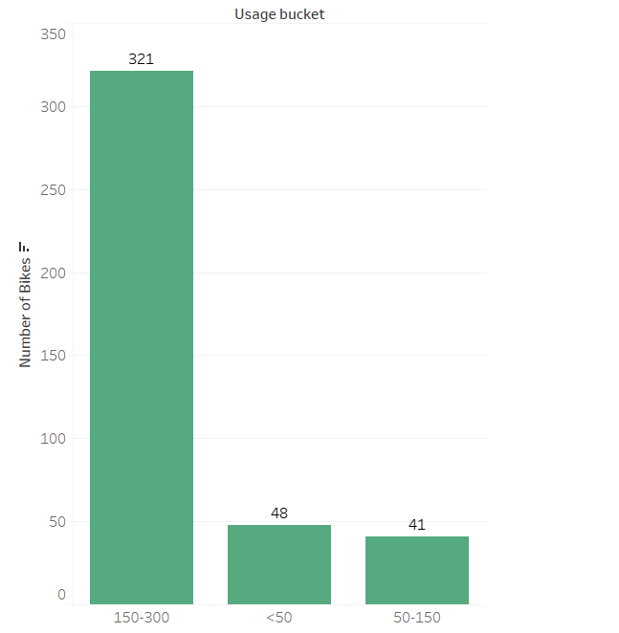
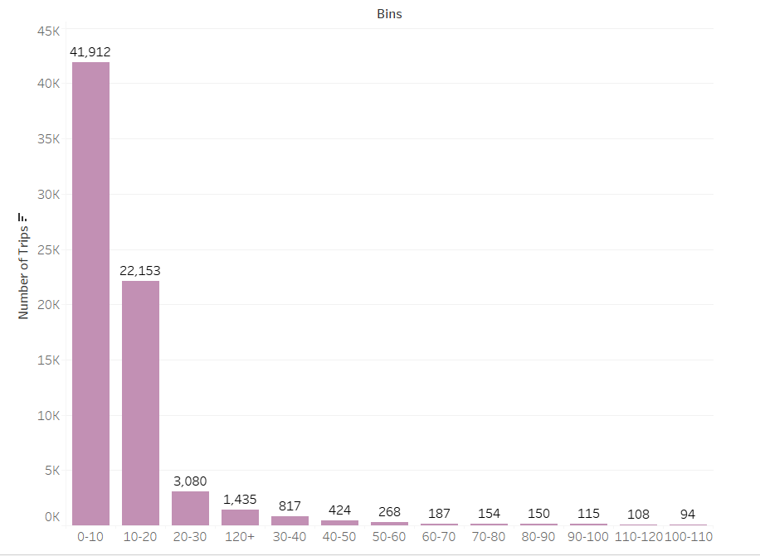
Bike Utilization
Number of Trips :
Most bikes: 150–300 trips - strong demand.
10% underused (<50 trips) - idle assets or repair needs. Focus maintenance on high-use bikes, redistribute low-use bikes = higher reliability & revenue efficiency.
Most Popular Durations:
Trend: Majority of trips are short rides (<20 min
Long Trips (120+ min):
Need investigation – Might indicate leisure/sightseeing, multiple stops, all-day commute, or bike/lock issues.
Each long trip may block 3–4 short rides, reducing efficiency and revenue potential.

Slide 9
Station Usage
Inbound (Most arrivals):
San Francisco Caltrain (Townsend at 4th) , San Francisco Caltrain 2 (330 Townsend)
Outbound (Most departures):
San Francisco Caltrain (Townsend at 4th) 2nd at Townsend
Net Givers (Send more bikes out):
Temporary Transbay Terminal (Howard at Beale) , Harry Bridges Plaza (Ferry Building)
Net Receivers (Receive more bikes in):San Francisco Caltrain (Townsend at 4th) Embarcadero at Sansome
Top 5 zip codes: 94107, 94105, Unknown, 94103, 94111
Bottom 5 Least Used Stations : MLK Library SF City Hall Washington at Kearny Golden Gate at Polk Broadway St at Battery St
Top 5 busiest stations: Caltrain (Townsend at 4th), Ferry Building, Embarcadero at Sansome, Caltrain 2 (330 Townsend), Market at Sansome
Around 31% of traffic comes from the top 5 stations.
Top 5 Busiest Routes:
Ferry Building → Embarcadero at Sansome
Townsend at 7th → Caltrain (Townsend at 4th):
Caltrain 2 (330 Townsend) → Townsend at 7th.
2nd at Townsend → Ferry Building
Embarcadero at Sansome → Steuart at Market
Demand concentrated at few hubs; some stations underused.
Inbound = trip ends, Outbound = trip starts; net balance shows shortage or pile-up risk.(Assumed)
Optimize supply at hubs, rebalance flows, and promote low-demand stations to improve utilization

Slide 10
Recommendations / Next Steps
Grow Rides
Capture weekend leisure demand through targeted promotions - +8–10% growth could add 740–920 extra trips in 6 months (apprx. 125–150 per month) with potential to convert to subscribers.
Partner with offices for dock space to expand commuter base and convert more subscribers.
Relocate or repurpose underused docks to maximize ROI.
Incentivize users with longer rides . (eg -‘X’ free miles after 100 miles )
Improve Reliability
Ensure top hubs (Caltrain, Ferry, Embarcadero) are always stocked.
Balance flows with predictive rebalancing and rider incentives. (Points to finish at low inbound station)
Focus maintenance on high-usage bikes to minimize downtime.
Investigate very long trips to prevent misuse and free bikes for more rides.
Next Steps:
Weekend promotions – A/B tests to check rider uptake /conversion to subscribers.
Engage office partners - Secure agreements for new or expanded dock locations.
Run station reallocation test - Close low-use /not financially viable docks and move capacity to a high-demand hub.
Deploy predictive models – Predict peak hours and stations .
Schedule maintenance by trip count - Reduce breakdowns and downtime.(Assuming no maintenance has been done in between)
Audit long-duration trips - identify misuse patterns and refine policies maybe introduce some maximum time limit or alerts.
Identify tourist locations – Potential for introducing day passes.

