Slide 1
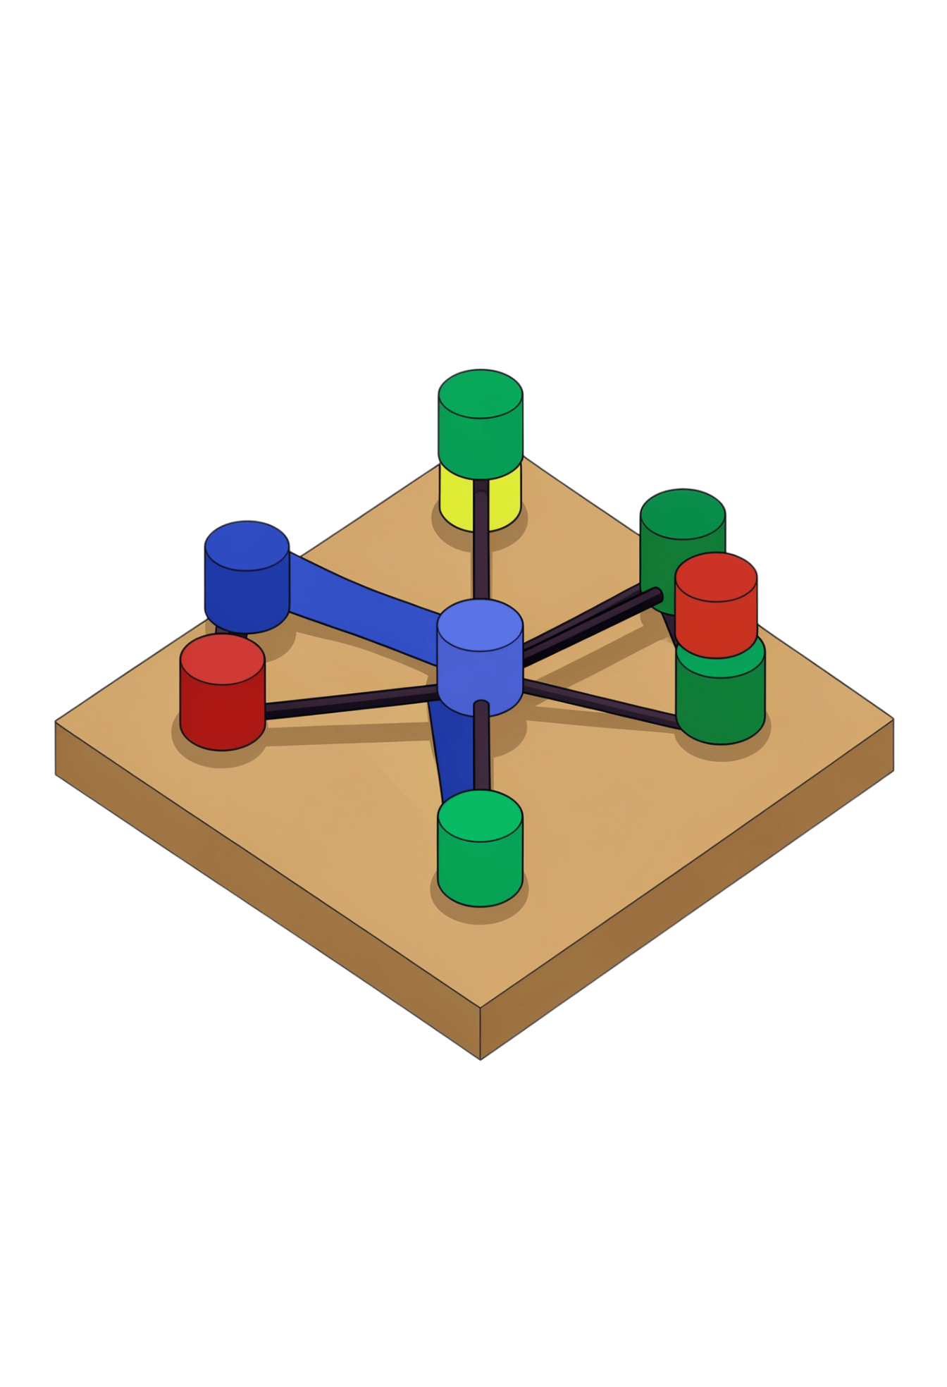
GRAPH TRAVERSAL · 01
DEPTH
FIRST
SEARCH
Go deep. Then return.
DFS visits vertices along one path as deeply as possible, then backtracks to try another.
Notes:
Introduce DFS as a graph traversal. It works on graphs and trees, moving through vertices and edges until a path cannot continue, then returning to an earlier choice.

Slide 2

DFS EXPLORES DEEPLY, THEN BACKTRACKS
The search repeats one simple rhythm.
01
02
03
04
05
Start
Visit
Go deeper
Backtrack
Repeat
Choose a starting node.
Move to an unvisited neighbor.
Keep moving while a new neighbor exists.
Return to the latest branching point.
Stop when every reachable node is visited.
Notes:
Keep the rhythm visible: start, visit, continue deeper, backtrack when stuck, then repeat from the next available branch.

Slide 3
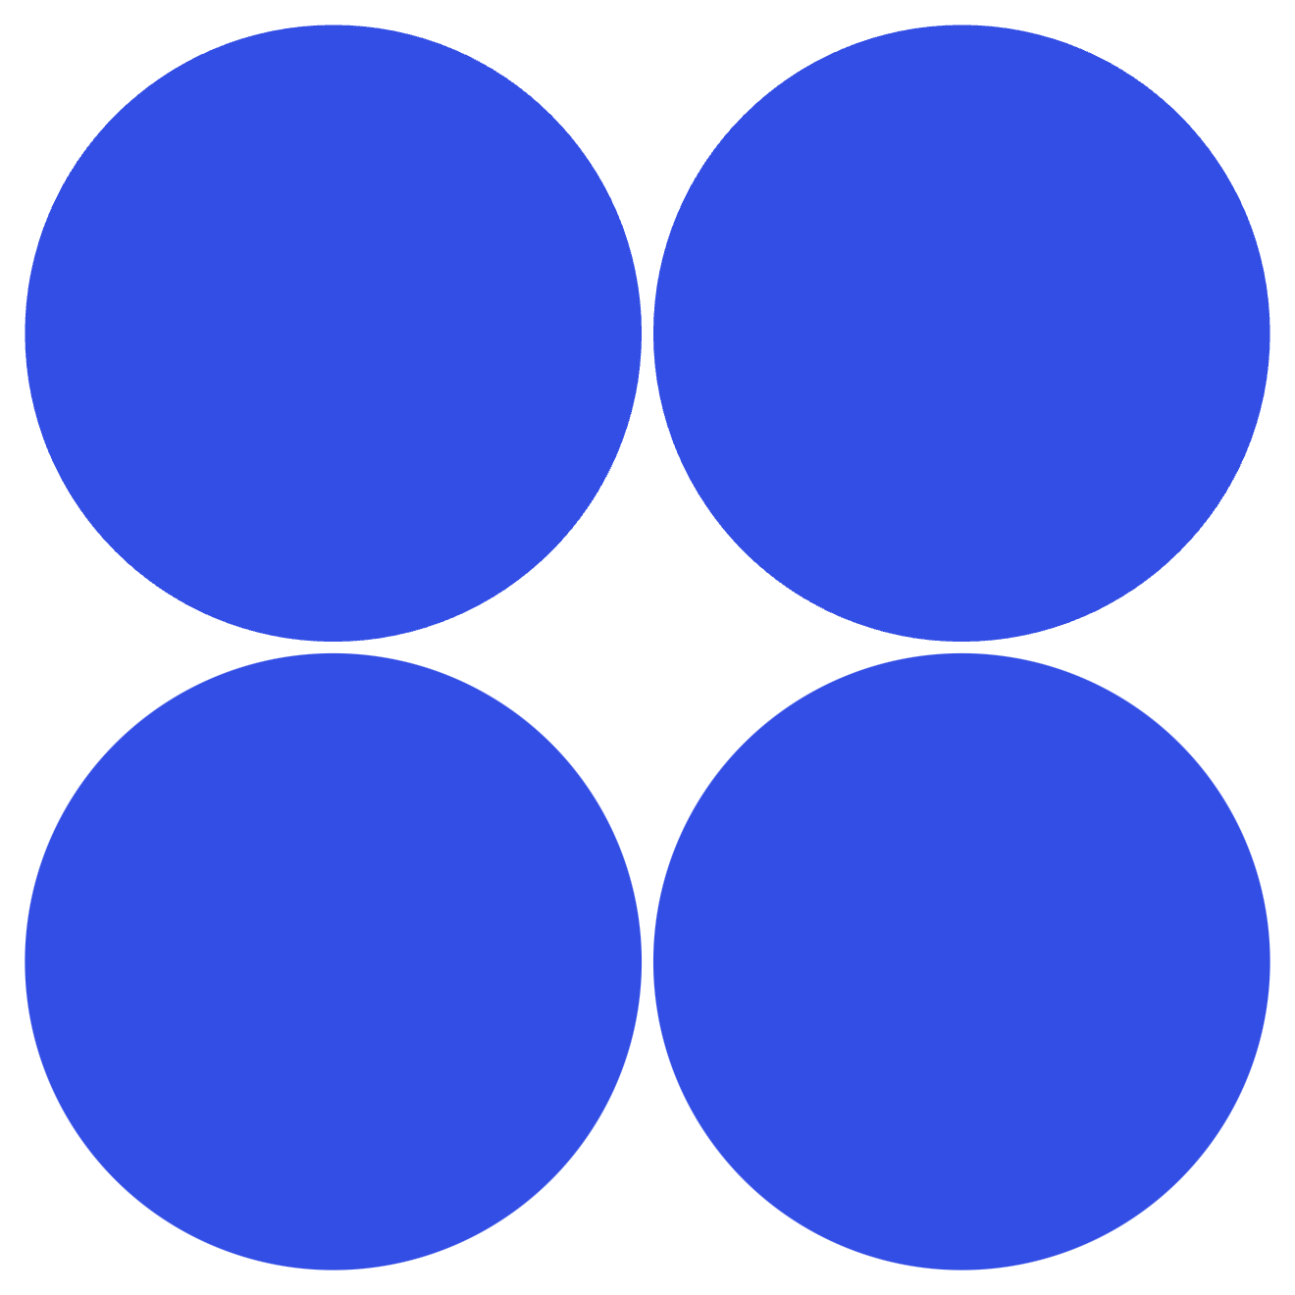
EXAMPLE: A → B → D → E → F → C
Start at A. Check neighbors in alphabetical order.
1
A → B — begin the path.
2
B → D — D has no new neighbor.
START
TRAVERSE
Begin DFS at A, neighbors alphabetical.
Visit A→B→D, show arrow and return to B.
3
↩ D → B — backtrack.
4
B → E → F — continue deeper.
CONTINUE
FINISH
From B→E→F, show arrow then return toward C.
Backtrack and visit C to complete traversal.
F → C — visit the final node.
5
Final order: A → B → D → E → F → C
Notes:
Walk the graph slowly. D is a dead end, so DFS returns to B. From B it takes E, then F, and finally reaches C through the remaining edge.

Slide 4

RECURSIVE DFS IN PSEUDOCODE
The visited set prevents loops in cyclic graphs.
1
DFS(graph, vertex)
2
mark vertex as visited
Two details matter
Visited set: each vertex is processed once, so cycles cannot cause infinite recursion.
Neighbor order: changing it can change the traversal order.
3
print vertex
4
for each neighbor of vertex
5
if neighbor is not visited
6
DFS(graph, neighbor)
Notes:
Explain the recursive call as the moment DFS goes deeper. The function remembers the current vertex while the next call explores its neighbor.

Slide 5
IMPLEMENTING DFS IN PYTHON
An adjacency list keeps the example compact.
graph = {
"A": ["B", "C"],
"B": ["A", "D", "E"],
"C": ["A", "F"],
"D": ["B"],
"E": ["B", "F"],
"F": ["C", "E"]
}
visited = set()
def dfs(vertex):
visited.add(vertex) # remember this visit
print(vertex, end=" ")
for neighbor in graph[vertex]:
if neighbor not in visited:
dfs(neighbor) # go deeper
dfs("A")
OUTPUT
A B D E F C
The set stops the search from revisiting A, B, or E through a cycle.
Example graph · start vertex A
Notes:
Point out the three key lines: add the vertex to visited, print it, then recursively call dfs for each eligible neighbor.

Slide 6
RECURSION OR AN EXPLICIT STACK?
Both remember where to return.
RECURSIVE
ITERATIVE
Call stack
Explicit stack
dfs(A) calls dfs(B)
push A
dfs(B) calls dfs(D)
pop A; push eligible neighbors
D returns to B
pop next node
B continues with E
repeat until the stack is empty
Call stack stores unfinished calls.
You control push order.
Important: Push order can change valid DFS sequences.
Notes:
Recursive DFS uses the language's call stack. Iterative DFS makes that memory visible as a data structure. In both versions, backtracking means returning to an earlier branching point.

Slide 7



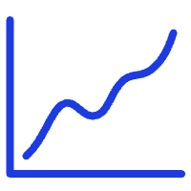

DFS IS LINEAR IN THE GRAPH SIZE
O(V + E)
Maze solving
Cycle detection
Components
Topological sorting
Path exploration
Explore one route, then return at dead ends.
Track visited nodes and back edges.
Find every node reachable from a start.
Order tasks in a DAG.
Search possible routes through a structure.
Time with an adjacency list.
V = vertices · E = edges
O(V)
Space for the visited set and standard traversal stack.
Notes:
With an adjacency list, each vertex and edge is examined a bounded number of times. That gives O(V + E) time. The visited set and traversal stack use O(V) auxiliary space.

Slide 8
THE TAKEAWAY
DFS
GO DEEP,
THEN RETURN
Explores depth first.
Recursive versions can hit stack-depth limits.
Order depends on neighbor ordering.
BFS
Explores level by level.
Finds shortest paths in unweighted graphs.
DFS is simple and useful for exploring graph structure.
It does not guarantee the shortest path in an unweighted graph.
Start
Visit
Explore deeper
Backtrack
Repeat
Notes:
Close by repeating the rhythm: Start, Visit, Explore Deeper, Backtrack, Repeat. DFS is a strong tool for structure and reachability, but BFS is the better choice when shortest unweighted paths are the goal.

