Slide 1


CUBESAT

Slide 2
TEAM
ANANT TRIPATHII
RUDRAKSH AHLAWAT
PULKIT SINGH RAJPUT
AIM
To develop a CubeSat of dimensions 15cm x 15 cm x 15cm and weight under 1 kg to observe the atmosphere of Venus and transmit back data to Earth.

Slide 3

COMPONENTS OF CUBESAT
Communication
Sensor
03
Power
01
02
Mechanical
04

Slide 4
COMMUNICATION
Relay Communication can be used to transmit data to earth when the satellite is far from earth, i.e, data can be transmitted to a bigger satellite and through that to earth. UHF can be used for this.
01
02
Direct Communication can be used when the satellite is near Earth. S-band frequency can be used for this.
The communication system of this CubeSat has been optimized to handle interplanetary data transmission efficiently while keeping within the size, weight, and power constraints. This system provides a solid balance of data integrity, reliability, and power efficiency essential for a successful mission to Venus. However, due to the CubeSat’s small size, it relies on relaying data through a larger satellite to Earth, as direct interplanetary communication would require significantly more power and a larger antenna array.
03

Slide 5
SENSORS
Gas Analyzers - To measure the composition of gases in the Venusian atmosphere (e.g., carbon dioxide, sulfuric acid, nitrogen). Mounted on the side panels facing towards Venus.Use for direct access to the atmosphere for accurate sampling without interference from other components.
01
Temperature Sensors - One sensor near the CubeSat’s exterior to monitor ambient temperatures, and another inside the CubeSat to monitor internal temperatures. To assess the thermal environment around the satellite and ensure that all components operate within their temperature limits.
02
02
03
Pressure Sensors - Similar to gas analyzers, pressure sensors should be mounted on a side panel with an unobstructed external port. For accurate readings of the pressure of the Venusian atmosphere.
03

Slide 6
04
Imaging Sensors - For capturing images of the Venusian atmosphere, clouds, and surface features to analyze reflectivity and chemical compositions.
Radiation Sensors - For measuring the levels of cosmic radiation and solar activity affecting the atmosphere of Venus. To be positioned on the outer frame of the CubeSat to measure incoming radiation without blockage from other components.
05
01
02
03

Slide 7
POWER
Power Generation can be done by solar panels. Solar Panels should be placed in such way that maximum sunlight exposure is reduce to increase efficiency
01
Power Storage can be done using Lithium Ion batteries due to their high energy density, rechargeability, and reliability. Batteries during sunlit periods and discharge during eclipse.
02
Power Distribution Unit regualtes and distributes power from the solar panels and batteries to all subsystems, including sensors, communication equipment, and onboard computers.
03

Slide 8
MECHANICAL
The Structure of CubeSat can be made using Aluminum Alloy(T6-6061) or Carbon Fiber composite , aluminum being better thermal regulator and cheaper, Carbon Fiber on the other hand is way lighter,6061-T6 alloy is 1.5 times denser than Carbon Fiber.
01
Any of the two materials can be used depending on the budget and weight requirement of the satellite. Both have their own pros and cons but if the budget permits carbon fiber is a wise choice.
02
To reduce the mass of the structure a honey comb structure can be used as the skeleton of CubeSat on which all the components are mounted, the heavier components are carefully placed near the center of gyration for better mobility.
03

Slide 9
04
Two foldable solar panels on 4 sides of the CubeSat shall be added. Gallium Arsenide solar cells can be implemented as they have a high efficiency of 0.3W/cc, giving us a max power output of 270W.
Battery Pack can be placed centrally along one of the side panels. Antenna can be mounted at the top of the CubeSat. Transceiver should be located near the antenna and same side of the battery for convenient wiring.
05
01
02
06
Gas Analyzers and Imaging Sensors should installed on side panels, on the sides facing Venus, to safeguard them from Solar Radiations.
Temperature and Pressure Sensors should be placed internally.
03

Slide 10
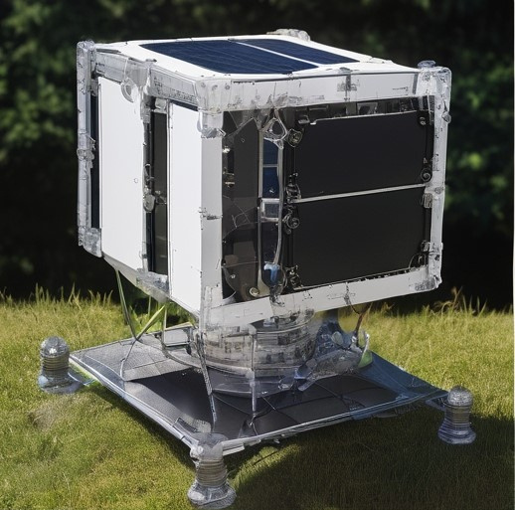
07
Overall the CubeSat will weigh around 900-980g giving room for more equipments if required.
01
A rough model of the
CubeSat.
03

Slide 11
WHAT COULD GO WRONG?
There is a chance of exceeding the 1kg limit as some more equipment might be required as we go on further testing. Weight distribution could also be a problem due to the small size
01
There is a chance of data loss or material damage due to radiation interference. The CubeSat is in a region high heat and radiation so solar flares could hamper its voyage.
02
Venusian Environment may cause a problem to the lifespan of its components even after shielding. High Cost is also a problem we should consider.
03

Slide 12
THANK YOU

