Slide 1
Predicting Car Prices using Machine Learning
December 6, 2022
By- Team 1
Aakriti Deora
Rudraksh Sugandhi

Slide 2
Content
Introduction
Problem Statement
Challenges
Related Work
Background knowledge
Architecture Diagram
Data | Data Preparation | Data Exploration
Results
Demo
Conclusion and Future Work

Slide 3
Introduction
Predicting car prices using Machine Learning is one of its applications which aims at estimating the cars prices.
This application can be used for setting the price of the car accurately from seller’s and buyer’s perspective.
COVID-19 has disrupted the production of chips used in car manufacturing, which resulted in car prices fluctuating heavily in both new and resale markets.
This project’s aim is to use the machine learning algorithm to develop a model for predicting the car prices.

Slide 4
Problem Statement
To develop a model that predicts the price of the car most precisely. The model has been trained with the following algorithms :
Linear Regression
Random Forest Regression
Gradient Boosting Regression
Extra Tree Regression – to extract the important features
Final implementation is done based on highest Test score produced by Random Forest Regression in our project.

Slide 5
Challenges
Overfitting: The Dataset was small so model could easily learn the pattern(Overfit), overcame this issue by Changing the hyperparameter.
Poor Quality Data: Before passing the dataset to the model, we must do one hot encoding on the categorical columns in the dataset.
Lack of Data: The dataset which we got is from Kaggle that has around 300 columns and with 8 features.
Front-End Integration: Trying to comprehend how Flask deploys the model and how parameters and arguments are provided.
Accuracy Matrix: Deciding Accuracy matrix,R2 is important in our context because it is a measure of error. Lower R2 values correspond to models with more error.

Slide 6
Related Work
AI Blue Book: Vehicle Price Prediction using Visual Features - : In this work, The Ai Blue book team is creating a series of machine learning models that estimate the price of a product based on its image, as well as show the features that result in greater or lower price predictions.
Price Prediction of Used Cars Using Machine Learning -: This paper aims to develop a model that predicts reasonable used car prices based on a variety of factors such as vehicle mileage, year of manufacture, fuel consumption, transmission, road tax by using Polynomial Regression and Decision Tree Regression, SVR.
Prediction Of Used Car Prices Using Artificial Neural Networks And Machine Learning -: It is a prediction model which is built so that it estimates the selling price of already used cars based on their features using Neural Network i.e. keras regression model.

Slide 7
Background Knowledge
Here are some term which we are going to use in upcoming slides:
Linear Regression
Random Forest Regression
Gradient Boosting Regression
Extra Trees Regression
R-Squared error
One Hot Encoding
Flask

Slide 8
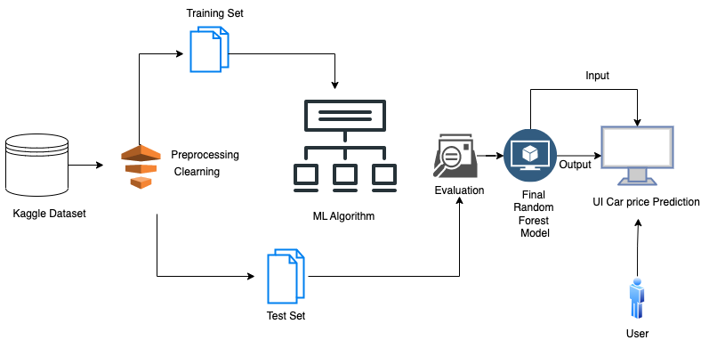
Architecture Diagram

Slide 9
Data
Source - The data has been taken from Kaggle.
The data can be used for a lot of purposes such as price prediction to exemplify the use of various algorithms in Machine Learning.
The dataset is dissected into two phases one is for training which is of 80% and the other is for testing which is of 20%.
This is the convention that in any Machine Learning Algorithm the dataset is divided into two parts.
Training phase describes the creating the model and the testing phase determines the bringing accuracy from the created model.
The columns in the given dataset are as follows:
1. Name: Name of the cars
2. Year: Year of the car when it was bought
3. selling_price: Price at which the car is being sold
4. km_driven: Number of Kilometres the car is driven
5. fuel : Fuel type of car (petrol / diesel / CNG / LPG / electric)
6. seller_type: Tells if a Seller is Individual or a Dealer
7. transmission: Gear transmission of the car (Automatic/Manual)
8. Owner: Number of previous owners of the car.

Slide 10
Data Preparation
Checked for any null values
Removed duplicate rows of data
Extracting important features from the dataset
Encoding the categorical features

Slide 11
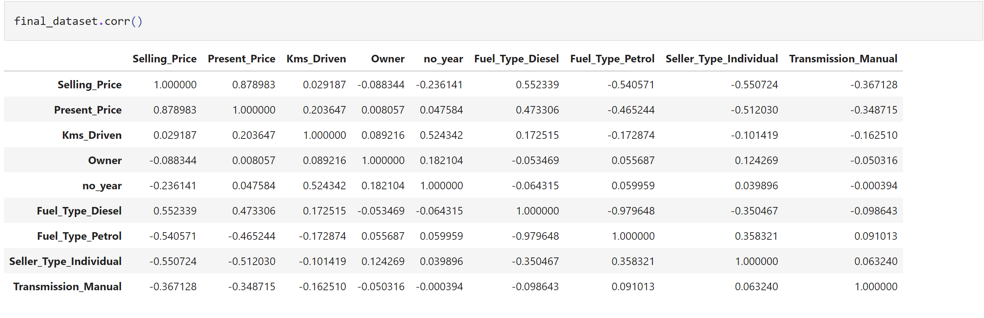
Correlation Matrix
Provide correlation b/w Variable
If the relationship is 1 then the relationship is strong, 0 means neutral.
Correlation is calculated using Pearson correlation formula.

Slide 12
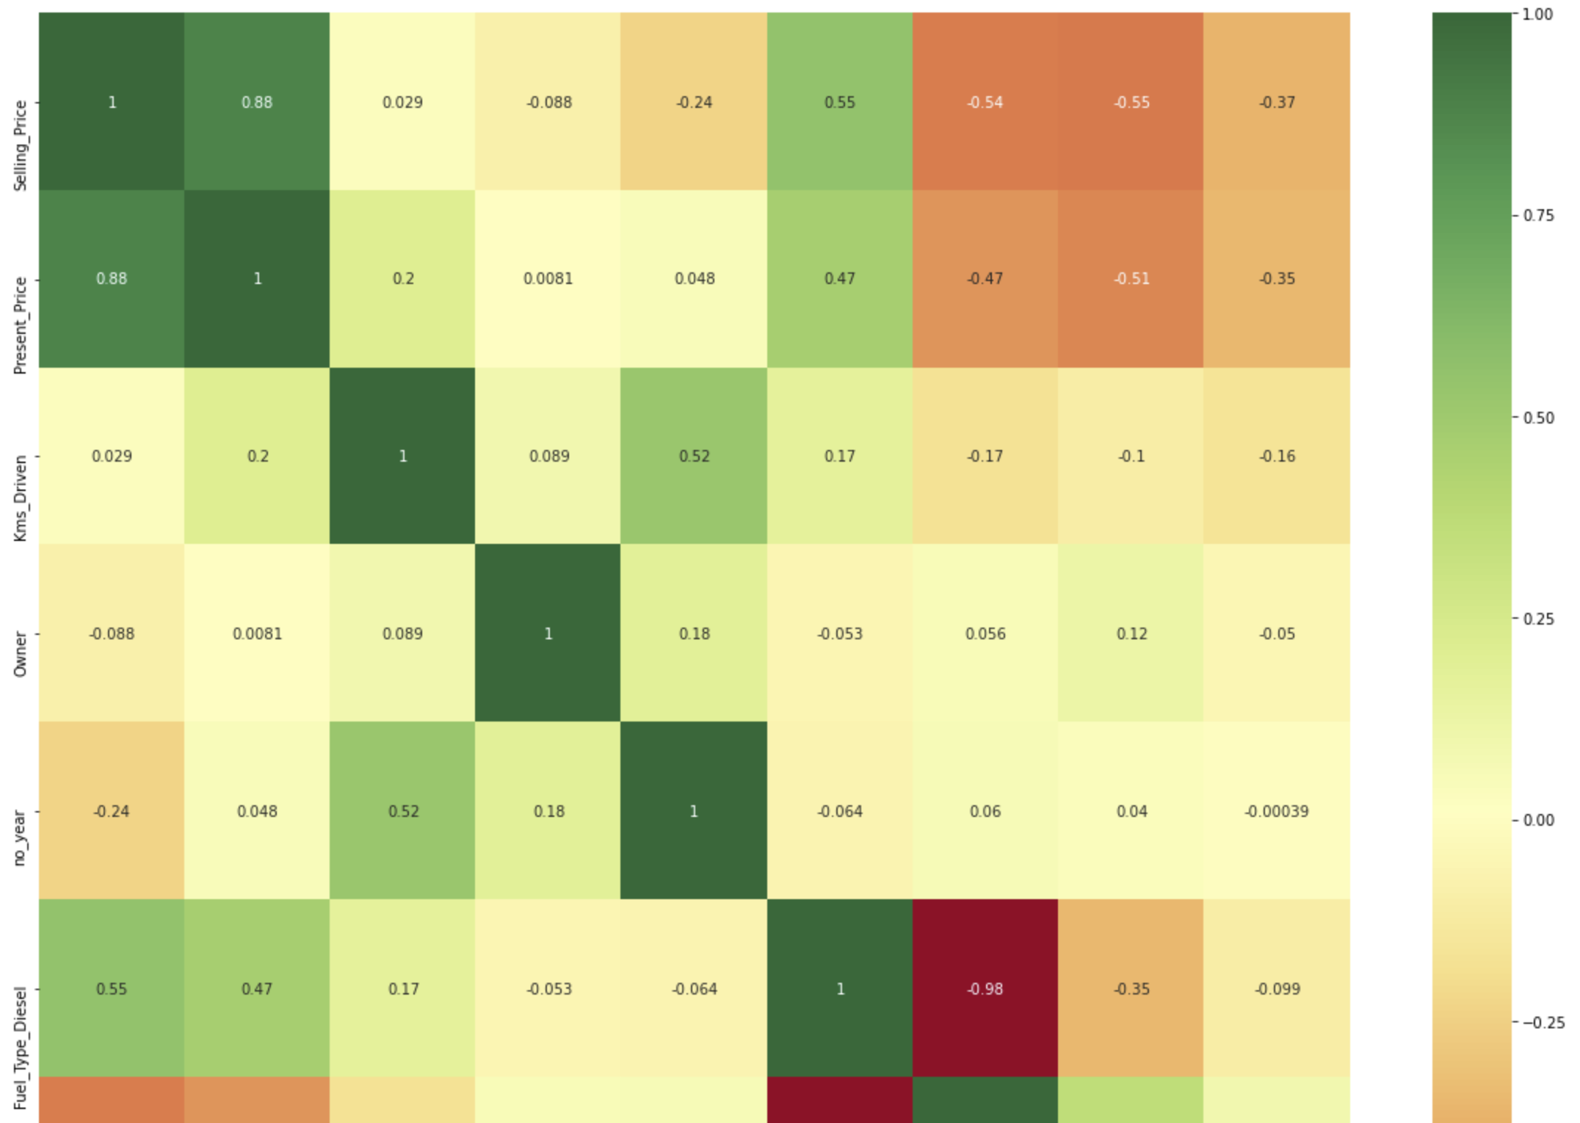
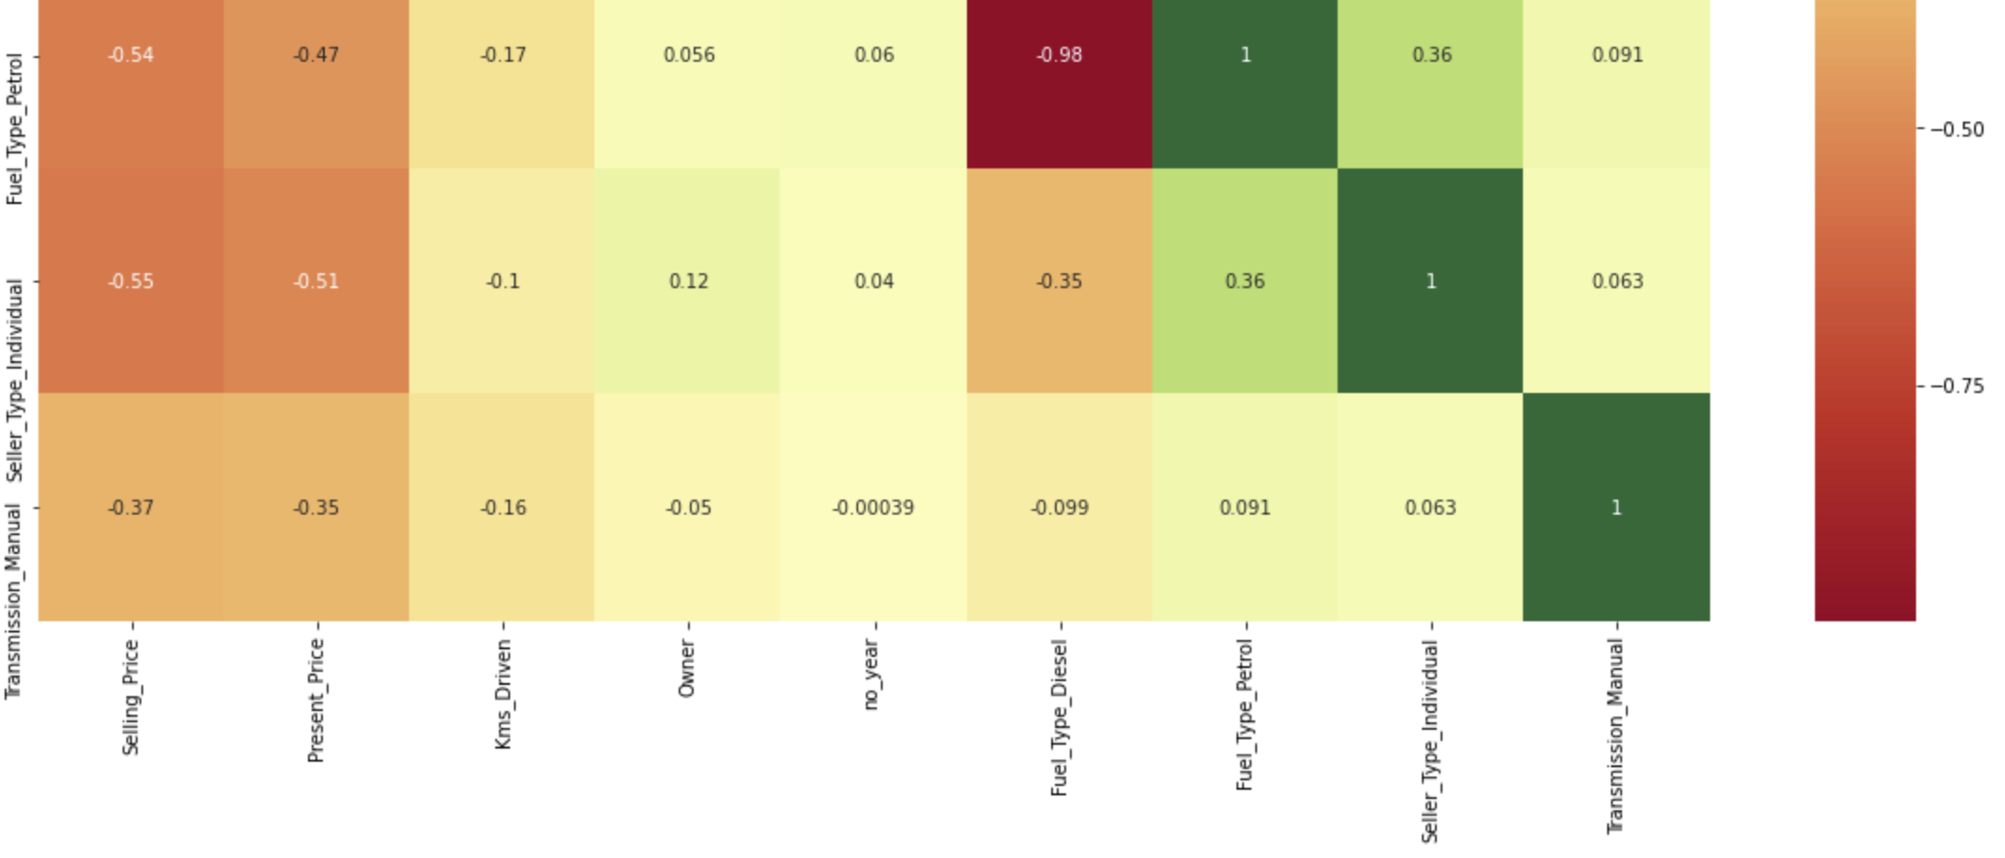
Heatmap visualization using seaborn lib

Slide 13
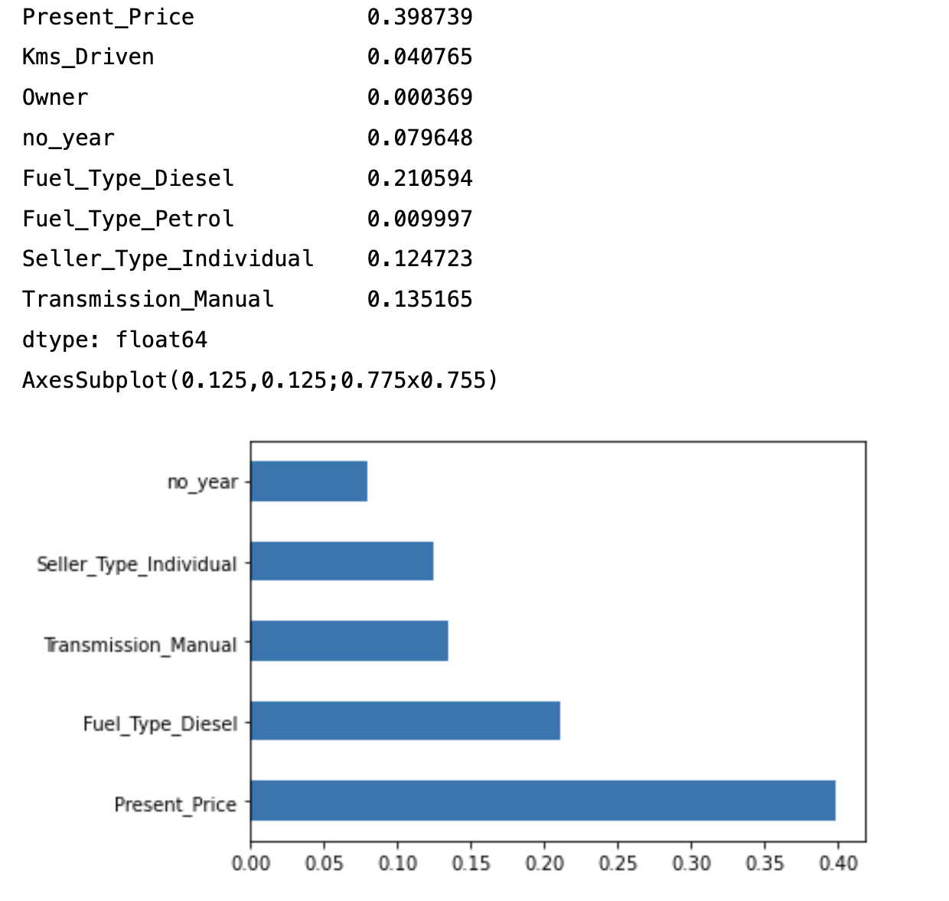
Feature Importance

Slide 14
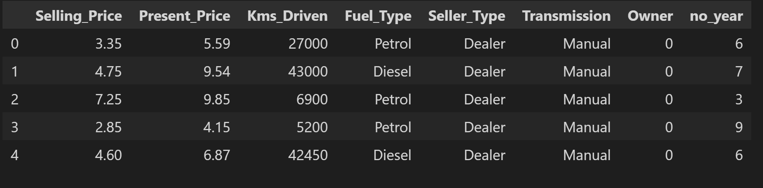
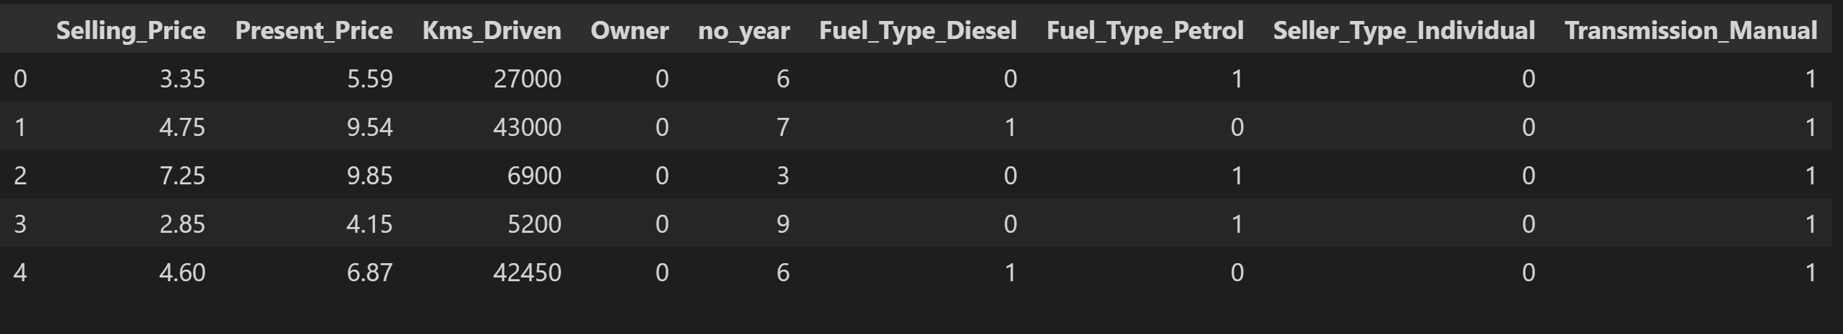
Encoding Categorical Features
Categorical feature is first converted into numerical using an ordinal encoder.
Then the numbers are transformed in the binary number. After that binary value is split into different columns

Slide 15
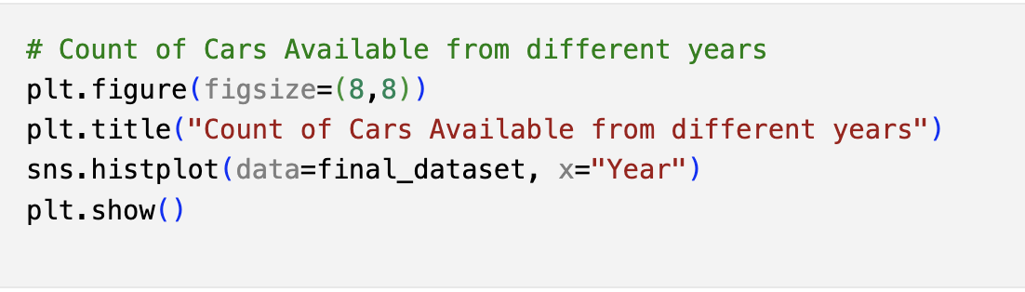
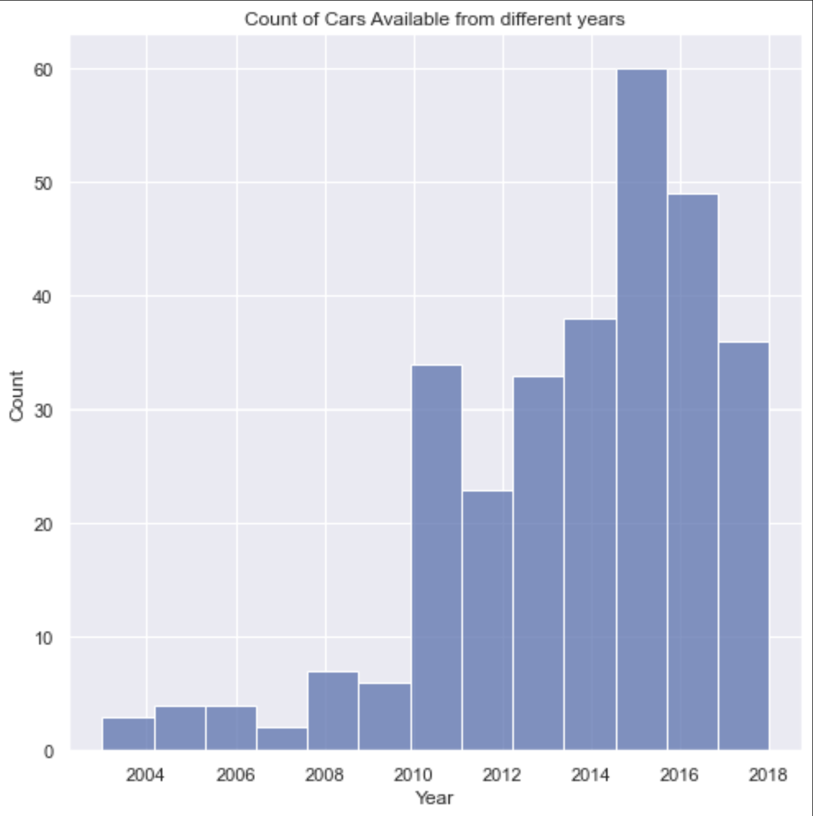
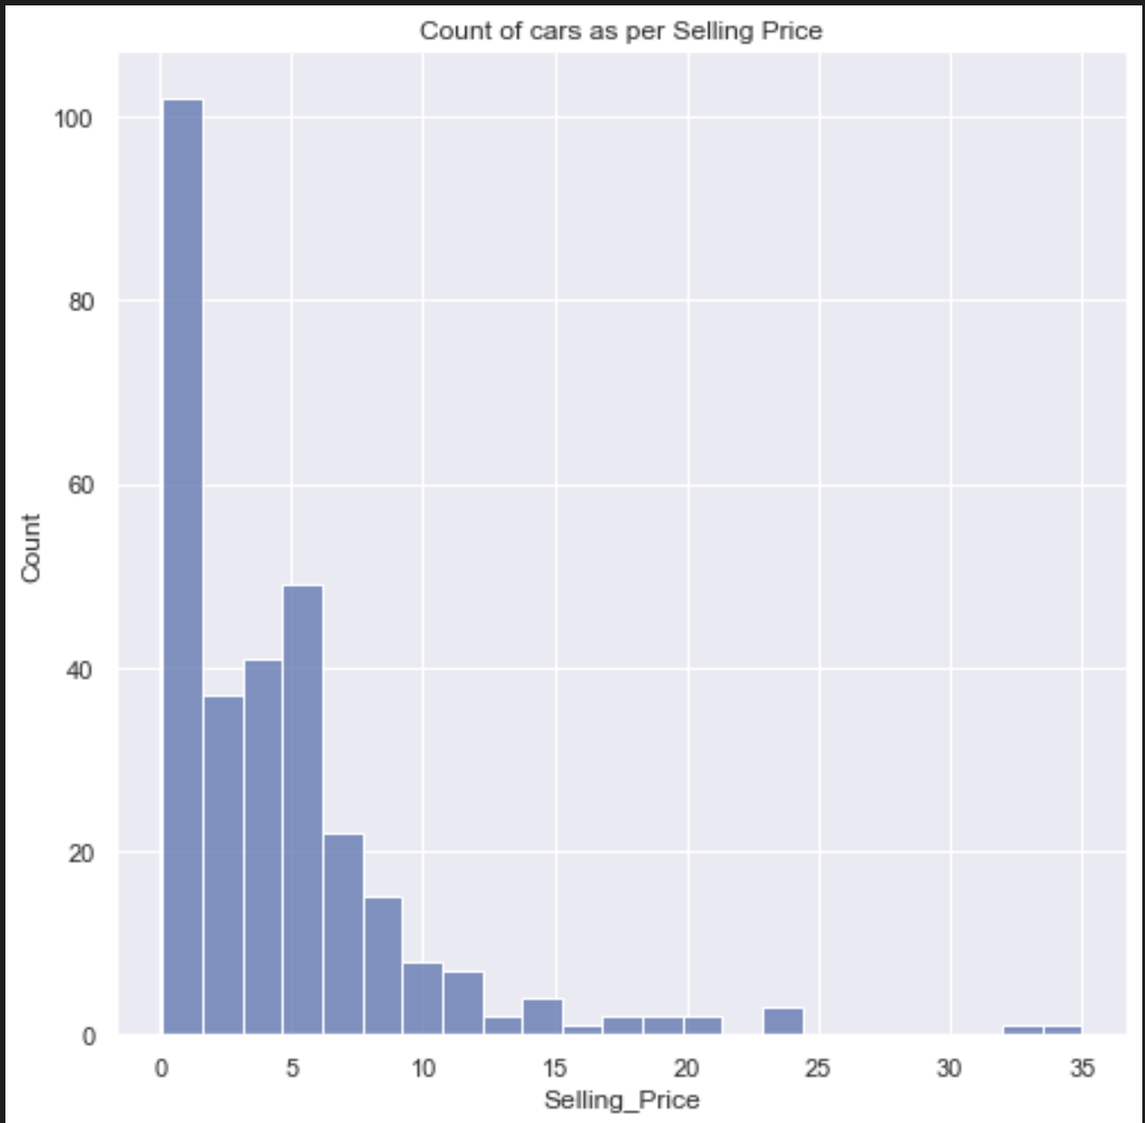
Data Visualization

Slide 16
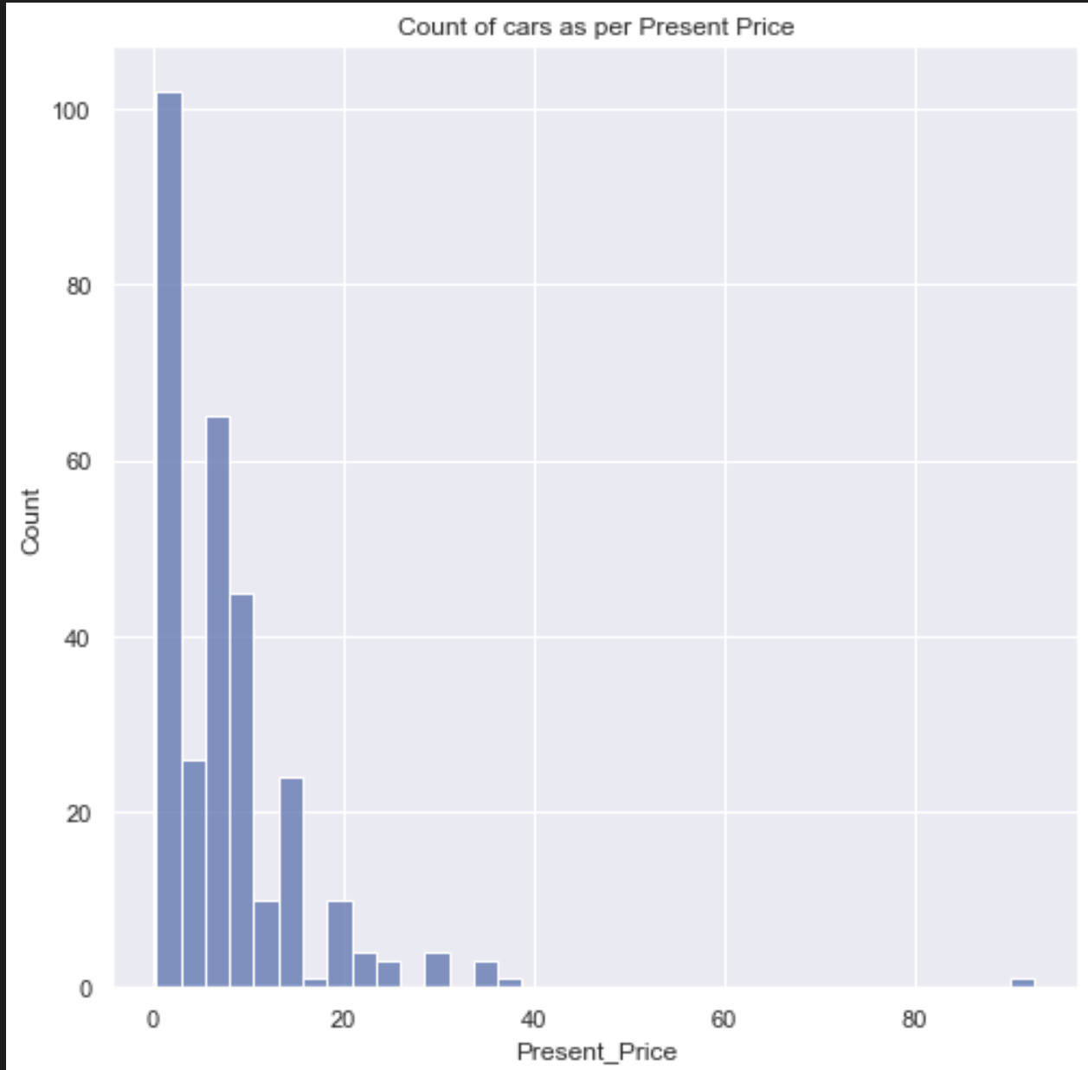
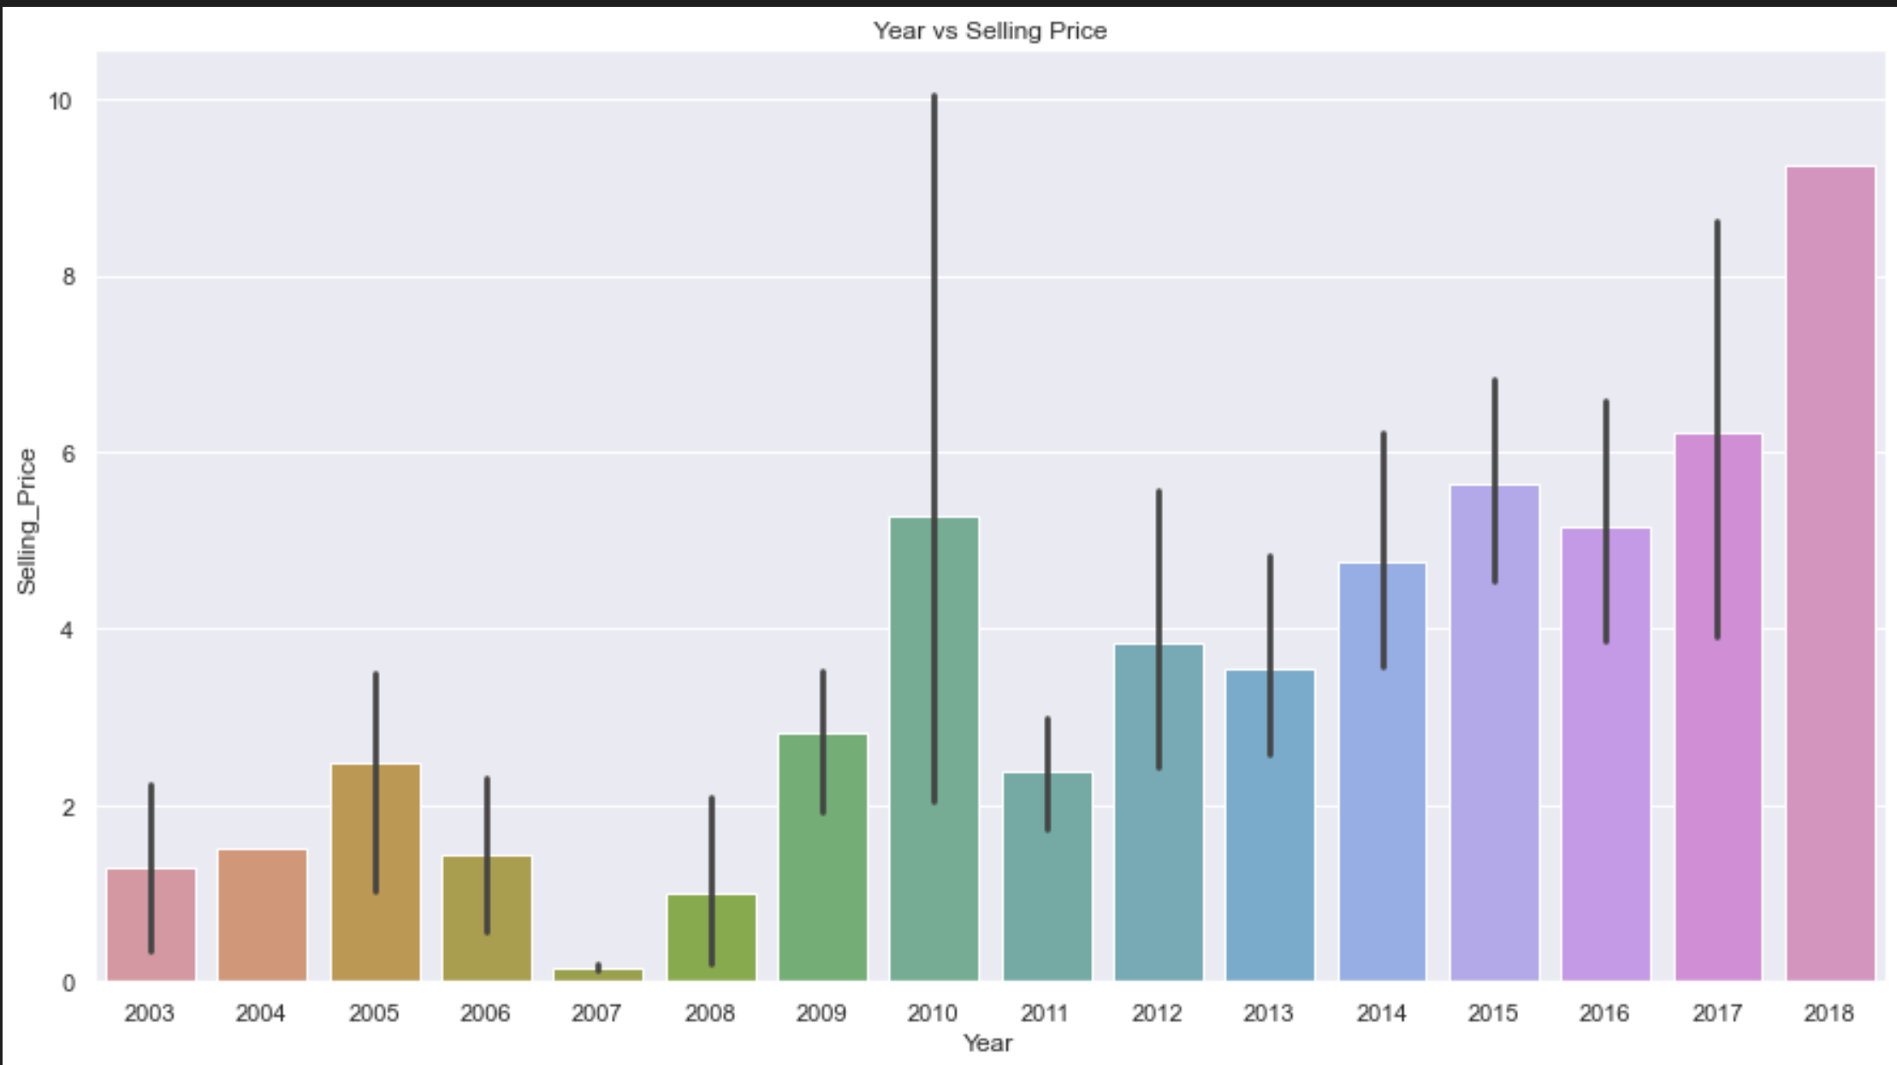
Data Visualization

Slide 17
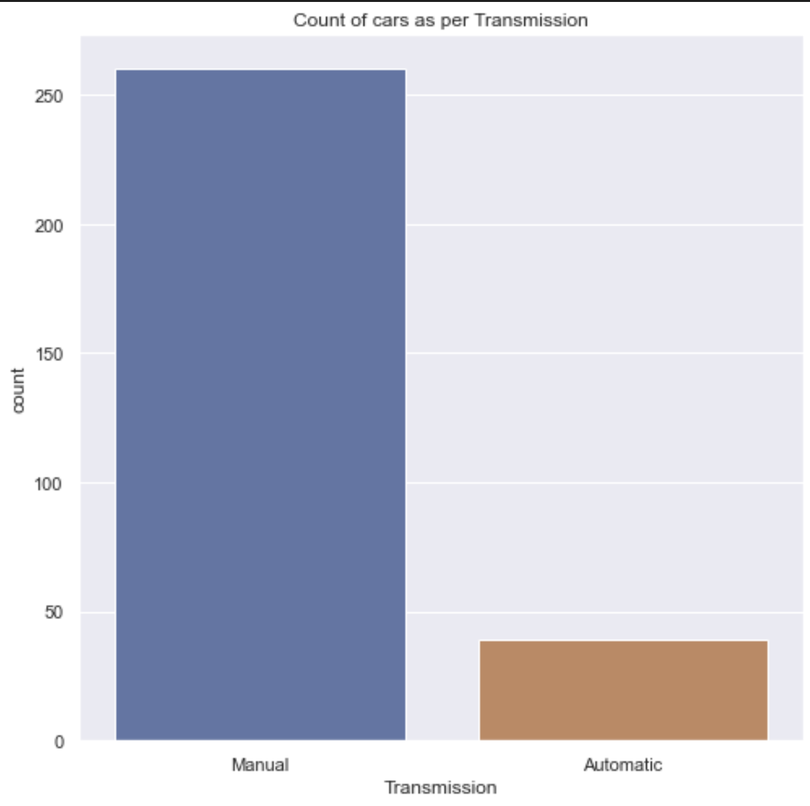
Data Visualization

Slide 18
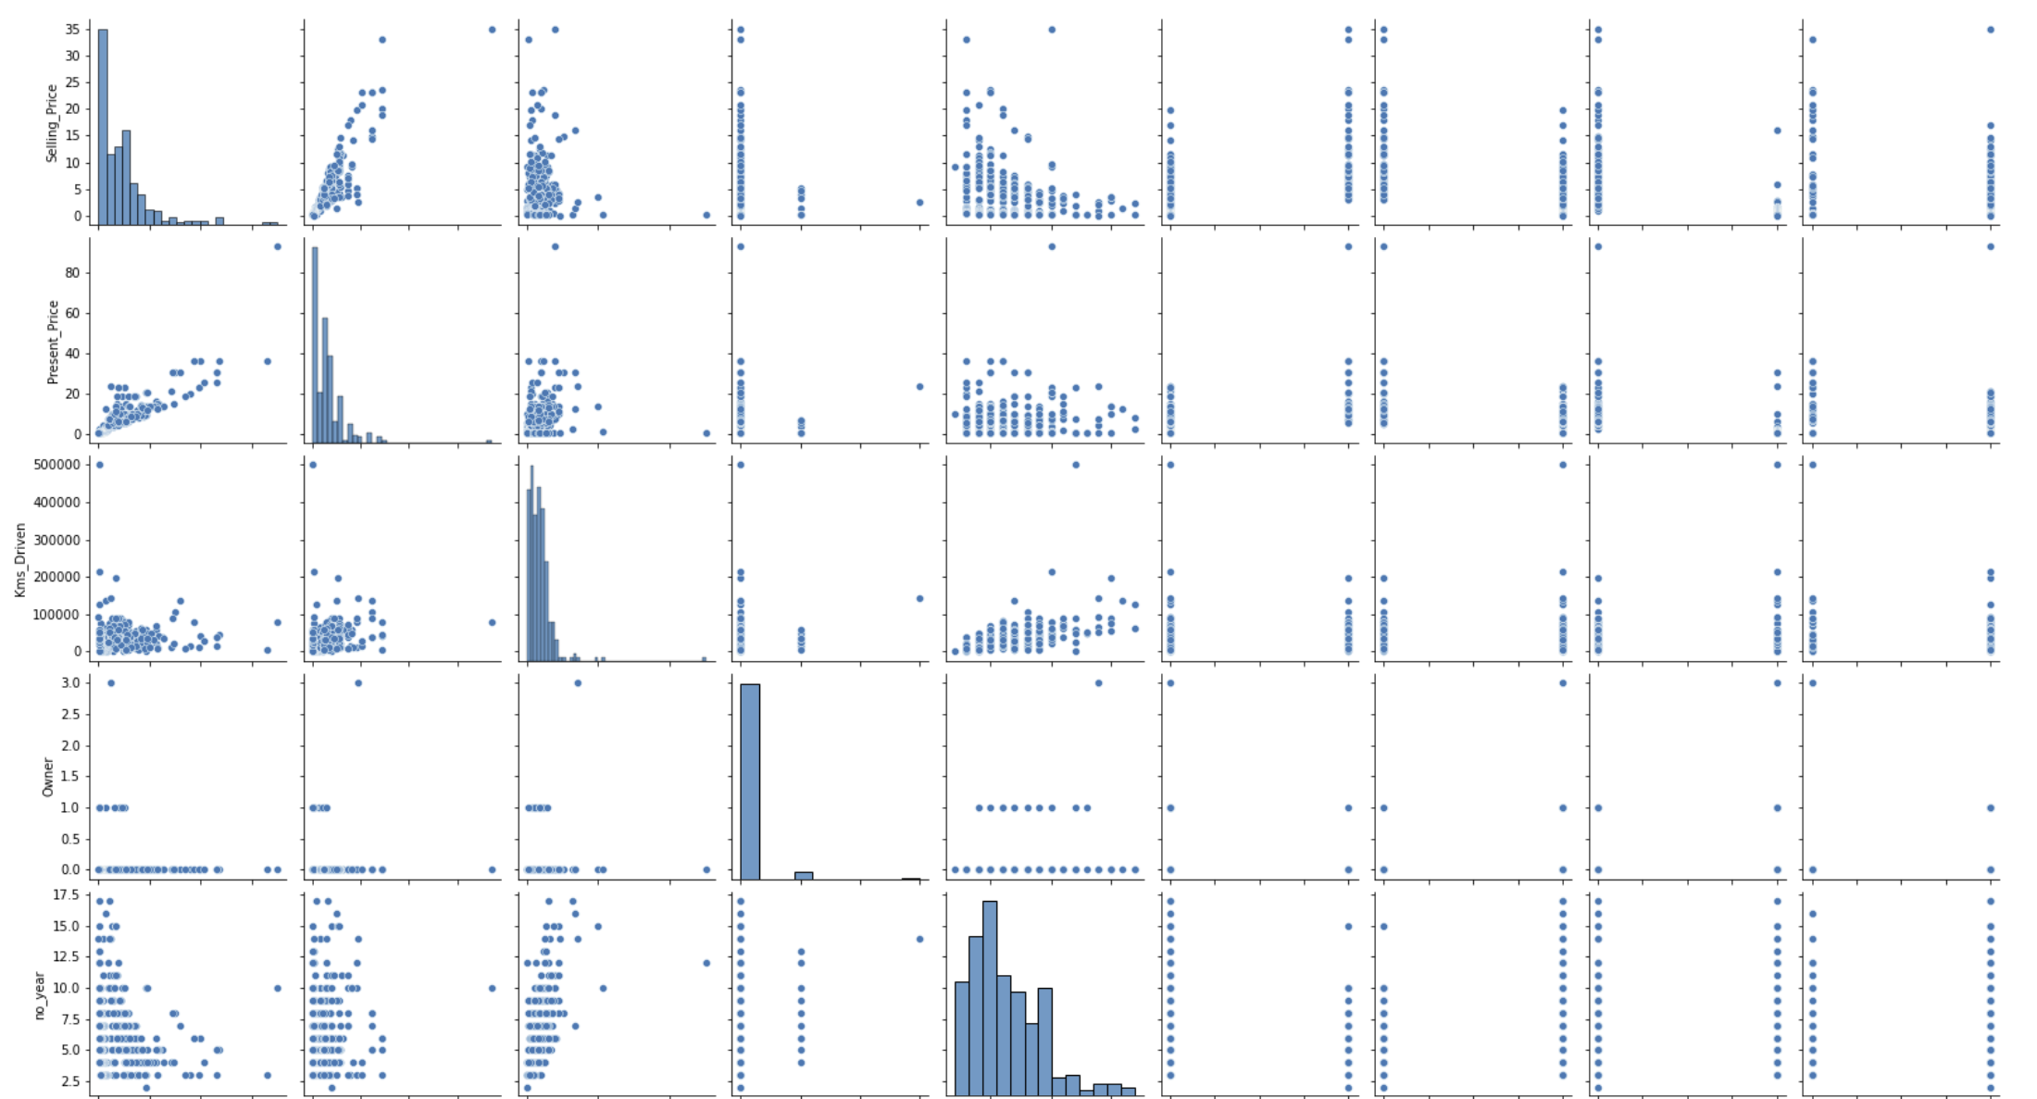

Slide 19
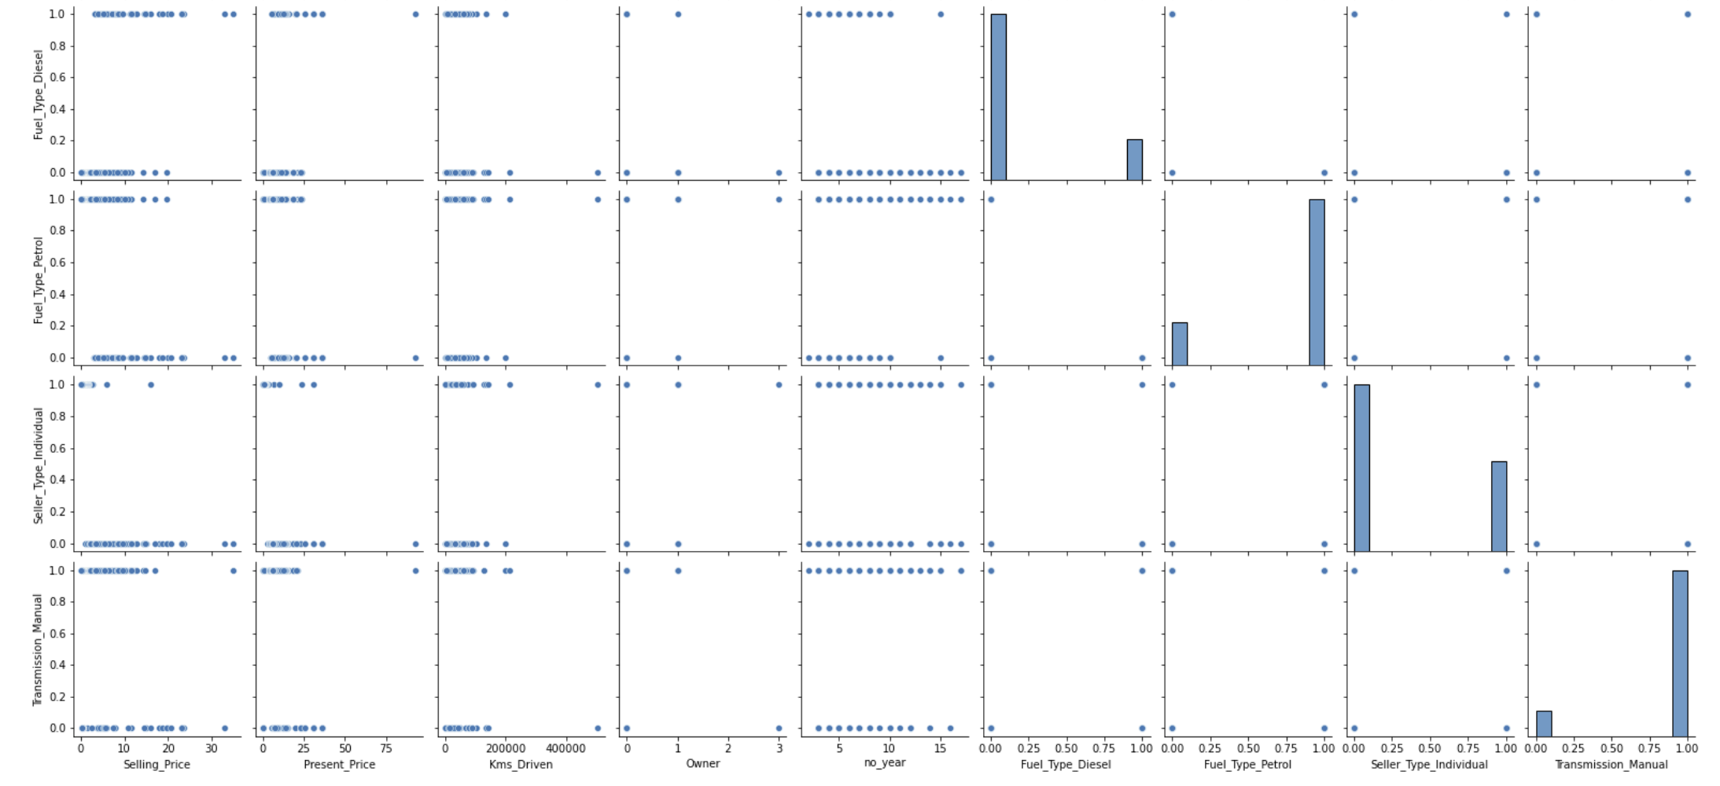

Slide 20
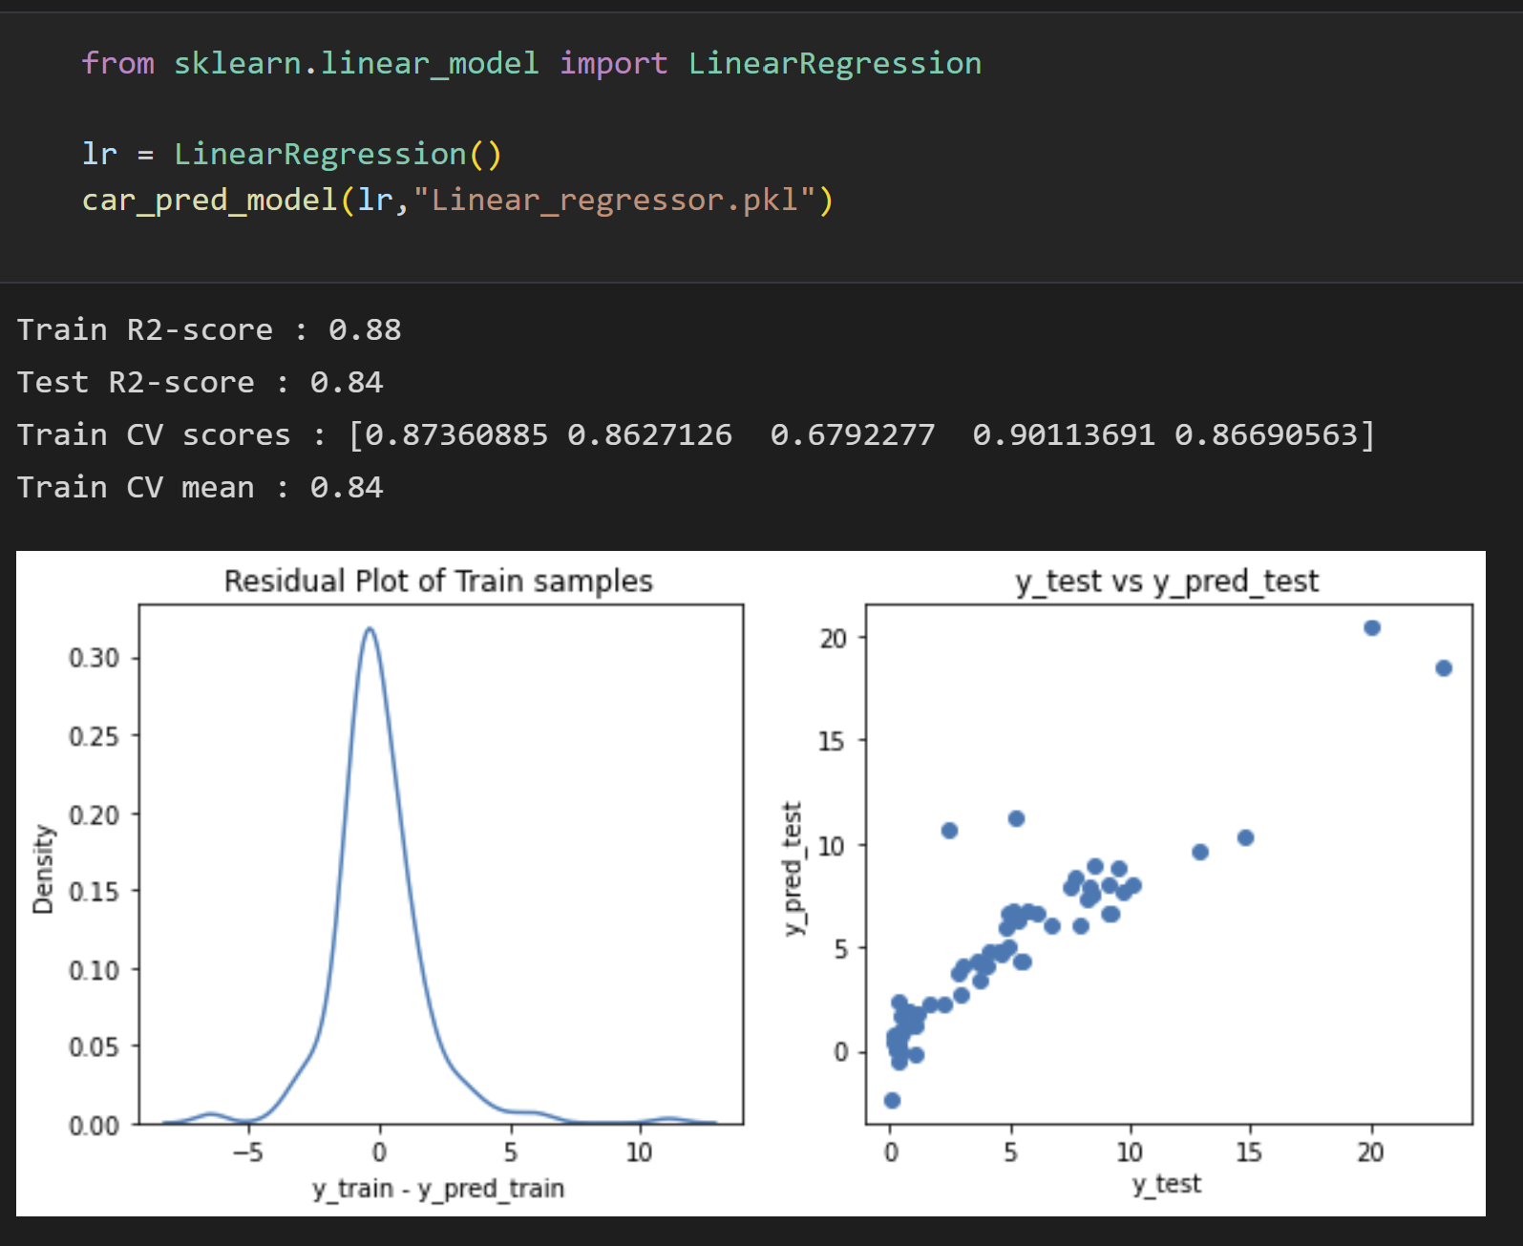
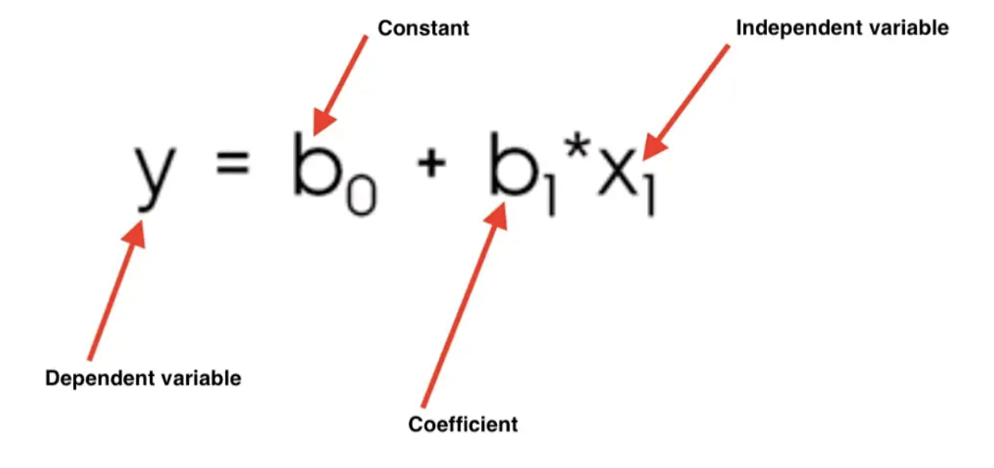
Linear Regression
Linear Regression is a statistical supervised learning technique to predict the quantitative variable by forming a linear relationship with one or more independent features.

Slide 21
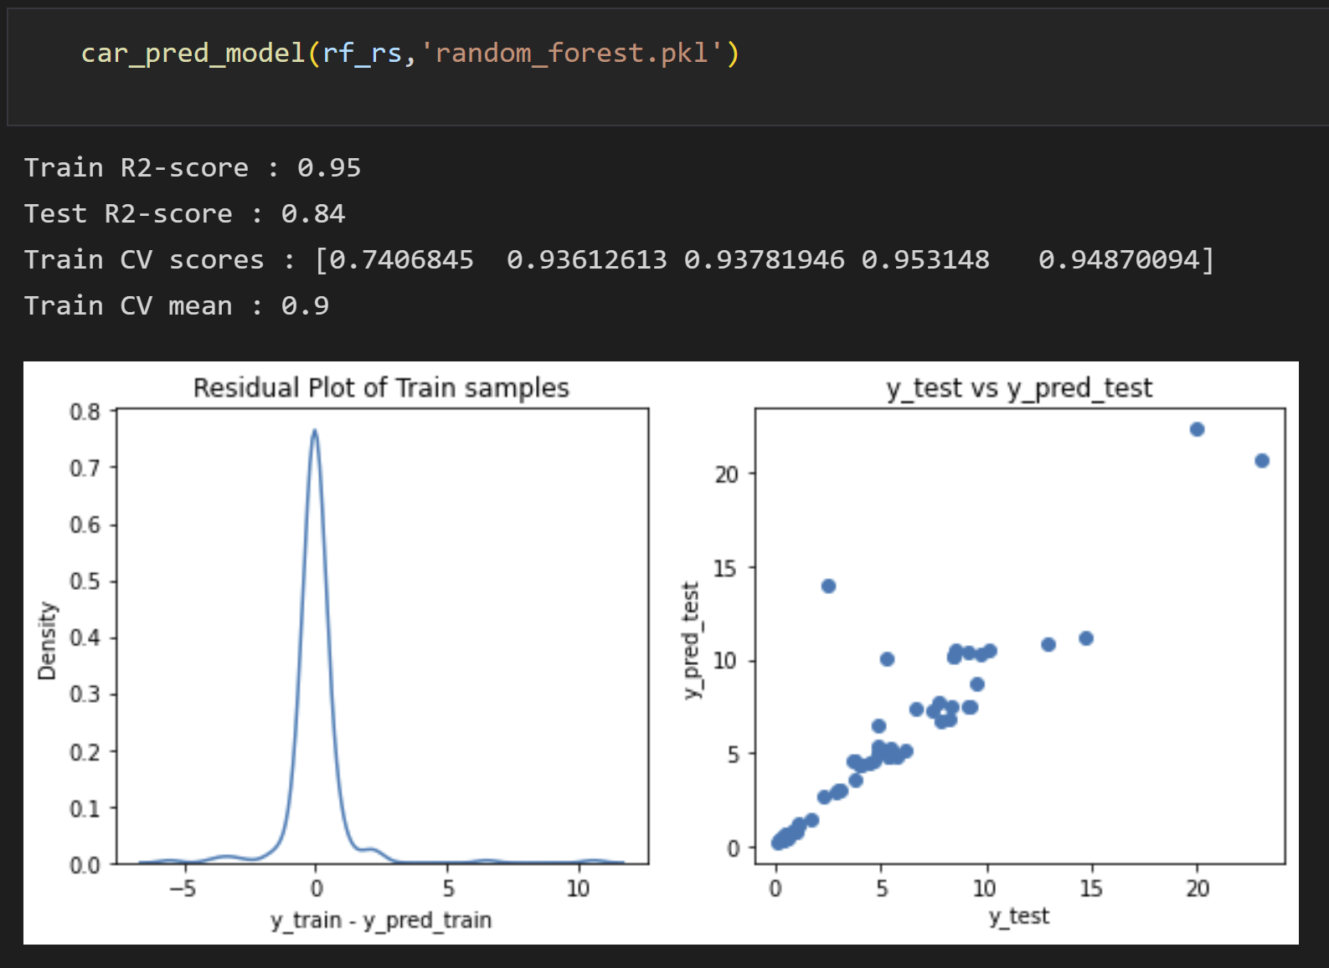
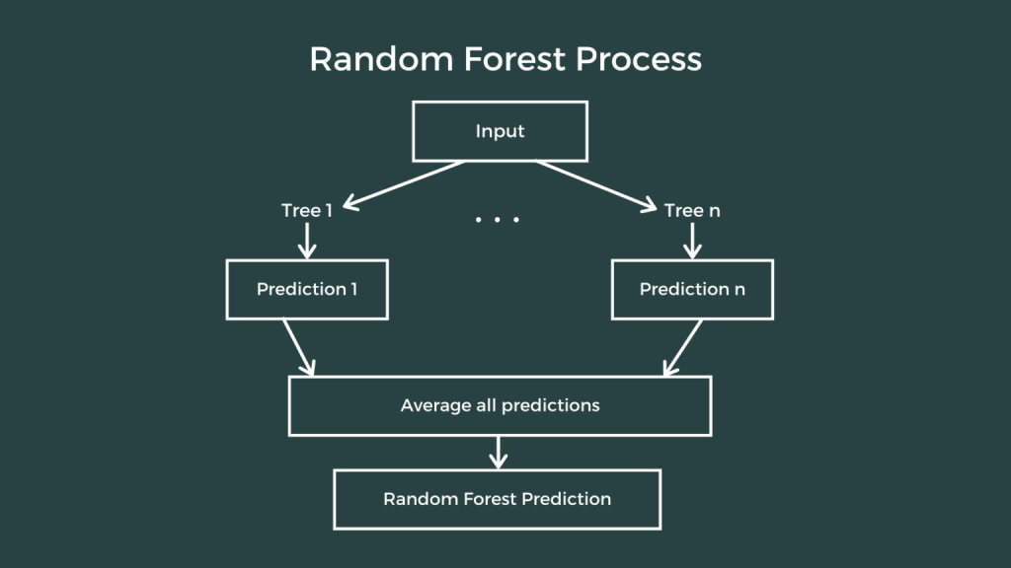
Random Forest Regression
It use the combination of multiple random decision trees each trained on a subset of data.
The use of multiple trees gives stability to the algorithm and reduces variance

Slide 22
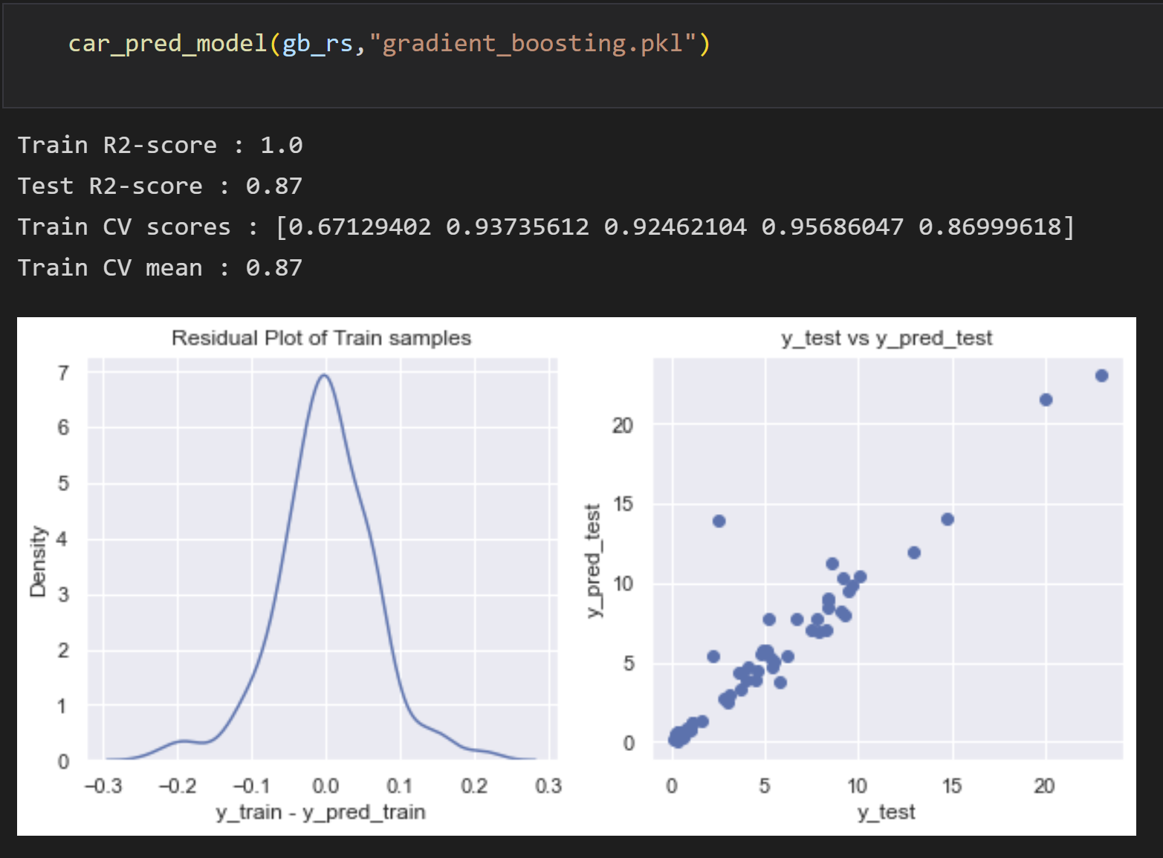
Gradient Boosting Regression
It is an ensemble technique which uses multiple weak learners to produce a strong model for regression and classification.
It relies on the intuition that the best possible next model, when combined with previous models, minimizes the overall prediction error.

Slide 23
Methodology
The Machine Learning methodology used in this project are
Linear Regression - It is the supervised learning-based algorithm which predicts a dependent variable value based on independent variable. It finds out the linear relationship between input and output.
Random Forest Regression - It is supervised learning algorithm that uses ensemble learning method for regression.
Gradient Boosting Regression - It is one of the most powerful algorithm in the field of Machine Learning. It removes the bias error of model and used for predicting not only continuous target variable but also categorical target variable.
Extra Trees Regression - Extremely Randomized tree classifier is a type of ensemble learning technique which aggregates the results of multiple de-correlated decision trees.

Slide 24
Conclusion and Future Work
Random Forest Regression performed better than the other regression models used to predict car prices.
Better User Interface implementation.
Training the models with more amount of data.
Train the model for new car price predictions with the suitable data source

Slide 25


