Slide 1

EXPLAINABLE DETECTION OF ONLINE SEXISM
AVANI DUBEY
RUDRAKSH SUGANDHI
SHAHRIAR BULBUL

Slide 2
01.
3
Introduction
TABLE OF CONTENT
02.
Motivation
4
03.
5
Problem Description
04.
6
Dataset
05.
11
Models
06.
16
Results
07.
17
4
Conclusion

Slide 3

INTRODUCTION
Detecting online sexism is challenging due to the subjective nature and nuances of language.
Developing an explainable model is essential to understand the reasons for sexist behavior and to develop effective interventions and policies.
This project aims to develop an explainable NLP model that can detect online sexism and provide explanations for its predictions.
By providing explanations for the model's predictions, the project aims to enhance the interpretability and transparency of the model.
The ultimate goal of this project is to contribute to the development of effective interventions and policies that can mitigate the harmful effects of online sexism.
By addressing the challenges of detecting online sexism and developing an explainable model, this project hopes to improve our understanding of this issue and promote a safer and more inclusive online environment.
3

Slide 4
MOTIVATION
Social media has provided people with a platform to express themselves and connect with others.
However, this platform has also enabled negative traits, such as online sexism, to spread more easily.
Social media's anonymity and lack of responsibility have made it easier for people to engage in online sexism, which can harm individuals and perpetuate damaging gender stereotypes.
It is crucial to identify and address online sexism in order to ensure that social media is a safe and welcoming environment for all users.
Online sexism is a pervasive and hazardous problem that can have negative effects on both individuals and society as a whole.
By developing a system that can identify instances of online sexism, we can take steps to reduce its impact and promote a more inclusive and respectful online community.
4

Slide 5
PROBLEM DESCRIPTION
The objective of this project is to create an explainable NLP model that can identify online sexismand offer justifications for its predictions.
The project's objective is to create a model that achieves high accuracy in identifying and classifying sexist language and can be used to assist human moderators in monitoring and addressing sexist language in the workplace and social media.
By doing this, our project intends to aid in the creation of efficient initiatives and regulations that can lessen the negative consequences of online sexism
5

Slide 6
TASK A
TASK B
TASK C
Task A is a
two-class (or binary) classification in which sys-
tems must predict whether or not a post is sexist.
To classify whether the text is sexist or not, we are initially training the data to preprocess the text and extract meaningful features from the text and then running it through different models to classify and predict whether the text is sexist
Task B distinguishes between four distinct categories of sexism
The second level of
our taxonomy categorizes sexist content into four
conceptually and analytically separate groups.The
four categories are
(1) Threats, plans to harm & incitement
(2) Derogation
(3) Animosity
(4) Prejudiced Discussion
Task C identifies one of 11 fine-grained sexism vectors.
The third level of our taxonomy disaggregates each category of sexism into fine-grained sexism vectors.
6

Slide 7
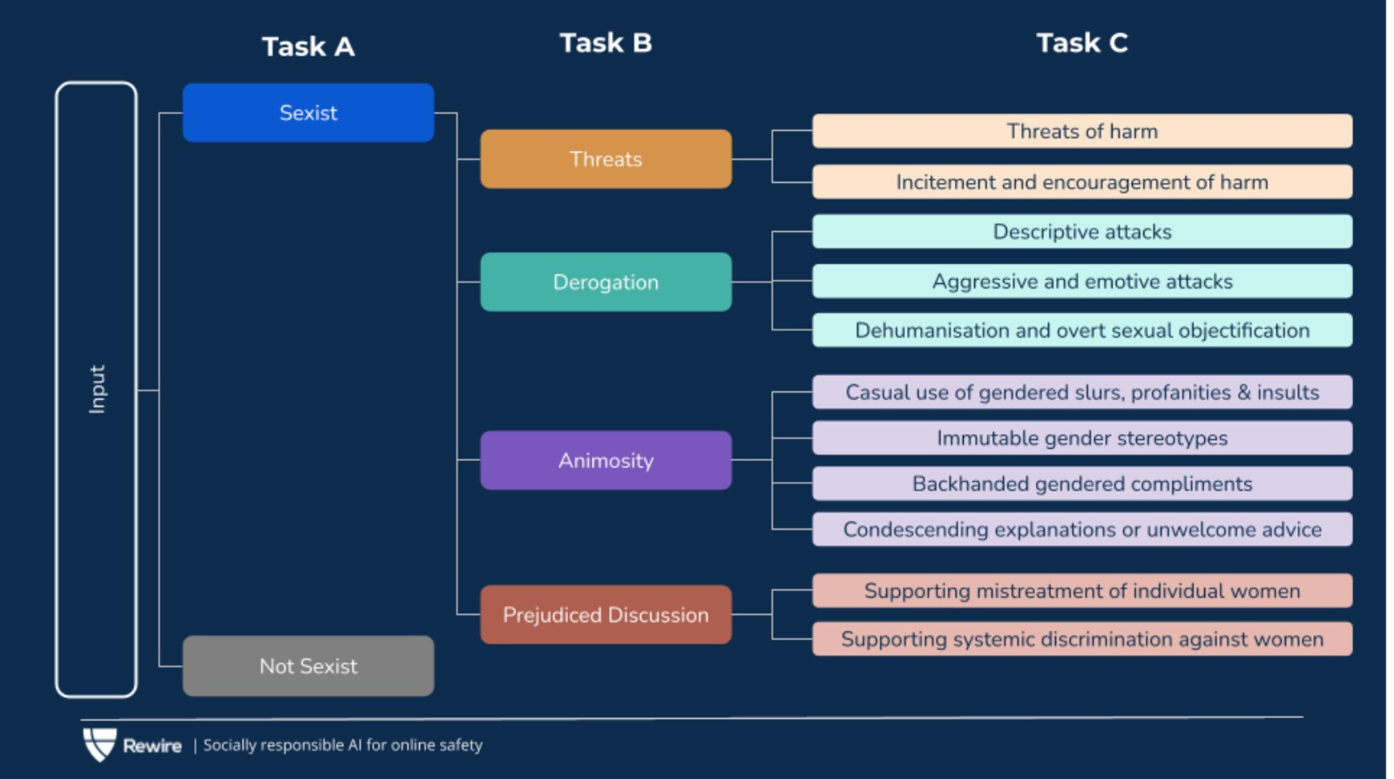

Slide 8
"I can't believe you're so emotional, typical of your gender"
01.Task A
02.Task B
03. Task C
The sentence is sexist because it makes a baseless generalization about women's emotions and reinforces gender stereotypes that women are overly emotional and unable to control their feelings.
This statement falls under the category of "animosity," It characterizes women in a derogatory manner by reducing them to emotional beings who are not in control of their emotions
This statement would fall under the factor of "immutable gender differences and gender stereotypes." It reinforces the harmful stereotype that women are overly emotional and cannot handle stressful situations.
8

Slide 9
DATASET COLLECTION
The Dataset was provided by SemEval 2023 Task 10 - Explainable Detection of Online Sexism (EDOS). Our labeled dataset has 14000 entries from Gab alternative for Twitter and from Reddit.
The training data consists of 14,000
entries with 10602 as not sexist and 3398 as sexist entries. The dataset is divided into 70% for training and 30% for testing.
The columns
are as follows: rewire id: a unique identifier for
each entry text: the input text label Task A: "label
Sexist" which means to detect whether it’s sexist
or not, Task B: "label category" which differs for 4
different categories, Task C: label vector identifies
one of the 11-grained sexism vectors
All entries are labeled initially by professional annotators. All of the annotators and specialists
were women.
9

Slide 10
DATA PREPROCESSING
Cleaning: The WordNet lemmatizer and the WordNet database OMW1.4 for multilingual word net databases were used for cleaning.
Encoding: One hot encoding and label encoding were used for data encoding.
Train-test split: The data was split into training and testing sets in a 70-30 ratio.
Regularization: Regularization techniques like LR reducer were used to prevent overfitting.
Embedding: MiniLM was used to convert sentences into sentence embeddings.
Data transformation: Data transformation was performed using MiniLM.
1o

Slide 11
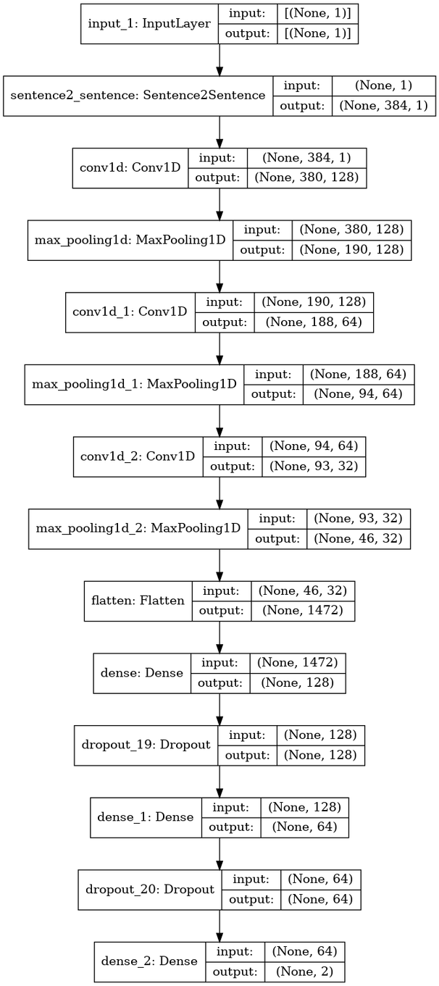
CNN
Convolutional neural network (CNN) that takes as input a sequence of word embeddings. The input is passed through several convolutional layers, each with different kernel sizes, followed by max-pooling and dropout layers.
The resulting feature maps are concatenated and fed into a dense layer with a ReLU activation function, followed by another dropout layer and a final dense layer with a sigmoid activation function that outputs a binary classification prediction.
The model takes an input layer with 384 embeddings followed by a convo1D layer and a max-pooling layer.
11

Slide 12
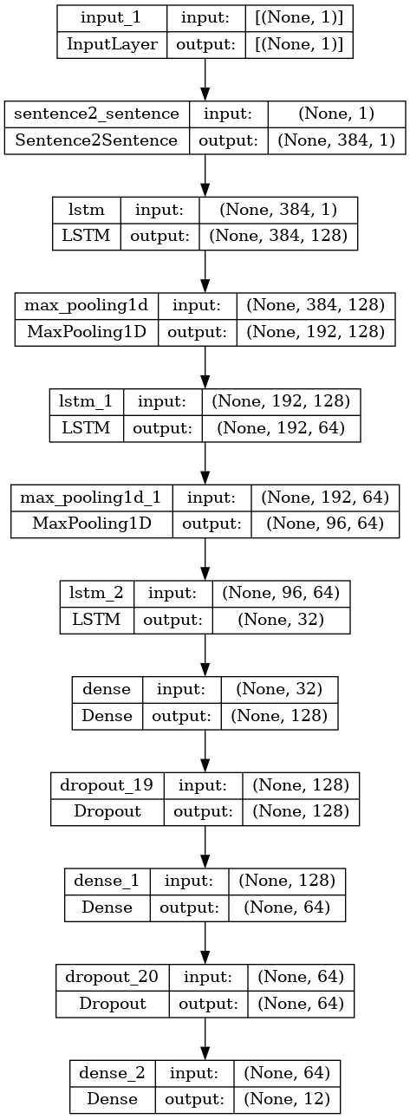
LSTM
The LSTM model was trained on a dataset consisting of text sequences to perform binary and multiclass classification.
The model was composed of an embedding layer followed by an LSTM layer with 64 units, and a dense layer with a sigmoid activation function as the output layer.
The model was trained for 20 epochs with a batch size of 612.
The results indicate that the LSTM model was effective in learning the underlying patterns in the text data and making accurate predictions.
13

Slide 13
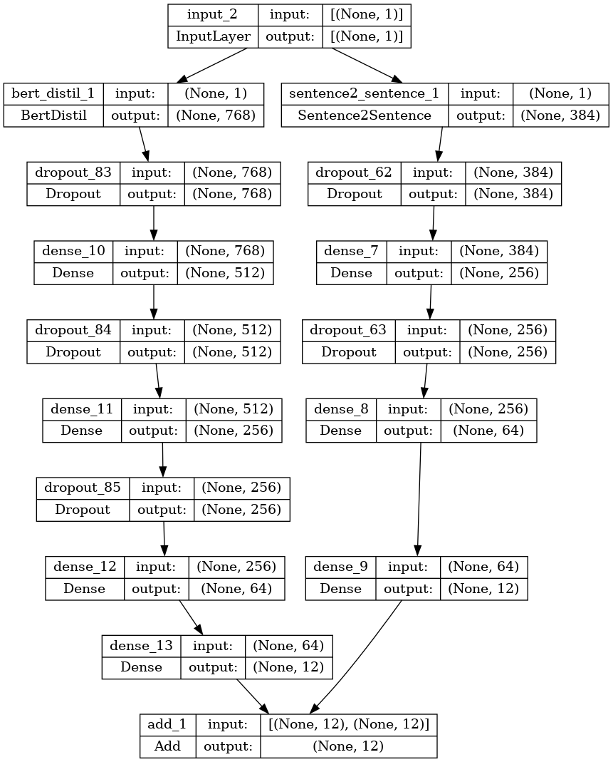
ROBERTA
The RoBERTa model is a type of transformer-based neural network architecture that was introduced in 2019 by Facebook AI. It is an extension of the BERT (Bidirectional Encoder Representations from Transformers) model.
Model fusing with RoBERTa and MiniLM involves combining the strengths of both models to improve the performance of the system on the task of sentence-to-sentence prediction.
To fuse these models, we have use an ensemble approach, where we train both models independently on the same dataset and combine their predictions using a voting or averaging technique.
By fusing these models, we can potentially achieve better performance than using either model alone
14

Slide 14
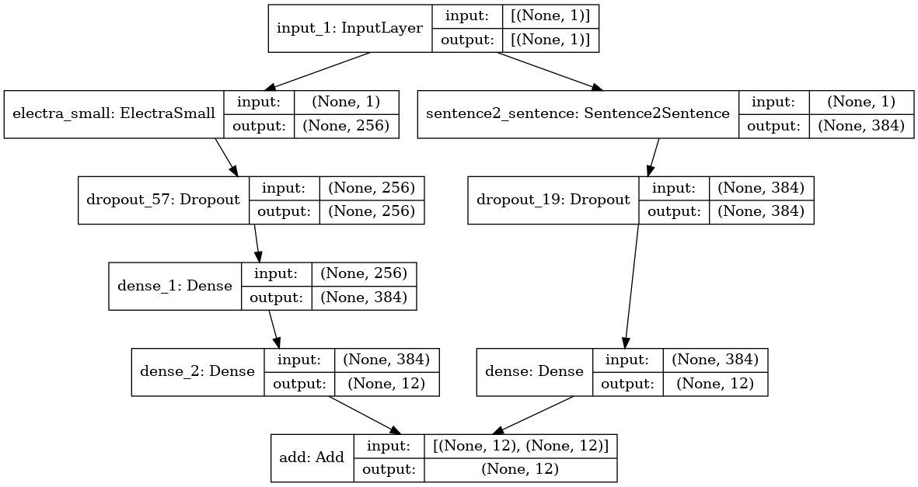
ELECTRA
The Electra model was used for the binary classification of text data in this project.The model architecture consisted of an Electra pre-trained transformer encoder, followed by a dense layer with ReLU activation and a sigmoid or softmax output layer.
The input text data was tokenized and passed through the Electra encoder to generate contextualized word embeddings.
The model was trained on a binary cross-entropy loss function using the Adam optimizer.
The Electra model also demonstrated better performance on other evaluation metrics, including precision, recall, and F1-score. These results demonstrate the effectiveness of the Electra model in binary text classification tasks
16

Slide 15
DISTILLBERT
The DistilBERT model is a variant of the popular BERT model.
The DistilBERT model is intended to be a more compact and computationally effective variant of BERT that can still perform well on a variety of NLP applications.
The DistilBERT model has several advantages over the complete BERT model, one of which is that it requires less processing. As a result, the model is simpler to train and deploy on a number of hardware platforms, such as mobile and edge devices.
Moreover, the DistilBERT model may be trained faster than the entire BERT model which is beneficial when working with big datasets or doing experiments with lots of different hyperparameters. The DistilBERT model is a popular option for many NLP applications because it offers a strong overall balance between performance and efficiency.
18

Slide 16
 | TASK A | TASK B | TASK C
DistilBert | 0.6647 | 0.6539 | 0.703
Roberta | 0.7817 | 0.644 | 0.612
CNN | 0.5346 | 0.419 | 0.399
LSTM | 0.4309 | 0.4488 | 0.388
Electra | 0.4462 | 0.6559 | 0.6524
Results
The Table Demonstrates the F1- Score of all the models and the model performing better on which classification task.

Slide 17
CONCLUSION
The final results suggest that RoBERTa is the most effective model for the task, given its high training accuracy and reasonable validation accuracy
The models used in this study were able to provide interpretable explanations for their decisions, which is important for understanding how the models arrived at their predictions.
Roberta outperformed the competition on Task A, Electra, and Distil-BERT both got relatively good scores . Electra has the highest F1-score for Task B , followed by DistilBERT. CNN has the lowest F1 score ,followed by RoBERTa and LSTM . DistilBERT has the greatest F1-score for Task C, followed by RoBERTa. In contrast to CNN and LSTM, which have the lowest scores.
Overall, our results demonstrate the effectiveness of our proposed model for the primary task of explainable detection of sexism in online comments. Our model achieves high performance while also providing interpretable explanations for its decisions.
20

Slide 18
Thank you
Q/A
Q/A

