Slide 1
Attrition & Salary Prediction
Rudranil Mitra
Case Study 2
DS 6306

Slide 2
Purpose
Goal is to predict the following
Predict Attrition
Predict Monthly Income
Perform EDA on the Attrition dataset
Notes:
Our initial idea was to scrape the web to find the missing values for ABV & IBU. However we encountered quite a few challenges in extracting the data from the internet due to inconsistencies in HTML formatting across different websites. Our final approach was to calculate the median values of ABV and IBU per style and impute them into the respective missing values. Before we did that, the missing Style values had to be addressed.
Upon examining the five rows of missing Style of beer, manual intervention was required.
- Belonging to Oskar Blues, "CROWLER" is not a beer, it's just a container. And "Can’d AID foundation" is not a beer. It's a charitable foundation.
From Cedar Creek Brewery, “Special Release” just refers to a series of beers.
Added Styles to Oktoberfest from Freetail Brewing Co. and to Kilt Lifter from Four Peaks Brewing Co.

Slide 3
Data Cleaning
Department
Renamed department names, as the department names were same as Job Description, causing issues while creating categorical variables
Removed the following fields
Over18
EmployeeCount
EmployeeNumber
ID
StandardHours
DailyRate
HourlyRate
MonthlyRate
Notes:
Our initial idea was to scrape the web to find the missing values for ABV & IBU. However we encountered quite a few challenges in extracting the data from the internet due to inconsistencies in HTML formatting across different websites. Our final approach was to calculate the median values of ABV and IBU per style and impute them into the respective missing values. Before we did that, the missing Style values had to be addressed.
Upon examining the five rows of missing Style of beer, manual intervention was required.
- Belonging to Oskar Blues, "CROWLER" is not a beer, it's just a container. And "Can’d AID foundation" is not a beer. It's a charitable foundation.
From Cedar Creek Brewery, “Special Release” just refers to a series of beers.
Added Styles to Oktoberfest from Freetail Brewing Co. and to Kilt Lifter from Four Peaks Brewing Co.

Slide 4
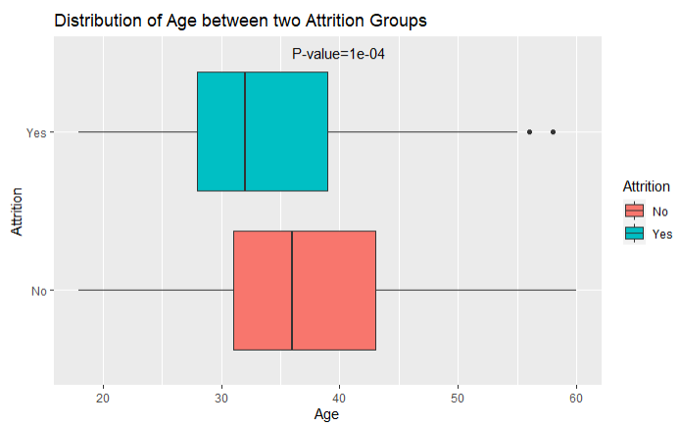
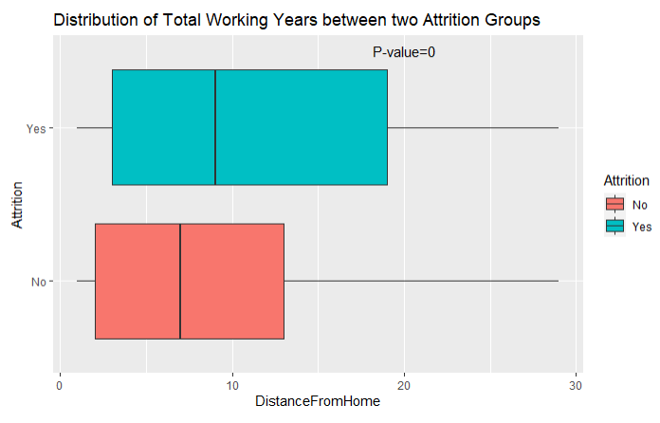
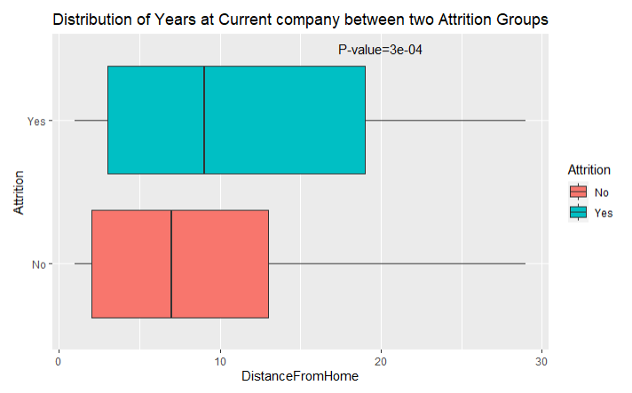
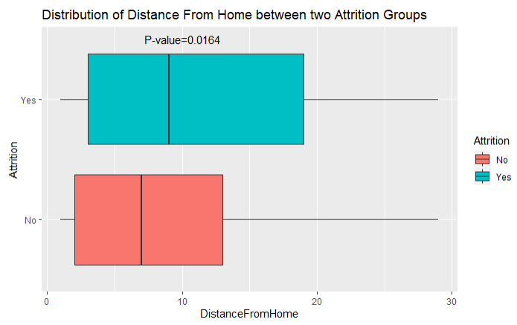
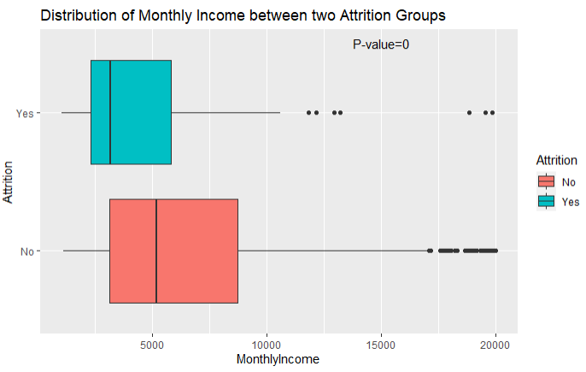
Factors Leading to Attrition
Looking at the p-value from t-tests we will choose three factors with lowest p-value
Total Working Years
Monthly Income
Age

Slide 5
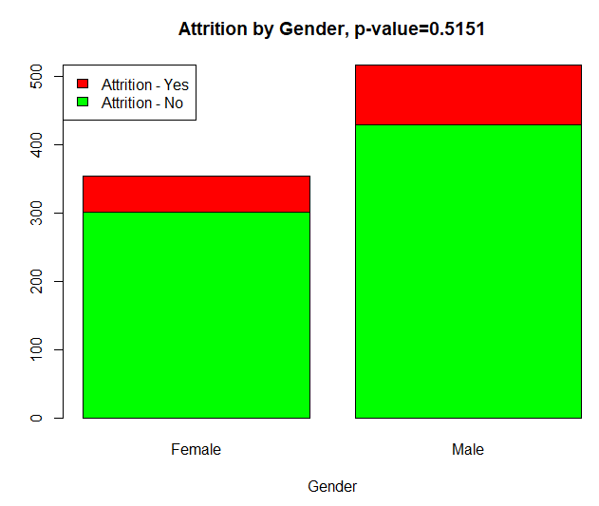
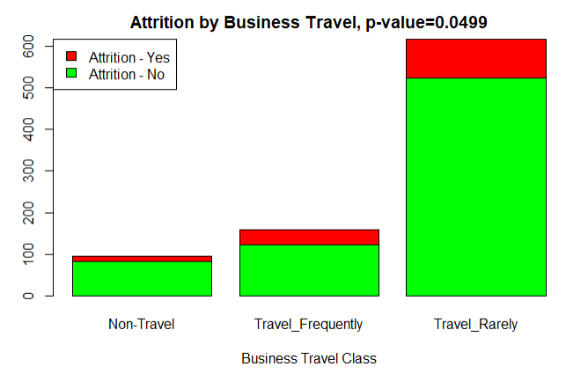
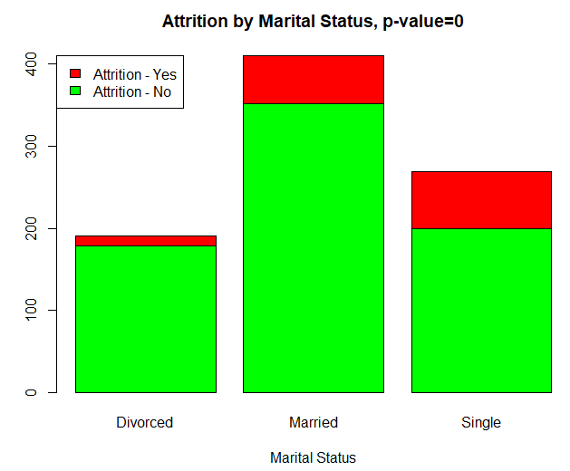
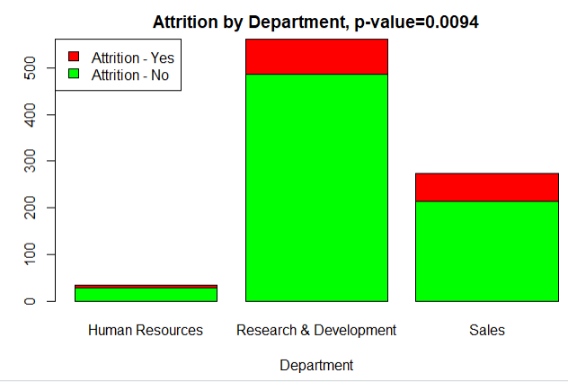
Factors Leading to Attrition
Looking at the p-value from chisq tests we can say that Business Travel, Marital Status and the Department in which the employee belongs may attribute to attrition

Slide 6
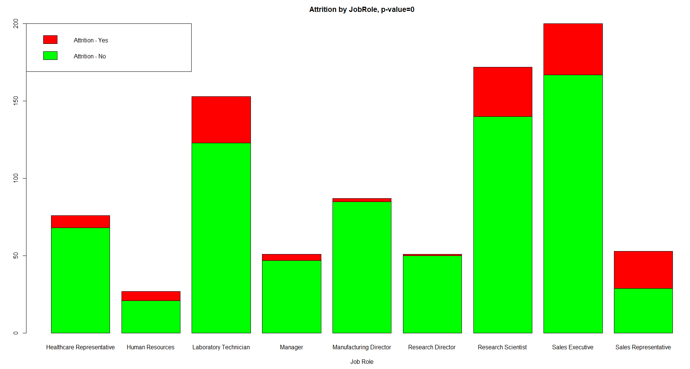
Factors Leading to Attrition
Looking at the p-value from chisq tests we can say that Job role does not play an important role in Attrition

Slide 7
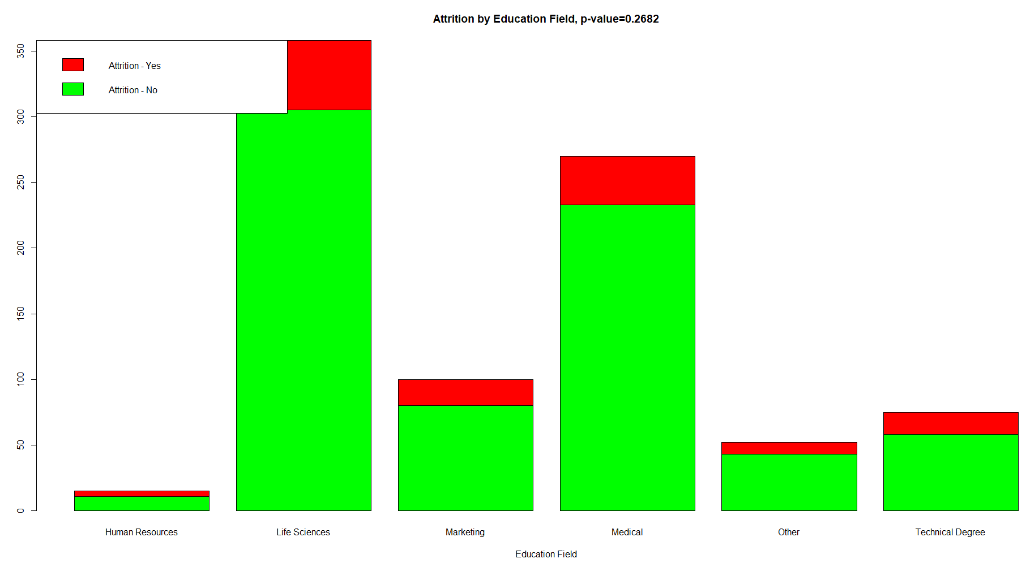
Factors Leading to Attrition
Looking at the p-value from chisq tests we can say that Education Field does not play an important role in Attrition

Slide 8
Factors Leading to Attrition
Looking at the p-value from chisq tests we can say that Education Field does not play an important role in Attrition

Slide 9
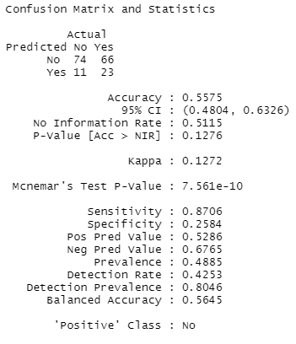
KNN Prediction
Use SMOTE to over sample minority class as dataset does not have even distribution of Outcome
Ran KNN with k = 10
Acceptable accuracy
Very Low Specificity, need further work on the model

Slide 10
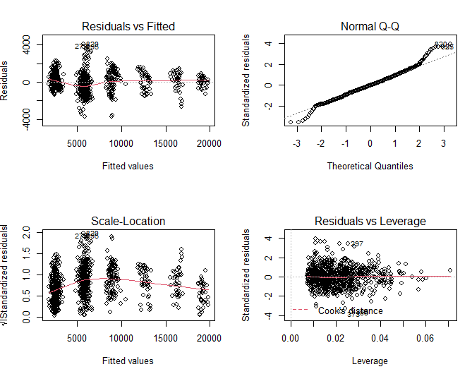

Linear Regression
Final variables from backward selection using AIC
BusinessTravel
Gender
JobLevel
JobRole
PercentSalaryHike
PerformanceRating
TotalWorkingYears
YearsSinceLastPromotion
YearsWithCurrManager
Assumptions
Residuals look like random cloud, so no evidence of non-linearity. Also residuals suggest equal variance
Residuals are normally distributed as suggested by QQ Plot
No outliers / influential points in the dataset

Slide 11
Conclusion
Look at significant factors leading to attrition
Work Life Balance ?
Compensation ?
Business Travel – Can we reduce travel?
Department – Can we provide more opportunities ?
Marital Status – Can we provide counselling services ?

