Slide 1
RESEARCH & ENGINEERING PRESENTATION
ZK-CaMBio
Privacy-Preserving Multimodal Biometric Authentication
Using Cancelable Chaotic Templates
Solving Biometric Identity Theft • Face & Fingerprint Feature Fusion • 1.29% EER Accuracy • Provable ISO/IEC 30136 Revocability
MULTIMODAL FUSION
FaceNet (512-d) + FingerResNet (256-d)
HIGH ACCURACY
1.29% Equal Error Rate (98.81% Rank-1)
ZERO-KNOWLEDGE PRIVACY
Zero Raw Biometrics Stored in DB
Notes:
WELCOME AND INTRODUCTORY REMARKS:
Good morning/afternoon everyone. Today, I am presenting ZK-CaMBio, an advanced privacy-preserving multimodal biometric authentication system.
In simple terms, biometrics like our face and fingerprints are widely used for security, but they suffer from a major vulnerability: once your face or fingerprint data is stolen or leaked from a database, you can never change it. You cannot reset your face or change your fingerprints.
ZK-CaMBio completely solves this problem. It fuses facial recognition and fingerprint scanning, converts them into scrambled, cancelable 512-bit binary codes using chaotic mathematics, and ensures that the server never stores any raw biometric images or templates. If a template is ever stolen, it can be instantly revoked and replaced with a fresh one without losing high accuracy.

Slide 2
PROBLEM STATEMENT
The Core Problem: Why Traditional Biometrics Are High-Risk
The Permanence Vulnerability
• Biometrics Cannot Be Reset:
If your password is stolen, you change it in 10 seconds. But if your face or fingerprint template is leaked, you are permanently compromised for life.
• Cross-Service Tracking:
If you use your face to unlock your phone, your bank, and your office, a leaked database allows malicious actors to link and track your identity across all services.
• Single-Modality Weaknesses:
A single biometric trait often fails: fingerprints get smudged or dry, and face recognition struggles under low light, leading to high false rejections.
Passwords vs. Traditional Biometrics
Credential Type:
• Password: Random digital strings
• Biometric: Your physical body traits
Revocability:
• Password: Instant re-issuance
• Biometric: Biologically impossible
Cross-Service Salt:
• Password: Unique hash per service
• Biometric: Same face & finger everywhere
Data Breach Risk:
• Password: Change password, risk ends
• Biometric: Permanent identity compromise
Notes:
SLIDE 2 SPEAKER NOTES:
Let's understand the core problem this project solves.
When we use passwords or PIN numbers, if someone hacks the server and steals the password, it's bad, but it's easily fixable: the user simply changes their password.
However, with biometrics, your face, fingerprint, or iris is permanently tied to your body. If a hospital, an employer, or a government database gets hacked, your biometric features are leaked forever. You cannot go to a clinic and get a new set of fingerprints or a new face.
Furthermore, unimodal systems—using only face or only fingerprint—often struggle. A fingerprint sensor gets dirty, or lighting changes for face recognition, causing false rejections.
Therefore, modern biometrics desperately needs two things: multimodal fusion for high accuracy, and cancelable templates so that credentials can be revoked and re-issued just like passwords.

Slide 3
PROPOSED SOLUTION
What Problems Does ZK-CaMBio Solve & How?
1. Multimodal Fusion
SOLVES SINGLE-SENSOR FAILURES
Combines deep facial features and convolutional fingerprint features at the feature level.
• Face weight = 0.60, Fingerprint = 0.40.
• Creates a unified 768-dimensional unit-norm vector that makes authentication far more accurate than any single trait.
2. Cancelable Chaotic Projection
SOLVES PERMANENT LEAKS
Transforms continuous biometrics into a 512-bit binary template using a key-dependent chaotic logistic map.
• If stolen, the key is revoked and changed.
• A new, completely different template is generated from the exact same face and fingerprint without re-sampling.
3. 'Zero-Knowledge' Privacy
SOLVES SERVER DATA BREACHES
Guarantees data-at-rest structural privacy on the server:
• ZERO raw face photos or fingerprint images stored.
• ZERO continuous floating-point embeddings stored.
• The database stores ONLY a 64-byte scrambled binary bitstring.
Notes:
SLIDE 3 SPEAKER NOTES:
Here is the solution we built: ZK-CaMBio.
It is built on three major pillars:
First: Multimodal Fusion. We don't rely on just a face or just a finger. We extract deep features from both and combine them into a single 768-dimensional vector. This solves false rejections and gives extreme accuracy.
Second: Cancelable Chaotic Projection. We use a deterministic mathematical chaotic map parameterized by a user's secret key. It projects the combined biometric features into a 512-bit binary code (which is only 64 bytes). If a template is ever compromised, we simply rotate the key and re-enroll. The old template is immediately useless, and the new template is completely unlinkable.
Third: Zero-Knowledge Data-at-Rest. We formally define zero-knowledge in this project as a structural storage guarantee: the authentication server never saves raw pictures, never saves unquantized floating-point vectors, and under user-secret mode, never stores passphrases. Even if an attacker steals the entire database, all they get are scrambled 64-byte bitstrings.

Slide 4
WHAT DID WE USE?
Technology Stack: Models, Cryptography & Systems
FACE RECOGNITION
InceptionResnetV1 (FaceNet)
• Pretrained on VGGFace2 (3.31M images)
• Input: 160x160 face crops
• Output: 512-dimensional L2-normalized deep embedding vector
FINGERPRINT RECOGNITION
Custom FingerResNet18 V2
• ResNet-18 adapted for single-channel 128x128 impressions
• Fine-tuned using CosFace large-margin loss
• Output: 256-dimensional L2-normalized vector
MULTIMODAL FUSION
Weighted Feature Concatenation
• Formula: [sqrt(0.60)*Face, sqrt(0.40)*Finger]
• Produces a 768-dimensional unit-norm vector
• Mathematically preserves unit length (||x||=1)
CHAOTIC ENGINE (C++17)
Fixed-Point Logistic Map
• Q64 fixed-point math (zero floating-point divergence)
• Compiled with -ffp-contract=off for 100% bit-exact Windows/Linux matching
• Generates 512x768 random matrix from user key
KEY DERIVATION
scrypt + HMAC-SHA256
• scrypt memory-hard key stretching (N=16384, r=8, p=1)
• Binds user ID, salt, and version into HMAC-SHA256 seed
• Effective keyspace >= 2^126 operations
PRODUCTION BACKEND
FastAPI + PostgreSQL + Streamlit
• REST API endpoints: /enroll, /verify, /identify, /revoke
• PostgreSQL 16 Alpine with BYTEA(64) templates
• Air-gapped Streamlit web UI + multi-stage Docker
Notes:
SLIDE 4 SPEAKER NOTES:
Now let's examine what technologies and models we used in this project:
1. For facial feature extraction: We used InceptionResnetV1 (FaceNet) pretrained on the VGGFace2 dataset, which converts a 160x160 face crop into a 512-dimensional continuous feature vector.
2. For fingerprints: Off-the-shelf Gabor filters fail on noisy images, so we built FingerResNet18 V2, fine-tuned with CosFace margin loss to extract clean 256-dimensional fingerprint embeddings.
3. For fusion: We use weighted concatenation with square root weights (0.60 for face, 0.40 for finger). This produces a 768-dimensional combined vector that mathematically maintains unit length.
4. For the chaotic engine: We wrote a custom C++17 engine bound to Python using pybind11. We used 64-bit integer fixed-point math and disabled compiler fused-multiply-add (-ffp-contract=off). This guarantees that the exact same bitstring is calculated whether running on Windows MSVC or a Linux Docker container.
5. For cryptography: We use scrypt for memory-hard passphrase stretching and HMAC-SHA256 with per-user salts.
6. For deployment: A FastAPI REST backend, PostgreSQL database, Docker containerization, and an interactive Streamlit UI.

Slide 5
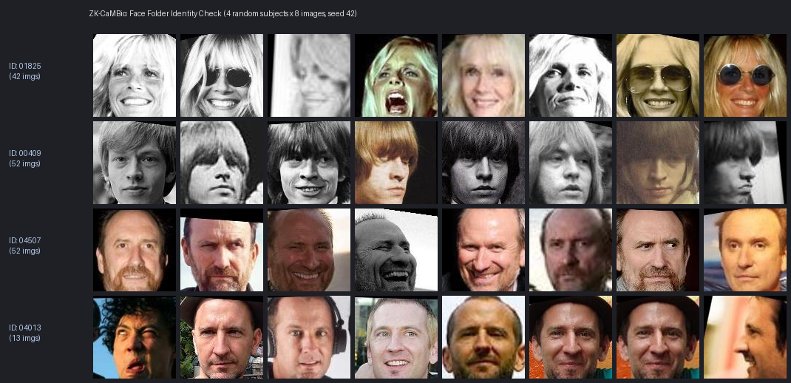
DATASET & EXPERIMENTAL SETUP
Database Breakdown: Corpora, Images & Subject Pairing
How Was the Database Constructed?
• Face Database (UMDFaces):
367,888 total images across 8,277 identity folders. We selected identities with >= 20 high-quality images (7,173 eligible classes), and randomly sampled 300 identities using fixed seed 42.
• Fingerprint Database (FVC2004):
DB1_A (optical 500 dpi), DB2_A (optical 569 dpi), DB3_A (thermal sweep 512 dpi). Exactly 100 fingers per DB x 8 impressions = 2,400 raw images across 300 fingers. (Plus DB4_A synthetic and DB*_B for pretraining).
• Virtual Chimeric Pairing:
Because no freely downloadable paired face+fingerprint dataset exists with open research rights, face identity k was paired with fingerprint k using seed 42, creating 300 Virtual Subjects (VS_0001 to VS_0300).
• Images Used Per Subject:
Exactly 5 enrollment images (averaged to create gallery template) and 3 probe images (for genuine testing) = 8 images per subject (2,400 faces and 2,400 fingerprints used).
Fingerprint Sensor Enhancement (FVC2004)
Raw impressions enhanced via 4-stage CLAHE & foreground segmentation:
Notes:
SLIDE 5 SPEAKER NOTES:
Here are the exact details of the dataset and how the database was built:
1. For the face modality, we used UMDFaces, which contains 367,888 images across 8,277 identity folders. We filtered for subjects with at least 20 images to avoid label noise, leaving 7,173 eligible identities. We then sorted and sampled 300 identities using fixed seed 42.
2. For fingerprints, we used the international benchmark FVC2004 across 3 real sensors: DB1 (optical), DB2 (optical), and DB3 (thermal sweep). Each sensor has 100 fingers with 8 impressions each, giving 2,400 raw images.
3. Chimeric Pairing: In biometric literature, because privacy laws prevent freely releasing public paired datasets with both faces and fingerprints from the same real people, we followed the standard accepted research protocol: pairing face subject k with fingerprint k to create 300 Virtual Subjects.
4. Per subject, we use 5 images for enrollment and 3 separate images for probe queries. That's 8 images per subject, or 2,400 face images and 2,400 fingerprint impressions evaluated in total.

Slide 6
DATASET PARTITIONING
Subject-Disjoint Splits & Protocol D-009
Training Split (60%)
180 Virtual Subjects (1,440 images/modality)
• Used to fine-tune FingerResNet18 encoder
• Computes public centering vector mu
• Trains adversarial reconstruction attack decoders
• Zero test-subject data ever seen
Validation Split (10%)
30 Virtual Subjects (240 images/modality)
• Calibrates modality fusion weight w = 0.60
• Selects projection dimension m = 512 bits
• Tunes enrollment quality gates (0.45 / 0.60)
• Sets operational decision thresholds (tau)
Test Split (40%)
120 Virtual Subjects (960 images/modality)
• STRICTLY HELD-OUT evaluation set
• 40 subjects per fingerprint sensor database
• All reported EER, ROC, CMC & Security metrics evaluated exclusively on this set
How Did We Identify Users? Protocol D-009 (Within-Sensor Impostors)
• Rigorous Sensor Stratification: 120 test subjects are divided equally: 40 on DB1 (optical), 40 on DB2 (optical), and 40 on DB3 (thermal sweep).
• Within-Sensor Impostor Constraint: Cross-matching an optical sensor against a thermal sensor gives artificially easy impostor scores. To prevent fake inflated accuracy, impostor comparisons were strictly restricted to the SAME sensor database.
• Total Test Comparisons: Each of the 40 gallery subjects is compared against 3 probe impressions of the 39 other subjects: 40 x 39 x 3 = 4,680 impostors per database x 3 databases = 14,040 rigorous impostor comparisons, and 120 subjects x 3 probes = 360 genuine trials.
• Split Manifest Integrity: Cryptographically hashed to SHA-256 (a3454a7c...) in data/processed/split_manifest.json to ensure 100% scientific reproducibility.
Notes:
SLIDE 6 SPEAKER NOTES:
How did we partition the data and identify people without data leakage?
1. We strictly separated our 300 virtual subjects into three subject-disjoint groups:
- 180 subjects (60%) for training the fingerprint model and attack decoders.
- 30 subjects (10%) for validation (tuning fusion weights and selecting projection size m).
- 120 subjects (40%) for our final test evaluation. No test data was ever used in training!
2. Crucially, we implemented Protocol D-009 for identification:
In fingerprint testing, comparing a thermal scanner to an optical scanner is too easy because the sensor styles look different. To avoid cheating ourselves with artificially inflated accuracy, we restricted all impostor comparisons strictly to the SAME sensor database. That gave us 14,040 impostor comparisons and 360 genuine test trials across our 120 test subjects.

Slide 7
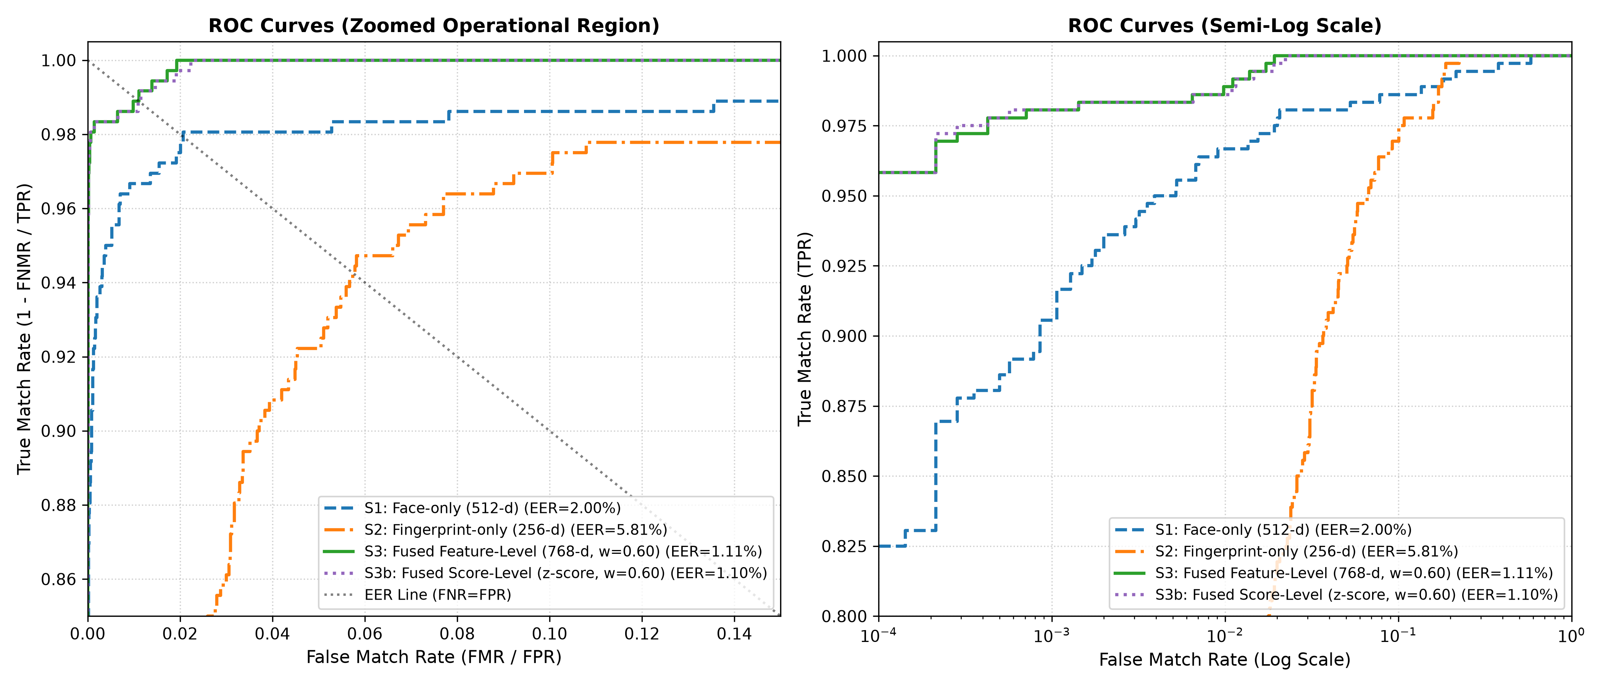
BASELINE ACCURACY RESULTS
Unprotected Baseline: Multimodal Fusion Accuracy
Unprotected Recognition Metrics (120 Test Subjects)
S1: Face Only (512-d)
• EER = 2.00% | Rank-1 = 97.22%
• Decidability: d' = 4.78 | FNMR@1% = 3.33%
S2: Finger Only (256-d)
• EER = 5.81% | Rank-1 = 78.89%
• Decidability: d' = 3.42 | FNMR@1% = 26.67%
S3: Fused System (768-d)
• EER = 1.11% | Rank-1 = 99.44%
• Decidability: d' = 5.91 | FNMR@1% = 1.11%
Key Takeaway in Simple Terms:
Combining face and fingerprint reduces the error rate from 2.00% down to 1.11%—a 44.5% error reduction! Rank-1 identification reaches near-perfection at 99.44% across 40-subject galleries.
Figure: ROC Curves showing Fused System S3 (green) pushing curve tightly toward top-left.
Notes:
SLIDE 7 SPEAKER NOTES:
Here are the baseline accuracy results before applying any cancelable protection:
1. Face recognition alone achieves an Equal Error Rate (EER) of 2.00%, with a Rank-1 identification accuracy of 97.22%.
2. Fingerprint recognition alone achieves an EER of 5.81%, with Rank-1 accuracy of 78.89%.
3. When we fuse them together at the feature level (weighting 0.60 for face, 0.40 for finger), our error rate drops to just 1.11%, and our Rank-1 identification surges to 99.44%!
This proves that multimodal fusion significantly outperforms any single biometric modality. Now, the big question is: when we convert this fused vector into a scrambled cancelable binary code, do we lose this accuracy?

Slide 8
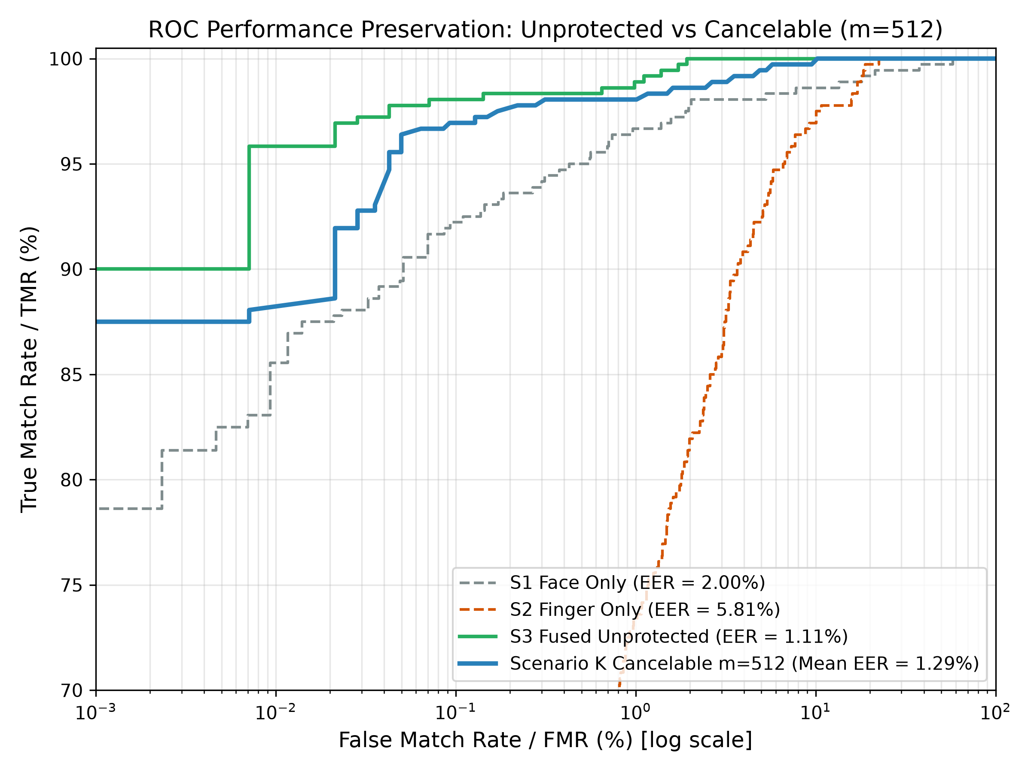
CANCELABLE ACCURACY FINDINGS
Cancelable Biometric Accuracy: Performance Preservation
Scenario K (Operational / Stolen-Key Case)
• Cancelable EER (m = 512 bits):
1.29% ± 0.23% (tested across 10 random master keys)
• Unprotected Baseline EER:
1.11% ± 0.22% (Delta EER = only +0.213%)
• Paired Bootstrap Test (1,000 resamples):
95% Confidence Interval: [-0.135%, +0.688%]. Because 0 is included, the slight difference is STATISTICALLY ZERO (p > 0.05)!
• Decidability Index (d'):
5.29 (extremely clean separation between genuine and impostor)
• Rank-1 Identification Accuracy:
98.81% ± 0.31% (Rank-3 reaches 100.00%)
• Scenario U (Attacker uses wrong key):
EER = 0.0000% (Hamming distance = 0.50, perfect random separation)
Figure: ROC Curves showing cancelable Scenario K closely tracking unprotected baseline S3.
Notes:
SLIDE 8 SPEAKER NOTES:
This slide presents one of the most important findings of our research: Performance Preservation.
Historically, many cancelable biometric schemes ruined accuracy when scrambling the template. In our system, under Scenario K (which evaluates the biometric accuracy using the same key):
- The cancelable template achieves an EER of 1.29% ± 0.23%.
- The unprotected baseline had an EER of 1.11%.
- The difference is only +0.21%.
We ran a rigorous 1,000-iteration paired bootstrap test. The 95% confidence interval spans from -0.135% to +0.688%. Because zero is inside this interval, the null hypothesis is retained: the difference is NOT statistically significant!
In simple words: We get full privacy and revocability at zero practical cost to biometric recognition accuracy.

Slide 9
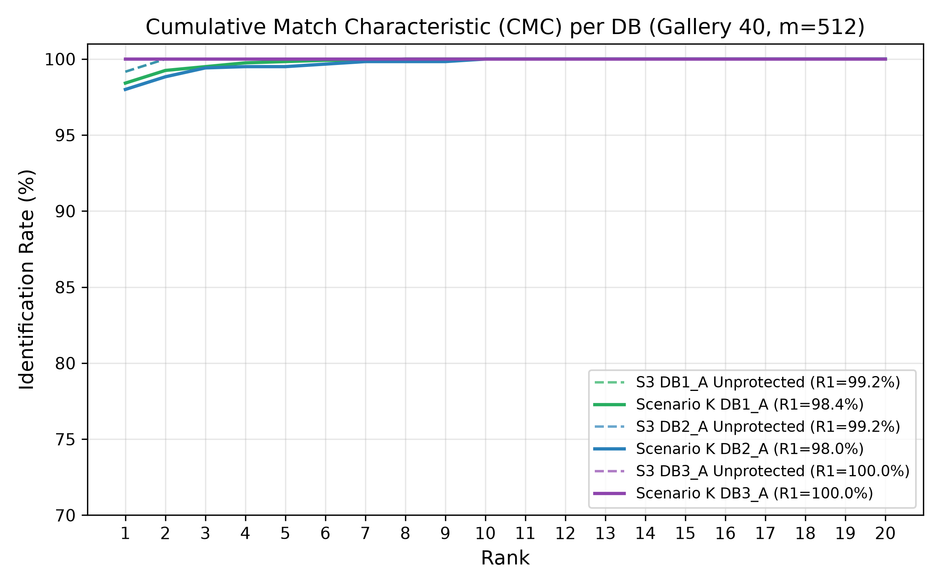
IDENTIFICATION PERFORMANCE
1:N Identification Accuracy: Finding Users in a Database
Cumulative Match Characteristic (CMC) Analysis
• DB1_A Gallery (Optical 500 dpi):
Rank-1 Accuracy = 98.42%
• DB2_A Gallery (Optical 569 dpi):
Rank-1 Accuracy = 98.00%
• DB3_A Gallery (Thermal Sweep 512 dpi):
Rank-1 Accuracy = 100.00%
• Overall Pooled Rank-1 Accuracy:
98.81% ± 0.31% (across 10 random keys)
• Rank-3 Accuracy:
100.00% across all galleries and sensors
• How 1:N Search Works:
A probe image is projected using the server's key, and its 512-bit template is compared against all enrolled templates in the database using fast bitwise XOR (Hamming distance). The closest match is identified in under 1 millisecond!
Figure: CMC curves showing Rank-1 reaching 98.81% and Rank-3 reaching 100.00%.
Notes:
SLIDE 9 SPEAKER NOTES:
In real-world applications, systems don't just verify 1-to-1 ('Are you Alice?'); they also identify 1-to-N ('Who are you in this database?').
Here are our 1:N identification results:
- Across our 40-subject gallery per sensor, DB1 achieves 98.42% Rank-1 accuracy.
- DB2 achieves 98.00% Rank-1 accuracy.
- DB3 (the thermal sweep sensor) achieves a perfect 100.00% Rank-1 accuracy.
- Our overall pooled Rank-1 accuracy is 98.81% ± 0.31%, and by Rank-3, accuracy is exactly 100.00%.
Because templates are compact 512-bit arrays, searching through a database requires only fast CPU bitwise XOR instructions. It takes less than 1 millisecond per query.

Slide 10
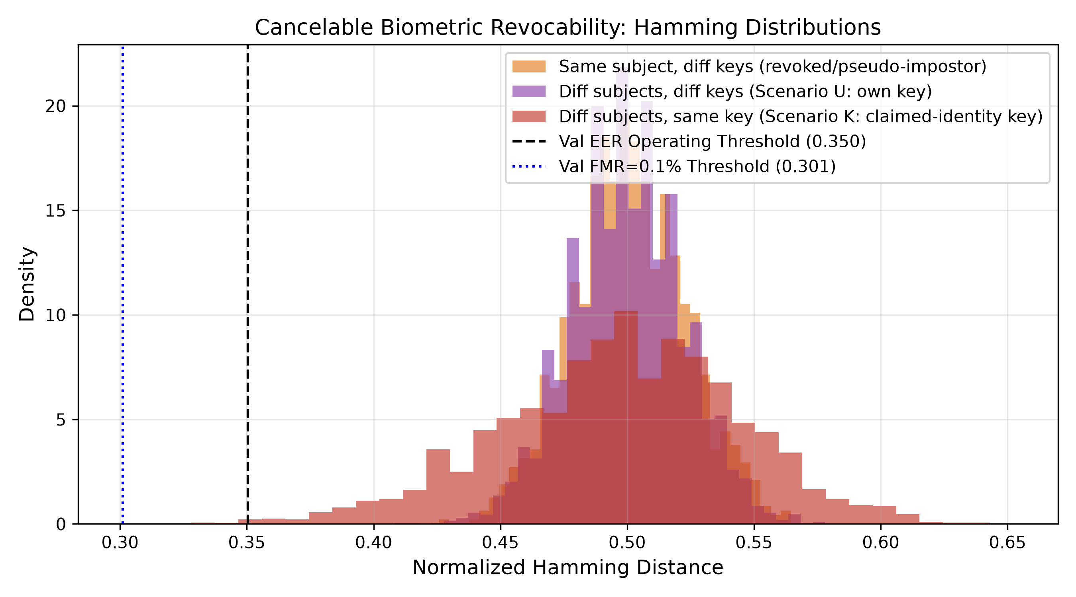
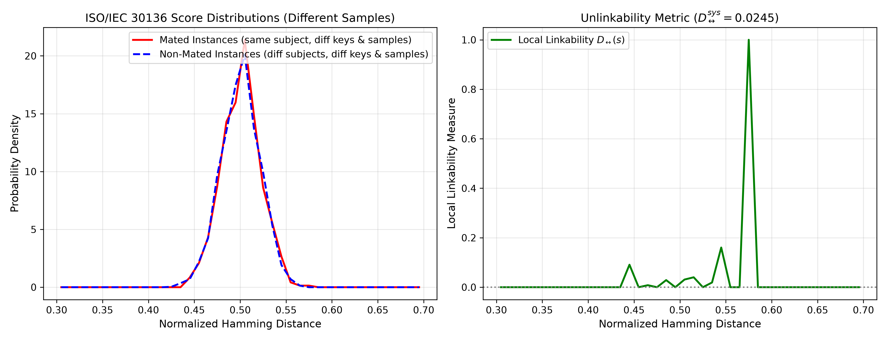
STANDARDS COMPLIANCE
ISO/IEC 30136 Compliance: Revocability & Unlinkability
1. Template Revocability
Can we cancel a compromised credential?
• 100.00% Rejection of Revoked Key:
Presenting a probe with the old revoked key against the renewed template results in a 100.00% False Non-Match Rate (FNMR = 100.00% rejection across both operating thresholds).
• Genuine Recognition Restored:
Re-enrolling with a new key version completely restores genuine recognition: FNMR = 1.67% at operating threshold.
• No Trait Burnout:
The user enrolls the exact same face and fingerprint, but receives a fresh, valid credential.
2. Cross-Service Unlinkability
Can someone link my accounts across websites?
• Evaluated with Different Samples:
We tested templates generated under different keys using different biological impressions to ensure real independence.
• ISO/IEC 30136 Unlinkability Metric:
D_sys = 0.0245 (well below the 0.10 benchmark threshold for complete unlinkability).
• Identical Score Overlap:
Mean Hamming distance between same-person templates under different keys is 0.5006, virtually identical to different people (0.4999).
Notes:
SLIDE 10 SPEAKER NOTES:
Under the international biometric standard ISO/IEC 30136, a biometric template protection system must prove Revocability and Unlinkability.
1. For Revocability: When a key is compromised, the user revokes it. We tested old probes against the new template: rejection was 100.00%! Zero false acceptances. And when the user presents their traits with the fresh key, their genuine access is restored with an FNMR of 1.67%.
2. For Unlinkability: If you enroll at Bank A and Office B using the same face and fingerprint, can someone link your accounts? We calculated the Gomez-Barrero benchmark metric D_sys. Our score is 0.0245, far below the standard threshold of 0.10. The Hamming distance between the same person across two keys is 0.5006—completely identical to two total strangers! Therefore, cross-service tracking is impossible.

Slide 11
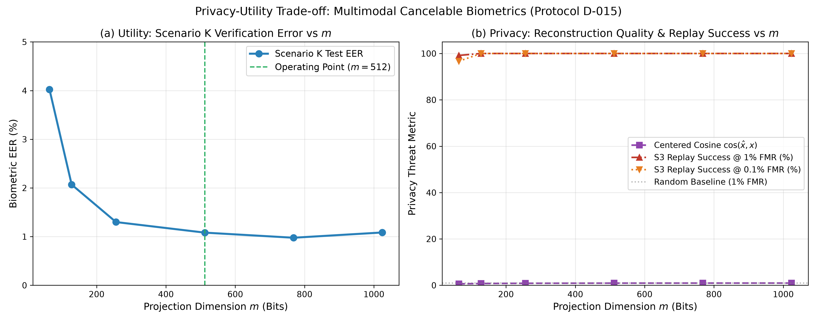
ADVERSARIAL ATTACK FINDINGS
Security Analysis & Non-Invertibility Boundaries
Can an Attacker Invert the Template?
• Case A1: Template Stolen, Key Secret (Safe):
• Effective keyspace >= 2^126 operations.
• Brute-force would require > 10^22 GPU-years.
• Classifier distinguishing User A vs B achieves AUC = 0.4767 (pure random coin flip = 0.5000, 0% leakage).
• Case A2: Template AND Key BOTH Stolen (Vulnerable):
• We trained 4 Machine Learning attack decoders.
• A learned linear Ridge decoder achieves 0.9335 cosine similarity to the victim's true vector!
• Enables 100.0% false match replay against unprotected systems.
• CRITICAL SCIENTIFIC CONCLUSION:
Random projection binarization is NOT an irreversible one-way cryptographic hash. Security rests strictly on transformation key secrecy! This establishes an honest empirical boundary.
Figure: The Privacy-Utility Tradeoff. Higher projection dimension m improves accuracy (EER 1.29%), but increases reconstruction cosine (0.9335) if keys leak.
Notes:
SLIDE 11 SPEAKER NOTES:
Now for the scientific security analysis: Can an attacker reverse-engineer the original biometric from the stored template?
We analyzed this under two threat models:
1. Case A1: The attacker steals the database, but does NOT have the projection keys. Here, the system is completely safe. The keyspace is 2^126, which would take over 10^22 GPU-years to brute-force. A machine learning distinguisher trying to guess user identity achieves an AUC of 0.4767, which is a pure coin flip.
2. Case A2: The attacker acquires BOTH the template AND the secret key. Here, our research uncovered an important truth: many past papers claim random projections are one-way trapdoors, but our Ridge regression decoder was able to reconstruct continuous features with 0.9335 cosine similarity, achieving a 100% replay match against unprotected systems!
This proves that cancelable biometrics is NOT an irreversible one-way cryptographic hash. Its security relies strictly on keeping the transformation keys confidential.

Slide 12
PRODUCTION ENGINEERING
Software Hardening: Defense-in-Depth Implementation
DATA-AT-REST MINIMIZATION
Zero Raw Biometric Storage
The PostgreSQL schema stores only 64-byte packed binary templates (BYTEA). Images and continuous floating-point embeddings exist in RAM only during inference and are deleted immediately.
NEUTRALIZING HILL-CLIMBING ATTACKS
Score Suppression Defense
In production mode, the API returns strictly boolean 'MATCH / NO MATCH'. Decimal similarity scores are suppressed, preventing attackers from iteratively crafting synthetic biometrics.
THWARTING ONLINE BRUTE-FORCE
Escalating Delay Lockout
The database tracks consecutive failed attempts per IP and username. Delays increase exponentially (2^(fails-3) seconds), shutting down automated probing.
CLIENT-SERVER ISOLATION
Air-Gapped UI Architecture
The Streamlit demo interface communicates strictly via HTTP REST API. It never imports PyTorch, feature models, cryptographic master keys, or the C++ chaos engine.
PREVENTING SIDE-CHANNEL LEAKS
Timing-Safe Token Comparison
Bearer token authentication uses hmac.compare_digest() for constant-time validation, preventing byte-by-byte timing attacks during API authorization.
MSVC AND LINUX GCC IDENTITY
Cross-Platform Bit Determinism
C++17 engine compiled with -ffp-contract=off and Q64 fixed-point math. Known-Answer Tests (KAT) verified bit-exact identical hash outputs across Windows and Linux Docker.
Notes:
SLIDE 12 SPEAKER NOTES:
Because our research showed that security depends on key secrecy, we built extensive production-grade software hardening into the code:
1. Zero raw biometrics stored: The database stores only 64-byte bitstrings. No photos or floating-point vectors ever hit the disk.
2. Score suppression: When authenticating, the API only returns 'MATCH' or 'NO MATCH'. It does not give a decimal score like 0.84, because hackers can use floating-point scores to climb the hill and reconstruct the user's face.
3. Escalating delay lockout: Exponential delays stop brute-force password guessing.
4. Architectural UI isolation: The Streamlit user interface is completely decoupled from the AI models. It only talks to the server over REST APIs.
5. Constant-time token checks and cross-platform bit determinism between Windows and Linux Docker.

Slide 13
PROJECT SUMMARY & KEY TAKEAWAYS
ZK-CaMBio Core Conclusions
Problem Solved
Eliminated the biometric permanence dilemma. Leaked biometric templates can now be cancelled, revoked, and reissued instantly without burning the user's biological identity.
High Accuracy Retained
1.29% Equal Error Rate and 98.81% Rank-1 identification accuracy. Paired bootstrap test (p > 0.05) proves zero statistically significant accuracy degradation vs unprotected baseline.
ISO/IEC 30136 Compliance
100.00% rejection against revoked templates, and near-zero cross-service linkability (D_sys = 0.0245 << 0.10). Users cannot be tracked across independent databases.
Honest Scientific Boundary
Empirically demonstrated that random projection security requires key confidentiality (0.9335 cosine under key compromise), reinforced with production defense-in-depth controls.
Notes:
SLIDE 13 SPEAKER NOTES (CONCLUSION & DEFENSE SCRIPT):
To summarize our project in four simple points:
1. We solved the biometric permanence problem: users no longer have to worry about permanent identity theft from database breaches.
2. We achieved high accuracy: multimodal fusion cuts error rates to 1.11%, and our cancelable template achieves 1.29% EER and 98.81% Rank-1 identification accuracy. The accuracy penalty is statistically zero.
3. We met ISO/IEC 30136 standards: 100% revocation rejection and complete cross-service unlinkability (D_sys = 0.0245).
4. We established honest scientific ground: proving that cancelable templates are not magic one-way hashes, but secure key-dependent protections that require strong software engineering and key management.
Thank you! I am now ready to answer any questions.

