Slide 1


TEAM
Nothing
UNO-VATE’24
Theme: Automation with IoT
Team Members:
Parth Kale
Rudransh Garewal
College - SRMKTR

Slide 2

Nothing
About
Us
We are first-year Electronics and Computer Engineering students at SRM Kattankulathur. Our program blends hardware and software, preparing us for innovative problem-solving. We're excited to learn and contribute to future technological advancements.

Slide 3


Nothing
Problem Statement
It is a Real-Time Stock and Inventory Management System, functioning as a smart container that measures articles in real-time, ensuring accurate tracking and monitoring of items.

Slide 4

Nothing
Abstract
The project is IoT-based grocery and inventory management system that integrates hardware and software to provide real-time inventory tracking. This system allows users to remotely check the stock in their containers and receive notifications when items are low.

Slide 5


Nothing
Introduction
The project is designed to provide just-in-time inventory updates, it transforms ordinary containers into intelligent devices capable of tracking stock levels and streamlining grocery purchases. The project will notify users when items are running low. The project comprises both hardware and software part. The hardware includes a smart plate that can be attached to any container, enabling it to measure weight and monitor contents in real-time. The software component features a mobile application that allows users to remotely track inventory and receive alerts.

Slide 6

Nothing
Methodology
Sensor reading from load cell will be amplified hx711 amplifier. This data will be read my arduino and displayed on a display in addition to this the sensor data will be send to firebase server with the help of wifi module. The mobile application will fetch the data from firebase server and display. The data is weight of the articles stored in that particular box.

Slide 7
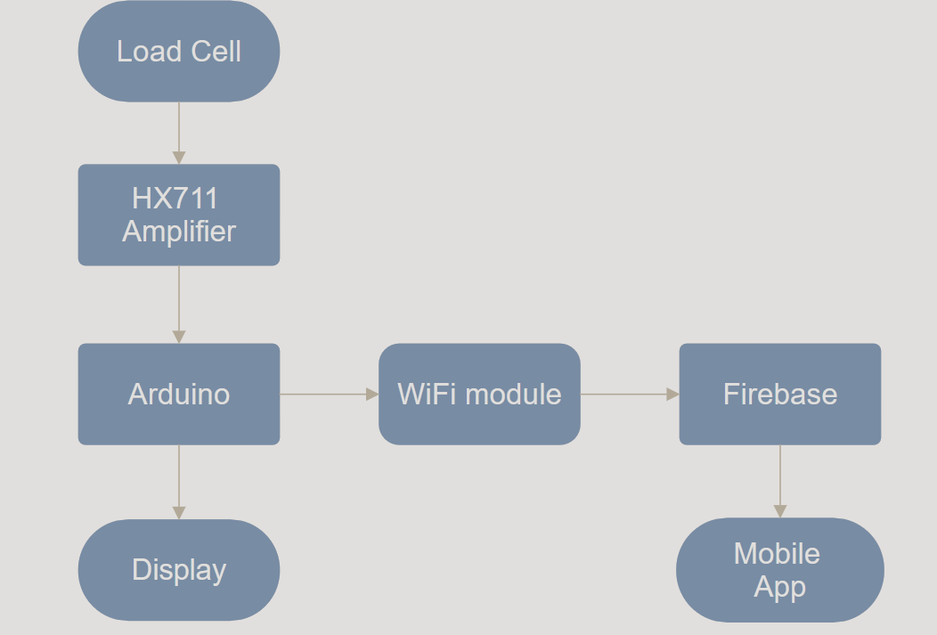
Nothing
Diagrams/Flowcharts

Slide 8

Nothing
Hardware
The hardware setup consists of an OLED display, load cells for precise weight measurement, and an ESP8266 microcontroller for wireless connectivity. It also includes essential components like a switch, Wi-Fi module for real-time data transmission, and a battery for portable power.

Slide 9


Nothing
Software
We developed a web app that interfaces with Firebase to fetch data from our custom hardware setup. The hardware, which we also programmed, includes components like load cells and an ESP8266. This system allows us to monitor and manage data in real time through the web application.

Slide 10
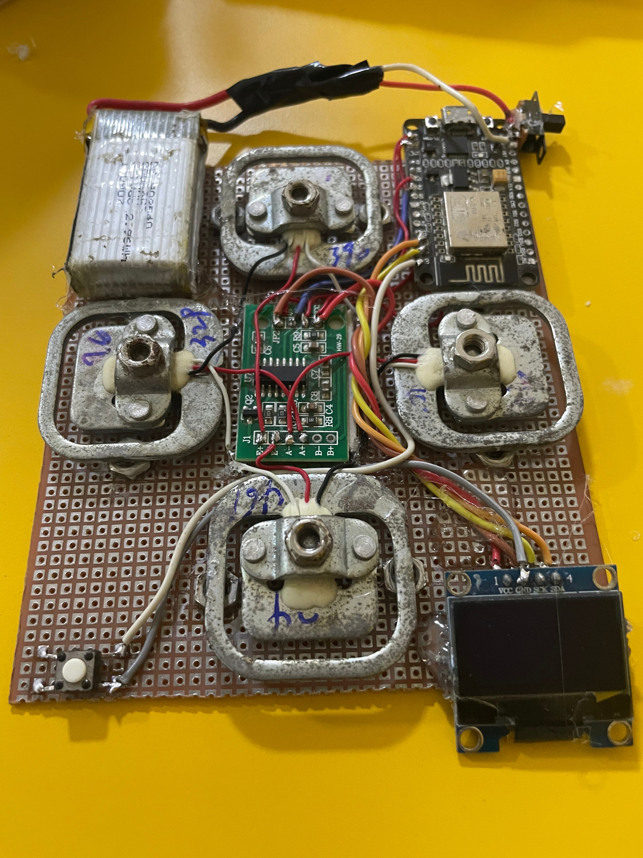
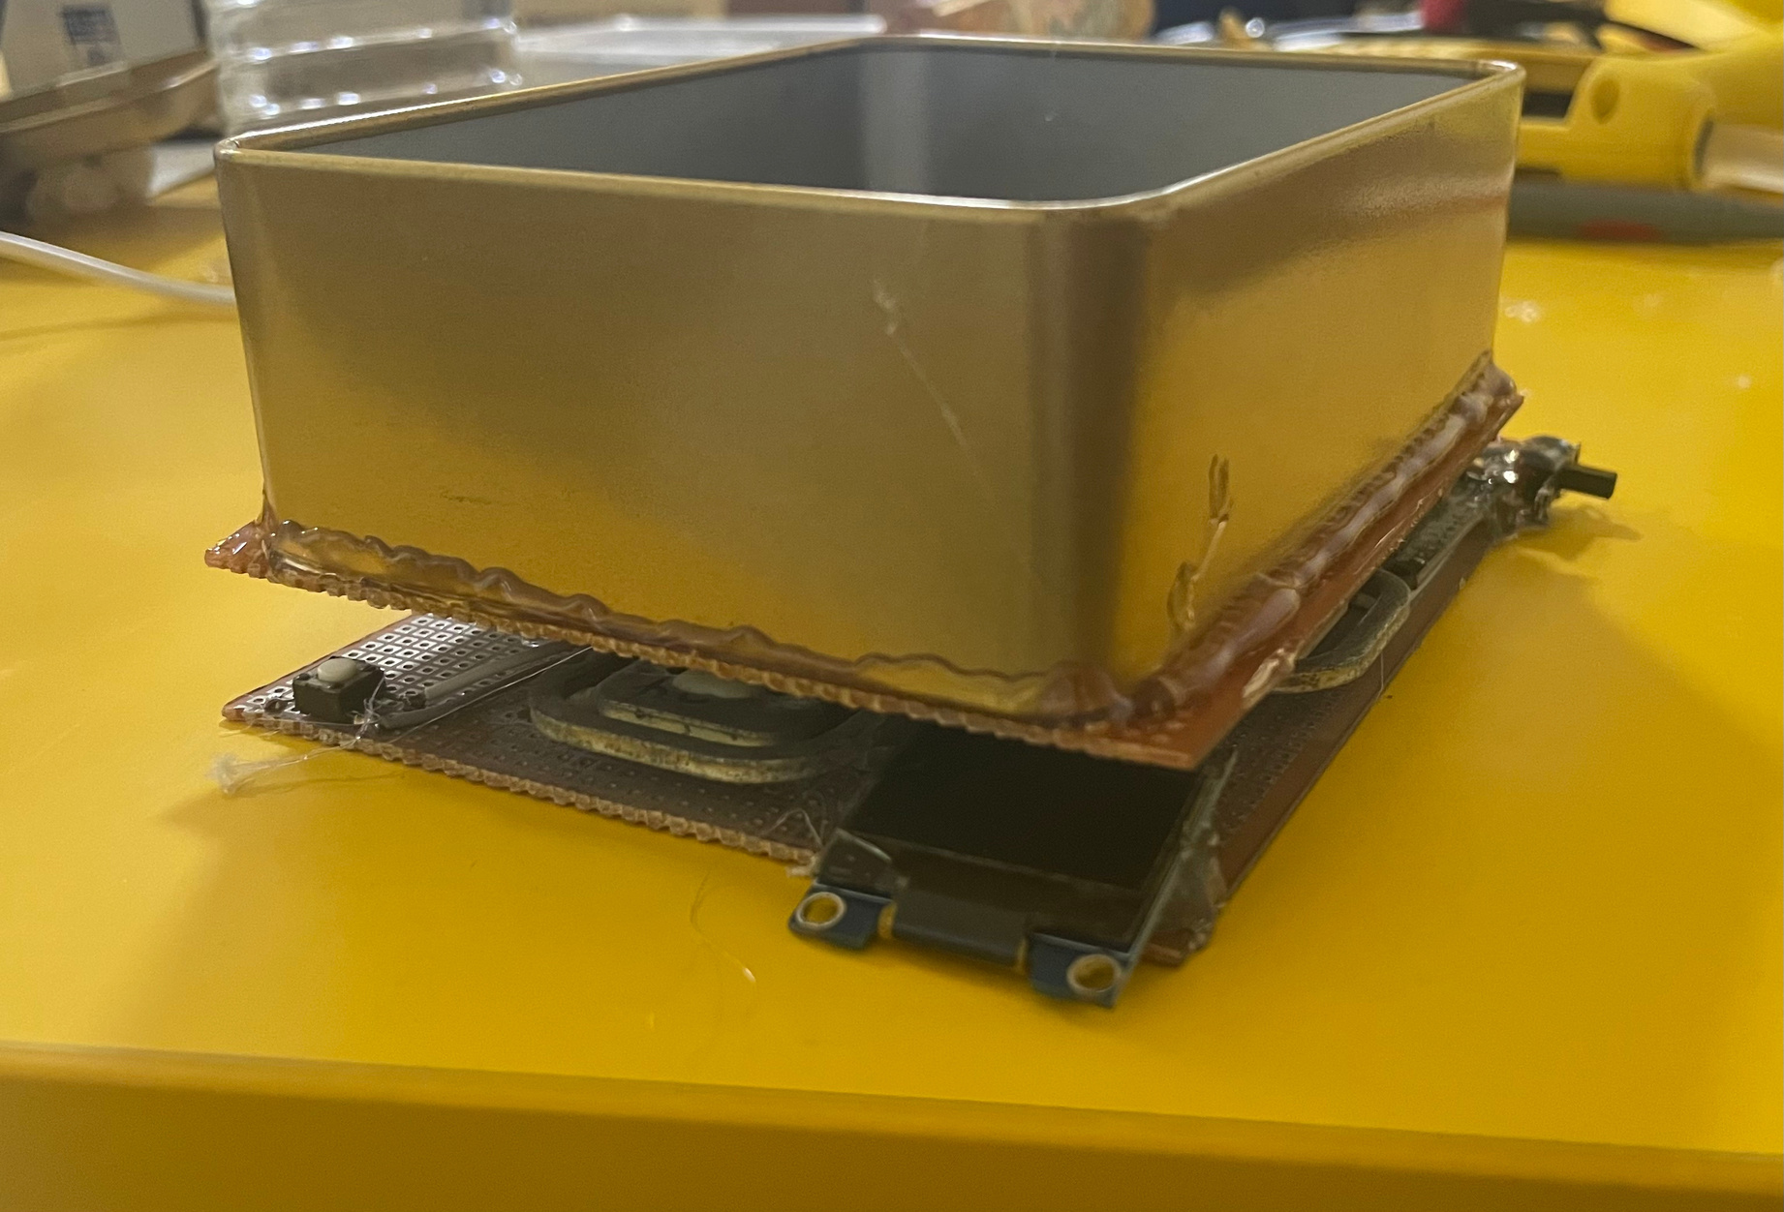
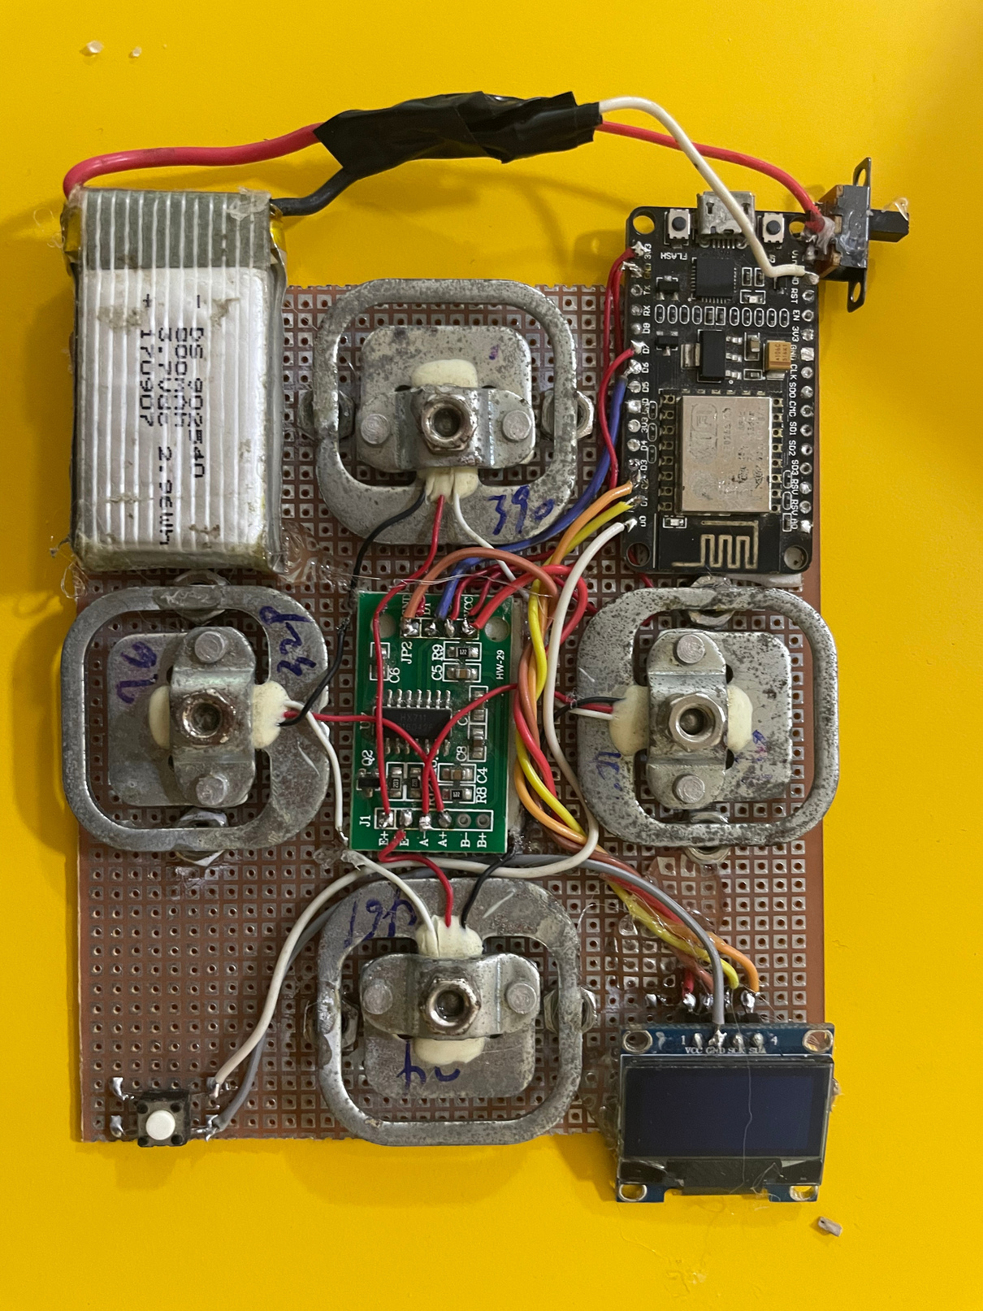

Slide 11

NOTHING
But
Something

Slide 12
thank
you

