Slide 1

SMART INDIA HACKATHON 2026
Problem Statement ID – SIH26132
Problem Statement Title- Strengthening Market
Linkage And Price Discovery For Farmers.
Theme - Agriculture, Food Tech And Rural Development
PS Category- Software
Team ID-
Team Name - MarketMinds

Slide 2
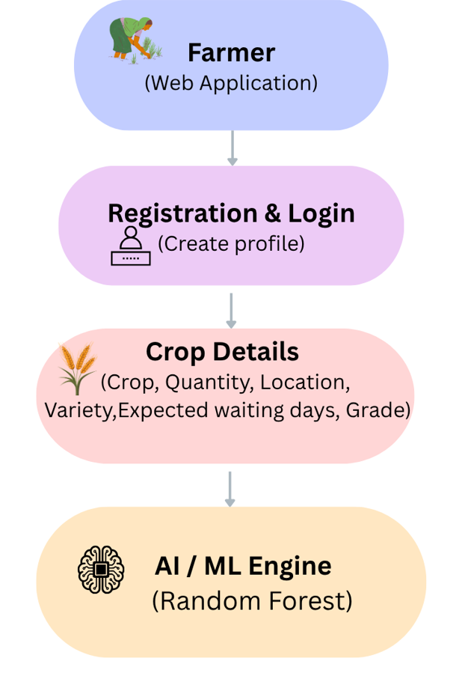
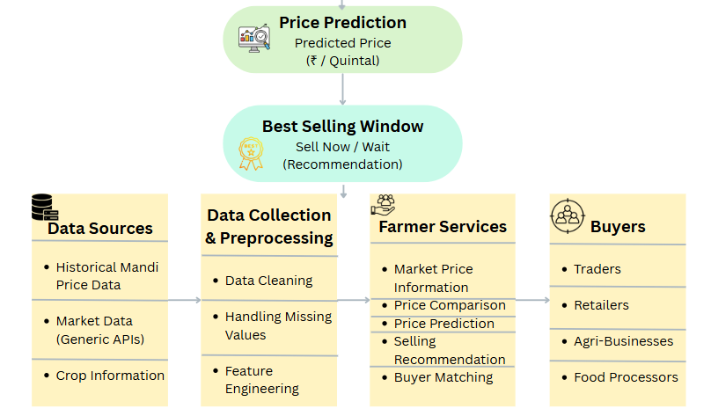
AI-Powered Agricultural Market Intelligence &
Price Discovery
MarketMinds
Real-world issue: Farmers often lack easy access to updated market information and struggle to choose the right market, selling time, and buyer.
Risk
VS
Solution
Price Information Gap
Market Price Discovery
Wrong Market Selection
Net Return Comparison
Why Important: Price differences, transport and storage costs, changing prices, buyer requirements, and small quantities can reduce farmers actual returns.
time, and buyer.
Uncertain Selling Time
AI Price Prediction
Solution: AI-powered platform compares markets, predicts prices, estimates expected net returns, matches buyers, and supports FPO aggregation.
Limited Buyer Access
Buyer Matching & FPO Aggregation
Prototype
Website

Slide 3
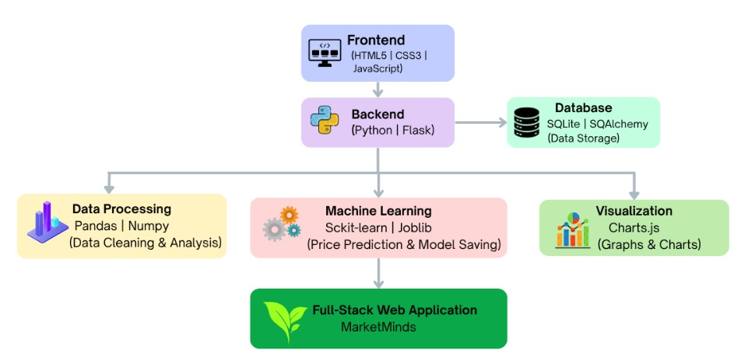
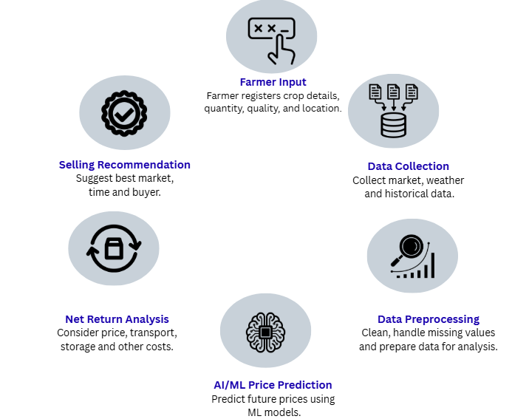
TECHNICAL APPROACH
Market
Minds
METHODOLOGY & PROCESS OF
IMPLEMENTATION
TECHNICAL ARCHITECTURE & WORKFLOW
1
6
2
5
3
4
GitHub

Slide 4
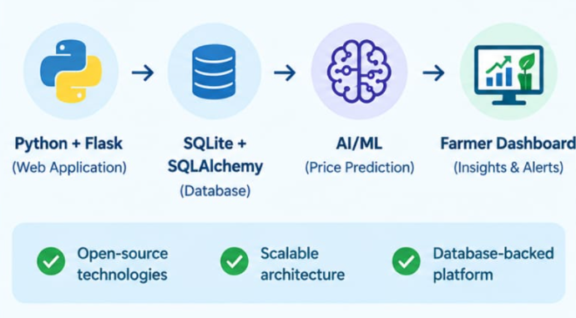
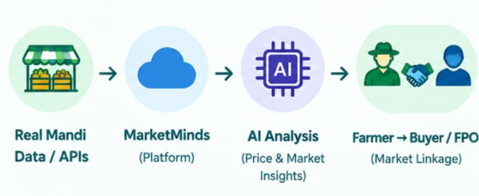
FEASIBILITY AND VIABILITY
Market
Minds
⚖️ FEASIBILITY
Technical: Can be developed using Python, Flask, HTML, CSS, JavaScript and Scikit-learn.
Data Availability: Agricultural market-price datasets are readily available for model training.
Cost Effective: Uses open-source technologies, keeping development costs low.
🤝 VIABILITY
Farmer-Centric: Helps farmers compare markets and make informed selling decisions.
Better Price Discovery: AI-based predictions can provide useful insights into expected crop prices.
Market Linkage: Connects farmers with suitable buyers and facilitates better offers.
Scalable: Can be expanded with real-time market APIs, logistics, digital payments and multilingual support.

Slide 5
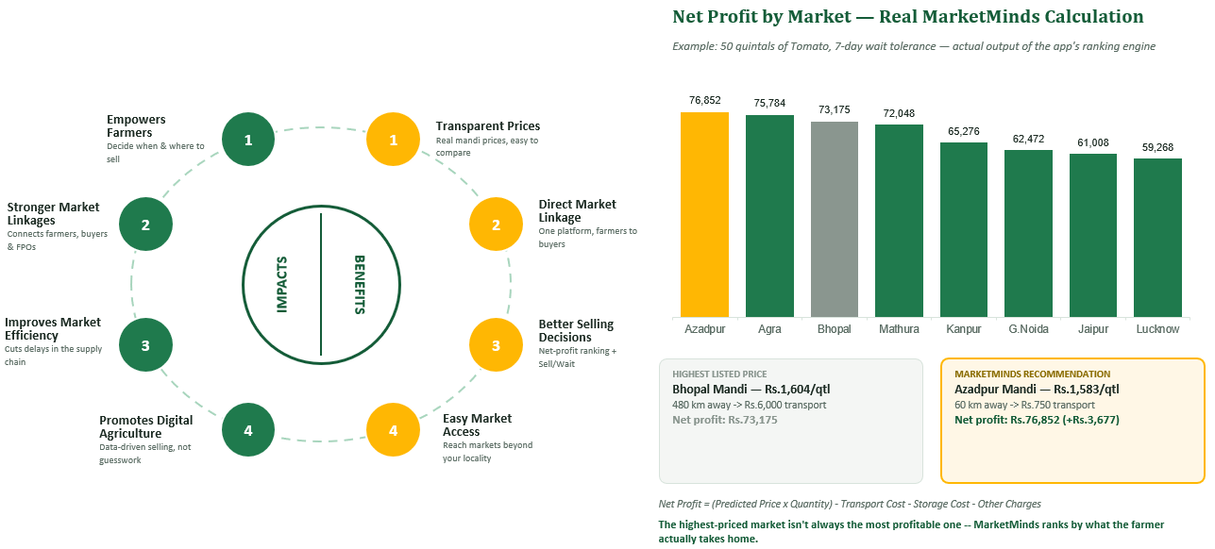
IMPACT AND BENEFITS
Market
Minds

Slide 6
Market
Minds
RESEARCH AND REFERENCES
Official govt. platform for agri trade
Live mandi arrivals & prices
Real-time price discovery
National mandi price database
Proof: real-time prices help farmers
e-NAM
Official Website
e-NAM
Dashboard
e-NAM
LivePrice Info
AGMARKNET
Govt. of India
PIB
e-NAM Empowers Farmers
enam.gov.in
enam.gov.in/dashboard
LivePrice Info
india.gov.in
pib.gov.in
RESEARCH FOCUS
1. Problem Understanding & Gap Analysis
Farmers lack real-time price access, mandi price gaps hurt bargaining power and direct buyer links are limited.
2. Market Data Analysis
Studied mandi price, arrivals & commodity data, transport cost and market demand shape selling decisions.
3. Existing Platform Study
Studied e-NAM for digital agri trading and AGMARKNET 2.0 for real-time mandi price & arrival information.
4. Technology Research
AI/ML can analyze historical prices & trends, APIs enable live data, mobile-first improves farmer accessibility.
6

