Slide 1
RUDRARAJU BHAVANA
Deep Learning Using CNN
3/21/2024 Annual Review

Slide 2
PROJECT TITLE
BLOG GENERATOR USING GAN
The project utilizes Streamlit and LangChain to develop a user-friendly interface for generating blog content using OpenAI's language model.
Users provide an idea for a blog article and select parameters such as tone, writing style, and complexity level through the Streamlit interface.
LangChain facilitates communication with OpenAI's language model, enabling the system to generate blog content based on user input.
The system gracefully handles errors, such as API timeouts, providing informative warnings and guidance to users for adjusting input parameters.
The generated blog content, tailored to the user's specifications, is displayed through the Streamlit interface, empowering users with a seamless and efficient content creation tool.
3/21/2024 Annual Review

Slide 3


AGENDA
Problem Statement
Project Overview
End users
Solution and its Value Proposition
The Wow in a Solution
Modelling
Results
3/21/2024 Annual Review

Slide 4

PROBLEM STATEMENT
The objective of this project is to create a blog generator utilizing Generative Adversarial Networks (GANs) to streamline and automate the generation of diverse and captivating blog content. By leveraging the capabilities of GANs, we aim to develop a system capable of producing high-quality blog articles across various topics and writing styles, catering to the needs of content creators and businesses seeking efficient content generation solutions.
3/21/2024 Annual Review

Slide 5

PROJECT OVERVIEW
This project aims to develop a user-friendly blog generator using Generative Adversarial Networks (GANs) to automate the creation of diverse and engaging blog content.
The system will allow users to input their desired topic, tone, and style preferences, and generate blog articles tailored to their specifications.
Key components include designing a GAN architecture for text generation, curating and preprocessing a dataset of blog articles, training the model on the dataset, developing a simple and intuitive user interface.
The project seeks to provide a seamless solution for individuals and businesses seeking efficient content generation methods for their blogs.
3/21/2024 Annual Review

Slide 6

WHO ARE THE END USERS?
Bloggers and Content Creators: Individuals who regularly publish content on blogs or websites and are looking for a tool to assist them in generating engaging articles.
Small Businesses and Startups: Companies with limited resources for content creation, such as small businesses and startups,
Marketing Agencies: Marketing agencies tasked with managing multiple clients' blogs may find a blog generator useful for quickly generating content tailored to each client's requirements and preferences.
Educational Institutions: Schools, colleges, and universities may use a blog generator to create educational content for their websites, student portals, or e-learning platforms.
Researchers and Writers: Researchers and writers who need to generate sample text for experiments, testing, or training purposes may also find a blog generator valuable.
3/21/2024 Annual Review

Slide 7
SOLUTION:
The solution is a GAN-based blog generator that allows users to input their preferences and generate customized blog articles automatically, catering to bloggers, businesses, and content creators seeking efficient content generation methods.
VALUE PROPOSITION:
1. Precision: Ensures accurate and tailored blog content generation for each user‘s needs.
2. Efficiency: Streamlines content creation processes, saving time and resources.
3. Versatility: Adaptable to diverse user preferences and industry
requirements.
4. Automation: Simplifies blog content creation, reducing manual effort and
increasing productivity.
5. Accessibility: Democratizes access to advanced content generation technology for all users.
3/21/2024 Annual Review

Slide 8

THE WOW IN YOUR SOLUTION
Cutting-Edge Technology: Our solution leverages GANs, revolutionizing content creation by generating diverse blog articles automatically.
Personalized Content: Users input preferences for topics, tones, and styles, receiving tailored blog content without the need for manual writing.
Time and Resource Efficiency: By automating content generation, our solution saves users valuable time and resources typically spent on writing and editing.
Wide Applicability: From individual bloggers to businesses and educational institutions, our solution serves a diverse range of users across various industries.
Seamless User Experience: With an intuitive interface, our solution offers a hassle-free and enjoyable content creation experience for users of all backgrounds.
3/21/2024 Annual Review

Slide 9
MODELLING
Data Collection: Gather a diverse dataset of blog articles covering various topics and styles, ensuring representation across different domains and writing formats.
Preprocessing: Clean and preprocess the dataset, including tasks such as tokenization, normalization, and removing irrelevant information or noise from the text.
Model Selection: Choose an appropriate GAN architecture for text generation tasks, considering factors such as model complexity, training speed, and compatibility with the dataset size.
Training: Train the selected GAN model on the preprocessed dataset, optimizing hyperparameters and adjusting training strategies to achieve the desired performance.
3/21/2024 Annual Review

Slide 10
Evaluation: Evaluate the trained model using metrics such as perplexity, BLEU score, or human evaluation to assess the quality and coherence of the generated text.
Fine-Tuning: Fine-tune the model based on evaluation results and user feedback, iteratively improving its performance and generating more realistic and diverse blog content.
Deployment: Deploy the trained model to a production environment, integrating it with the user interface and ensuring scalability and reliability for real-world usage.

Slide 11
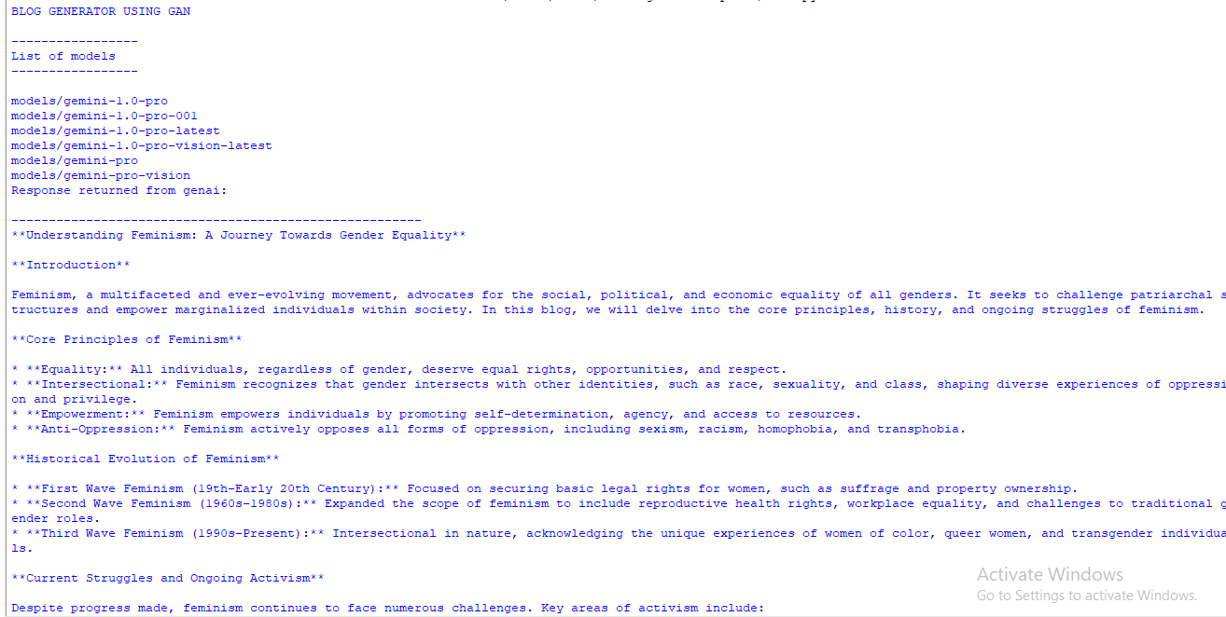
RESULTS
3/21/2024 Annual Review

Slide 12
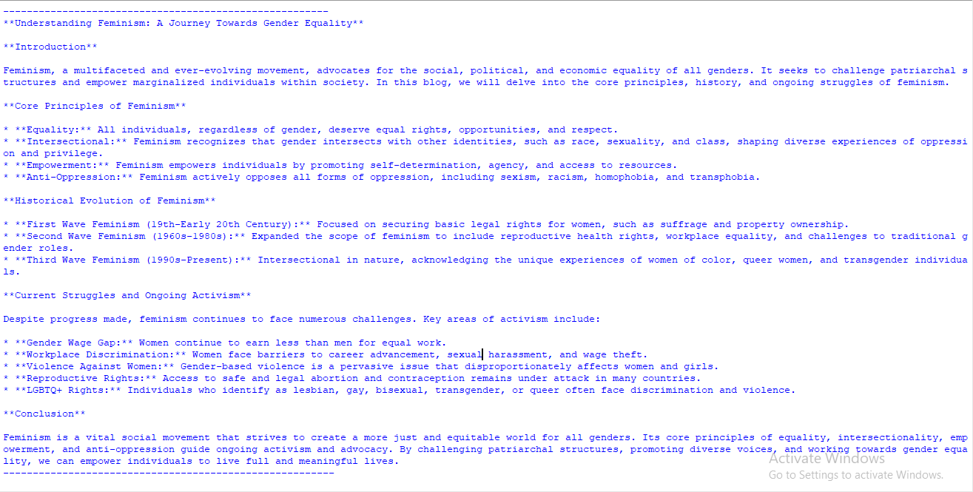
DEMO LINK: https://drive.google.com/file/d/1jQI6MI8bnCDhMOPfymwUevn21YfAc0m1/view?usp=sharing

