Slide 1
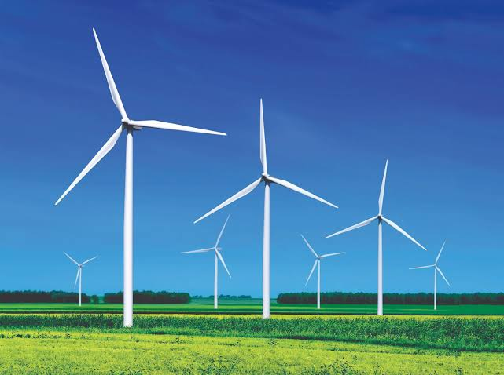

Bangladesh University Of Engineering & Technology
Department Of Electrical & Electronic Engineering
EEE 306
Project Presentation On
Wind Power Plant Simulation Using Simulink
Level-3 Term-1
Submitted by-
K.M. Zulfikar Sadik
Rudra Roy
Tanjima Tabassum Shoshi
Farhat Yesmin Prio
Yeasmin Jahan Rima

Slide 2
Objectives
Making a wind turbine model (Induction Generator Type) using Simulink.
Varying the wind speed to observe the change in different characteristics of the turbine such as Power, Torque, Efficiency etc.
Plotting the various characteristics with varying speed.
Finding the maximum efficiency which can be extracted from the turbine (Betz limit).

Slide 3
Introduction
What is Wind power?
- The use of wind to provide mechanical power through wind turbines to turn electric generators for electric power.
Why wind turbines?
-To harness this natural resource in the best possible way wind turbines are designed.
Most common type turbine
-All the wind turbines used today are usually horizontal-axis machines with 3 bladed rotor spinning in a vertical plane.

Slide 4
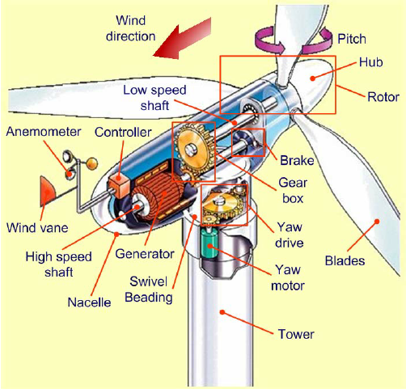
Internal Structure of a Wind Turbine:
Wind energy is used to rotate these blades
Converts kinetic energy of the wind into mechanical energy.
This mechanical energy is then converted to electrical energy using a generator.

Slide 5
Principal Components
Wind Turbine Induction Generator (Phasor Type) of 1.5 MW base power.
Three-Phase Grid and Three-Phase Transformer.
Capacitor Bank and Grounding Resistor.
Ramp Function.
VI measurement block and Power (Phasor) block.
Different blocks like gain, scope, display etc. for data visualization.
MATLAB function block for calculating efficiency.

Slide 6
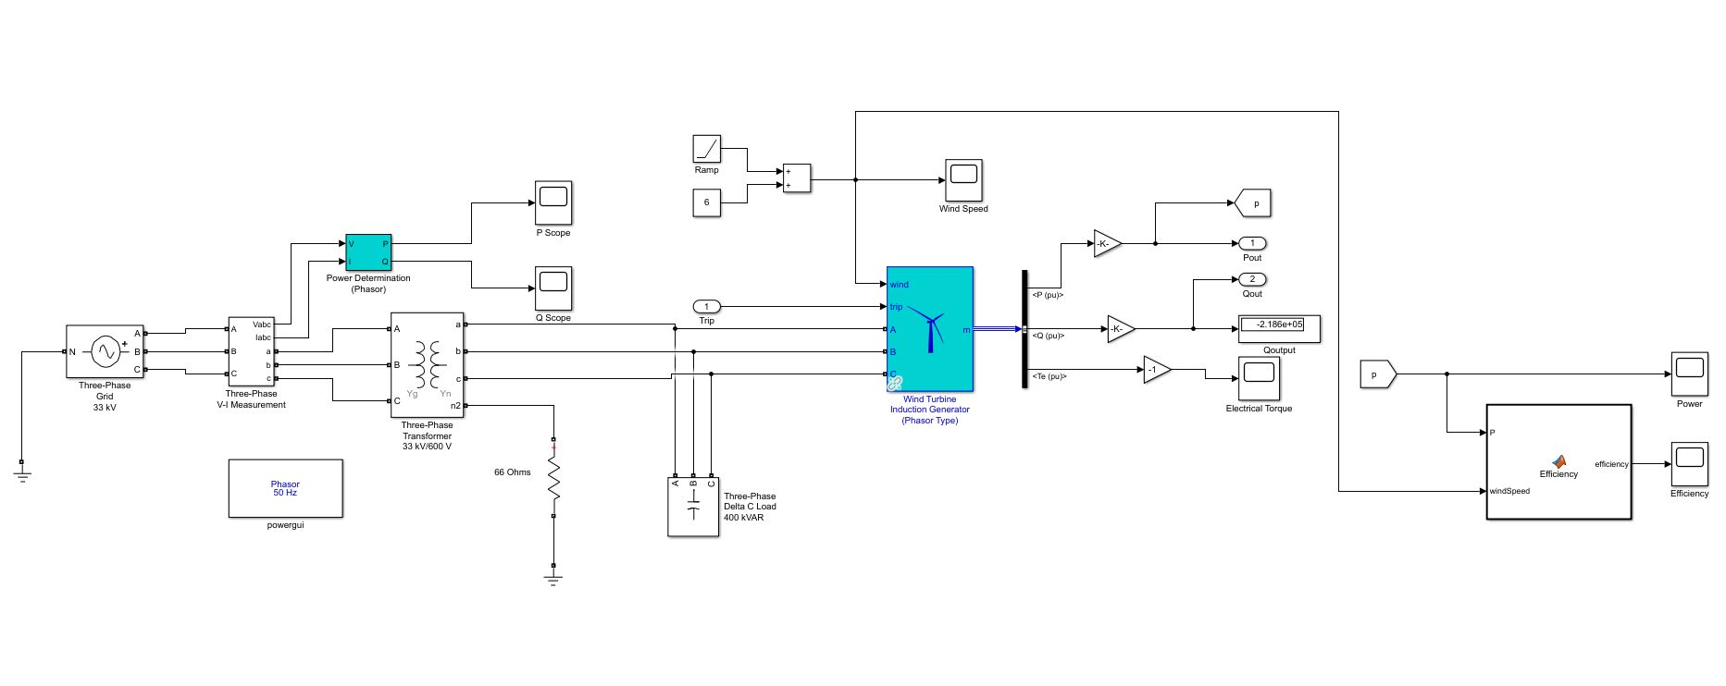
Simulink Model
Fig: Simulink Model of a 1.5 MW Wind Turbine Induction Generator

Slide 7
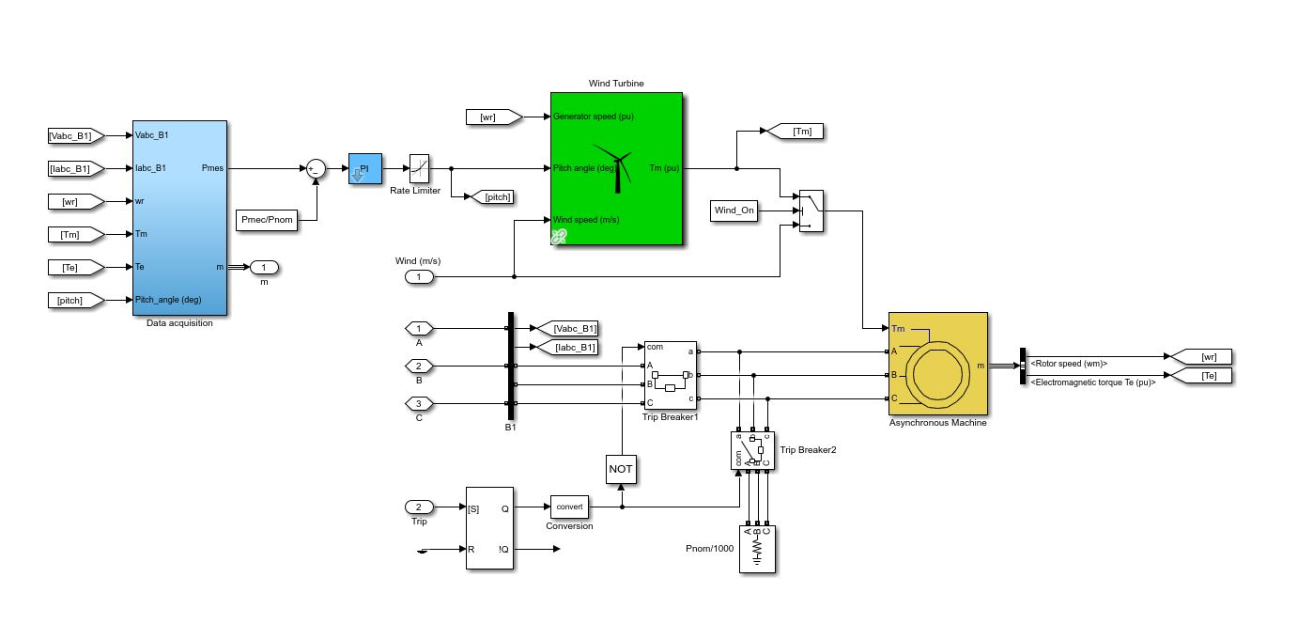
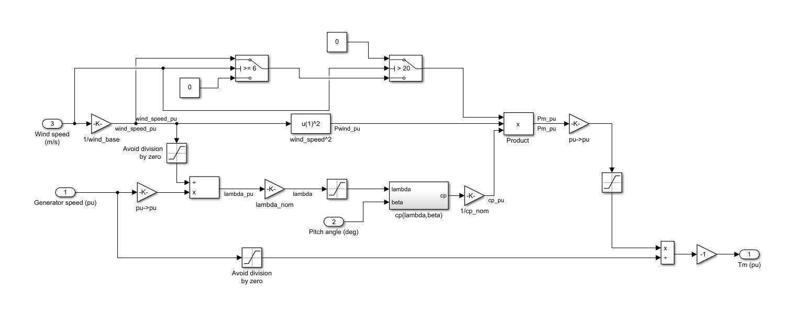
Inside Wind Turbine Induction Generator:
Inside Wind Turbine:

Slide 8
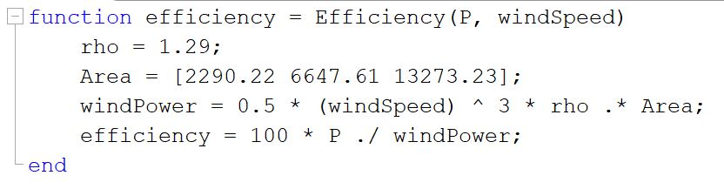
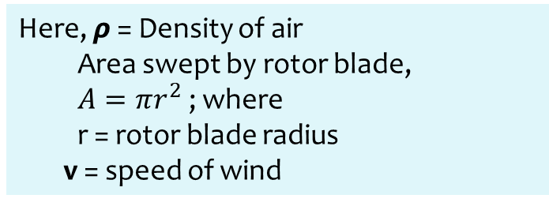



Mathematical Equations
Wind Power, $P_{w}= \frac{1}{2}ρAv^{3}$
Here, $ρ$ = Density of air
Area swept by rotor blade,
$A=πr^{2}$; where
r = rotor blade radius
v = speed of wind
Let, output electrical power = $P_{e}$
Efficiency = $\frac{P_{e}}{P_{w}}$
*Maximum achievable efficiency from a wind turbine is 59.3 % which is known as Betz Limit
MATLAB Function to calculate efficiency for different rotor-swept areas

Slide 9
Workflow
Creating Simulink Model Of Wind Turbine
Varying speed and creating logic for cut-in and cut-out speeds of turbine.
Building MATLAB function to calculate efficiency
Finding limitations and ways to improve the model
Comparing output graphs with theoretical knowledge
Plotting real power vs time graph, efficiency vs time graph and other graphs

Slide 10
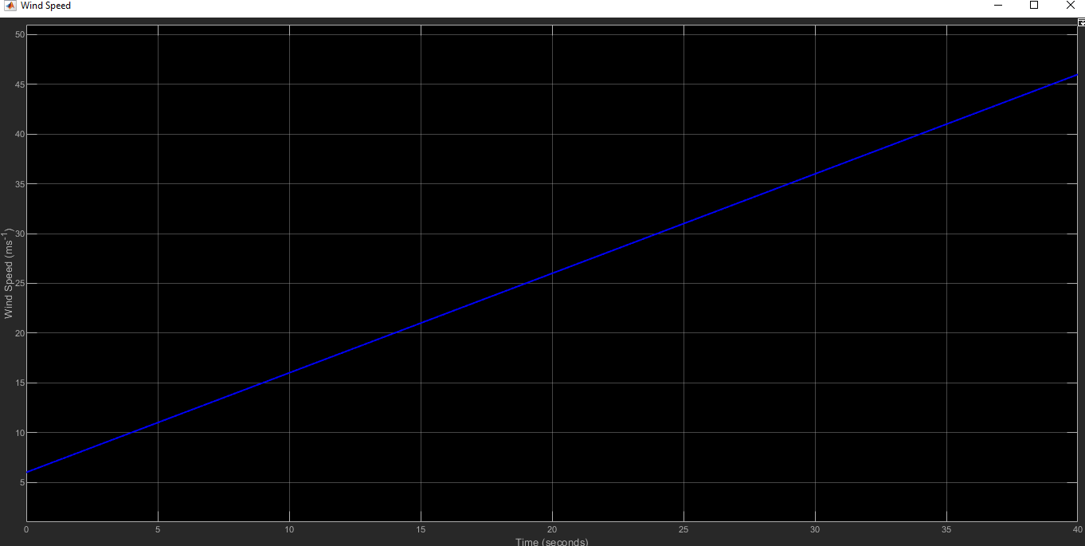
Windspeed vs Time graph

Slide 11
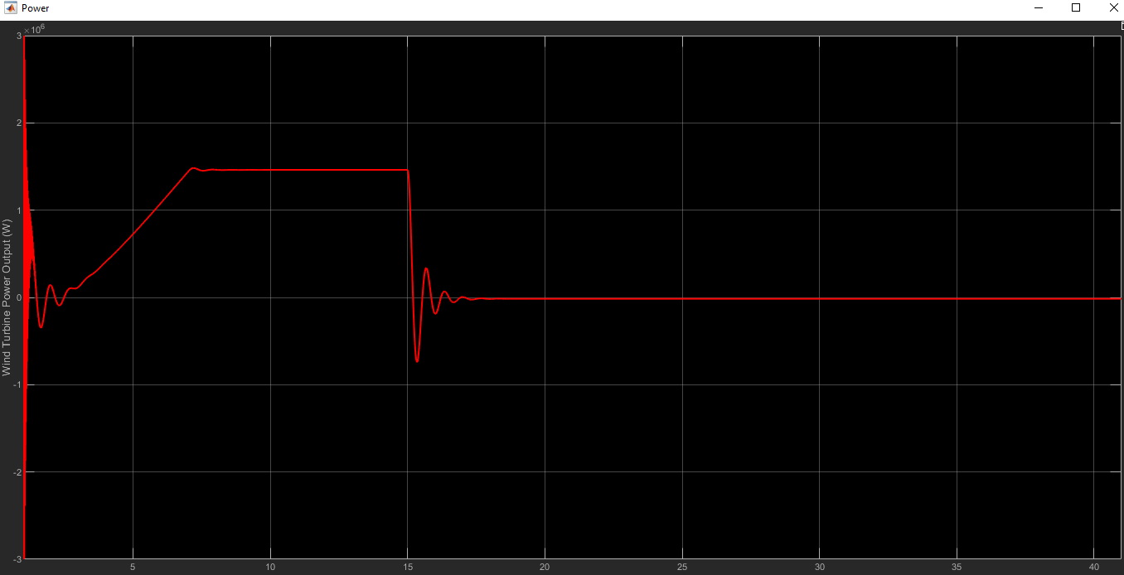
Real Power vs Time graph

Slide 12
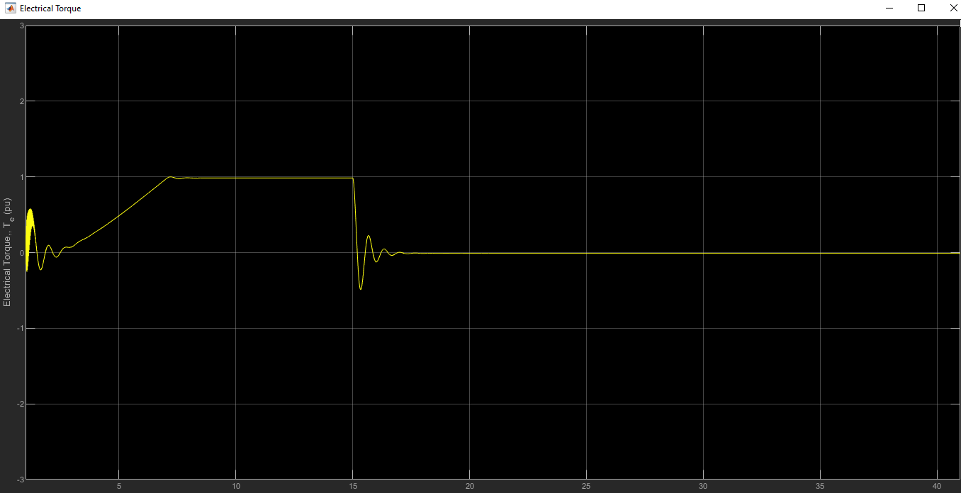
Electric Torque graph

Slide 13
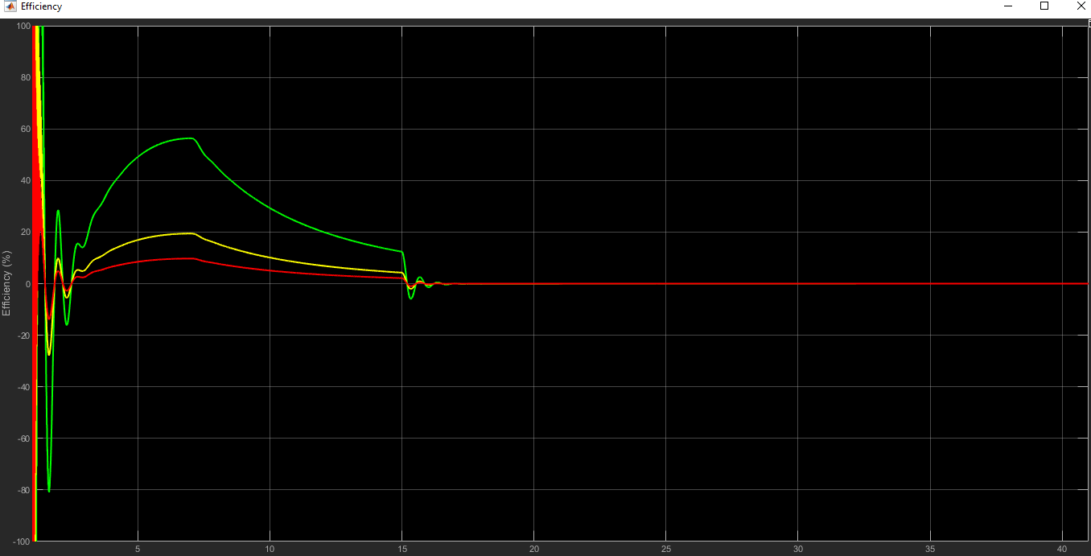
Efficiency graph

Slide 14
Limitations of the project
A plant protection unit for the system has not been integrated in the model.
Some transient phases have been seen in the graphs which couldn’t be mitigated.
A rather simple grid model has been used to demonstrate the project.
How to control the plant in overloaded condition has not been projected.

Slide 15
Conclusion
Despite having some discrepancies with real-life wind turbine systems, our main objectives to observe different characteristics of a wind turbine with varying speed have been fulfilled. We observed our desired curves and matched them with our theoretical knowledge. A lot has been learnt by us about Simulink and Wind Systems by performing this project.

Slide 16


