Slide 1


End-to-End Analytics Pipeline
Data Engineering with Docker, DBT,SQL, Python
Presented By - Rudra Sharma
DATE – 24-04-2026

Slide 2

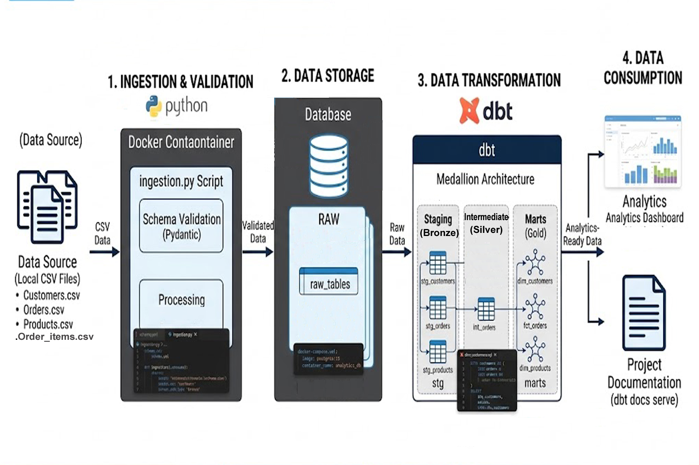
End-to-End Analytics Pipeline and Folder Architecture
dbt_project/ │ ├── data/ # CSV files │ ├── customers.csv │ ├── products.csv │ ├── orders.csv │ └── order_items.csv │ ├── ingestion.py
│ ├── models/ │ ├── staging/ # Bronze │ │ ├── stg_customers.sql │ │ ├── stg_products.sql │ │ ├── stg_orders.sql │ │ └── stg_order_items.sql │ │ ├── intermediate/ # Silver │ │ └── int_orders.sql │ │ ├── marts/ # Gold │ │ ├── dim_customers.sql │ │ ├── dim_products.sql │ │ └── fct_orders.sql │ │ └── schema.yml # tests │ ├── macros/ │ └── clean_string.sql │ ├── analyses/ │ └── analytics_queries.sql │ ├── dbt_project.yml ├── docker-compose.yml └── README.md

Slide 3

Data Pipeline Execution Flow
Step-by-Step Flow 4 CSV Files (Raw_Customers, Raw_ Orders, Raw_ Order_Items, Raw_ Products).
Ingestion (Python/Pydantic):
Python script reads CSV ➔ Field Validates Schema ➔ Loads into Dockerized Postgres.
Transformation (dbt):
Staging: Raw data cleaning order_stg etc.(Bronze layer)
Intermediate: Business logic and joins int_order. (Silver layer)
Marts: Analytics-ready fact and dimension tables dim_product,fact_order.(Gold layer)
Final View (Analytics):
Cleaned data ready for reporting.

Slide 4

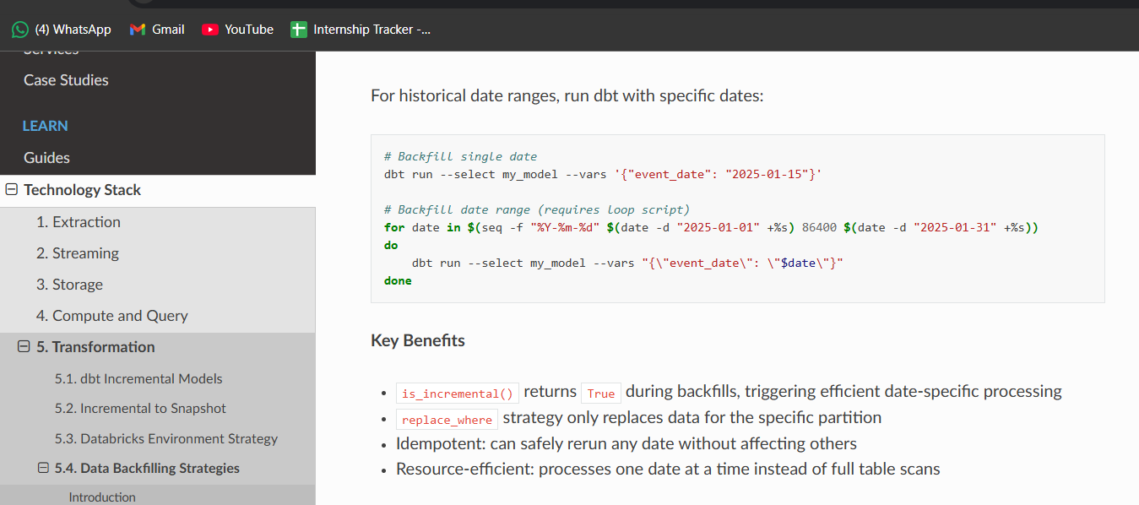
Backfill Strategy Documentation Reference
{% if is_incremental() %}
-- This checks if the table already exists.
-- If yes, do not reload all data again (no full refresh).
{% if var('backfill_start_date', False) and var('backfill_end_date', False) %}
-- Backfill mode:
-- If start and end dates are provided,
-- only that specific date range will be processed.
-- This helps fix old data without touching the full table.
WHERE order_date >= '{{ var("backfill_start_date") }}'
AND order_date <= '{{ var("backfill_end_date") }}'
{% else %}
-- Normal incremental mode:
-- Find the latest date already present in the table.
-- Then load only the new data after that date.
WHERE order_date > (SELECT MAX(order_date) FROM {{ this }})
{% endif %}
{% endif %}

Slide 5
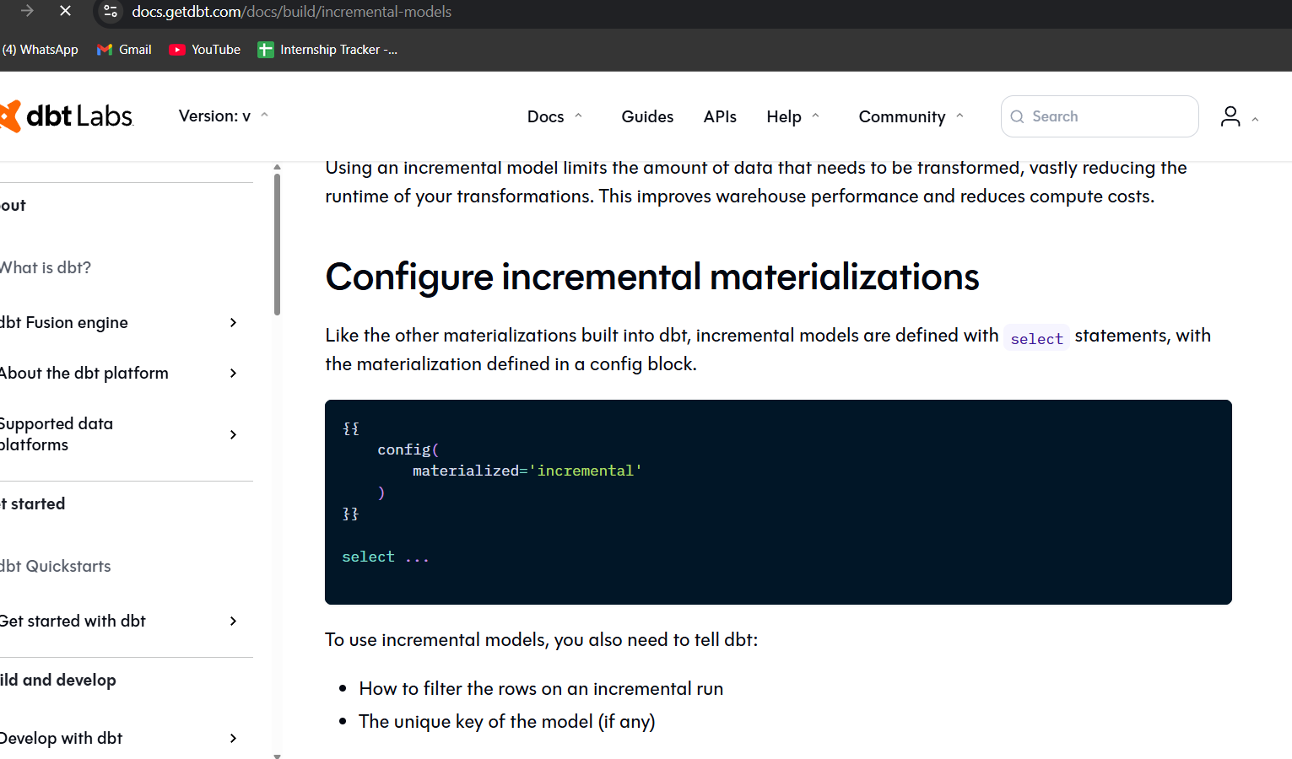

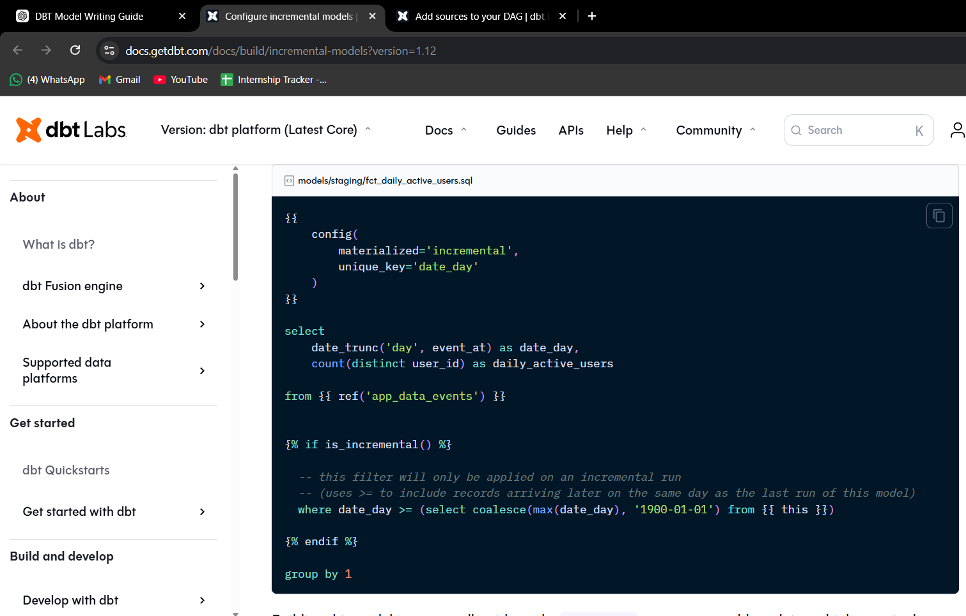
Incremental Model Ref
{{ config(materialized='incremental') }}
👉 This means:
Load only new data
Do not reload full table every time
Makes pipeline faster
Incremental Logic
WHERE order_date > (SELECT MAX(order_date) FROM {{ this }})
👉 This means:
Get only new records
Avoid duplicate data

Slide 6
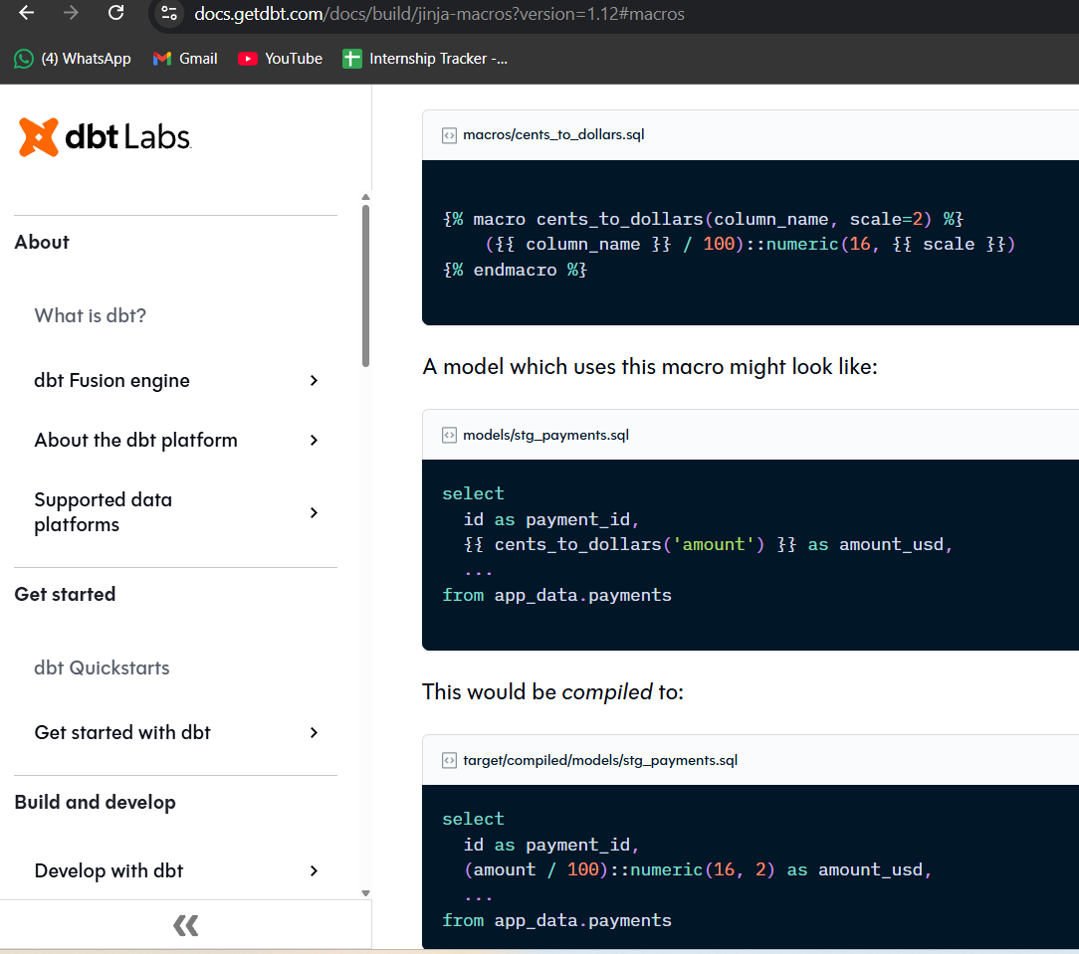
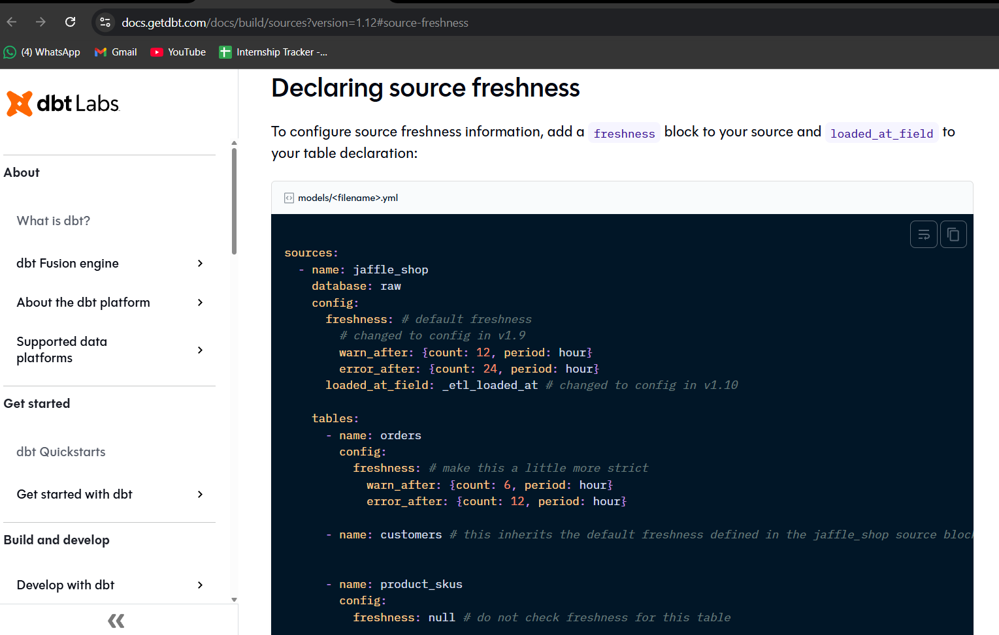
Macros Ref
{% macro clean_string(column_name) %} TRIM(UPPER(COALESCE({{ column_name }}, 'UNKNOWN'))) {% endmacro %}
Reusable function in dbt and Cleans text data
👉 Example:
Input: " rura " -> Output: RUDRA
SELECT {{ clean_string('name') }} FROM customers
👉 Benefit:
Write code once, use many times Keeps code clean and consistent
DBT Data Freshness
loaded_at_field: "order_date::timestamp"
freshness:
warn_after: {count: 12, period: hour}
error_after: {count: 24, period: hour}
Warning if data is older than 12 hours
Error if data is older than 24 hours
Helps monitor data pipeline

Slide 7

Ingestion and DBT Commands
Step | Command | What it does | What to do next
1 | docker-compose up -d | Starts PostgreSQL database | Load data
2 | python ingest_data.py | Loads CSV data into raw tables | Check dbt connection
3 | dbt debug | Checks if dbt is connected to database | Run models
4 | dbt run | Builds all models (staging → intermediate → marts) | Run tests
5 | dbt test | Checks data quality (null, duplicates, relationships) | Check freshness
6 | dbt source freshness | Checks if data is fresh or outdated | Run incremental
7 | dbt run | Loads only new data (incremental run) | Try full refresh
8 | dbt run --full-refresh | Rebuilds full table from scratch | Try backfill
9 | dbt docs generate | Creates documentation files | Open docs
10 | dbt docs serve | Opens data model in browser | Run queries
11 | SQL Query | Get insights from data (sales, revenue, etc.) | Final output

Slide 8
Thank You

