Slide 1


E-Commerce Analytics Project
M2 –with Docker, DBT,SQL, Python,Semantic,Power BI Reporting & Dashboard Layer
Rudra Sharma

Slide 2
Agenda
What this project does
How data flows from raw tables to dashboard
The Gold layer — fact and dimension tables
Dataset numbers at a glance
Who the two dashboards are for
Three real patterns we found in the data
Dashboard walkthrough
How a metric is actually calculated (DAX)
Known limitations and tech stack

Slide 3
What This Project Does
This milestone turns the Gold layer from M1 into dashboards that answer real business questions, for two different audiences.
Leadership / Business — revenue, growth, customer trends
Operations / Analyst — fulfillment, campaigns, inventory, returns
Everything is backed by a semantic layer, so both dashboards pull from the same metric definitions — no two teams seeing different numbers for the same thing.
dim_customers
|
dim_campaigns ─── fct_orders ─── dim_products
|
dim_date
The Gold layer is built as a Star Schema — one fact table in the middle, surrounded by dimension tables that describe it.
fct_orders — the center. One row per order line.
dim_customers — who placed the order
dim_products — what was bought
dim_campaigns — which campaign it came from (if any)
dim_date — when it happened, with year/month/quarter hierarchy

Slide 4
How Data Moves: M1 to M2
PostgreSQL Raw Tables (Bronze)
dbt Staging — stg_orders, stg_customers, stg_products, stg_campaigns
dbt Intermediate — int_orders (joins orders + products + campaigns, calculates total_amount)
dbt Marts — fct_orders (incremental) + dim_customers + dim_products + dim_campaigns + dim_date
Semantic Layer — semantic_layer.yml
Power BI Dashboard — BERT_Dashboard.pbix
Tech Stack
PostgreSQL — the data warehouse, raw and transformed tables
Python + Pydantic — raw ingestion and validation
dbt — transformations, testing, documentation
(semantic_layer.yml) — one source of truth for every metric
Power BI — the dashboards themselves
Docker — runs PostgreSQL locally, consistent every time

Slide 5
# Project Structure
ecommerce_analytics/
├── models/
│ ├── staging/
│ │ ├── stg_orders.sql
│ │ ├── stg_customers.sql
│ │ ├── stg_products.sql
│ │ └── stg_campaigns.sql
│ ├── intermediate/
│ │ └── int_orders.sql
│ └── marts/
│ ├── fct_orders.sql
│ ├── dim_customers.sql
│ ├── dim_products.sql
│ ├── dim_campaigns.sql
│ ├── dim_date.sql
│ └── metricflow_time_spine.sql
├── analyses/
│ └── dashboard_queries.sql
├── semantic_layer.yml
├── dbt_project.yml
├── ingestion.py
├── BERT_Dashboard.pbix
└── README.md

Slide 6
fct_orders — The Fact Table
Grain: 1 row = 1 unique order line
Unique key: MD5(order_id + customer_id + product_id)
Materialization: Incremental — only new rows load on each dbt run
total_amount = quantity × unit_price × (1 − discount/100)
Total_revenue_amount = total_amount if Delivered, else 0
is_delivered_order / is_returned_order — simple 1/0 flags used by most KPIs
discount_bucket — 0–10% / 11–20% / 21–30% / 30%+

Slide 7
The Dimension Tables
dim_customers
customer_id, name, age_group, gender, city, state
membership_type (Gold/Silver/Bronze)
customer_segment (Premium/Regular/Budget)
dim_products
category, subcategory, brand, season_tag
mrp, profit_margin_pct, stock_level
dim_campaigns
campaign_id, campaign_name, expected_performance
9 named campaigns, e.g. Diwali Dhamaka, Big Billion Days, Republic Day Sale
dim_date
full_date, year, month, quarter
month_name, day_name

Slide 8
The Dataset, in Numbers
January 2025 – May 2026, the dataset covers:
25,000 order rows / 24,500 unique orders / 4,000 customers
Average 6.25 orders per customer; 1,400 customers (35%) ordered more than once
22,295 Delivered (89.2%), 1,977 Returned (7.9%), 728 Cancelled (2.9%)
₹29.16 Cr total delivered revenue, ₹13,081 average order value
Best month: October 2025 (₹3.30 Cr). Weakest month: February 2025 (₹1.01 Cr)

Slide 9
Leadership: Questions We Answer
Page: Executive | Who: CEO, Business Head, Investors
Total revenue? ₹29.16 Cr (Jan 2025–May 2026)
This month's revenue? ₹2.02 Cr (May 2026)
How many customers? 4,000 costomer,1400 35% of them repeat buyers
Average order value? ₹13,081 per delivered order
Return rate? 7.9% — healthy (5–10% is normal)
Best state? Delhi #1, then Karnataka, then Maharashtra

Slide 10
Operations: Questions We Answer
Pages: Operation + Second Operation | Who: Ops Manager, Analyst, Campaign Manager
Best campaign? Diwali Dhamaka — 1,758 orders in October alone
Cancelled orders? 728 total, about 2.9% cancellation rate
Best-selling category? Electronics — over 60% of revenue most months
Do discounts drive volume? 11–20% discount bucket has the highest order volume
Delivered vs returned? 22,295 delivered vs 1,977 returned

Slide 11
Spike: October 2025 — The Diwali Effect
Revenue ₹3.30 Cr · 3,183 orders · 1,529 customers · +50.4% vs September +120.6% vs aug
October 2025 is the biggest spike in the whole dataset — orders jumped 50% in a single month, right after September's pre-festive buildup.
Diwali Dhamaka campaign alone brought in 1,758 orders
Big Billion Days added another 1,425 orders, running at the same time
Electronics made up 62% of the month's revenue (₹2.04 Cr)
Delhi, Karnataka and Maharashtra all surged together
Takeaway: festive season + sale campaigns together are our biggest revenue driver. Plan inventory and campaign budget for October in advance next year.

Slide 12
Dip: Jun–Aug 2025 — Monsoon Slump
Jun ₹1.34 Cr → Jul ₹1.19 Cr → Aug ₹1.08 Cr — 3 months declining in a row
From May's ₹2.21 Cr peak to August's ₹1.08 Cr is a 51% drop over three months — the longest decline in the dataset.
"Monsoon Saver Sale" campaign managed only 263 orders in July, 240 in August — it barely worked
"Back to School" in June got just 606 orders; 592 orders came in with no campaign at all
August had only 646 customers — the lowest of any month
No major festive event falls in this window — it's pure organic demand, and it's weak
Takeaway: review monsoon campaign spend, the Monsoon Saver Sale isn't earning its budget. Avoid heavy inventory bets in this window.

Slide 13
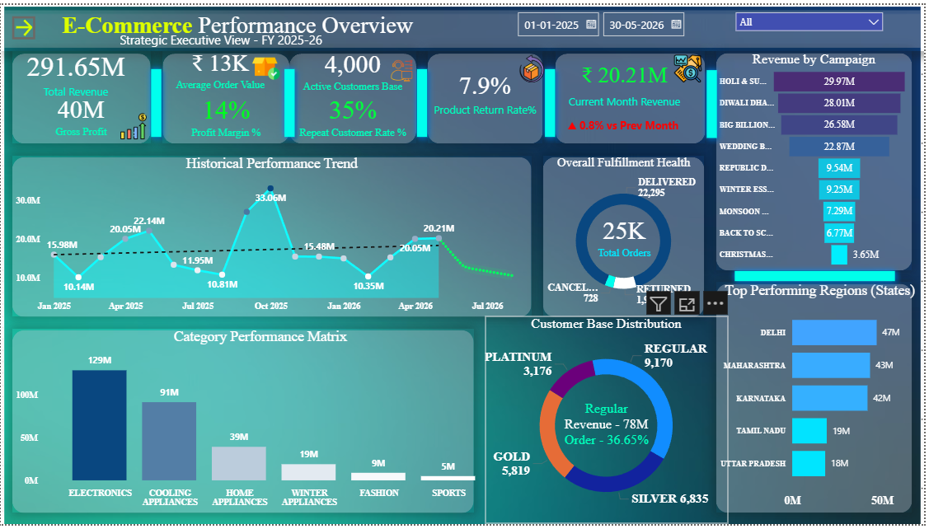
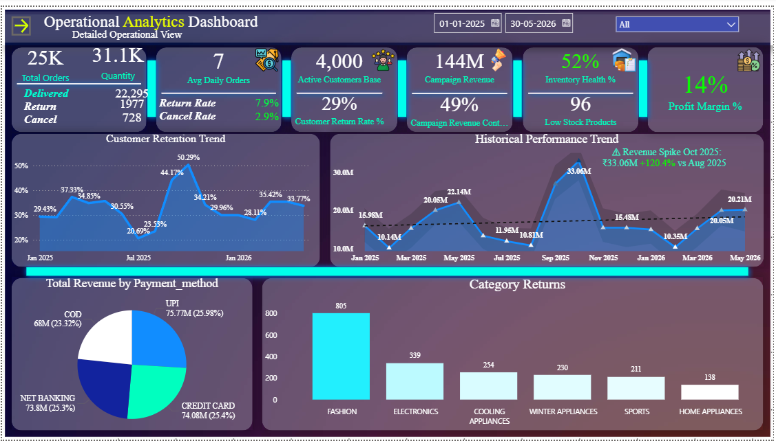
Dashboard

Slide 14
Pattern: February — Same Dip, Both Years
Feb 2025: ₹1.01 Cr (792 customers) | Feb 2026: ₹1.04 Cr (804 customers)
February dips every single year in this dataset — both years show almost the exact same pattern, so this looks structural, not random.
Wedding Bonus campaign performs nearly identically both years — around 480–488 orders, consistently weak
February is only 28 days — fewer days means fewer orders by default
Demand saturation right after Republic Day Sale in January — customers already bought what they wanted
Takeaway: this is a structural, repeatable weak spot. Rethink Wedding Bonanza, and factor the 28-day month into planning.

Slide 15
Dashboard Walkthrough
Page 1 — Executive
Revenue, orders, AOV and return rate cards, a revenue trend line with MOM,YOY And Forcast Line revenue by state map, and order status breakdown.
Page 2 — Operation
Delivered/returned/cancelled KPIs, campaign revenue funnel, campaign performance table, and membership type breakdown.
Page 3 — Second Operation
Revenue and returns by category, top subcategories, discount bucket analysis, payment method split, and revenue by gender/age group.

Slide 16
How a Metric Is Actually Built
Total Revenue
SUM(net_revenue_amount), where net_revenue_amount is total_amount only if the order was Delivered, else 0.
Why: a returned or cancelled order's money was never actually earned.
Result: ₹29.16 Cr
Return Rate %
DIVIDE(Total Returned Orders, Total Orders, 0)
Total Returned Orders is just SUM(is_returned_order), a 1/0 flag set in dbt.
Result: 7.9%

Slide 17
Known Data Limitations
500 of 25,000 rows share a duplicate order_id — handled with an MD5 surrogate key in fct_orders
campaign_id is nullable — about 49% of June 2025 orders had no campaign attribution at all
profit_margin_pct is a snapshot at ingestion time, not historical — old profit figures may be off if margins changed since
stock_level is also a snapshot, not real-time inventory

Slide 18
Thank You

