Slide 1


E-Commerce Cloud Data Platform
M3 – Batch + Streaming Ingestion, BigQuery Medallion Architecture, Dataplex Governance, Cloud Run & Dataflow on GCP
Rudra Sharma
Project ID: m3-ecom
Region: asia-south2 (Delhi)

Slide 2
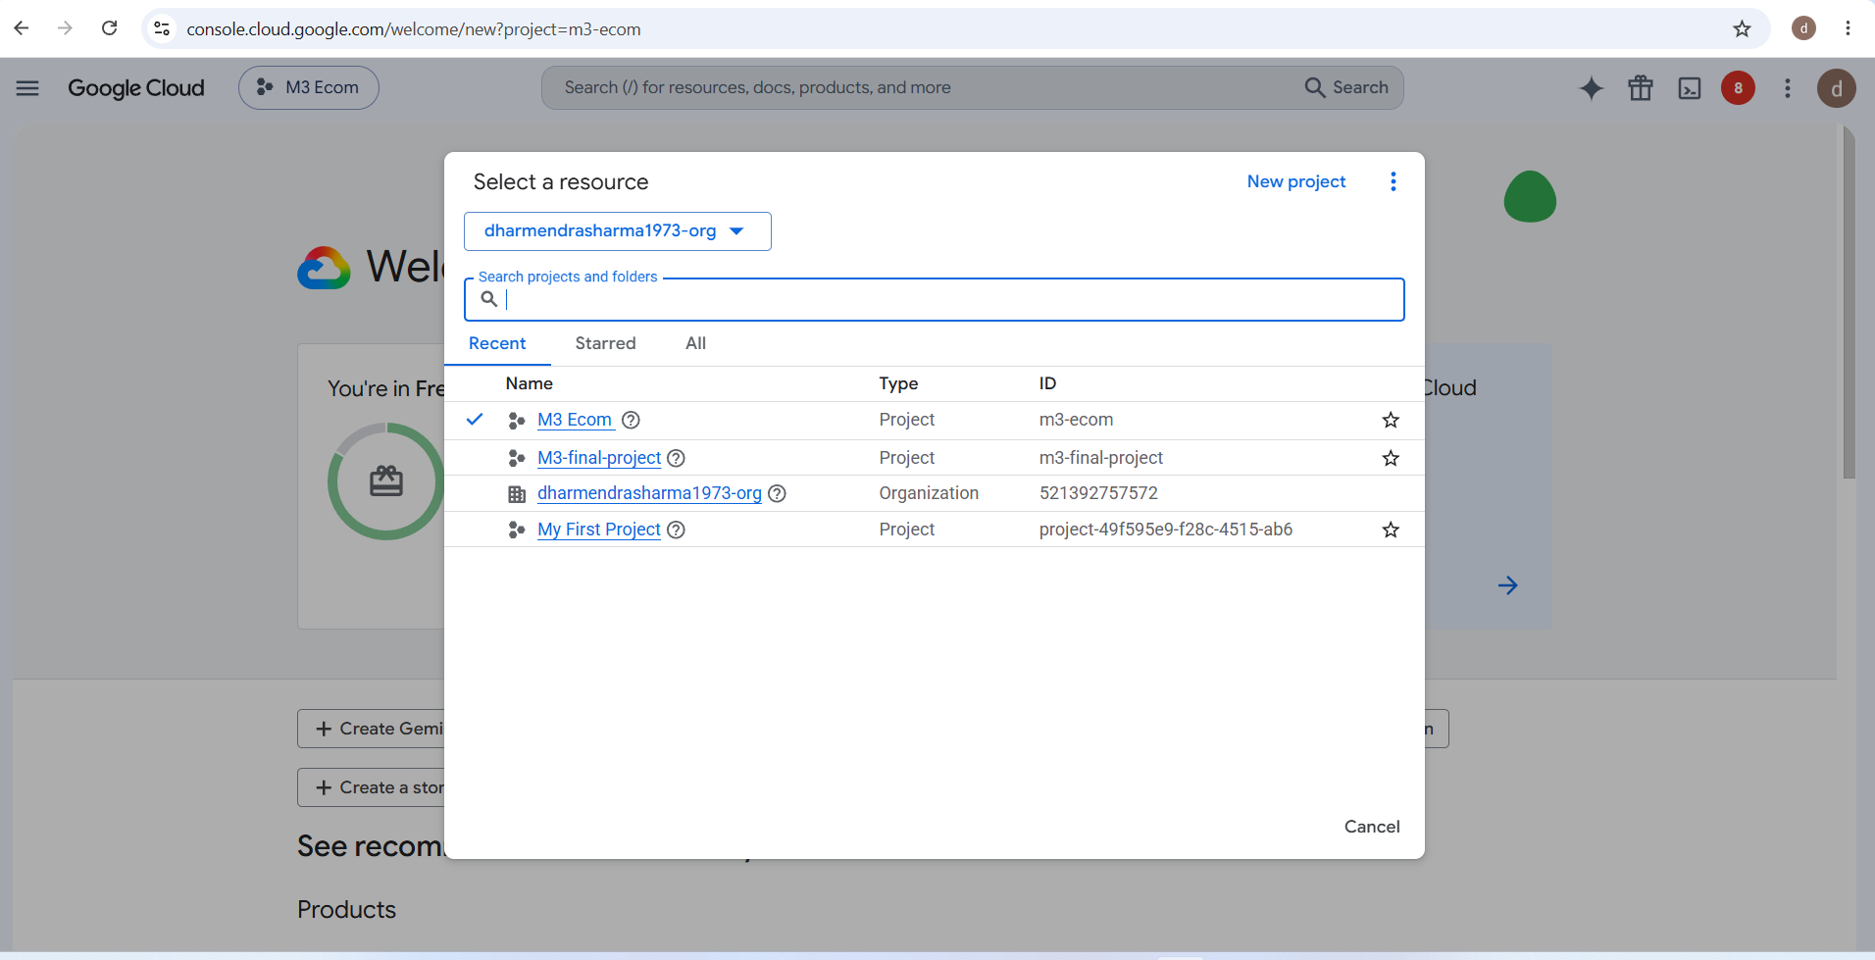
What This Project Does
This project is a complete, end-to-end cloud-native data platform built on Google Cloud Platform for a retail/e-commerce company. It was built to demonstrate how a real company would move order data from raw source files all the way into a governed, secure, business-ready reporting layer.
Order data comes into the platform from two different kinds of sources, because in the real world, not all data arrives the same way:
Batch data — historical order records that already exist in bulk, such as last year's sales history. These arrive as files and get uploaded and processed all at once.
Streaming data — new orders that are happening right now, one at a time, in near real time. These are simulated using Google Cloud Pub/Sub.
Both of these paths are cleaned, checked for errors, deduplicated, and finally stored in BigQuery. On top of BigQuery, a dbt project organizes everything into a proper layered data warehouse — starting from staging, moving to intermediate, and ending in business-ready marts. The final layer feeds directly into a Looker Studio dashboard. Everything is also registered in Dataplex for governance, and the most sensitive tables have both row-level and column-level security applied.

Slide 3
# Project Structure
M3_Project/
├── ingestion/
│ ├── batch_ingest.py (batch pipeline: validate, convert, upload, merge)
│ ├── stream_publish.py (publishes sample orders to Pub/Sub)
│ ├── dataflow_pipeline.py (Apache Beam streaming pipeline)
│ ├── requirements-dataflow.txt
│ └── .env.example
├── sql/
│ ├── 01_create_raw_tables.sql
│ ├── 02_analytics_queries.sql
│ ├── 03_row_level_security.sql
│ ├── 04_verification_queries.sql
│ └── 05_stream_dedup_reconciliation.sql
├── dbt_project/
│ ├── models/staging/ (one model per raw source)
│ ├── models/intermediate/
(int_orders_unioned.sql)
│ └── models/marts/ (dimension tables, fact_orders, rpt_sales_summary)
├── data/
│ ├── batch/ (customers.csv, products.csv, campaigns.csv, orders_historical.csv)
│ └── stream/ (orders_new.csv, replayed as Pub/Sub messages)
├── docs/
│ ├── gcp_commands_used.md (every gcloud/bq command used, in order)
│ └── data_governance.md (write-up on governance and reliability)
├── screenshots/ (console proof for every resource created)
├── Dockerfile (packages batch ingestion as a Cloud Run Job)
└── README.md

Slide 4
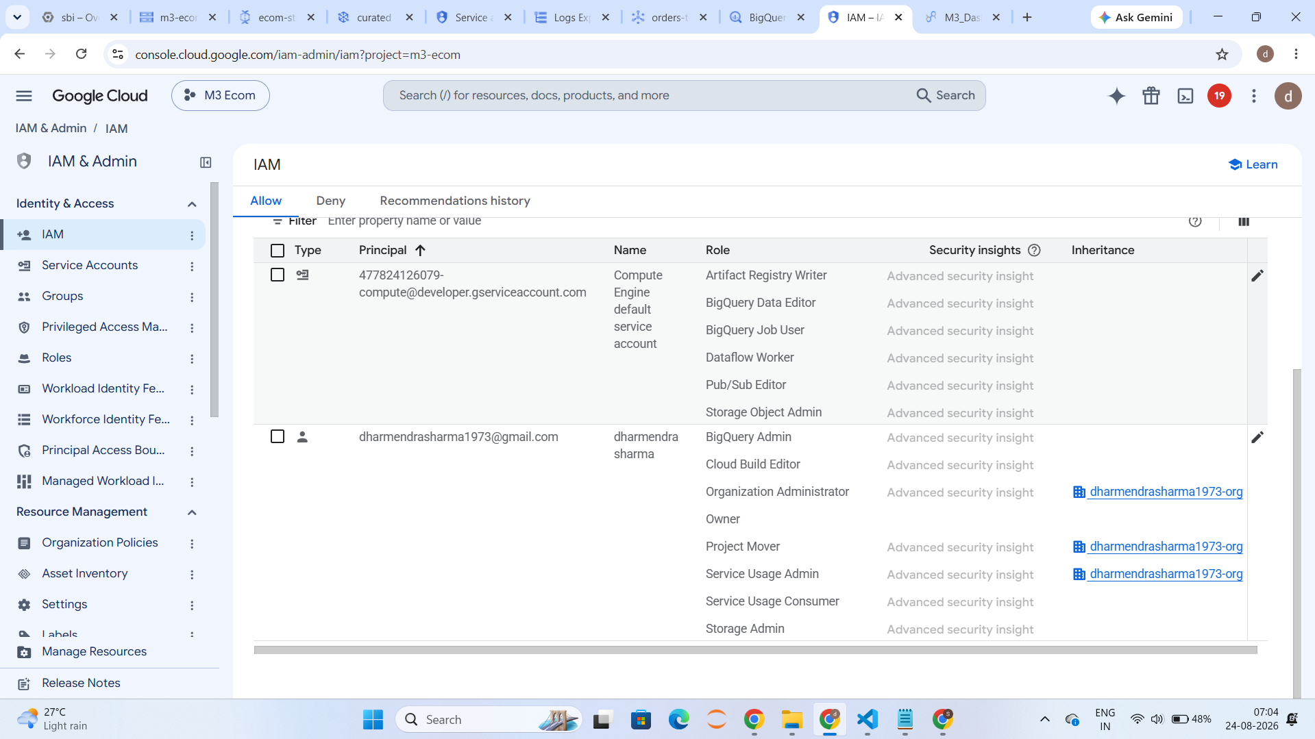
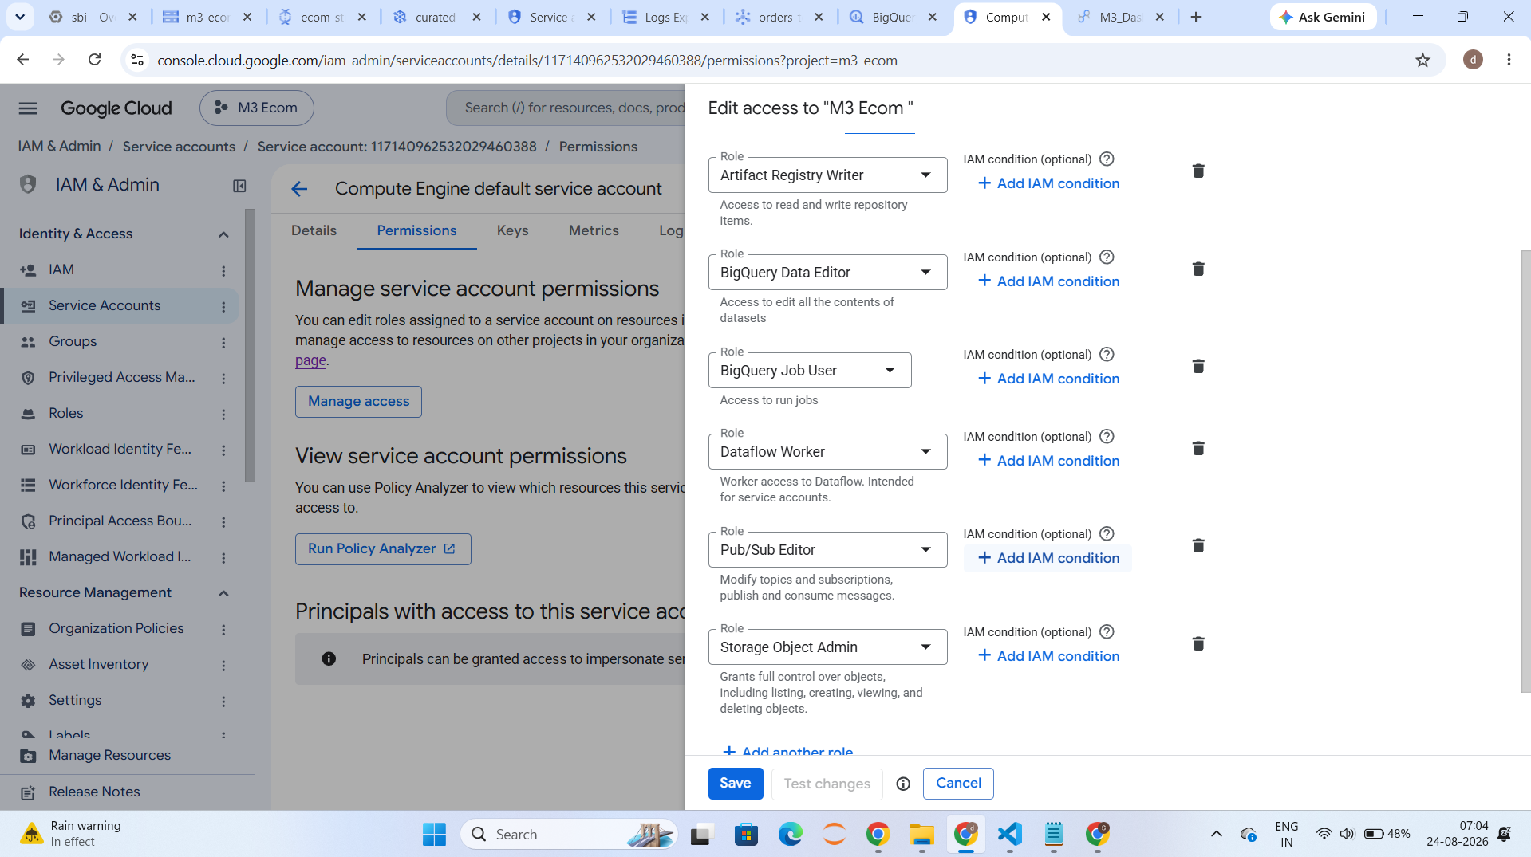
IAM & Security Setup
Proper IAM roles were granted to the Compute Engine default service account, which runs the Dataflow worker: BigQuery Data Editor, BigQuery Job User, Dataflow Worker, Pub/Sub Editor, Storage Object Admin, and Artifact Registry Writer. Getting this permission set right was itself part of the debugging process

Slide 5
Project setup and enabling APIs
gcloud auth login
gcloud auth application-default login
gcloud config set project m3-ecom
gcloud services enable \
storage.googleapis.com \
bigquery.googleapis.com \
pubsub.googleapis.com \
dataflow.googleapis.com \
dataplex.googleapis.com \
datacatalog.googleapis.com \
run.googleapis.com \
cloudbuild.googleapis.com \
artifactregistry.googleapis.com \
logging.googleapis.com

Slide 6
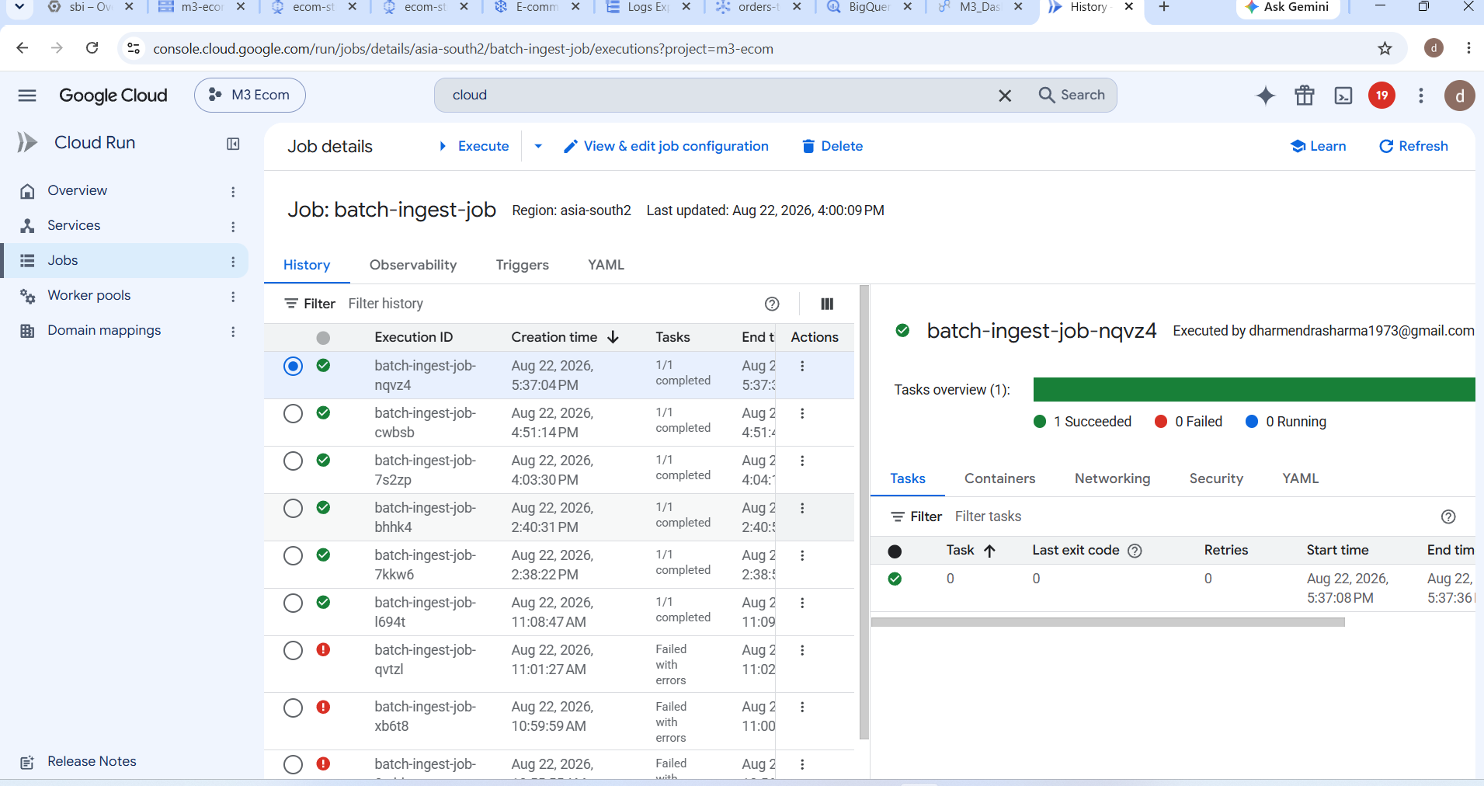
Cloud Run
The batch ingestion script was also packaged to run as a Cloud Run Job, in addition to running directly on a local machine, to demonstrate a real production deployment path. A Dockerfile at the root of the repository copies the ingestion folder and installs dependencies, and the exact same batch_ingest.py script runs inside the container as runs locally

Slide 7
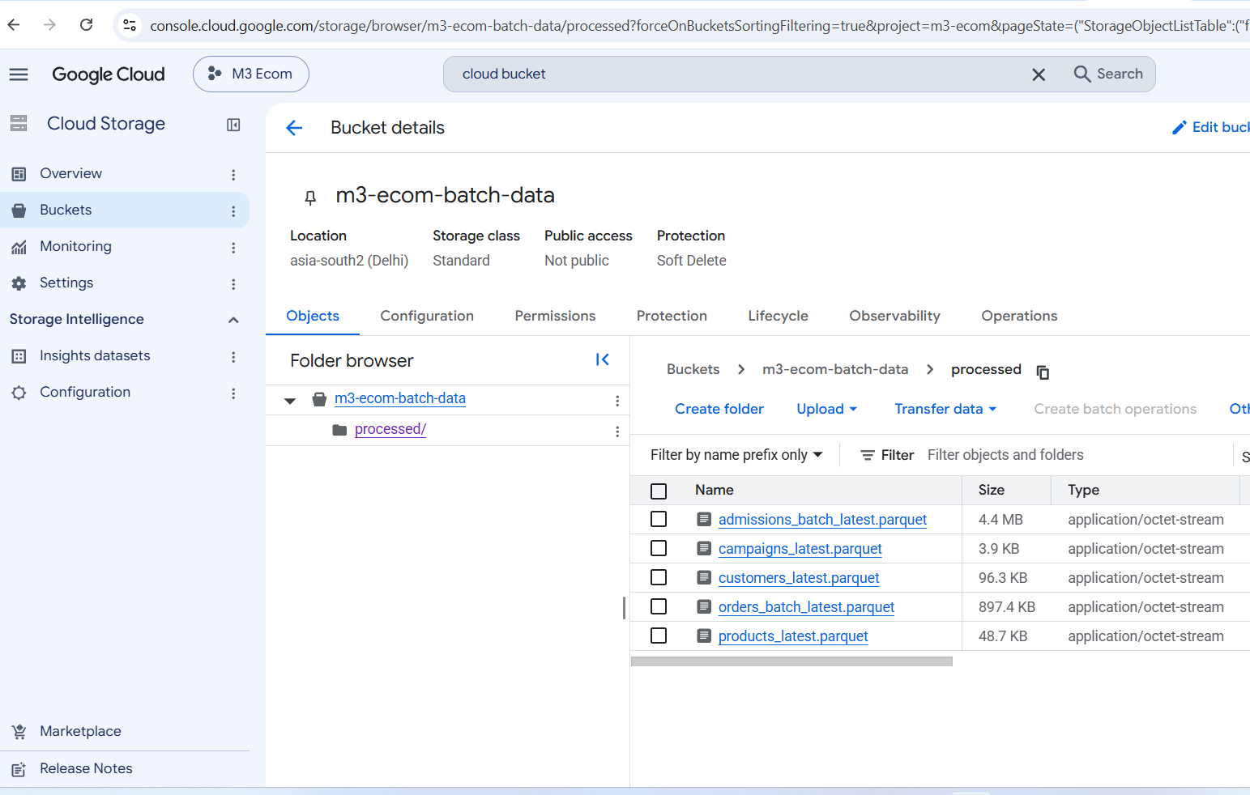
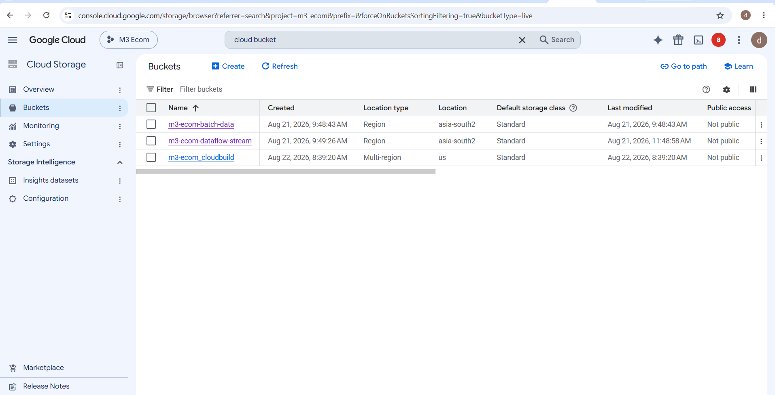
Cloud Storage Buckets
Three Cloud Storage buckets were created in the asia-south2 region: m3-ecom-batch-data to hold batch-processed Parquet files, m3-ecom-dataflow-stream for Dataflow's staging and temp files, and m3-ecom_cloudbuild for container build artifacts. The batch bucket's processed/ folder shows the actual Parquet outputs — customers, campaigns, products, and orders — confirming the batch pipeline successfully wrote its output.

Slide 8
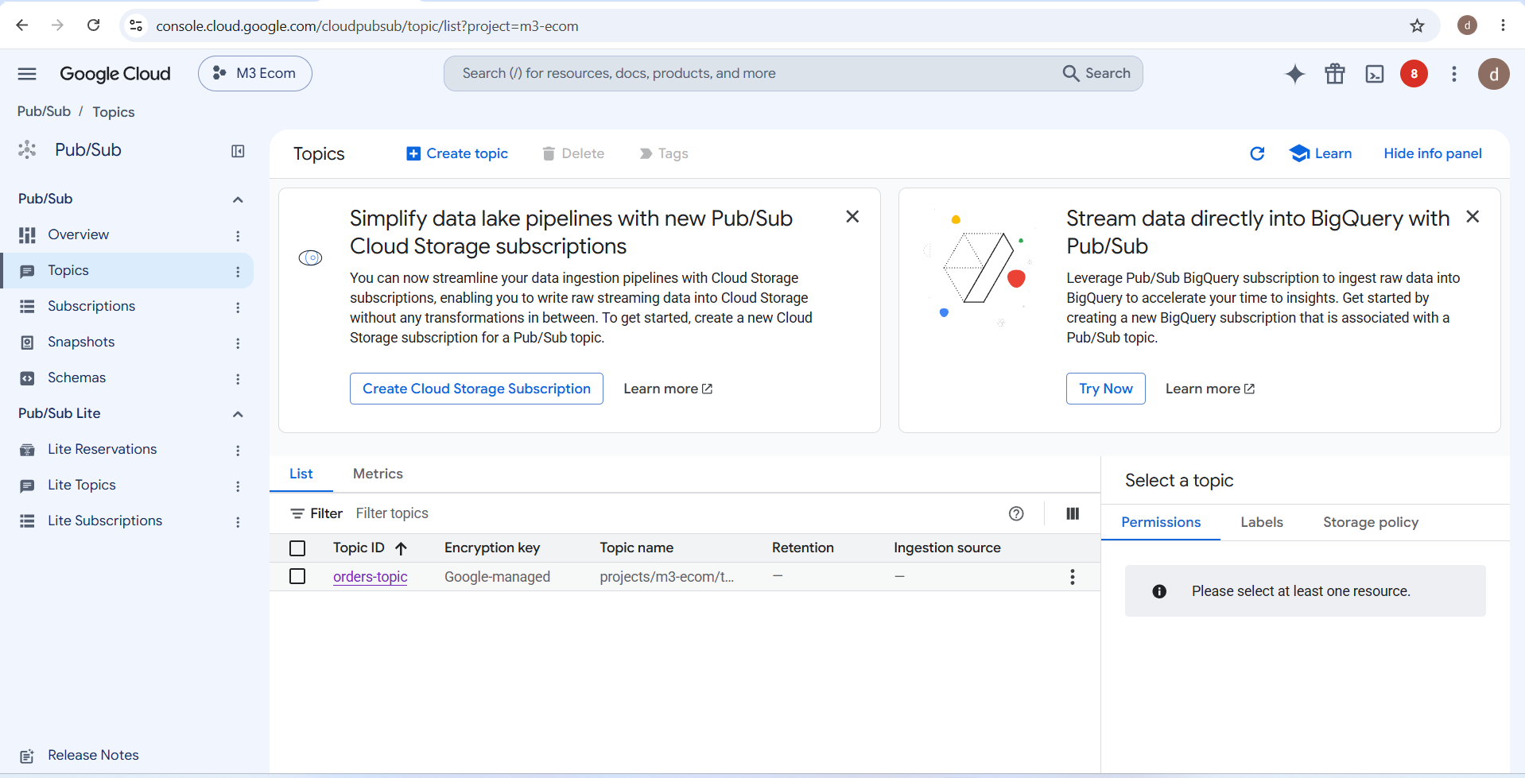
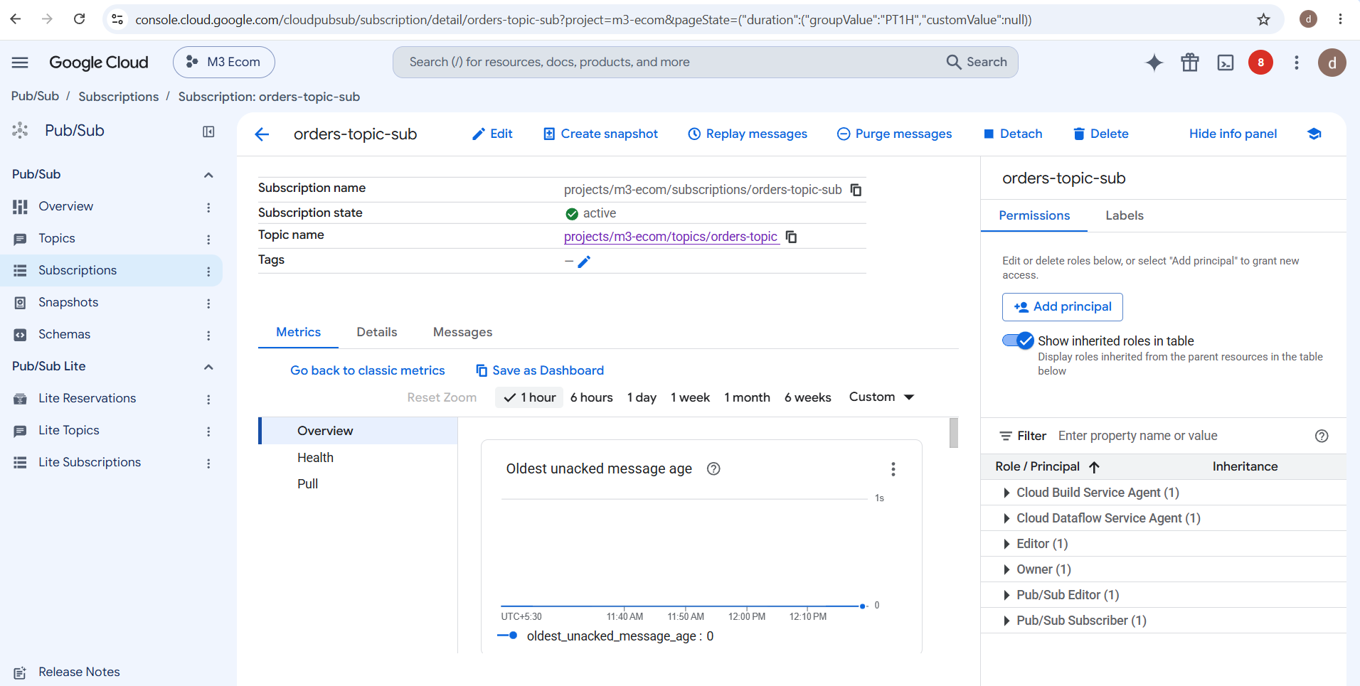
Pub/Sub Setup
A Pub/Sub topic called orders-topic was created, along with a subscription orders-topic-sub used by the Dataflow pipeline to pull messages. The subscription shows an active state, with an oldest unacked message age of zero — meaning the pipeline is keeping up with incoming messages in real time.

Slide 9
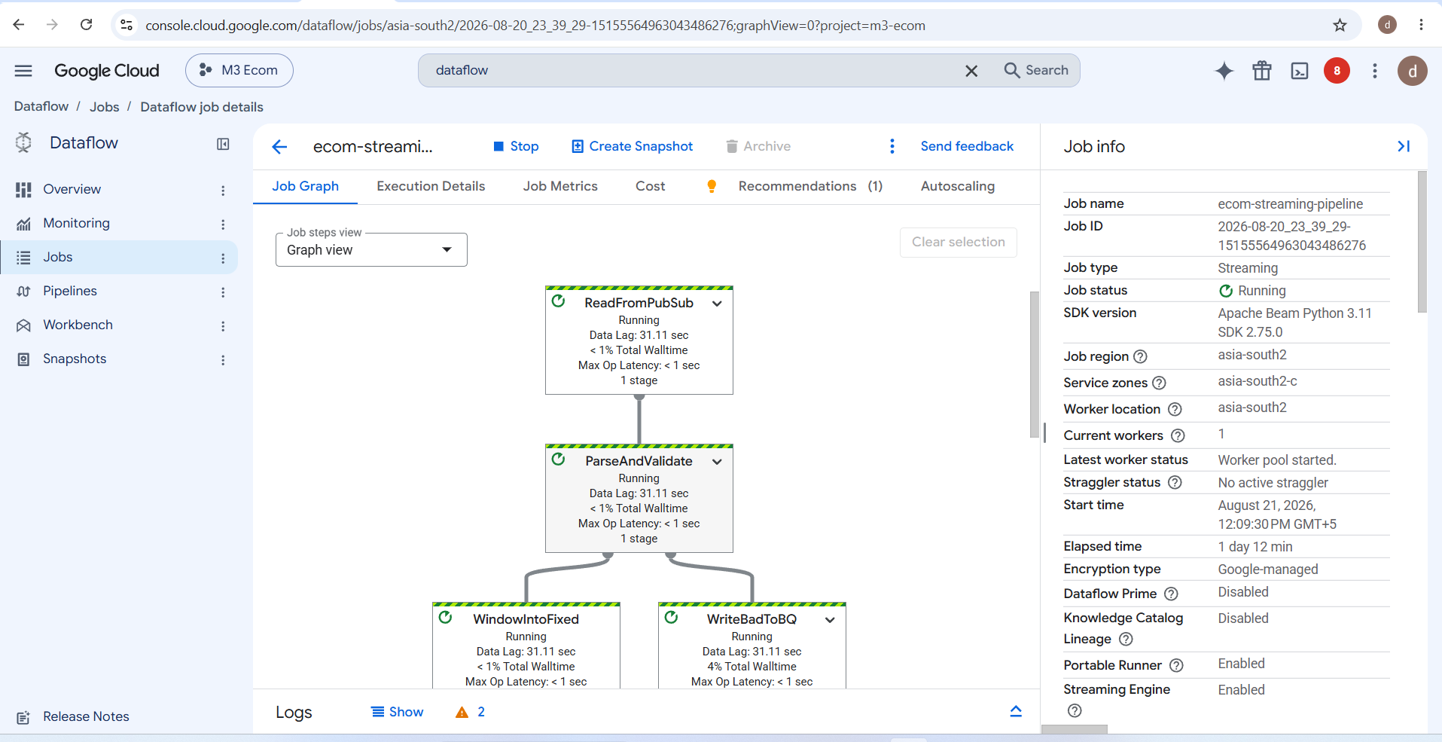
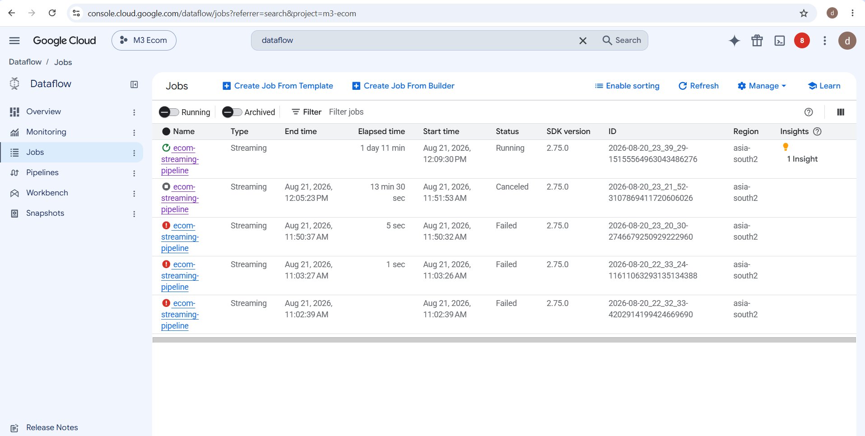
Dataflow Streaming Job
The Dataflow job ecom-streaming-pipeline runs continuously in streaming mode. The job graph shows every stage exactly as designed: reading from Pub/Sub, validating and parsing, windowing, grouping and deduplicating by order ID, and finally writing good and bad records to separate BigQuery tables. Earlier failed job attempts, visible in the job history

Slide 10
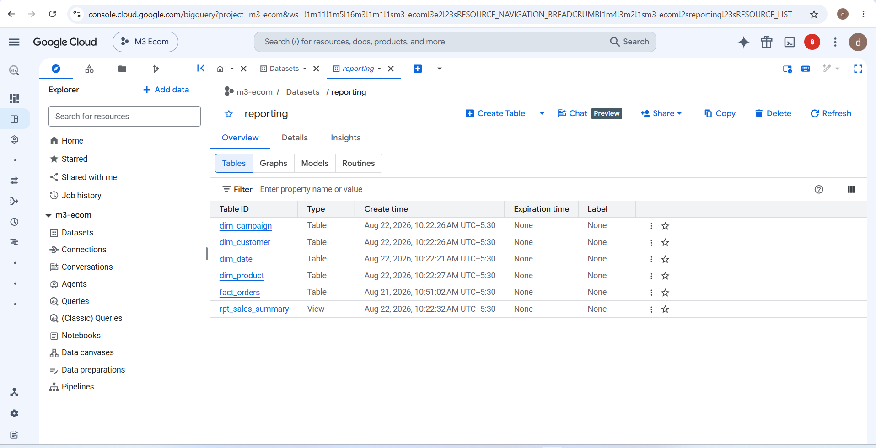
BigQuery: Raw, Processed, and Reporting Layers
Dataset | Purpose | What lives here
raw | Landing zone — an exact, untouched copy of whatever arrived from source | orders_batch, orders_stream, orders_batch_errors, orders_stream_errors, customers, products, campaigns
processed | Cleaned, typed, and renamed data, built entirely by dbt as views | stg_orders_batch, stg_orders_stream, stg_customers, stg_products, stg_campaigns, int_orders_unioned
reporting | Final, business-ready layer that people and dashboards actually query | dim_customer, dim_product, dim_campaign, dim_date, fact_orders, rpt_sales_summary

Slide 11
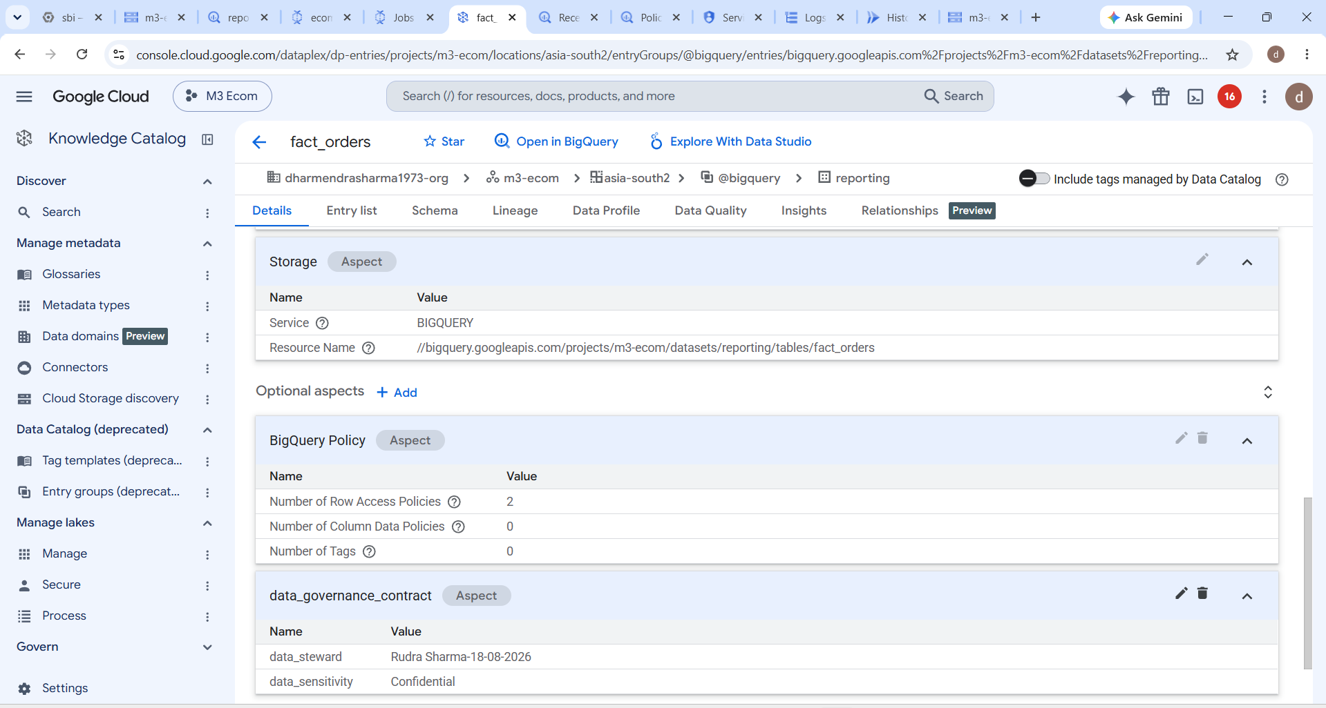
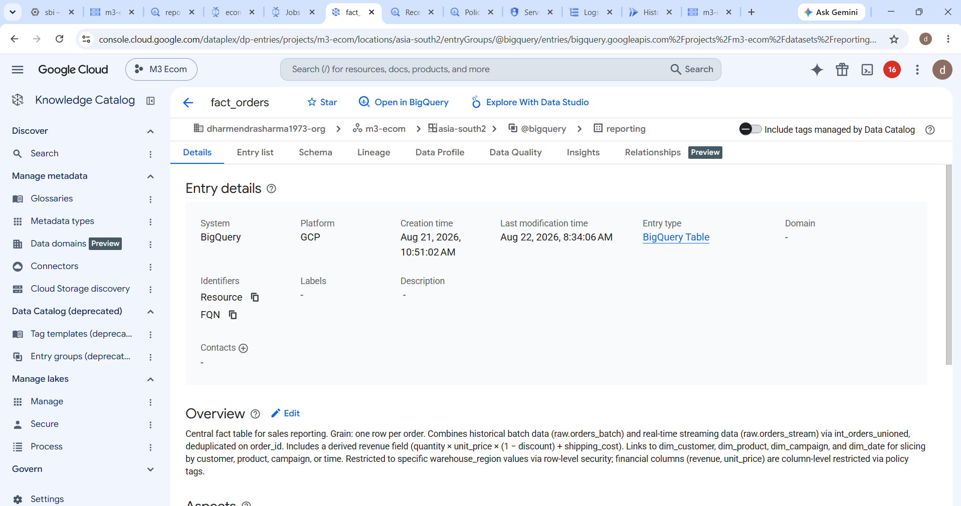
Data Catalog: Table-Level Metadata
Beyond dataset-level registration, Dataplex's Data Catalog also captures column-level detail for individual tables. The fact_orders entry shows an auto-generated overview describing its grain, sources, and security setup, along with a custom data_governance_contract aspect recording the data steward, sensitivity level (Confidential)

Slide 12
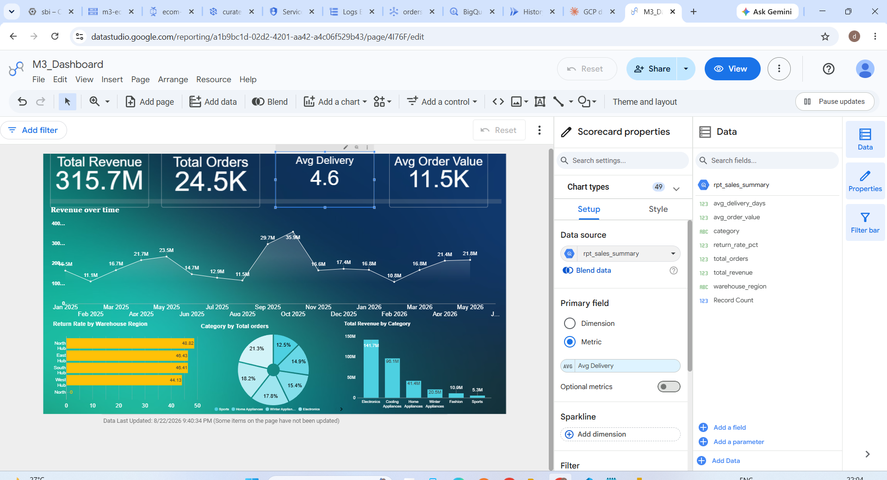
Dashboard
File | Rows
orders_historical.csv (batch) | 24,985
orders_new.csv (stream) | 37
customers.csv | 4,000
products.csv | 1,200 (6 categories × 200)
campaigns.csv | 9
Dataset Summary
Order status breakdown: Delivered 89%, Returned 8%, Cancelled 3% · Return rate 7.9% · ~49% of orders have no campaign attached (organic) · Payment methods and warehouse regions are split roughly evenly
Intentionally dirty data (for testing):
10 bad rows in batch (ORD_BAD_B01–B10): missing fields, negative/zero/text quantity values
500 duplicate order_id in batch (for dedup testing)
10 bad rows in stream (ORD_BAD_S01–S10): same issues plus one incorrectly formatted date
2 special rows in stream (ORD_LATE_TEST) — for late-arrival testing, dated close to the current date

Slide 13
Security: Row-Level and Column-Level Security
Row-Level Security Defined in sql/03_row_level_security.sql, a row access policy was created directly on reporting.fact_orders. In this demo, a specific test user is restricted so they can only see rows where warehouse_region equals West Hub — they cannot see orders from any other region, even though the underlying table contains all of them. In a production environment, this single user would be replaced with an IAM group, so an entire team of regional analysts automatically gets the same restriction.
Column-Level Security This was implemented using Data Catalog policy tags. A taxonomy called ecom_sensitive_finance was created, and sensitive columns were tagged with it. Any user who has not been explicitly granted the fineGrainedReader role on that taxonomy sees a NULL value for those columns instead of the real data, even if they otherwise have full read access to the table. This demonstrates fine-grained protection of sensitive data without needing to build and maintain separate restricted copies of the same table.

Slide 14
Requirement Coverage Summary
Area | Status
Cloud Storage, Pub/Sub, Dataflow, BigQuery, Dataplex all configured | Complete
Batch ingestion and streaming ingestion both implemented | Complete
Deduplication, invalid record handling, error logging, transformations | Complete
Raw, processed, and reporting datasets, including one reporting view | Complete
Dataplex dataset registration, metadata viewing, and lineage | Complete
Stretch : both Cloud Run and Dataflow used | Complete additional credit:
Stretch: idempotent duplicate handling | Complete additional credit:
Stretch: invalid records routed to a separate error table | Complete additional credit:
Stretch: late-arriving record handling | Complete additional credit:
Stretch: Row-Level and Column-Level Security together | Complete additional credit:
Stretch: Looker Studio dashboard | Complete additional credit:
Stretch: Cloud Logging | Complete additional credit:
Stretch: Parquet formats | Complete additional credit:

Slide 15
Thank You

