Slide 1


Inventory Service
FastAPI + PostgreSQL Backend
Presented By - Rudra Sharma
M4 Project | October 2026

Slide 2


Agenda
1. Overview - What the project is and what M4 asked for
2. Tech stack - Tools used and why
3. Architecture - Layers, files and request flow
4. Database - Tables, keys and migrations
5. API - 11 endpoints + 3 API designs
6. Auth & roles - JWT, Google login, 3 roles
7. Setup - Docker, env variables, pgAdmin
8. Testing & demo- 3 tests, Postman, live demo

Slide 3

Project overview
11
API endpoint
2
Database Tables
3
User Roles
3
Automated tests
What it is
Who can do what
Staff, inventory managers and one admin have different rights on items and users.
How it runs
One command (docker compose up) starts PostgreSQL, pgAdmin and the API.
A backend to manage inventory items. Users sign up, log in and get a JWT token

Slide 4

M4 requirements: all delivered
Must submit
Stretch goals
Also from the course
Pydantic validators
SQLAlchemy ORM + Alembic
Middleware + background task
CORS, dotenv, pytest fixtures
✓ REST_API_Design.md
✓ FastAPI service + Auth
✓ PostgreSQL integration
✓ GraphQL_Design.md, gRPC_Design.md
✓ Database_Design.md with ERD
✓ JWT_Design.md
✓ Dockerfile + docker-compose
✓ README, Postman, 3 unit tests-
✓ Pagination on GET /items
✓ Google social login
✓ Role-based access
✓ Swagger / OpenAPI docs

Slide 5
Tech stack
FastAPI
PostgreSQL 15
SQLAlchemy
Pydantic
Web framework. Swagger docs are generated automatically.
Main database. Runs in Docker.
ORM for queries. Alembic handles migrations.
Validates every request and shapes every response.
JWT + Google
Docker Compose
pytest
Postman
Token login with bcrypt passwords and Google Sign-In.
db + pgAdmin + web with one command.
3 tests on a temporary SQLite database.
Collection with test scripts for every request.

Slide 6
Project structure
app/
main.py app, CORS, middleware
config.py reads .env
database.py engine + session
models.py User, Item tables
schemas.py Pydantic models
auth.py hash, JWT, roles
login_page.py Google button
routers/
auth.py items.py users.py
alembic/ migrations
tests/ conftest + 3 tests
docs/ design docs, Postman
Dockerfile docker-compose.yml
requirements.txt .env.example
What each part does
routers/ receive the request, return the response
schemas.py Pydantic checks input, shapes output
auth.py passwords, tokens, who is logged in, roles
models.py Python classes that map to tables
database.py connection pool, one session per request
alembic/ versioned database changes
docs/ REST, GraphQL, gRPC, DB, JWT designs

Slide 7

Architecture
Client
Swagger / Postman
FastAPI app
port 8000
PostgreSQL 15
port 5435
JWT
SQLAlchemy
verifies Google ID token (optional)
Routers
Schemas
Auth
Models
Database
Take request, return response
Validate in, shape out
Hash, JWT, role checks
Classes = tables
Pool + session
Validation (Pydantic)
Security
name 1 to 50, trimmed
email valid format
phone optional, 7 to 15 digits
password 8 to 64 chars
quantity integer >= 0
bcrypt password hashes
Google never merged (409)
Duplicate signup gives 409
.env is git-ignored

Slide 8
Database design
users | Type / rule
id | INTEGER, PK
name | VARCHAR(25), required
email | VARCHAR(50), UNIQUE
phone | VARCHAR(20), optional
password_hash | NULL for Google users
role | admin / manager / staff
items | Type / rule
id | INTEGER, PK
name | VARCHAR(50), indexed
quantity | INTEGER, >= 0
price | NUMERIC(10,2)
created_by | FK to users.id
Keys and relations
Roles and permissions
One user creates many items (items.created_by to users.id). A user who has items cannot be deleted.
Action | staff | manager | admin
Sign up / log in | ✓ | ✓ | ✓
Create and read items | ✓ | ✓ | ✓
Update own items | ✓ | ✓ | ✓
Update any item | - | ✓ | ✓
Delete items | - | ✓ | ✓
List users | - | - | ✓
Change a user role | - | - | ✓
staff: default for everyone. manager: promoted by admin with PATCH /users/{id}/role. admin: only one, created from ADMIN_EMAIL and ADMIN_PASSWORD in .env.

Slide 9
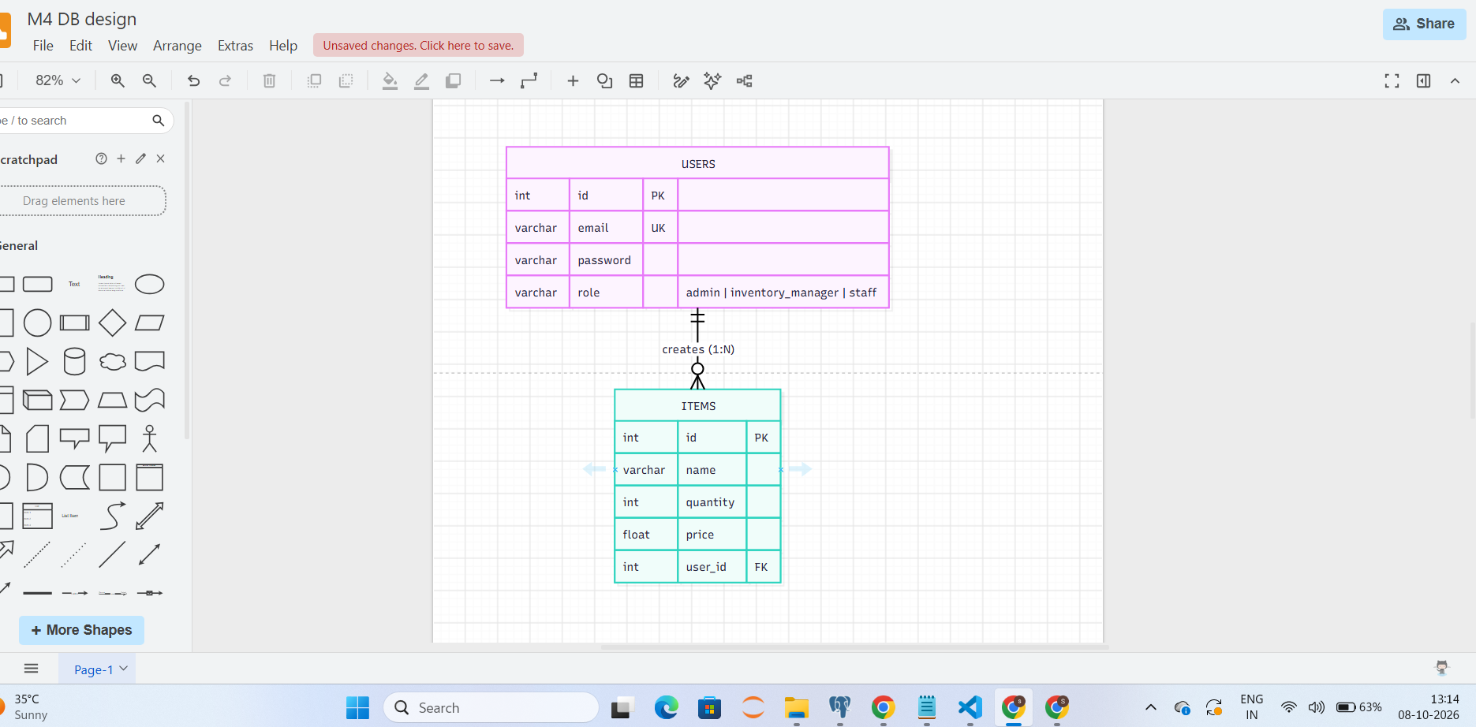

Slide 10
API endpoints
Method | URL | Who | OK
GET | /health | public | 200
POST | /auth/signup | public | 201
POST | /auth/login | public | 200
POST | /auth/google | public (Google page) | 200
POST | /items | any logged-in user | 201
GET | /items?page&limit&search | any logged-in user | 200
GET | /items/{id} | any logged-in user | 200
PUT | /items/{id} | staff (own), manager, admin | 200
DELETE | /items/{id} | manager, admin | 204
GET | /users | admin | 200
PATCH | /users/{id}/role | admin | 200
Tests: 3 passed
Test | What it proves
test_signup_and_login | 201 signup, 409 duplicate email, token on login, 401 wrong password
test_item_crud | 401 without token, create / read / update, 422 for negative quantity
test_roles | staff delete gives 403, admin delete gives 204

Slide 11
Google Sign-In flow
Open /login
Google token
Send token
Verify
Our JWT
Page shows the Google button
User signs in, Google returns an ID token
Browser posts the id_token to /auth/google
Server checks signature, expiry and client id
User found or created as staff, JWT returned
Signup, login and JWT
Signup
Login
Use token
Password hashed with bcrypt. Role is staff. A background task logs a welcome message.
Email found, hash checked.
Send Authorization: Bearer token. Valid for 60 minutes.

Slide 12
Thank You

