Slide 1
EDUCATIONAL TECHNOLOGY (ED-TECH)
Team members of Quantum debuggers:
RUDRIK PATEL
PRINCE TADHANI
YASHVI SUVARIYA
KENISHA VORA

Slide 2
What is Ed-tech?
EdTech combines two major domains: computer hardware and software, as well as educational theory, to assist students in learning. While it may appear convoluted, it all comes down to teaching while utilizing technology in any form - whether as a complement in the classroom or as a learning platform in and of itself.
EdTech consists of:--
Platforms for education
Management of learning systems
Media
Knowledge repositories
Social media tools

Slide 3
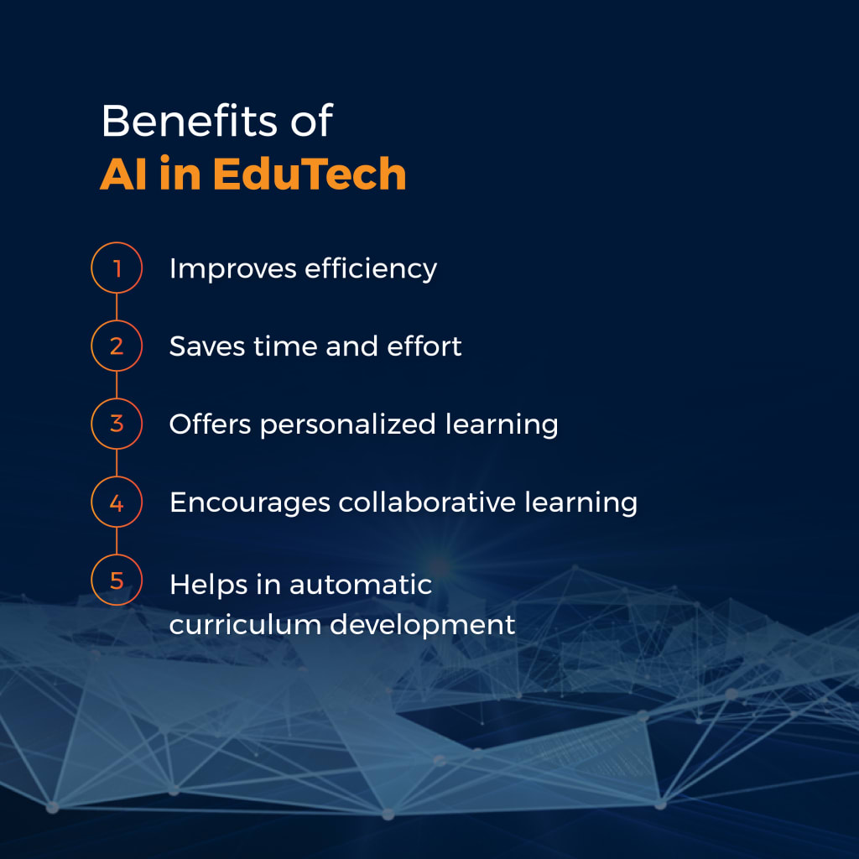
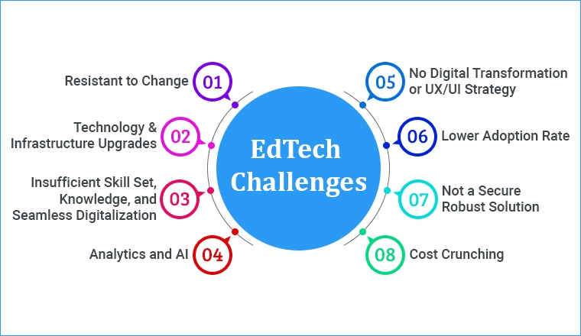
Benefits & challenges of Ed-tech:

Slide 4
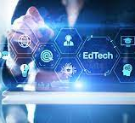
WHAT OUR PROJECT IS ABOUT?
Many organizations have struggled with data collecting and acquisition. Education was one of the most affected industries during and after COVID. And, as the number of difficulties grows, the key difficulty that many organizations face is data archiving and management.
We recognized this issue and decided to develop a system that automates the entire process of data collecting from the marksheet. It can read most GSEB and CBSE marksheets with ease and save them in the database with high accuracy and efficiency using the OCR technique.

Slide 5
Approach of our Project:
We will convert the pdf file that the user has uploaded into a picture.
That image will be processed using the Easy-OCR module, which will locate the text within the image.
The unstructured text will subsequently be added to a list.
The processing module will next process and evaluate the unstructured content to convert it to structured text.
The module will find the subject and its relevant marks in the structured text and display the result on the webpage.
Finally, all of the results will be saved in the database.

Slide 6
Libraries & Frame-work used for Project:
Easy-OCR
Flask
pdf2image
Poppler

Slide 7
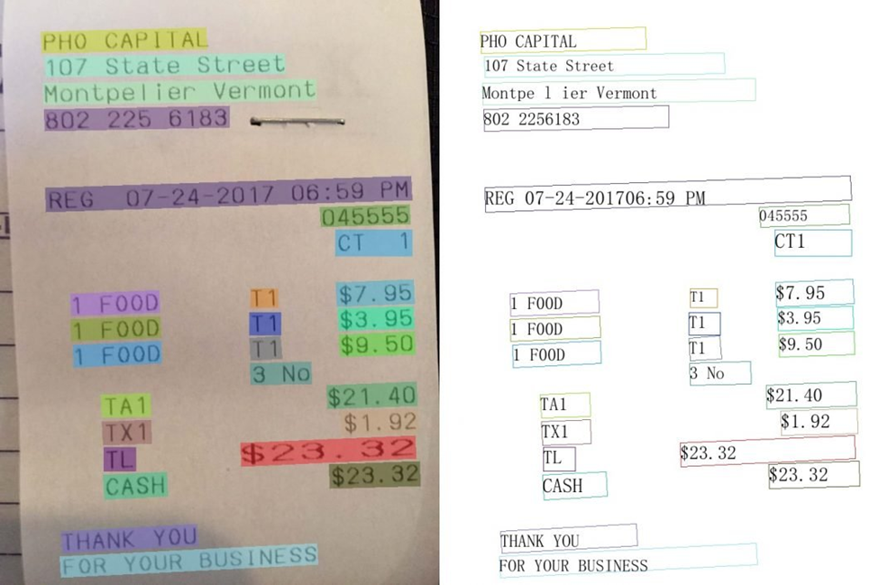
What is Easy-OCR(Optical Character Recognition)?
OCR is an abbreviation for Optical Character Recognition, which is the technology used to turn scanned photos, PDFs, and other documents into editable and searchable text files.
OCR captures characters and text from a document, converts it to digital format, and then converts it into an editable document, such as a word processing file, that can be modified, searched, and shared.

Slide 8

What is flask?
Flask's framework is more explicit than Django's framework, and it is also easier to learn because it requires less basic code to construct a simple web application. A Web-Application Framework, often known as a Web Framework, is a set of modules and libraries that allow developers to construct apps without having to write low-level code such as protocols, thread management, and so on.
Flask is built with the WSGI (Web Server Gateway Interface) toolkit and the Jinja2 template engine.

Slide 9
What is Poppler in python?
Poppler is a free software utility package that allows you to render Portable Document Format (PDF) documents.
python-poppler is a Python binding to the poppler-cpp library. It allows to read, render, or modify PDF documents.
Freedesktop.org is funding its development.
It is widely used on Linux systems[3] and is supported by the free source GNOME and KDE desktop environments' PDF readers.

Slide 10
The following programming languages were utilized to create our project:
Python
Html
CSS
Java-script

Slide 11
Our main target:
Managing result data is a large responsibility for both students and instructors, and our project may assist in storing prior data of results by using pdf of results.
As a result, universities and students can save their data on our website.
We give a secure and simple solution to store the result output simply by utilizing pdf.

Slide 12
How to access our project:
Choose GSEB or CBSE based on your preferences.
Upload the grade sheet.
Submit the form by clicking the Submit button.
You will observe markings produced within a few seconds.

Slide 13
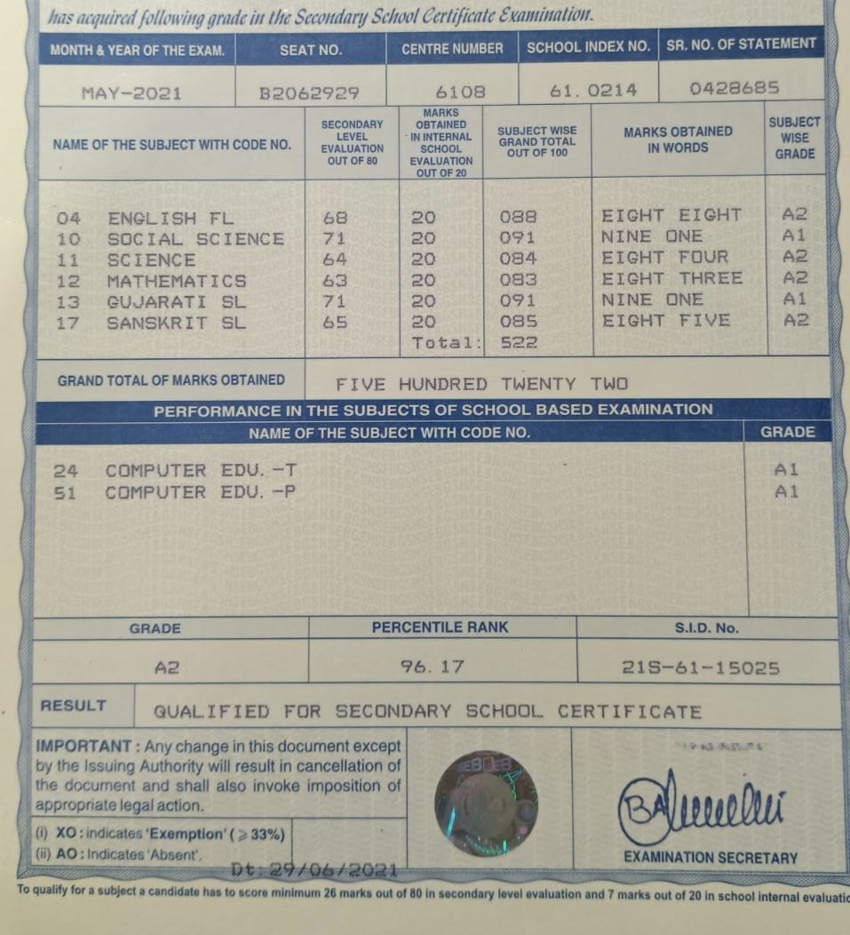
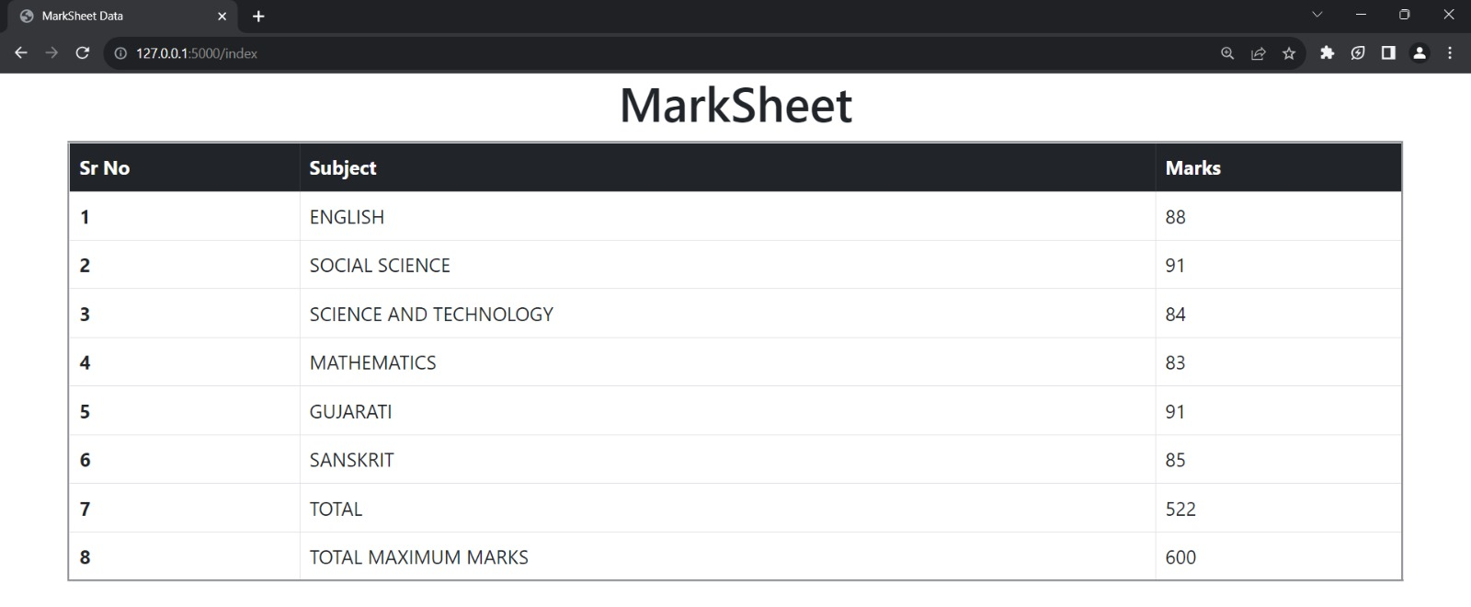
Our project Output:
→→→

Slide 14
Thank you

