Slide 1
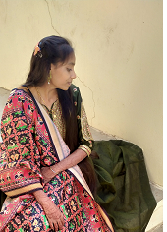
RESUME
Name :- HINGLADIYA MADHVI GANESHBHAI
Mobile No :- 9428822468
Email :- madhvipatel3101@gmail.com
____________________________________________________________________
PERSONAL DATA :-
Father’s Name :- GANESHBHAI
Mother’s Name :- RANJANBEN
Date of Birth :- January 31,2002
Nationality :- Indian
Heigh :- 5cm
Weight :- 35kg
_______________________________________________________________________________________________________________
Education Qualification :-
Xth passed form C.B.S.E
XIIth passed form C.B.S.E
Under Graduation (BCA)
_______________________________________________________________________________________________________________
Language Known :-
Gujrati
Hindi
_______________________________________________________________________________________________________________
Hobbies :-
Travelling
Reading

