Slide 1
Project IV: SOCKS4 Server
指導教授 : 吳毅成

Slide 2
Architecture (1/3)
Browser
SOCKS
SERVER
HTTP
SERVER
HTTP REQUEST
HTTP REQUEST
REPLY
HTML
REPLY
HTML

Slide 3
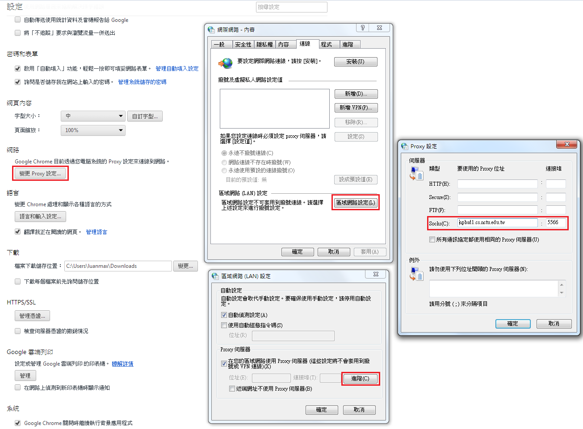
Related work

Slide 4
Architecture (2/3)
COMMAND
COMMAND
Browser
HTTP
SERVER
CGI
SOCKS
SERVER
RAS
RESULT
RESULT
COMMAND
RESULT

Slide 5
Architecture (3/3)
FIP
CLIENT
SOCKS
SERVER
FTP
SERVER
FTP REQUEST
FTP REQUEST
REPLY
REPLY
DATA
DATA
DATA
DATA

Slide 6
Related work
測試請不要用FileZilla
建議使用FlashFXP

Slide 7
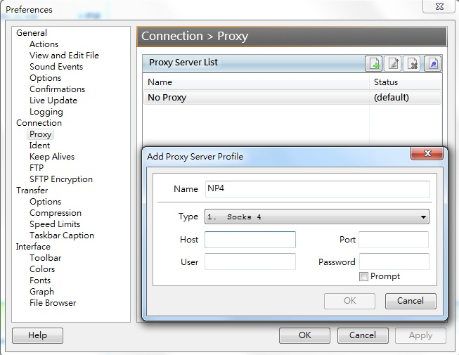
Related work
Options → Preferences→Connection→Proxy
Add entry
Socks4, Host/Port

Slide 8
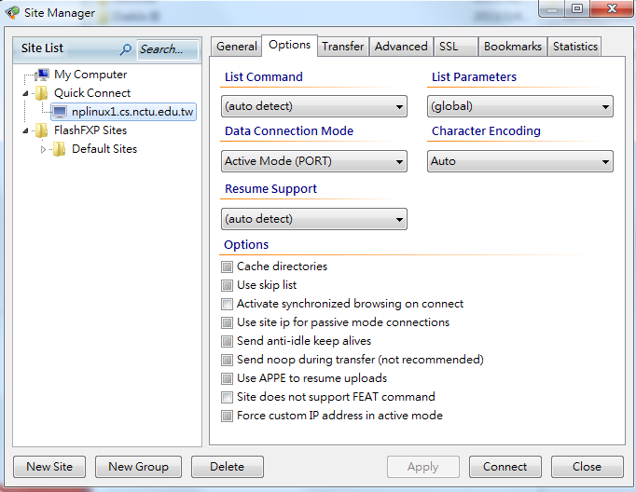
Related work
Sites → Site Manager→Option→ Data Connection Mode
Change to Active Mode(PORT)

Slide 9
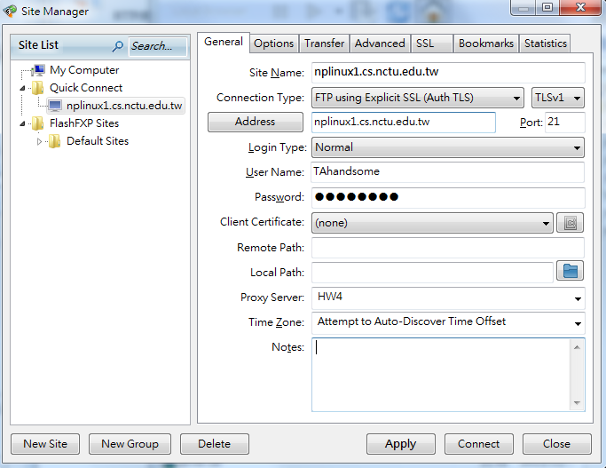
Related work
Sites → Site Manager→General → Apply
Connect

Slide 10
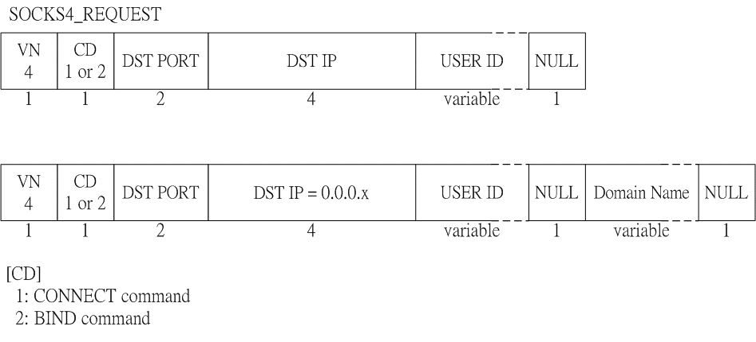
Implementation

Slide 11
Implementation
Request
read(sock, buffer, size);
unsigned char VN = buffer[0] ;
unsigned char CD = buffer[1] ;
unsigned int DST_PORT = buffer[2] << 8 |
buffer[3] ;
unsigned int DST_IP = buffer[4] << 24 |
buffer[5] << 16 |
buffer[6] << 8 |
buffer[7] ;
char* USER_ID = buffer + 8 ;

Slide 12
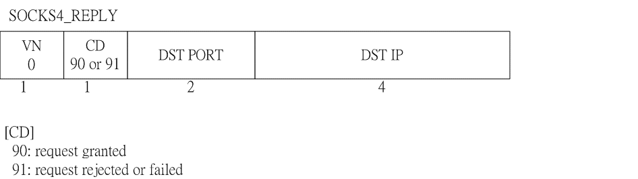
Implementation

Slide 13
Implementation
Reply
package[0] = 1;
package[1] = (unsigned char) CD ; // 90 or 91
package[2] = port / 256;
package[3] = port % 256;
package[4] = ip >> 24;
package[5] = (ip >> 16) & 0xFF;
package[6] = (ip >> 8) & 0xFF;
package[7] = ip & 0xFF;
write(sock, package, 8);

Slide 14
Protocol
Connect mode
Bind mode

Slide 15
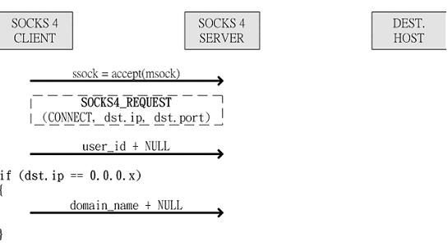
Connect mode

Slide 16
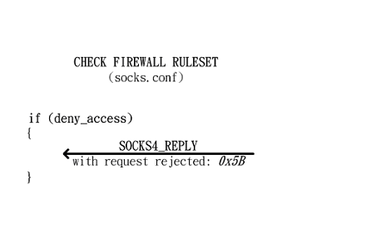
Connect mode

Slide 17
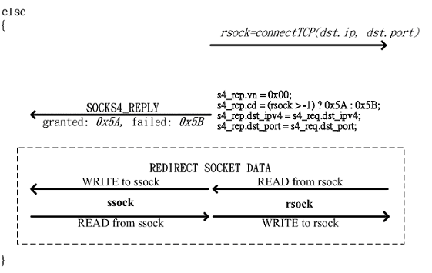
Connect mode

Slide 18
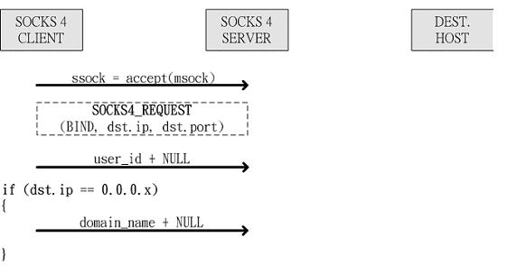
Bind mode

Slide 19
Bind mode

Slide 20
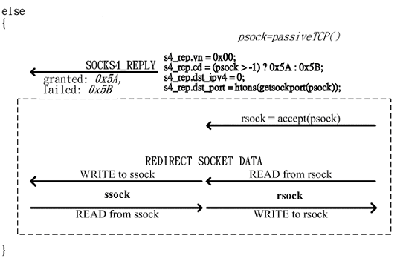
Bind mode

Slide 21
END

