Slide 1
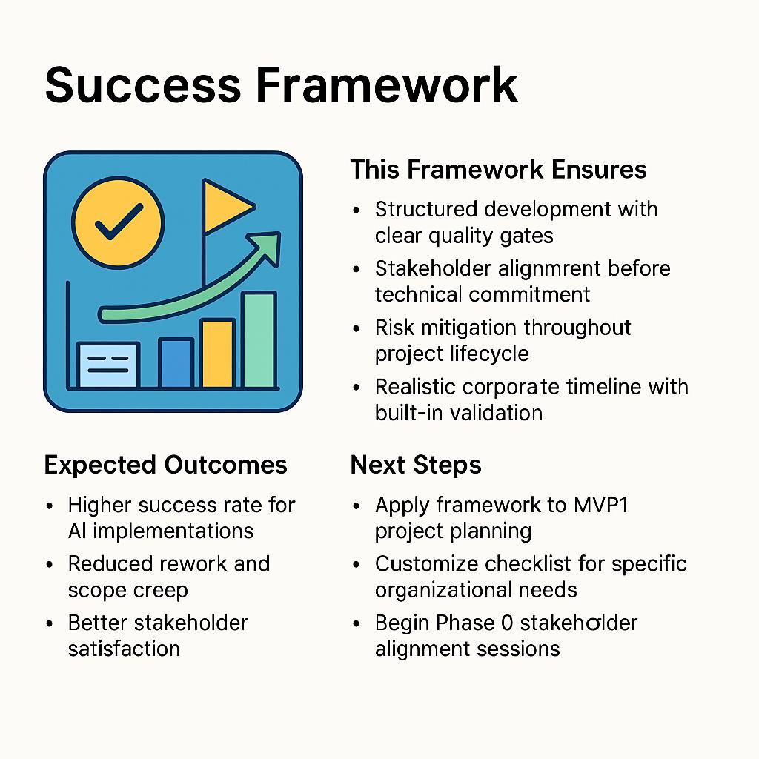
Success Framework
This Framework Ensures
Structured development with clear quality gates
Stakeholder alignment before technical commitment
Risk mitigation throughout project lifecycle
Realistic corporate timeline with built-in validation
Expected Outcomes
Higher success rate for AI implementations
Reduced rework and scope creep
Better stakeholder satisfaction
Maintainable, documented systems
Next Steps
Apply framework to MVP1 project planning
Customize checklist for specific organizational needs
Begin Phase 0 stakeholder alignment sessions

