Slide 1
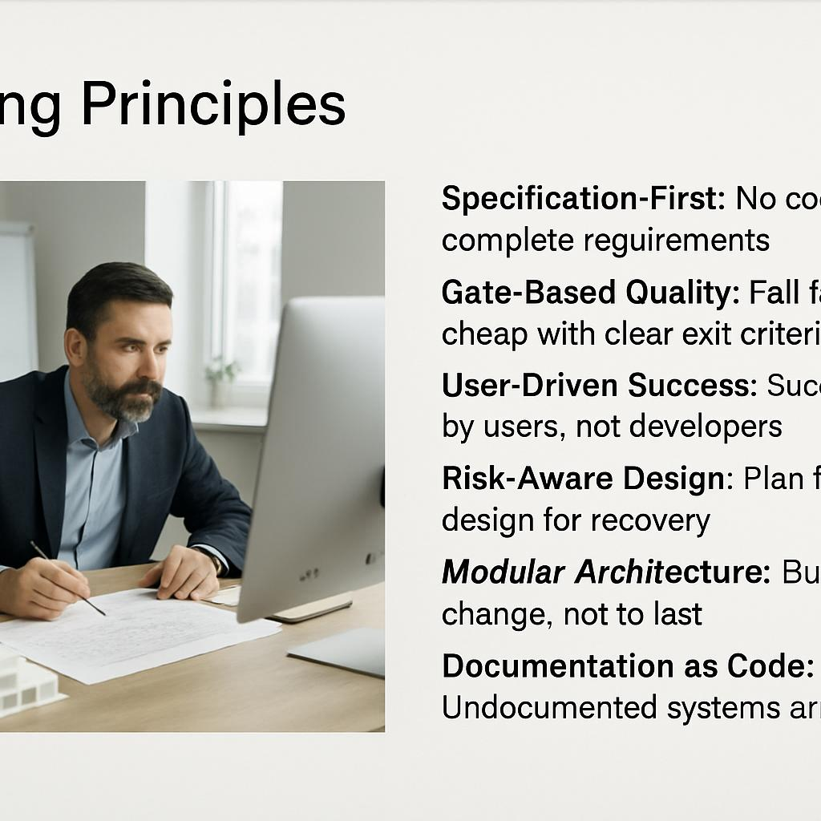
Guiding Principles
Specification-First: No code without complete requirements
Gate-Based Quality: Fail fast, fail cheap with clear exit criteria
User-Driven Success: Success defined by users, not developers
Risk-Aware Design: Plan for failure, design for recovery
Modular Architecture: Build to change, not to last
Documentation as Code: Undocumented systems are unmaintainable
Corporate Integration: Technology serves business processes

