Slide 1
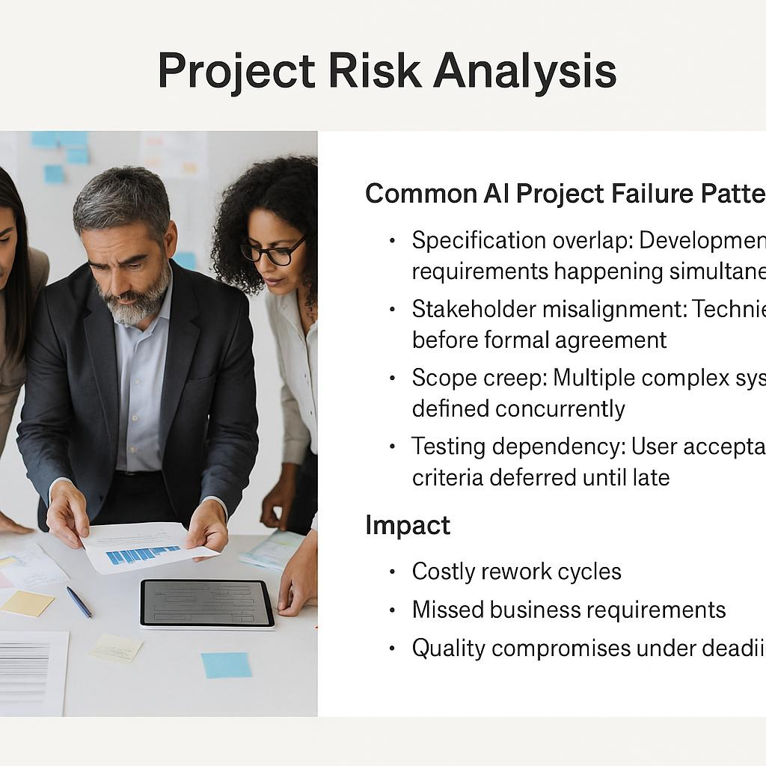
Project Risk Analysis
Common AI Project Failure Patterns
Specification overlap: Development and requirements happening simultaneously
Stakeholder misalignment: Technical work before formal agreement
Scope creep: Multiple complex systems defined concurrently
Testing dependency: User acceptance criteria deferred until late
Impact
Costly rework cycles
Missed business requirements
Quality compromises under deadline pressure

