Slide 1
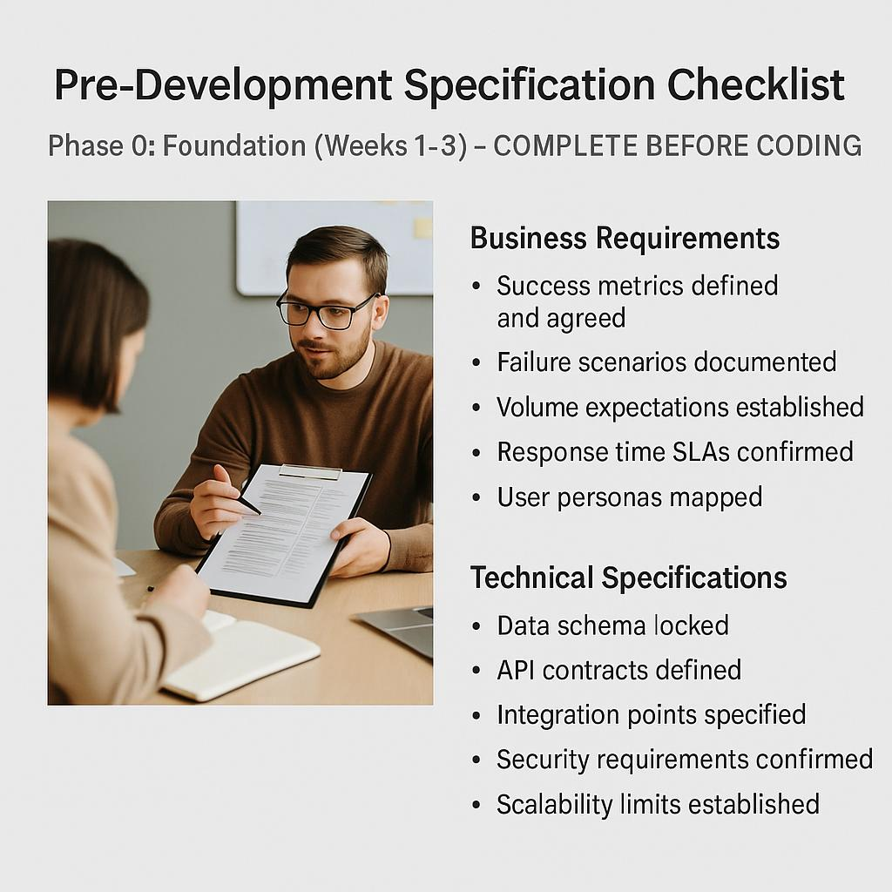
Pre-Development Specification Checklist
Phase 0: Foundation (Weeks 1–3) – COMPLETE BEFORE CODING
Business Requirements
Success metrics defined and agreed
Failure scenarios documented
Volume expectations established
Response time SLAs confirmed
User personas mapped
Technical Specifications
Data schema locked
API contracts defined
Integration points specified
Security requirements confirmed
Scalability limits established

