Slide 1
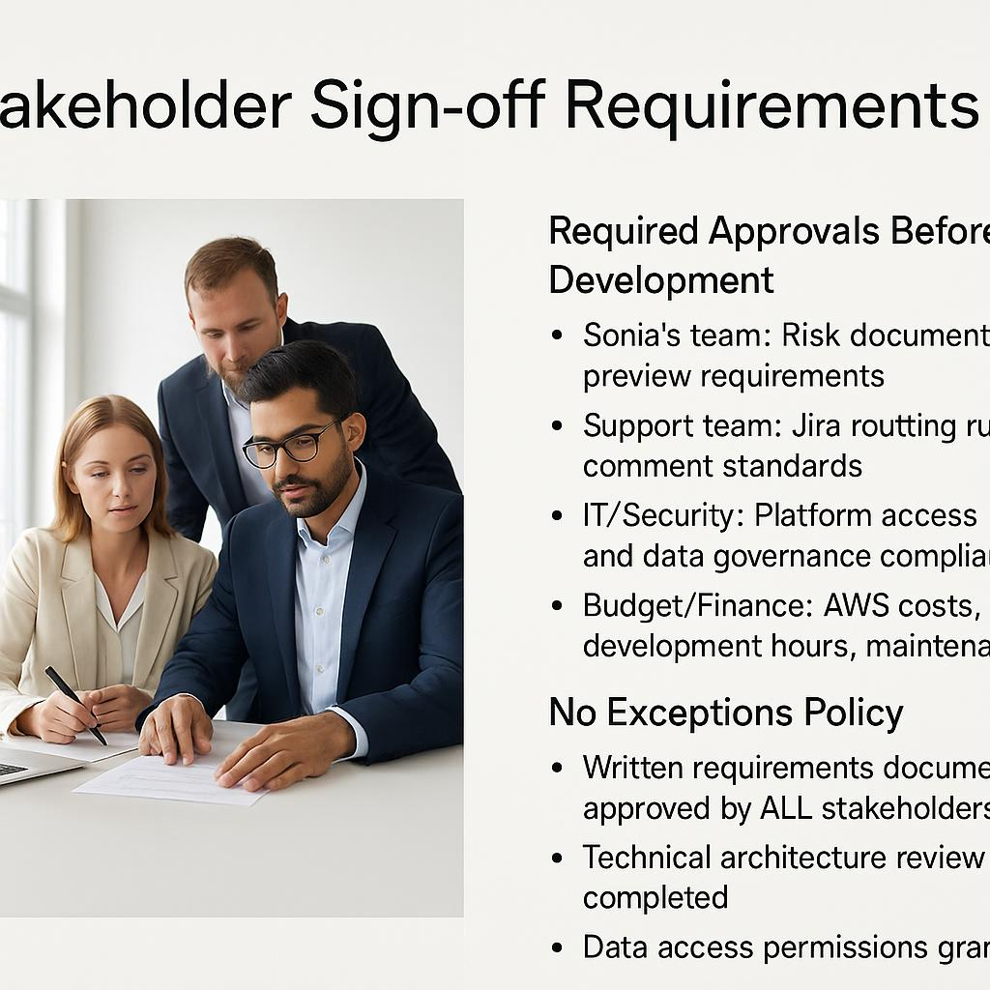
Stakeholder Sign-off Requirements
Required Approvals Before Development
Sonia's team: Risk document types and preview requirements
Support team: Jira routing rules and comment standards
IT/Security: Platform access and data governance compliance
Budget/Finance: AWS costs, development hours, maintenance
No Exceptions Policy
Written requirements document approved by ALL stakeholders
Technical architecture review completed
Data access permissions granted
Success metrics and testing plan agreed

