Slide 1
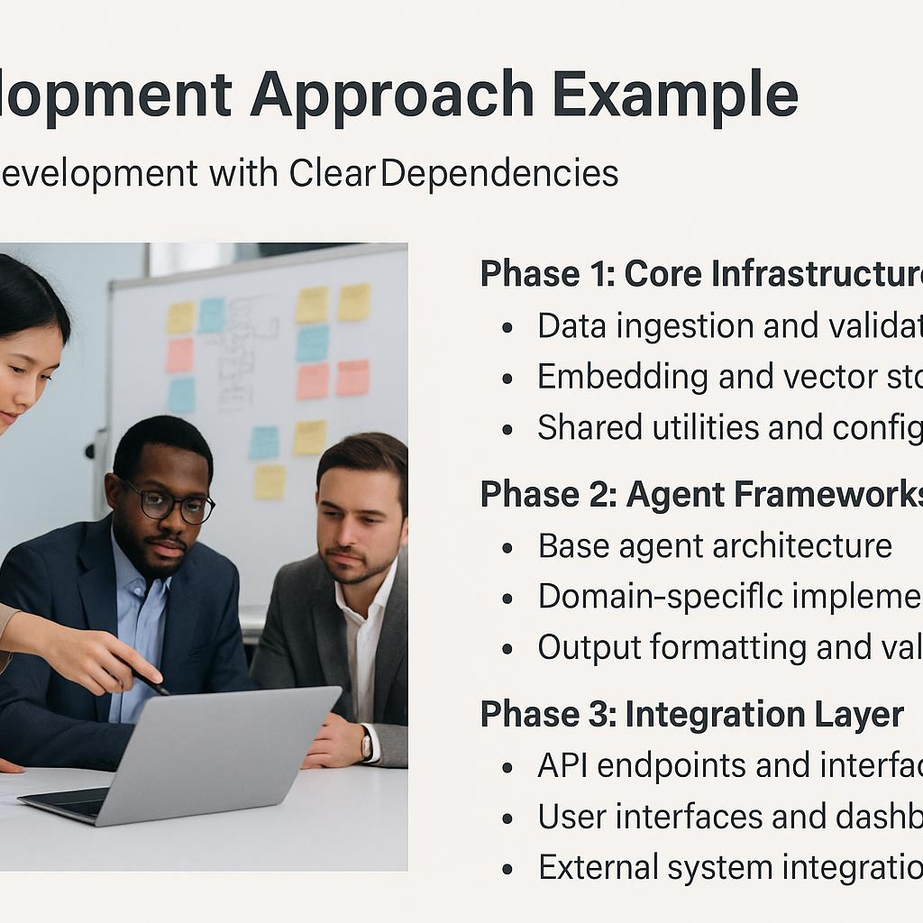
Development Approach Example
Phased Development with Clear Dependencies
Phase 1: Core Infrastructure
Data ingestion and validation
Embedding and vector storage
Shared utilities and configuration
Phase 2: Agent Frameworks
Base agent architecture
Domain-specific implementations
Output formatting and validation
Phase 3: Integration Layer
API endpoints and interfaces
User interfaces and dashboards
External system integrations

