Slide 1
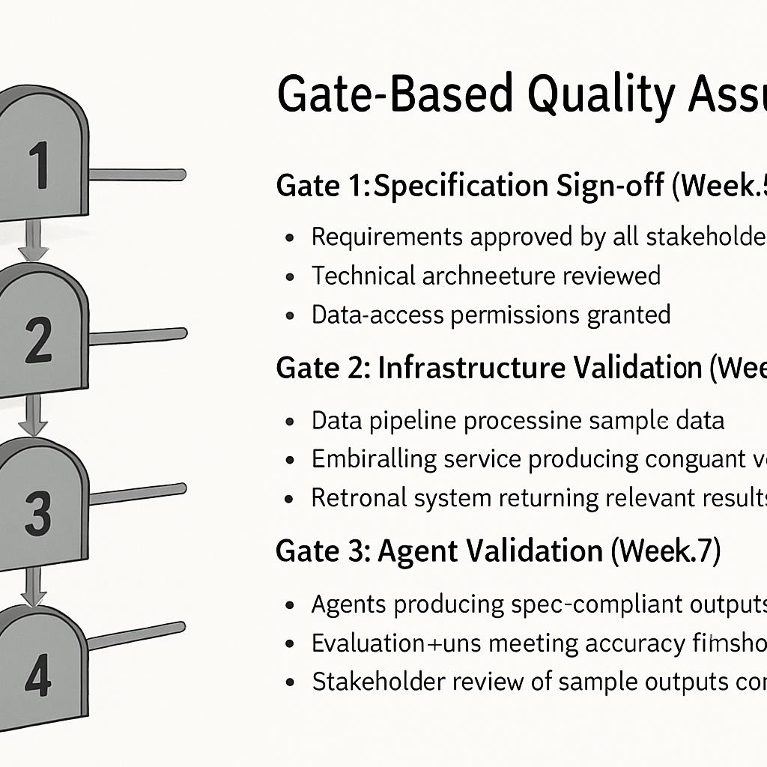
Gate-Based Quality Assurance
Gate 1: Specification Sign-off (Week 3)
Requirements approved by all stakeholders
Technical architecture reviewed
Data access permissions granted
Gate 2: Infrastructure Validation (Week 5)
Data pipeline processing sample data
Embedding service producing consistent vectors
Retrieval system returning relevant results
Gate 3: Agent Validation (Week 7)
Agents producing spec-compliant outputs
Evaluation runs meeting accuracy thresholds
Stakeholder review of sample outputs completed
Gate 4: Integration Testing (Week 9)
End-to-end testing completed
Security review passed
Load testing within limits

