Slide 1
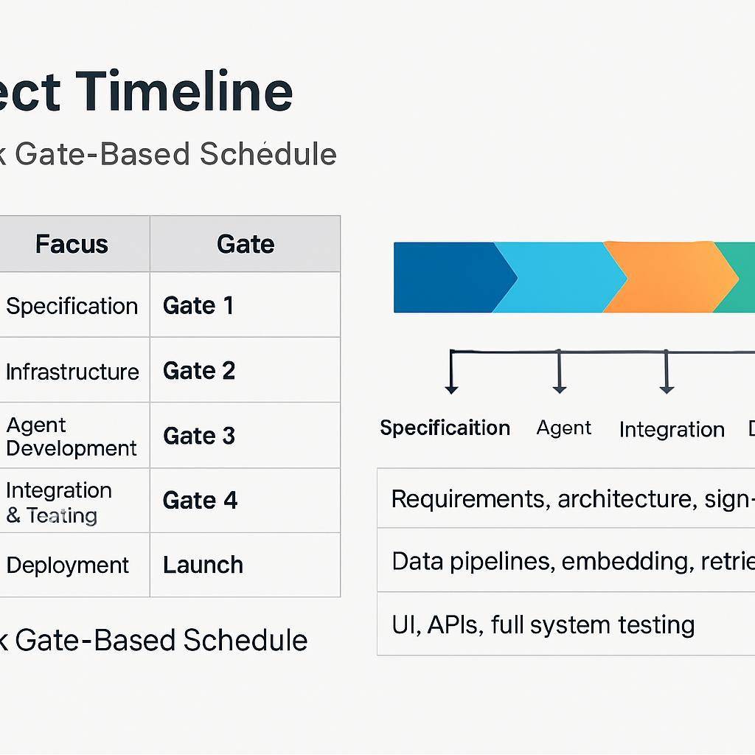
Project Timeline
12-Week Gate-Based Schedule
Weeks 1–3 – Specification (Gate 1): Requirements, architecture, sign-offs
Weeks 4–5 – Infrastructure (Gate 2): Data pipelines, embedding, retrieval
Weeks 6–7 – Agent Development (Gate 3): Working agents, evaluation results
Weeks 8–9 – Integration & Testing (Gate 4): UI, APIs, full system testing
Weeks 10–12 – Deployment (Launch): Production-ready system

