Slide 1
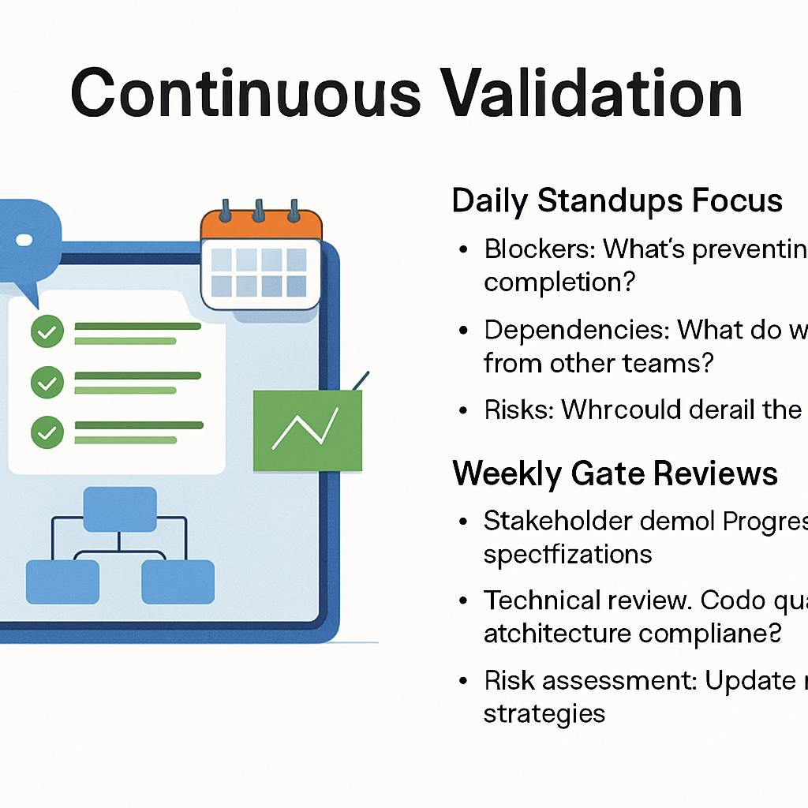
Continuous Validation
Daily Standups Focus
Blockers: What's preventing gate completion?
Dependencies: What do we need from other teams?
Risks: What could derail the timeline?
Weekly Gate Reviews
Stakeholder demo: Progress against specifications
Technical review: Code quality, architecture compliance
Risk assessment: Update mitigation strategies
Quality Practices
Prototype early for stakeholder feedback
Test continuously, don't wait for integration
Document all decisions and rationale

