Slide 1
ENSEMBLE LEARNING · FINAL PROJECT REPORT
Boosting vs. Bagging
An Empirical Comparison of Ensemble Methods
A Comparative Analysis of AdaBoost and Random Forest
Rufet Dosteliyev · Raul Agayev · Emil Ahmedli · Nicat Eleskerli
AI Academy, National AI Center
Spring 2026

Slide 2
MOTIVATION
Motivation & Research Question
1
Comparative study
THE CENTRAL QUESTION
Custom, from-scratch implementations of every core algorithm — not library black boxes.
“Under what conditions does boosting outperform bagging, and vice versa — and why?”
2
Bias-variance lens
Designed to expose how each paradigm trades bias against variance as complexity grows.
3
Noise robustness
Stress-tested under label noise to see which ensemble degrades gracefully.
2

Slide 3
METHODOLOGY
From-Scratch Implementations
DT
AB
RF
Decision Tree
AdaBoost
Random Forest
CART methodology with exhaustive split search. Supports Gini impurity or entropy, plus sample_weight for the boosting module.
Discrete SAMME variant using depth-1 stumps. Sample weights re-computed each round; stump trained on weighted data.
Bootstrap sampling with sqrt feature sub-sampling per split. Out-of-bag (OOB) error estimated from held-out trees.
Code: https://github.com/Rufet132/v1.0-final
3

Slide 4
EXPERIMENTAL SETUP
Data Overview & Experimental Setup
Dataset | Samples | Features | Classes | Character
Breast Cancer Wisconsin | 569 | 30 | 2 | Clean, binary, low-dim
Adult Income | 6,000 | 104 | 2 | One-hot encoded, mild imbalance
Covertype (subset) | 6,000 | 54 | 7 | Multi-class, imbalanced (0.47% min.)
MNIST 3-vs-8 | 6,000 | 784 | 2 | High-dimensional, raw pixels
Preprocessing
Standardized features; Adult rows with missing values dropped (<8%); scaler fit on train split only
Metrics
Accuracy, Macro F1, AUC-ROC (micro-averaged for multi-class)
Validation
5-fold cross-validation, fixed random seed (42)
4

Slide 5
MAIN RESULT
Head-to-Head: Boosting vs. Bagging
Boosting (AdaBoost) wins
Bagging (Random Forest) wins
KEY FINDING
Boosting wins only on Breast Cancer (+0.53%).
Bagging wins
Adult (+0.47%), MNIST (+2.99%), and decisively Covertype (+13.62% F1).
5

Slide 6
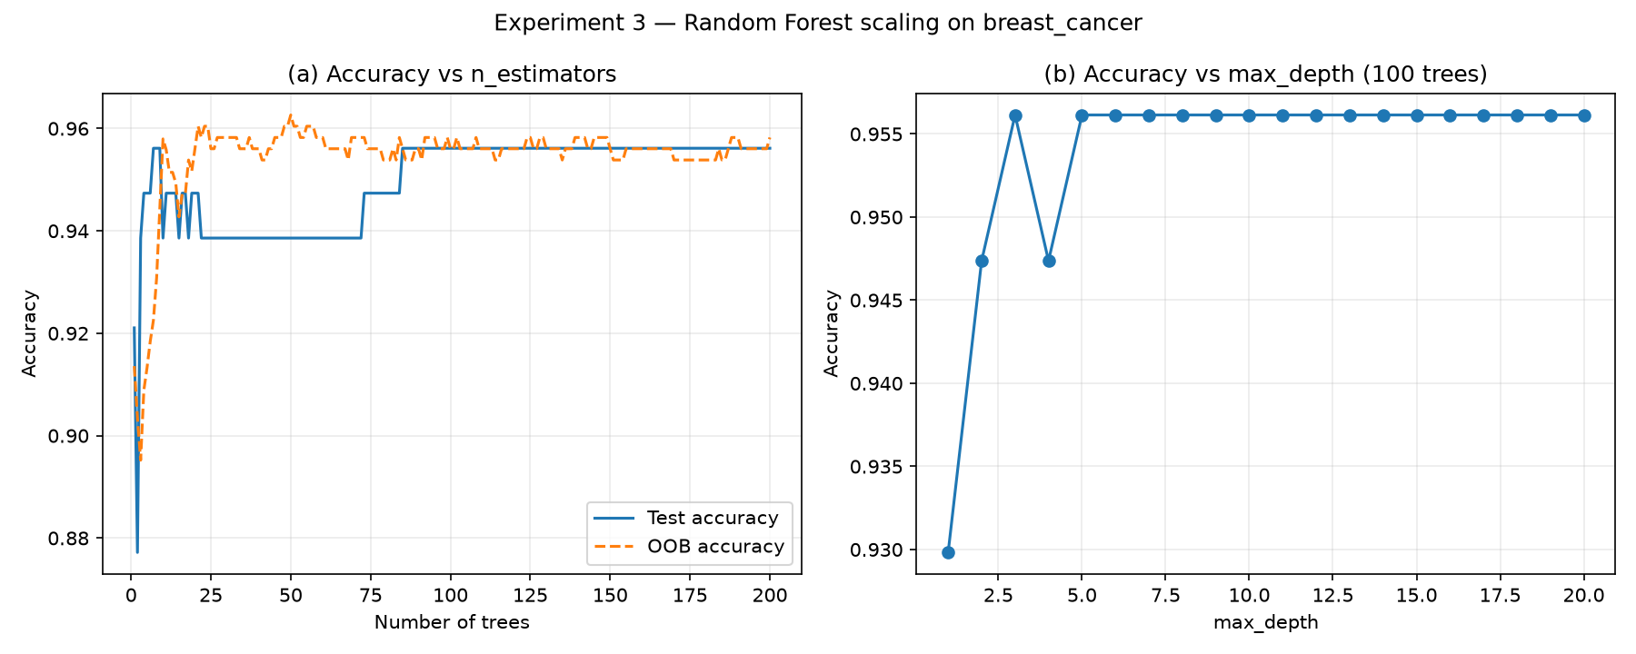
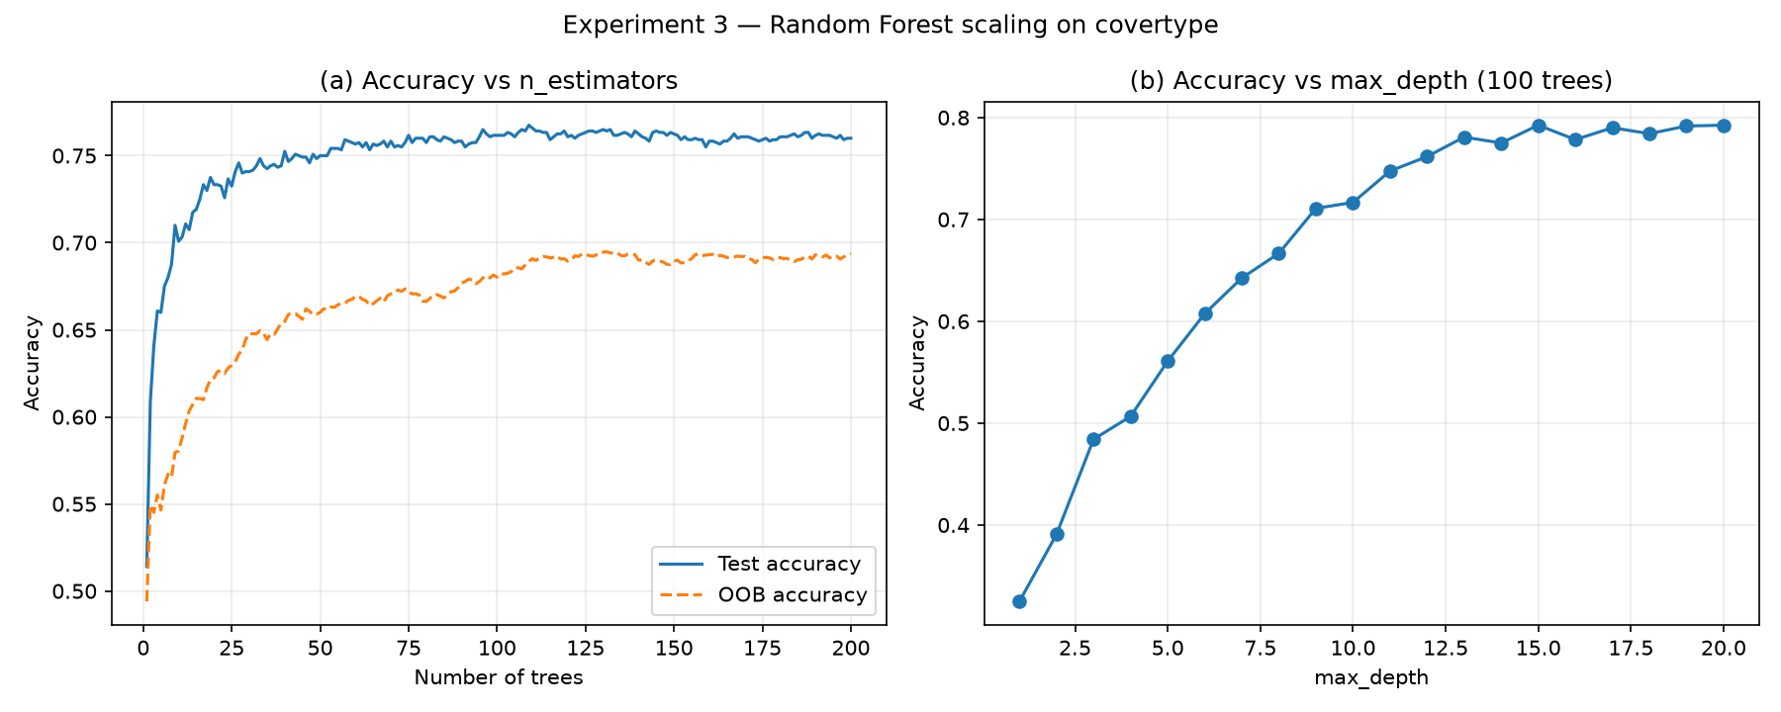
SCALING BEHAVIOUR
Random Forest: Scaling with Estimators
(a) Breast Cancer — stabilizes almost immediately
(b) Covertype — climbs steadily, then plateaus
Discussion
Random Forest test accuracy climbs smoothly with more trees and settles into a stable plateau — adding estimators never hurts. OOB error tracks held-out test error closely across all four datasets, confirming it as a reliable, no-extra-cost validation signal.
6

Slide 7
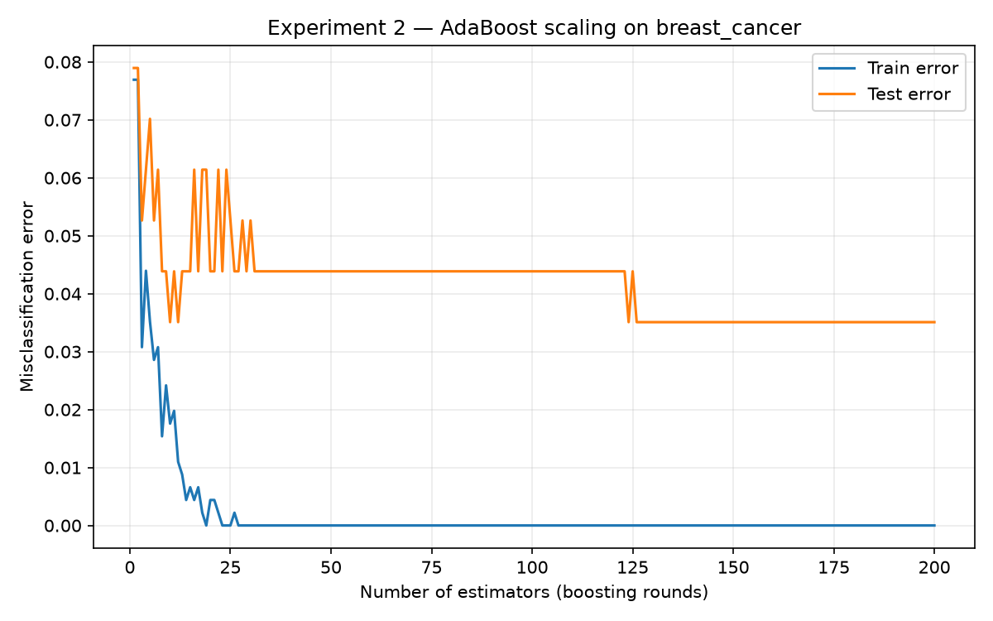
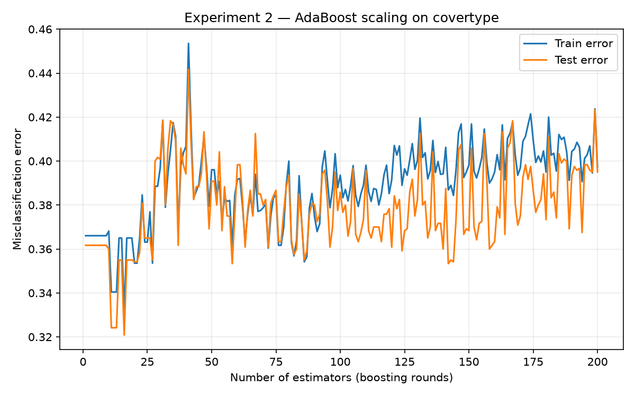
SCALING BEHAVIOUR
AdaBoost: Scaling with Stumps
(a) Breast Cancer — train error hits zero, test error plateaus
(b) Covertype — both errors stay high and noisy
Discussion Point: depth-1 stumps let AdaBoost drive training error to zero on simple data, but it plateaus — or fails to converge at all — once the decision boundary needs more than one split per round.
7

Slide 8
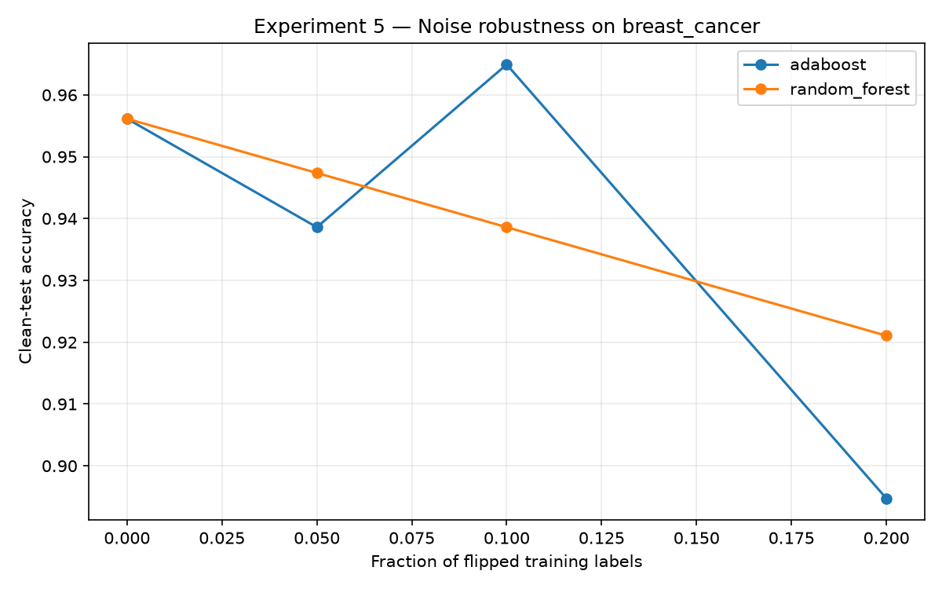
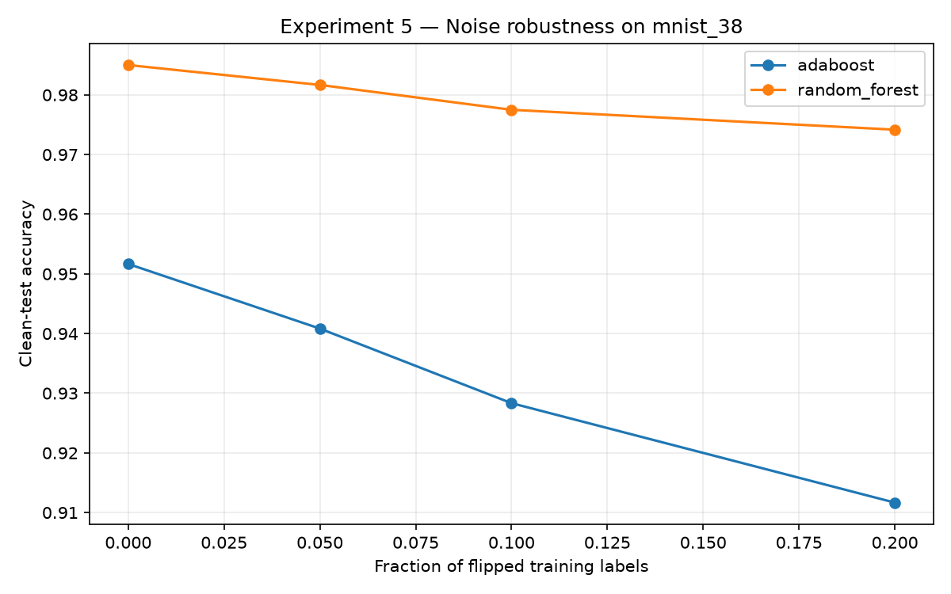
ROBUSTNESS
Sensitivity to Label Noise
(a) Breast Cancer
(b) MNIST 3-vs-8
Key takeaway: AdaBoost's accuracy degrades 3–4× faster than Random Forest as label noise rises — its exponential reweighting locks onto mislabeled outliers, forcing later stumps to overfit corrupted points. Random Forest's independent bootstrap averaging smooths the damage out.
8

Slide 9
WHY IT HAPPENS
Bias-Variance Trade-off
~17%
Random Forest suppresses variance further — the source of its edge in stability and robustness.
Bias reduction — both ensembles, essentially tied vs. a single tree
Model | Bias² | Variance | Mean Error
Decision Tree | 0.0526 | 0.0696 | 0.0831
AdaBoost | 0.0439 | 0.0241 | 0.0469
Random Forest | 0.0439 | 0.0188 | 0.0533
Breast Cancer bootstrap decomposition, 100 replicates — a ceiling effect ties bias reduction; variance is where the paradigms diverge.
9

Slide 10
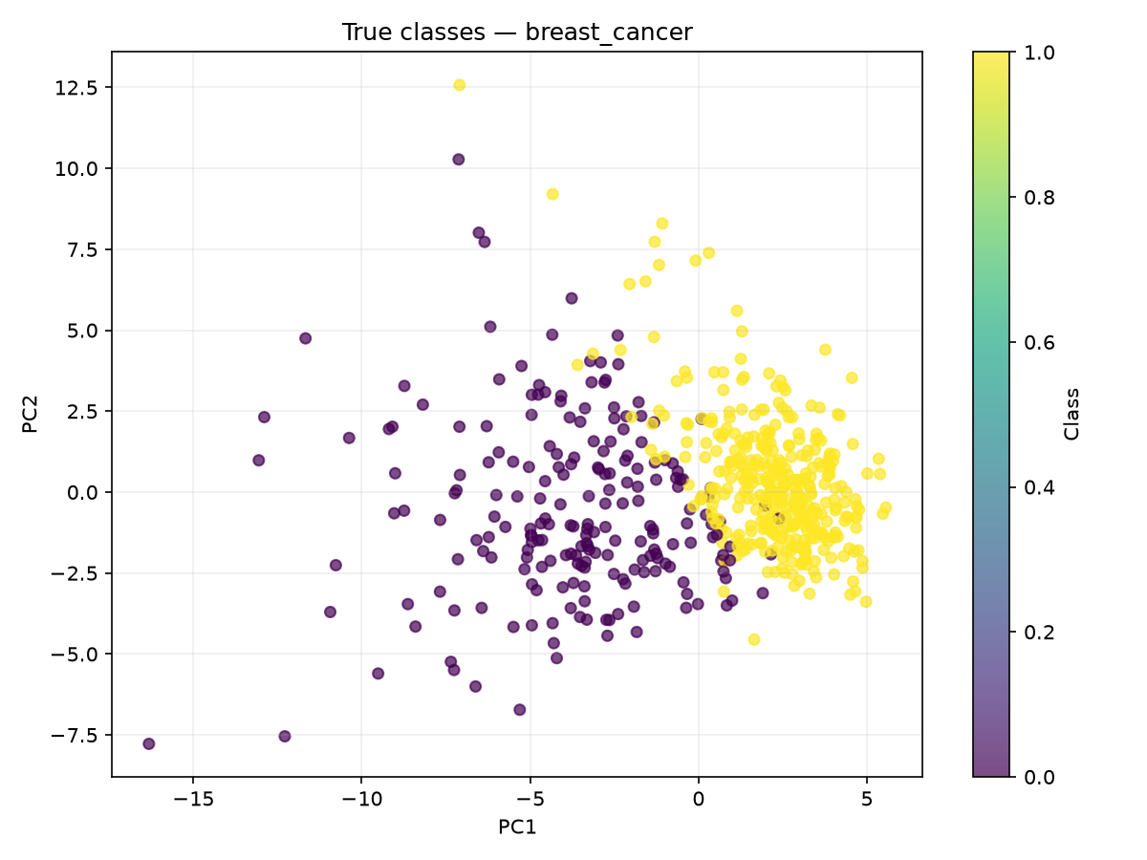
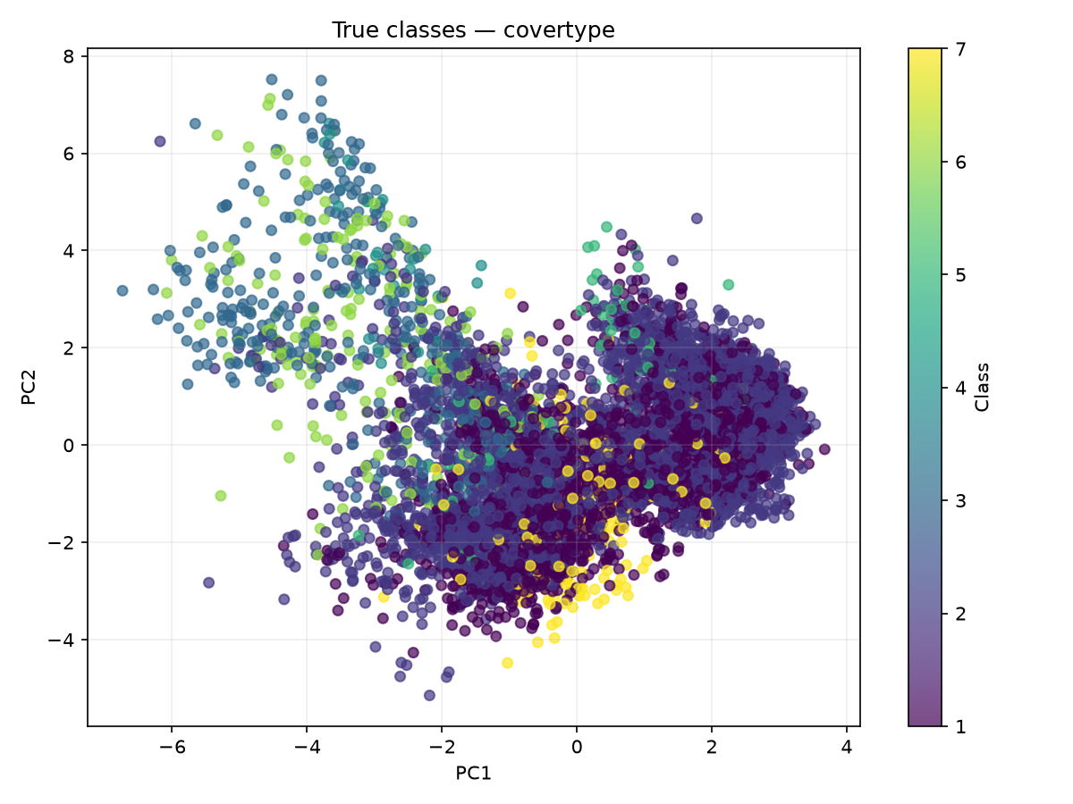
UNSUPERVISED INSIGHTS
Cluster-Label Agreement Foreshadows Difficulty
High ARI predicts high ensemble accuracy. Low ARI correctly flags feature-space overlap and difficulty — data topology matters for model selection.
Breast Cancer — ARI = 0.67
Covertype — ARI ≈ 0.1–0.2
10

Slide 11
CONCLUSION
Boosting for Small & Clean.
Bagging for Large & Complex.
Variance reduction: Random Forest suppresses variance 73% vs. AdaBoost's 65%
Noise robustness: AdaBoost degrades 3–4× faster under label noise
Scalability: Bagging wins Adult, MNIST, and decisively Covertype as complexity grows
11

Slide 12
LOOKING AHEAD
Limitations & Extended Work
PRIMARY LIMITATION
EXTENDED WORK — ALREADY DELIVERED
AdaBoost used only depth-1 decision stumps. Single-axis splits cannot capture multi-feature interactions, which constrained ensemble expressiveness on complex, high-dimensional spaces like Covertype.
Gradient Boosting Machines (GBM)
SAMME.R real-valued boosting
t-SNE manifold visualizations
Deeper weak learners (depth 3–8) could close the gap on multi-class problems.
These bonus components corroborate the core findings and give deeper geometric visibility into ensemble decision boundaries.
12

Slide 13
REFERENCES
Key References
Hastie, Tibshirani & Friedman
The Elements of Statistical Learning, 2nd ed., Springer, 2009
Freund & Schapire
A decision-theoretic generalization of on-line learning and an application to boosting, J. Comput. Syst. Sci., 1997
Breiman
Bagging predictors, Machine Learning, 1996
Breiman
Random forests, Machine Learning, 2001
Quinlan
Induction of decision trees, Machine Learning, 1986
13

Slide 14
Thank You
Questions & Discussion
https://github.com/Rufet132/v1.0-final

