Slide 1

Growth
An internal talent marketplace for Home Credit Philippines
Action Learning Project · Ruffa Gayla Gonzales, Organisational Effectiveness · September 2026
17%
₱18.5M
₱2.06M
6 mo
of roles filled
from inside
a year that
costs us
to build and run
for three years
to pay for
itself
Notes:
Fifteen minutes: roughly seven on the deck, eight in the product. I will show you the problem, show you the thing working, then show you the money.
One sentence up front: we fill 17% of our roles from the inside, the benchmark is 30%, and the gap is costing us about 18.5 million pesos a year in revenue we never book. Growth closes it for 2.06 million over three years, which is 617 pesos per employee per year in the pilot and 87 across the whole company.

Slide 2
EXECUTIVE SUMMARY
We are buying from outside what we already have inside.
WHAT WE ARE ASKING FOR
THE PROBLEM
Build Growth for a 1,113-person pilot — IT, HR and Operations, mass and non-mass.
Over 2023–2026 we opened 1,008 non-mass vacancies. 463 people applied from inside. 170 got the job — a 17% internal fill rate against a 30% market benchmark.
₱2.06M
three-year cost, all in
And saying no has a price. We have turned down 293 internal applicants since 2024. 79 have since resigned — 27% against a 17% company average, with career the reason they gave.
₱617
per employee a year
6 months
to pay for itself
THE CAUSE
5× – 14×
cheaper than buying a platform
Not selection — visibility. Nothing shows an employee a role they would fit, and nothing tells a manager the person they need is already on payroll.
Working prototype already built. You will see it in eight minutes.
2
Notes:
This is the whole case on one slide. Everything after it is evidence.
The 17% is ours: 170 accepted out of 1,008 non-mass vacancies posted between 2023 and 2026. The 30% is the published market benchmark for internal fill; mature marketplaces run 40-50%.
The 293/79 number is the one I would hold onto. It is not modelled, it is a headcount we can check: 293 people raised their hand across the last three years, we told them no, and 79 have since resigned — 27% against a 17% company average, and career was the top reason they gave on the way out. MyPulse says the same thing from the other side: 88% eNPS on growth. People want this and cannot find it.
If asked "is this causal" — no, not proven, and I have not put a peso on it. There is NO turnover benefit anywhere in the financial case. It is here because it is why the marketplace has four shelves rather than one: a "no" has to route somewhere other than the exit. The holdout in the adoption plan is how we settle it.

Slide 3
THE PROBLEM
Four out of five roles go to someone we have not met.
Internal job posting data, 2024 to 2026 — three years, company-wide.
1,008
463
17%
170
vacancies opened
internal applicants
internal fill rate
internal hires
the benchmark is 30%
Then look at the people we turned down.
43%
16
₱5.2M
In 2025 we said no to 67 internal applicants. Today 38 are still here. We have already lost 29 of them.
of that cohort has
already left
more than a 28%
comparator predicts
replacement cost
of that excess
The 67 and the 38 are HRIS fact. The comparator attrition rate is not yet confirmed — see appendix. Source: HC Connect 2024–2026.
3
Notes:
Read the funnel left to right and it looks like a selection problem. It is not.
463 applications across three years, from a company of 20,587 people. That is the real number: fewer than eight internal applications a week, company-wide. People are not being rejected in droves — they are not applying, because they cannot see the roles.
The bottom band is the part that should worry us, and I want to be precise about what is measured and what is not.
MEASURED: 67 people raised their hand in 2025, we said no, and 29 have since left. 43% of that cohort. That comes straight out of HRIS and anyone can re-pull it.
NOT MEASURED: what to compare it against. An earlier draft of this used 19% as a company average. I have withdrawn that — it traced back to a placeholder tile in the v1 prototype dashboard, not to Payroll. The right comparator is attrition among band B and C non-mass staff, because that is who these applicants are; a whole-company rate would be dragged up by mass operations. HR has been asked for it.
The 16 and the 5.2 million on this slide assume a 28% comparator, which is what the 15-point excess I model implies. The appendix shows the case from 20% to 35%. If anyone asks the obvious question — what if the comparator is 35% — the answer is that the expected case still clears a ratio of 4.3, and I would rather show you that range than defend a number I cannot source.

Slide 4
WHY IT HAPPENS
Three blind spots, none of which is a people problem.
01
02
03
Employees cannot see it
The manager cannot find them
The record does not exist
Vacancies sit in a tool nobody browses. Gigs and immersions are arranged privately. You hear about the role after it is filled.
There is no skills inventory. A hiring manager cannot ask "who inside can already do this?", so the default is to post externally.
Skills live in CVs, IDPs and people's memories. Nothing is verified, nothing is current, none of it is searchable.
The constraint is not that our people are unqualified. It is that the market inside Home Credit has no shelves.
88%
463 applications in three years is not apathy. People say they believe they can grow here — they cannot find where.
believe they can grow at Home Credit
eNPS on growth opportunity
4
Notes:
Keep this to twenty seconds. It is the bridge between the problem and the product.
The point to land: every one of these three is a systems gap, not a talent gap or a manager-attitude gap. That matters because it means the fix is buildable rather than cultural, and buildable things have costs and timelines you can approve.
If a panel member pushes on manager hoarding — it is real, and it is on the risk slide. But hoarding cannot explain 463 applications; you cannot hoard a role nobody applied to.

Slide 5
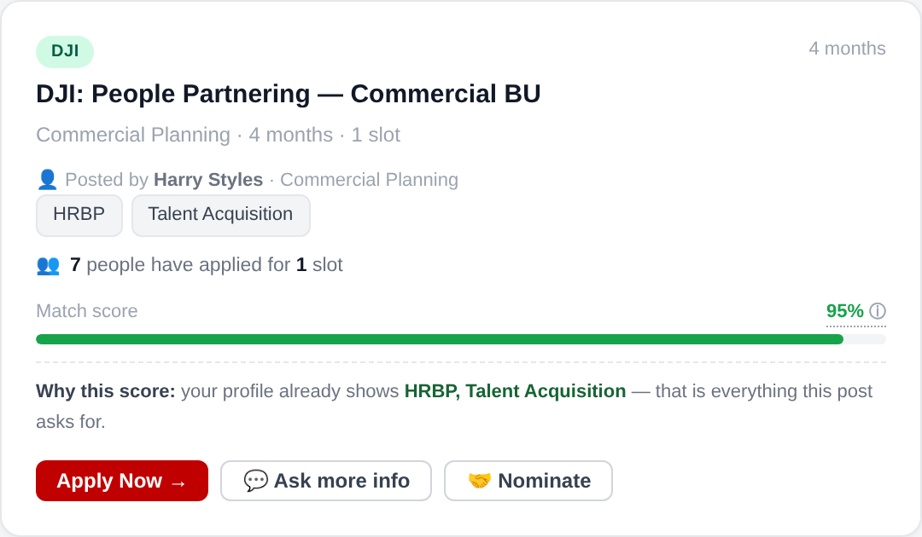
THE SOLUTION
One place. Every opportunity. Scored against you.
FOUR SHELVES
EVERY POST IS SCORED AGAINST YOUR PROFILE
Vacancies
Permanent internal roles, mirrored from HC Connect
Gigs
Short projects, days to weeks, alongside the day job
Job immersions
Three to nine months in another function
Service offers
An employee offering a skill to the business
Plus a skills passport. Seeded from MyDevelopment and LinkedIn, verified by delivery.
An AI model reads the post and your profile, returns a score, and says why. It never blocks an application.
5
Notes:
Thirty seconds, then straight into the demo.
The four shelves matter because a vacancy is a once-a-year event but a gig is a once-a-month one. If the only thing on the marketplace is permanent roles, most people have no reason to come back, and the people we turn down leave with nothing. The gigs, immersions and service offers are the second door — and they are the answer to the 67/38 problem.
On the AI: it is Claude, called in batch when a post goes live. It scores against verified skills, self-declared skills, stated aspiration and track record. The reasoning is shown on every card, and a low score never stops anyone applying. That was a deliberate design decision — an opaque gate would have killed trust in week one.
Cost of the AI is 40,544 pesos a year at 1,113 people. It is on the cost slide and it is not inside IT's 1,785,500 build figure.

Slide 6
WHAT IS NEW HERE
Four choices that make this more than a job board.
1
A rejection has somewhere to go
2
The AI explains itself, and never gates
Every marketplace on the market is a board: one slot, one winner, everyone else leaves with nothing. Growth routes a "no" to a gig, an immersion or a service offer.
Each match shows its reasoning in plain language, and no score can block an application. An opaque ranking engine would have cost us trust in week one.
3
Skills carry provenance
4
Built before it was bought
Verified by delivered work, uploaded by HR, or self-declared — and the rubric weights them differently. A claimed skill is never treated as a proven one.
A working prototype exists today, made inside Organisational Effectiveness. We are asking you to fund a build you can use in this room, not a slide.
The first two are the ones that matter. A board raises applications and therefore raises rejections, and our data says rejection is what makes people leave.
6
Notes:
This is the slide for the creativity and innovation criterion, and it is forty seconds.
The honest framing: internal talent marketplaces are not a new product category. Gloat, Fuel50 and Eightfold have existed for years. What is designed here rather than copied is the response to a problem the category has not solved — that a marketplace which only sells permanent roles manufactures rejection, and rejection is what pushes people out. Our own 67/38 cohort is the evidence. The four shelves exist because of it.
On provenance: most systems treat a self-declared skill and a demonstrated one as the same string. Ours does not — verified, HR-uploaded and self-declared carry different weight in the match rubric, and the employee can see which is which on their own profile. That is what stops the skills inventory rotting into a wish list.
If the Chief AI Officer asks what is genuinely AI here rather than rules: the model reads unstructured job posts and unstructured profiles and produces a scored, explained judgement about adjacency — it understands that workforce planning is close to capacity planning without anyone maintaining a synonym table. The deliberate constraints are that it never ranks people against each other, never gates an application, and always shows its reasoning.

Slide 7
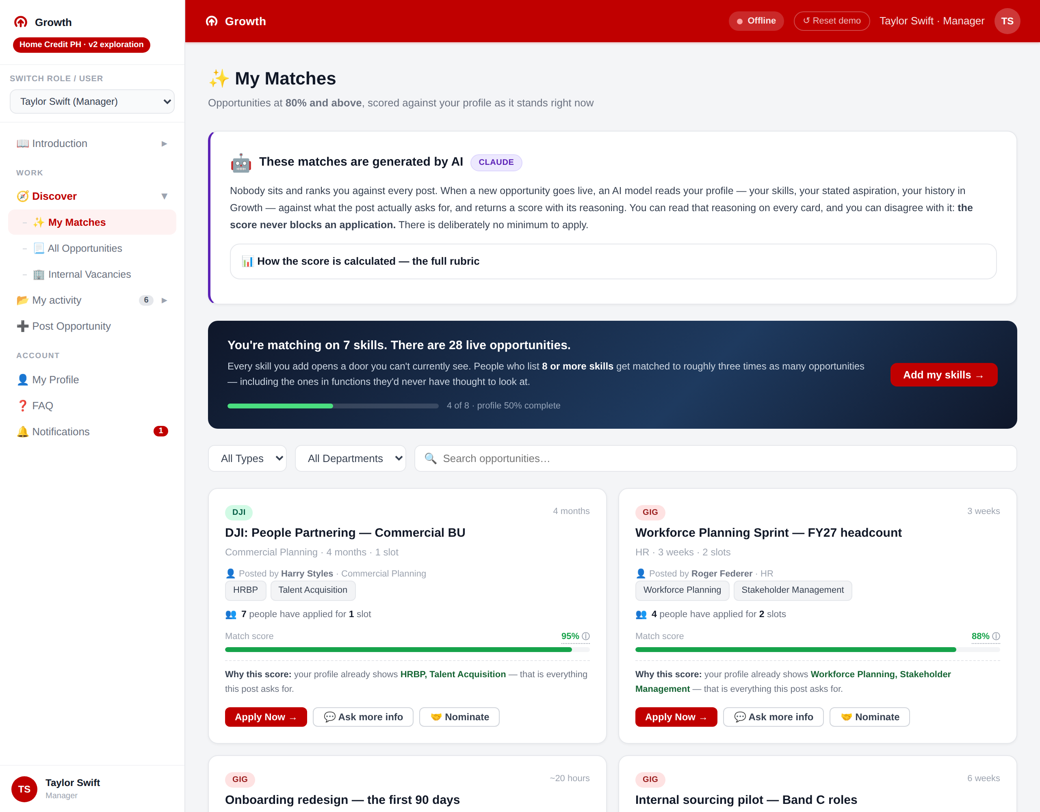
LIVE DEMONSTRATION
Let me show you
the working product.
1
An employee finds a match they never would have seen
2
They add one skill — and the matches change in front of you
Built and running today. No vendor, no licence, no integration project.
3
A manager posts a gig; HR approves it; it appears on the shelf
4
Work is closed out — and lands on the employee profile
7
Notes:
Eight minutes. Four beats, in this order, and do not improvise beyond them.
1. Sign in as Taylor Swift. Go to My Matches. Point out that the matches are 80% and above, and read one "why this score" line out loud. The panel needs to hear that the machine explains itself.
2. Go to My Profile and add a skill. Come back to My Matches. New opportunities appear. This is the single most persuasive twenty seconds in the demo — the marketplace is live, not a mockup.
3. Switch role to a manager. Post a gig. Switch to HR admin, approve it. Switch back to employee, and it is on the shelf with an applicant count. This proves the full loop, including governance.
4. Close out a completed immersion with a rating, then open the employee profile and show it recorded there. That is how a skill becomes verified rather than claimed.
If the demo fails: the screenshots in the appendix cover beats 1 and 3. Do not spend more than thirty seconds troubleshooting.

Slide 8
THE FINANCIAL CASE
Staying at 17% costs us ₱18.5M every year.
Per year, company-wide, at 336 non-mass vacancies a year. The incremental value of moving to the benchmark — not a three-year total.
17%
30%
50%
where we are
the benchmark
mature marketplaces
Internal fills, a year
57
101
168
Hiring cost avoided, a year
₱1.83M
₱3.22M
₱5.37M
Revenue lost to vacancy, a year
₱22.35M
₱39.44M
₱65.73M
Value captured, a year
₱24.17M
₱42.66M
₱71.10M
VALUE WE FORGO EVERY YEAR
baseline
₱18.49M
₱46.93M
One internal fill is worth ₱423,219. ₱31,989 of hiring cost we avoid, and ₱391,230 of revenue we do not lose — 69 days of output at ₱5,670 per employee per day. This is a speed case.
8
Notes:
This is the slide the CFO will test, and there is one number on it that carries everything.
NINETY-TWO PER CENT of the value is the revenue line. It is 69 days — bands C and D take 151 days to fill from outside and 82 from inside — multiplied by 5,670 pesos, which is net revenue divided by headcount divided by working days. So this is a SPEED case. The cost-per-hire saving is real but it is small change beside it.
Be ready for the obvious challenge, and I would rather raise it myself: lost revenue is not lost profit. If you want a contribution margin applied to that line, the case scales straight down with it and still clears comfortably — at a 50% margin the three-year value is 29.8 million against a 5.3 million org-wide cost, at 30% it is 19.6 million, at 20% it is 14.5 million. Even at twenty per cent this returns 2.7 times. The appendix has the table. Tell me the margin you want and I will hold the case to it.
The hiring-cost row is 35,367 pesos for a band C hire less the 3,378 of HR and TA cost we still pay when the move is internal. That 3,378 is not a saving and I have taken it out everywhere.
Two things I have deliberately NOT claimed. First, there is no turnover benefit in this case at all — an earlier version had one, and taking it out means nothing here depends on an attrition figure HR has not yet confirmed. Second, the 69 days is bands C and D combined while the hiring cost is band C alone; band C on its own is 42 days, which would put a fill at 270,000 rather than 423,000. The mixed basis comes from the working sheet, and it is the less conservative of the two.

Slide 9
WHAT 30% ACTUALLY TAKES
We cannot get there on today's applicant flow.
Every figure on this slide is a yearly rate. 463 applications over three years produced 170 hires — a 37% success rate.
156
a year today
AND HERE IS THE CATCH
More applications means more rejections.
275
a year for 30%
At a 30% fill rate we turn down 174 people a year instead of 99. On today's evidence, rejection is what makes them leave.
458
a year for 50%
So it cannot only sell jobs.
A "no" routes to a gig, an immersion or a service offer instead of to the exit. That is why Growth has four shelves and not one.
Internal applications have to rise 1.8× to reach the benchmark, and 2.9× to reach 50%. That is the whole job: make the roles visible and make people worth matching.
9
Notes:
This slide exists because "let us get to 30%" is the kind of target that gets approved and then quietly missed. The arithmetic says why.
463 applications produced 170 hires over three years — a 37% success rate. If that rate holds, 30% of 336 vacancies means 101 internal hires a year, which needs 275 applications, up from 156. Nearly double.
The catch is genuine and I would rather raise it than have it raised at me. Doubling applications while holding the success rate means rejecting 174 people a year instead of 99. Our own data says a rejected internal applicant resigns at 27% against a 17% company average, with career the reason given. Scale that naively and we would be building a machine that generates attrition.
The four shelves are the mitigation. A vacancy is zero-sum — one slot, one winner. A gig is not. An immersion is not. A service offer is not. Those absorb the people a vacancy turns away, and they are the reason the retention benefit in the model is defensible rather than wishful.
This is the answer if anyone asks what is actually innovative here versus a job board.

Slide 10
BUILD OR BUY
The two things we could buy instead, and what they are.
Three-year planning bands. Not quotes — no vendor in the set publishes per-seat pricing.
CAREER AND MOBILITY TOOLS
TALENT INTELLIGENCE SUITES
₱10.7M
US$12/seat/yr
₱29.3M
US$30/seat/yr
Fuel50 · Gloat
Eightfold · Workday Talent Marketplace
Opportunity marketplace and career pathing. Below 2,000 seats the contract minimum binds, so the price is the same at 1,113 or 1,986. Company-wide it is ₱49.2M.
A skills-inference engine inside a wider HR suite, with implementation services and a multi-module commitment. Company-wide it is ₱127.6M.
WHAT BUYING WOULD GIVE US
WHAT IT WOULD COST US BEYOND THE LICENCE
A mature skills ontology we have not built, external benchmarking, a contractual support SLA, and a vendor roadmap. These are real and we do not have them.
Fit. No vendor ships job immersion under Policy 211_2021, service offers, or HC Connect and MyDevelopment wiring. Four to nine months to implement, and they own the skills data model.
Build now, revisit buying at scale. ₱2.06M proves demand at 1,113 seats, where vendor minimums make per-seat economics worst — 5× to 14× the cost of building it. If it works across 20,470 people, buying becomes a fair question, with real usage data behind the RFP.
No vendor here publishes per-seat pricing. Bands derive from how enterprise HR SaaS is structured. ₱61 = US$1.
10
Notes:
Be scrupulous here: I built these bands from how enterprise HR SaaS is typically structured. They are not quotes and no vendor in the set publishes per-seat pricing. If anyone treats them as firm, correct them.
The two tiers are genuinely different products. Fuel50 and Gloat sell an opportunity marketplace and career pathing — closest to what we have built. Eightfold and Workday sell a skills-inference layer inside a wider suite, which is more capability than we need and usually comes with a multi-module commitment.
The honest case for buying, which I would rather make myself than have made at me: they have spent years on a skills ontology, they benchmark against other companies, and they carry a support SLA. We have none of that, and our 0.2 to 0.3 FTE of ownership from year two is the thin end of that problem.
The case against, at our size: 1,113 seats is below every vendor minimum, so we would pay a minimum contract value rather than for seats — the worst possible per-seat economics. The bands here are a dollar-per-seat rate plus an implementation fee, floored at that minimum: 12 dollars a seat plus 70,000 for the mobility tools, 30 dollars plus 250,000 for the suites. At 1,986 seats the minimum still binds, so widening the pilot to all non-mass costs a vendor nothing extra and costs us 133,000 pesos. Company-wide the per-seat rate takes over and the gap widens rather than closes — 49 million and 128 million against our 5.3. And none of them ship developmental job immersion, which is a Home Credit policy instrument, or service offers, or day-one wiring into HC Connect and MyDevelopment.
So the recommendation is sequencing, not ideology: build cheap now to prove people actually use it, and if it works across the whole company, run a real RFP with real usage data behind it.

Slide 11
STRATEGIC ALIGNMENT
Three of the eight priorities run on internal talent.
We cannot buy a bench, tech capability and a performance culture all at once.
THE EIGHT PRIORITIES '27–'29
WHAT GROWTH DELIVERS AGAINST THEM
People & Culture
Builds tech talent from the inside
Capabilities · performance culture
Deep Focus on Tech
Gigs and immersions let Operations, Risk and HR people do real IT and analytics work before we pay a headhunter for it.
Core platform · Unified Data
Expand Horizons
Strengthens the middle-management bench
MSME · secured loans · e-commerce
POS — defend position
Band B pivots and Band C lateral moves become visible, matched and tracked — from people already on payroll.
Acquisition and retention channel
Cash Loan
Creates the people half of Unified Data
Profitable, sustainable CLX
App-led lifecycle
A live, verified skills inventory as a by-product. "Who can do X?" answered from data rather than memory.
Personalised engagement
Risk & Collections
Staffs new growth engines in days
Scorecards · CE tools
Secure local funding
MSME, e-commerce and the app journey resourced from internal capacity instead of contractors.
Diversify base · hold spreads
HCPH Strategic Priorities '27–'29, Go Wide Go Deep (draft) · HR Strategic Priorities · OneHR Operating Model.
11
Notes:
Forty seconds. Name the three, say why, move on. Do not read the right column.
Three of eight, not six — I would rather claim three convincingly than eight loosely. People & Culture, Deep Focus on Tech and Expand Horizons all depend on internal talent supply, and none of them can be met by hiring alone at the pace the plan assumes.
The strongest single argument in this room: Deep Focus on Tech needs engineers and data people we are currently buying at a premium through headhunters, and our own Operations and Risk populations contain people who could cross into that work if there were a route. Gigs and immersions are that route, and they cost us nothing but a manager saying yes.
The asset is not the app. It is the first live, verified skills inventory this company has had — and it stays current because people update it to get matched, which is the reason every previous attempt at a skills database died.
If the Chief AI Officer asks where AI sits: it reads unstructured job posts and profiles and returns an explained score. It does not make selection decisions, does not rank people against each other, and never gates an application.

Slide 12
COST AND PAYBACK
₱2.06M for the pilot. ₱5.32M for all 20,470.
Three-year totals. The build is bought once, so the whole company costs 2.6× the pilot — not 18×.
THREE-YEAR COST
WHAT COMES BACK, COMPANY-WIDE
 | Pilot | Non-mass | Org wide
Headcount | 1,113 | 1,986 | 20,470
Build — bought once | ₱1,785,500 | ₱1,785,500 | ₱1,785,500
AI matching (Claude), a year | ₱40,544 | ₱72,345 | ₱745,674
Email, a year | ₱15,987 | ₱28,527 | ₱294,035
Platform and monitoring, a year | ₱25,620 | ₱25,620 | ₱76,860
HR reconciliation, a year | ₱9,000 | ₱9,000 | ₱60,000
THREE-YEAR TOTAL | ₱2,058,953 | ₱2,191,976 | ₱5,315,207
Per employee, a year | ₱617 | ₱368 | ₱87
₱18.5M
a year at the 30% benchmark
₱55.5M over three years
6 months
to pay back the ₱5.32M
benefit starts month 4, ramped
12.6 fills
to break even, over three years
against 44 more a year at 30%
Widening the pilot to all non-mass costs ₱133,023. The build never moves; only AI and email track headcount.
The benefit is company-wide at every scope. Only the ₱5.32M column is a true ratio — 10.4× at the benchmark.
Watch the AI line. 63% of the full-org run, against 44% at the pilot.
The pilot buys proof, not the prize.
Build costed by IT in man-hours, excluding AI. ₱61 = US$1. Benefit starts month 4, ramped to 40% through year 1.
12
Notes:
Three numbers to hold: 2.06 million for the pilot, 5.32 million for the whole company, 87 pesos per employee per year at full scale.\n\nNote the time base. The last slide was per year. This one is a three-year total, because that is how the build is funded.\n\nSTART WITH THE COST TABLE. It answers the question the CFO is already forming: if 1,113 people cost 2 million, does the whole company cost 38? No. 5.32 million, because the build never moves. Only AI matching and email track headcount at all.\n\nThe row I would linger on is the middle column. Widening from the 1,113-person pilot to every non-mass employee — 1,986 people — costs 133,000 pesos over three years. That is the cheapest decision on this page, and it is worth asking the room whether the pilot boundary should simply be all non-mass instead. Band C and D vacancies are non-mass roles, so that scope is where the benefit actually sits.\n\nNOW THE HONEST CAVEAT, and I want to raise it rather than have it raised. The benefit on the right is COMPANY-WIDE. 336 vacancies a year is the whole company, not the pilot. So the only line on this page that is a genuine benefit-cost ratio is 55.5 million against 5.32 million, which is 10.4 times. If someone divides 55.5 million by the pilot cost and gets 27, stop them — that compares a company-wide prize against a fenced-off cost. The pilot captures its own slice.\n\nPayback: the arithmetic on the sheet gives three and a half months, dividing cost by three years of benefit. I am quoting six, which assumes the build is paid up front and nothing matches until month four while shelves are seeded and skills loaded. Six is the number I would defend.\n\nExcluded from the cost, and material: 0.2 to 0.3 FTE of internal ownership from year two. At 0.25 FTE the three-year org-wide cost is about 6.7 million and the ratio falls from 10.4 to roughly 8.3. Still comfortable, and I would rather you heard it from me.

Slide 13
HOW IT RUNS
Where the data comes from, and where it stops.
No new system of record. Growth reads from what we already run, and writes back one field.
SOURCES
STORE
MATCH
SURFACES
HRIS
Supabase Postgres
Claude scores fit
My Matches
Band, function, manager. Nightly.
Encrypted in transit and at rest.
A score, plus its reasoning in words.
Everything at 80% and above.
MyDevelopment
Row-level security
Batch, on change
Quarterly email
Learning and LinkedIn seed skills.
›
You see yours. A manager sees theirs.
›
Not per page view. The cost control.
›
Three best matches. One click.
HC Connect
SSO via Azure AD
Four factors
Manager shortlist
Open vacancies onto the shelf.
No separate password or leaver process.
Verified 50 · claimed 20 · rest 30.
Their own applicants, with evidence.
People
Retention
What we send
Skills inventory
Employees correct. Managers post.
Profile +12 months. Log 24 months.
Skills and role text. No name or ID.
The planning asset, kept current.
GOVERNANCE
DPIA signed before build starts
Immersions governed by Policy 211_2021
HR approves every post before it goes live
The model never gates an application
Audit trail on every match
13
Notes:
One minute. This is the slide IT, the DPO and the Chief AI Officer will each want, for different reasons.
For IT: there is no new system of record. Growth reads from HRIS, MyDevelopment and HC Connect, and the only thing it writes back into a corporate system is one source-field value on a requisition. Supabase gives us Postgres, authentication, row-level security and scheduled jobs in one managed service — that is the lever that took a separate API service out of the build.
For the DPO: row-level security means a manager sees applicants to their own post and nothing else. Authentication is Azure AD single sign-on, so joiners and leavers are handled by the process we already run — nobody has to remember to deprovision. LinkedIn data is employee-supplied and opt-in. Retention is profile-while-employed plus twelve months, referral log twenty-four. The DPIA is costed into the build and is a launch gate, not a follow-up.
For the Chief AI Officer, four design constraints, and I would say all four out loud. One: the prompt carries skills, role text and stated aspiration — no name, no employee ID, no band, no salary, no protected attributes. Two: it scores a person against a post, never people against each other. Three: it never gates an application; a low score is advice, and anyone can apply anyway. Four: the reasoning is shown on every card, so an employee can see why and disagree.
On commercial data terms specifically: zero-data-retention is an available enterprise configuration, and confirming it in the DPA with Anthropic is on the pre-build checklist. I am not claiming it is already in place — that is a procurement action, and it should be closed before the first real profile is loaded.
On cost control, since the previous slide raised it: batch scoring, rescoring only on change, and the cheaper model tier are the three levers, and all three are already in the design rather than being things we would bolt on later.

Slide 14
ADOPTION
An empty marketplace dies in week one.
So we stock the shelves and seed the profiles before anyone is invited in.
BEFORE LAUNCH — 90 DAYS
AT LAUNCH AND AFTER
1
Seed the shelves
1
Launch comms
25 opportunities live before anyone is invited in, each committed by a named manager.
Town hall demo, a film of one real internal move, and the CEO posting the first opportunity.
2
Seed the skills
2
Quarterly top-match email
Pre-filled from MyDevelopment and LinkedIn. People correct a draft, not fill a blank page.
Your three best matches, by name, one click to apply. This is what doubles applications.
3
Recruit six champions
3
Measure it properly
Managers who post and hire early. "Talent Exporter" recognition to ExCo.
Hold back half of requisitions from promotion for a quarter. That settles the retention claim.
Year-one target: 275 internal applications · 60% of the pilot with a populated profile · 25 opportunities live at any time.
14
Notes:
The failure mode for every internal marketplace is the same: it launches, it is empty, people look once and never return. So the first three items all happen before anyone is invited in.
On seeding skills — this is why MyDevelopment and LinkedIn matter. A blank profile is a dead profile. If we pre-fill from records we already hold and ask the employee to correct rather than author, completion goes from a twenty-minute chore to a two-minute one. Data protection position: LinkedIn data is employee-supplied and opt-in, and the DPIA covers it.
On the quarterly email — this is the mechanism that does the heavy lifting on the previous slide. We need applications to go from 154 to 275 a year. A quarterly note saying "here are your three best matches, by name" is the cheapest way to get there. It costs 15,987 pesos a year, it is on the cost slide, and it is the line I would defend last if the budget were cut.
On measurement — the holdout is not optional. It is what turns the retention number from an argument into a finding, and it is what I would want to bring back to this room in twelve months.
Further comms detail if asked: the launch film features one real internal mover telling their own story; a monthly "new on the shelves" digest; and a standing item in the ExCo pack showing posts, applications and fills by function — visibility of who is NOT posting is what moves managers.

Slide 15
THE ASK
Three decisions.
1
Approve the build
CFO
₱1.54M in year one, ₱2.05M over three. Pilot goes live in IT, HR and Operations — 1,113 people.
2
Commit the source field
CPO
Recruitment adds a "Growth Marketplace" value to HC Connect. A form change, free, and without it no attributed hire can be proved.
3
Name the six champion managers
ExCo
Six leaders who commit to posting a gig or an immersion before launch. Without stock on the shelves, nothing else here works.
We are paying to find people we may already employ. ₱614 per employee a year stops that.
15
Notes:
Close on the three asks and then stop talking. Do not summarise.
The second ask is the one people underestimate. Without a "Growth Marketplace" source value in HC Connect, every internal hire that came through the marketplace is invisible in our own data and gets attributed to the recruitment tool. It costs nothing and it is the difference between coming back here in a year with evidence and coming back with anecdotes. Get it agreed before the build starts, not after.
The third ask is the one that determines whether this works. Six managers, each committing one gig or one immersion before launch. If nobody in this room will name them, the honest answer is that the organisation is not ready and we should not spend the 1.78 million yet.

Slide 16
APPENDIX
What one internal fill is worth, and the one input that matters.
92% of the case is a single line. Here it is, and here is what happens if you discount it.
Band C cost per hire, paid to TA
+₱35,367
IF YOU APPLY A CONTRIBUTION MARGIN
Lost revenue is not lost profit. Discount that line and the whole case scales with it.
But HR and TA still run the internal process
−₱3,378
margin | per fill | 3-yr @30% | ratio
none — as built | ₱423,219 | ₱55.5M | 10.4
50% | ₱227,604 | ₱29.8M | 5.6
30% | ₱149,358 | ₱19.6M | 3.7
20% | ₱110,235 | ₱14.5M | 2.7
Revenue per employee, per working day
₱5,670
Filled in 82 days, not 151 — 69 days of output kept
+₱391,230
VALUE OF ONE INTERNAL FILL
₱423,219
Even at a 20% margin it returns 2.7×. Tell me the margin you want and the case holds to it.
No backfill deduction, no turnover benefit. Both were in an earlier draft. This is the simpler and more defensible pair of lines.
One mixed basis, stated. 69 days is bands C+D combined; the hiring cost is band C alone. Band C on its own is 42 days — a fill at ₱270,129.
16
Notes:
Turn to this the moment anyone questions the size of the number, and volunteer it if the CFO looks sceptical.\n\nThe left side is the whole benefit model. Two lines, nothing else. Band C cost per hire less the HR and TA cost we still pay internally, plus 69 days of revenue per employee. That is it.\n\nWhat is NOT here matters as much. There is no backfill deduction — an earlier draft subtracted the cost of hiring into the seat the mover leaves behind, and that has been taken out. There is no turnover benefit either, so nothing in the case depends on the attrition comparator HR has not given us. Both simplifications make the case smaller in structure and easier to defend line by line.\n\nThe right side is the real conversation. 5,670 pesos is net revenue divided by headcount divided by working days — it is revenue, not margin, and the header on my own working sheet says "contribution margin", so I expect this question. If the CFO wants a margin applied, the table shows exactly where we land. At fifty per cent it is 5.6 times, at thirty 3.7, at twenty 2.7. It does not break the case at any plausible margin, and I would rather agree the number in the room than defend a hundred per cent.\n\nThe last box is a mixed basis I am choosing to disclose. The 69-day gap is bands C and D combined; the hiring cost is band C alone. Band C measured on its own is 42 days, which puts a fill at 270,000 instead of 423,000 — about a third lower. Both come from the same time-to-hire file. I have used the sheet's basis and flagged it rather than quietly picking the bigger one.

Slide 17
APPENDIX
The rejection evidence — and why none of it is in the numbers.
This is the reason Growth has four shelves. It is deliberately worth ₱0 in the business case.
WHAT WE CAN COUNT
 | 2024 | 2025 | 2026 | total
Turned down | 51 | 67 | 175 | 293
Since resigned | 20 | 29 | 30 | 79
AND IT IS WORTH NOTHING IN THE CASE
Not one peso of the ₱18.5M is turnover.
An earlier draft priced avoided replacement cost into the benefit. It is out. Association is not causation, and the comparator we would need has never been confirmed. It would have been the weakest line in the pack.
27%
of the people we turned down have resigned
17%
is the company average attrition
SO WHY SHOW IT
Because getting to 30% means turning down 174 people a year instead of 99. A marketplace that sells only permanent roles manufactures rejection at scale. The gig, immersion and service-offer shelves are what a "no" routes to instead of the exit.
88%
MyPulse eNPS on growth — they want this
Career was the reason they gave on the way out.
Design evidence, not financial evidence.
17
Notes:
Use this slide for two different challenges.\n\nThe first is "why four shelves and not just a job board". This is the answer. 293 people have raised their hand and been told no since 2024. 79 have since resigned — 27 per cent against a 17 per cent company average, and career was the reason they gave. Doubling applications to reach the benchmark doubles the rejections too. A marketplace that only sells permanent roles manufactures attrition, so a "no" has to route somewhere.\n\nThe second is "are you inflating the benefit with soft retention numbers". No — and this is the slide that proves it. There is zero turnover benefit in the case. An earlier version of this pack carried one and I removed it, because association is not causation, the exposure window across the three years is uneven, and the comparator attrition rate for band B and C non-mass staff has never been confirmed. If I had left it in, it would have been the first thing attacked and the weakest thing in the pack.\n\nSo: this is design evidence, not financial evidence. It justifies the shape of the product. The money slide stands entirely on speed and cost per hire.\n\nIf someone asks what it would have been worth: at 10 points of excess attrition and a replacement cost of roughly three quarters of annual basic, it is a few million a year. I am not claiming it. If the holdout in year one shows a real effect, that is the number we come back with — measured, not modelled.

Slide 18
APPENDIX
Every number, and where it came from.
Anything marked as a planning assumption has not been measured and should be challenged.
MEASURED — HOME CREDIT DATA
MODELLED — AND HOW HARD
Internal job posting, 2023–2026: 1,008 non-mass vacancies, 463 internal applicants, 170 accepted. Internal fill rate 17%.
Turned down 2024–2026: 51, 67, 175 = 293. Since resigned: 20, 29, 30 = 79 — 27%, against a 17% company average, career the top reason.
TA cost per hire, 2025: ₱35,367 band C. HR/TA cost per hire ₱3,378, incurred on internal fills too and therefore not a saving.
Time to hire: bands C+D 151 days external against 82 internal. Band C alone 177 against 135.
MyPulse eNPS on growth: 88%.
Build: ₱1,785,500, costed by IT in man-hours, excluding AI.
Headcount: 1,113 pilot · 1,986 non-mass · 20,470 company.
Revenue per employee per day ₱5,670 = net revenue ÷ headcount ÷ working days. REVENUE, not margin — 92% of the benefit rests on it.
The 69-day gap is bands C+D; the hiring-cost line is band C alone. Mixed basis, and the less conservative of the two.
NO backfill deduction and NO turnover benefit. Both were in an earlier draft and both are out.
336 non-mass vacancies a year, company-wide. Benefit is company-wide at every cost scope.
Success rate held at 37% as applications rise — the rate that produced 170 hires from 463 applications.
Vendor bands are RFP planning ranges, not quotes: US$12/seat/yr + $70k, and US$30/seat/yr + $250k, floored at the contract minimum. ₱61 = US$1.
Source: ALP_Computations.xlsx tab v2, reproduced by exec-model.py · Internal — do not distribute outside the organization.
18
Notes:
Do not present this. It is here so that any number challenged from the floor can be answered by turning to one slide.
The division is deliberate: the left column is data we hold and can re-pull, the right column is judgement. If a panel member wants to argue, point them at the right column — that is where the argument is, and I have already taken the conservative side of every item in it.

Slide 19
APPENDIX
What could go wrong, and what we have done about it.
The two gates are free — both are decisions, not budget.
RISK
IMPACT
WHAT WE HAVE DONE
Managers do not post
Empty shelves, and the marketplace dies in week one.
Twenty-five opportunities committed before launch. Six named champions. "Talent Exporter" recognition to ExCo.
GATE
Recruitment declines the source field
No attributed hire can be proved. We come back in a year with anecdotes.
Secure it before the build starts. It is a form configuration, not an integration.
GATE
Employees arrive to an empty profile
No skills on file means no matches, an empty board, and no second visit.
Pre-load from MyDevelopment and LinkedIn. Correcting a draft beats authoring one.
HIGH
The retention lift is smaller than modelled
The benefit case thins. At zero it falls back to the measured floor.
Already halved from what the data shows. The year-one holdout settles it either way.
HIGH
Build overruns
Three-year cost rises toward ₱2.9M; ratio falls to about 3.2.
Still clears, and still far under the vendor bands.
MED
19
Notes:
Two of these are gates rather than risks: manager supply and the source field. Both are decisions this room can make today, both cost nothing, and the project should not start without them. Saying that out loud is what makes the rest of the risk table credible.

