Slide 1
UE24CS352A · MACHINE LEARNING MINI-PROJECT
Keyword Recommendation
for Clinical Trial Search
Collaborative filtering on Medical Subject Headings (MeSH)
Ramneek Gautam · Rufus Thomas
Review deck · source statistics preserved
Existing slide figures and later experimental runs are kept distinct.

Slide 2
Searchers miss relevant medical vocabulary
01 · PROBLEM FRAMING
• Clinical-trial queries are often short and omit related clinical concepts.
• Lexical retrieval can only exploit terms represented in the query or index.
• The recommender predicts additional MeSH concepts that may expand a query before retrieval.
Target workflow
Query → detected MeSH concepts → predicted additional concepts → expanded retrieval
Research question: can co-occurrence patterns across trial records predict useful missing terms?
UE24CS352A · CF MeSH keyword recommender · source-labelled results
2

Slide 3
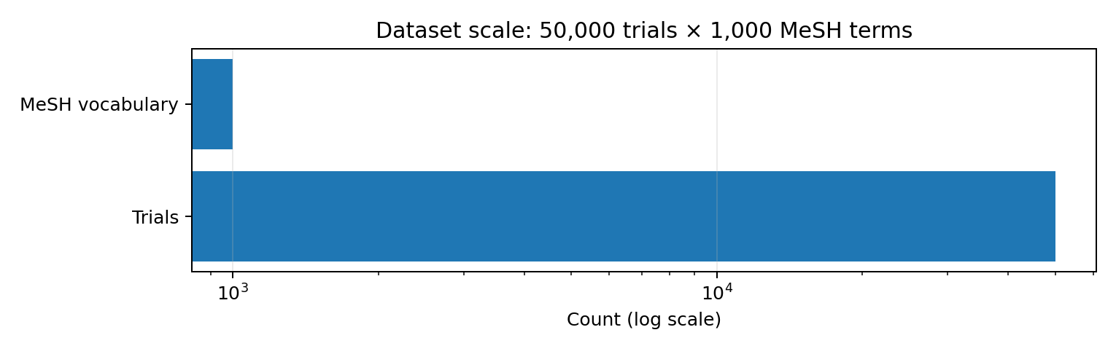
50,000 trial records × 1,000 MeSH concepts
02 · DATASET AND REPRESENTATION
Representation
Trials are documents; MeSH terms are items. A TF–IDF utility matrix encodes term importance per trial.
The source write-up reports 3.2% non-zero cells. A later demo run reported a different density; these run-specific values must not be merged.
UE24CS352A · CF MeSH keyword recommender · source-labelled results
3

Slide 4
From free text to a sparse utility matrix
03 · DATA PIPELINE
1 · Normalize concepts
2 · Extract mentions
3 · Weight terms
MeSH descriptors and entry-term synonyms map to canonical concepts.
A word-level Trie scans text with longest-match-first behavior.
Counts become TF–IDF values; absent terms have zero utility.
Uᵢⱼ = log₁₀(1 + countᵢⱼ) × log₁₀(N / dfᵢ)
The source excludes the ambiguous concept “Volition”. The 1,000-term vocabulary also limits the search space.
UE24CS352A · CF MeSH keyword recommender · source-labelled results
4

Slide 5
Predict a term from its neighbours
04 · MODEL
R̂ᵢⱼ = ReLU( Σf Wᵢf · Θᵢf · Rfⱼ + bᵢ )
Fixed neighbour weights
Learned parameters
Non-negative outputs
W is based on cosine similarity between term profiles; its diagonal is zero.
Θ and b are optimized with mini-batch gradient descent and L2 regularization.
ReLU constrains predictions to the non-negative TF–IDF range.
Evaluation masks 50% of each test trial’s non-zero terms and ranks candidate terms at K=3.
UE24CS352A · CF MeSH keyword recommender · source-labelled results
5

Slide 6
Evaluation must match the research question
05 · METRICS AND PROTOCOL
APTK (K=3)
MSE / MSER
Bootstrap CI
Measures top-three ranking precision against masked-out terms.
Measure reconstruction error on the TF–IDF utility scale.
Quantifies test-document sampling uncertainty for a particular run.
• Popularity recommends frequent absent terms; item-kNN uses cosine similarity between term profiles.
• A single random split does not establish robustness across alternative splits.
• Masked-term recovery is a proxy; it does not by itself establish better end-to-end trial retrieval.
UE24CS352A · CF MeSH keyword recommender · source-labelled results
6

Slide 7
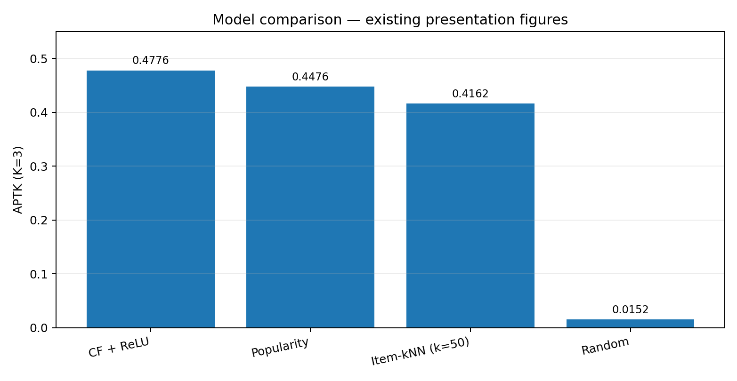
Model comparison: existing slide statistics
06 · PRESERVED BASELINE
Interpretation
CF + ReLU: 0.4776
Popularity: 0.4476
Item-kNN: 0.4162
Random: 0.0152
These are the figures in the existing CF keyword recommender presentation; they remain the reference baseline.
UE24CS352A · CF MeSH keyword recommender · source-labelled results
7

Slide 8
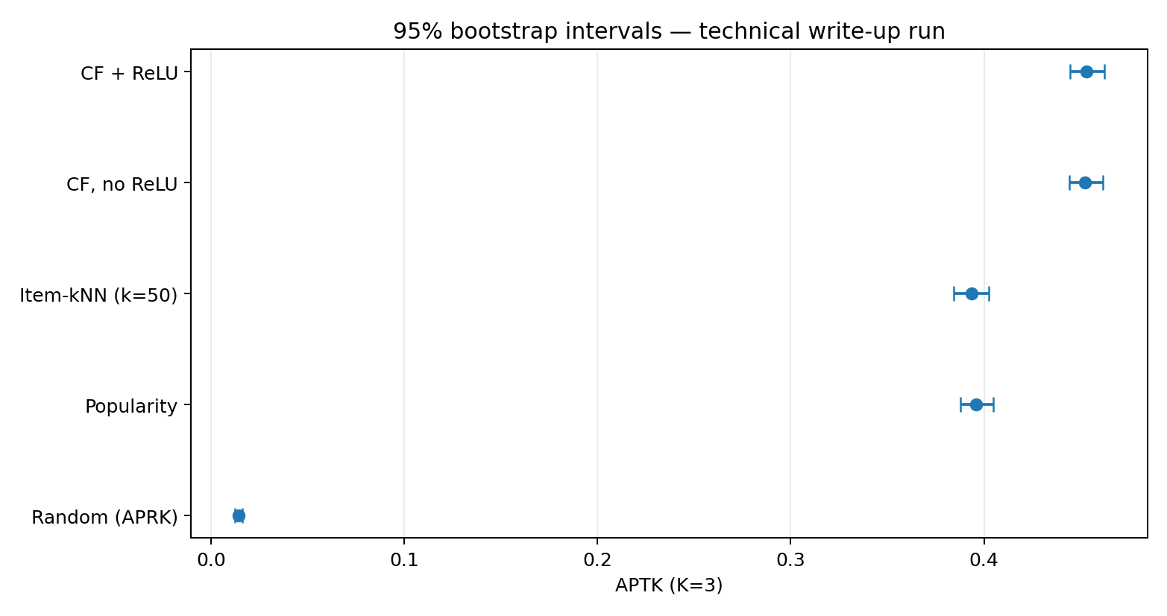
Uncertainty: technical write-up run
07 · SEPARATE REPORTED EXPERIMENT
Source values
CF + ReLU 0.4529 [0.4444, 0.4622]
Item-kNN 0.3938 [0.3844, 0.4026]
Popularity 0.3961 [0.3879, 0.4050]
Random 0.0143 [0.0123, 0.0162]
Do not attach these confidence intervals to the 0.4776 slide figures: they come from a different reported run.
UE24CS352A · CF MeSH keyword recommender · source-labelled results
8

Slide 9
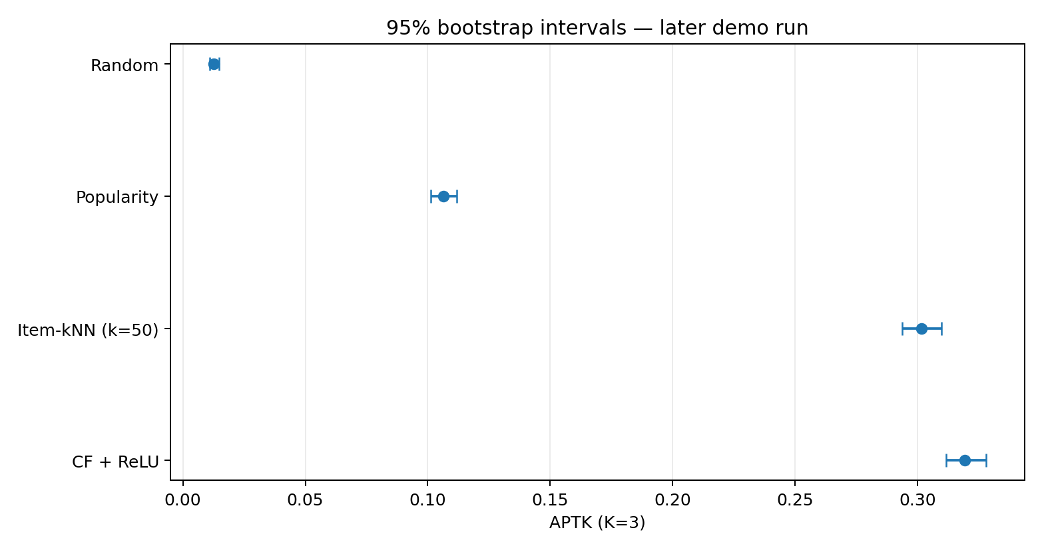
Later demo run: confidence intervals
08 · SEPARATE DEMO EXPERIMENT
Demo metrics
CF + ReLU 0.3193 [0.3116, 0.3279]
Item-kNN 0.3016 [0.2937, 0.3097]
Popularity 0.1064 [0.1013, 0.1118]
Random 0.0127 [0.0109, 0.0147]
Run configuration: 50,000 documents × 1,000 terms; APTK=0.3193 for CF+ReLU. Separate from the original slide benchmark.
UE24CS352A · CF MeSH keyword recommender · source-labelled results
9

Slide 10
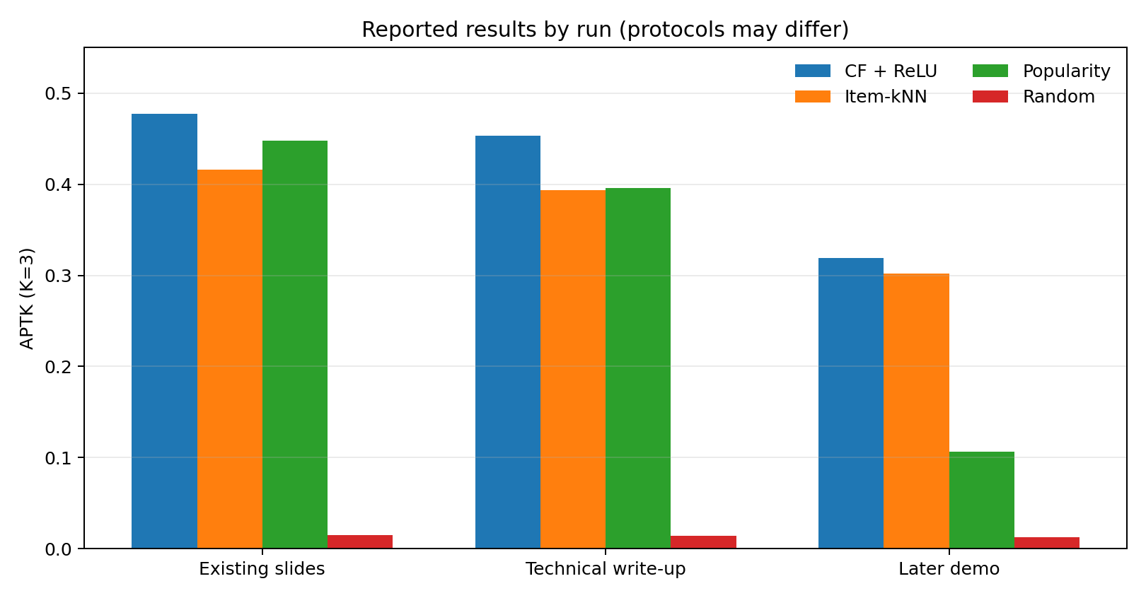
Reported scores vary across runs
09 · COMPARABILITY CAVEAT
Interpret cautiously
The source slide, technical write-up, and later demo report different APTK values. Vocabulary, split, masking, or configuration may differ; the files do not establish protocol equivalence.
This chart is descriptive, not a controlled comparison of model improvements.
UE24CS352A · CF MeSH keyword recommender · source-labelled results
10

Slide 11
A ranking score can still look generic
10 · QUALITATIVE LIMITATION
• Hand-written lung-cancer, hypertension and Alzheimer’s queries returned recurring broad terms.
• Examples included Therapeutics, Safety, Disease, Child and General Surgery.
• Neoplasms appeared in the Alzheimer’s example despite weak query-specific fit.
Candidate direction
A query-specific score can discount terms that receive high predictions for nearly every query. This is exploratory until evaluated quantitatively.
APTK rewards masked-term recovery; clinical usefulness requires a separate evaluation.
UE24CS352A · CF MeSH keyword recommender · source-labelled results
11

Slide 12
Hyperparameter tuning: current evidence
11 · DEVELOPMENT-STAGE WORK
Objective
What is known
What is not known
Select τ, k, λ and learning rate using development APTK; report complementary error metrics.
One later demo searched 15 configurations. The screenshot showed only the first two results.
No full tuning table is available in the supplied context; do not invent the remaining points or claim a winner.
Selection rule: fit on train → select on development → freeze configuration → evaluate held-out test once.
UE24CS352A · CF MeSH keyword recommender · source-labelled results
12

Slide 13
Next experiments that would strengthen the claim
12 · RESEARCH PLAN
• Rebuild the vocabulary and utility matrix for every cutoff; audit cache invalidation.
• Run the same split and masking protocol for every candidate model.
• Use development data for hyperparameter selection; keep test data untouched until the configuration is frozen.
• Evaluate query-specific ranking with the same held-out protocol.
• Measure retrieval quality with and without query expansion, not just masked-term precision.
UE24CS352A · CF MeSH keyword recommender · source-labelled results
13

Slide 14
Conclusion: a promising prototype, not yet validated retrieval
13 · TAKEAWAYS
• The existing slides report CF + ReLU as the top model at APTK 0.4776.
• The write-up and later demo contain distinct result sets and must remain separately labelled.
• Qualitative query checks expose a gap between numerical ranking quality and query-specific relevance.
• The next scientific step is a reproducible comparison and end-to-end retrieval evaluation.
No new improvement is claimed until comparable experiments establish it.
UE24CS352A · CF MeSH keyword recommender · source-labelled results
14

