Slide 1
Update on BRSKI-AE: Alternative Enrollment Protocols in BRSKI
draft-ietf-anima-brski-ae-02
https://datatracker.ietf.org/doc/html/draft-ietf-anima-brski-ae
Repo URL: https://github.com/anima-wg/anima-brski-ae
David von Oheimb (Ed.), Steffen Fries, Hendrik Brockhaus, Eliot Lear
IETF 114 – ANIMA Working Group

Slide 2
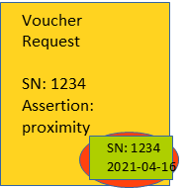
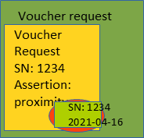

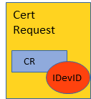

BRSKI-AE: abstract protocol overview
Pledge (caller)
IDevID
Manufacturer trust anchor
Domain Registrar, RA / LRA / enrollment proxy
LDevID (Reg)
IDevID Cert CA
S/N Pledge
PKI RA
PKI RA credentials
PKI CA
PKI CA credentials
MASA
MASA credentials
S/N verification
Verification of pledge signature and IDevID (pledge)
TLS with provisional accept of registrar certificate
Initial steps: Voucher request/response handling as in BRSKI
S/N verification
Verification „reg-cert“ in prior-signed-voucher
Issues voucher with assertion proximity
Voucher-request {S/N, reg-cert, …}
Voucher-request {prior-signed-voucher, …}
Voucher {reg-cert, assertion, …}
Voucher {reg-cert, assertion, …}
Accept registrar certificate
Voucher-status
Device audit log
Adapted step: Application of alternative enrollment protocol (e.g., Lightweight CMP)
Request CA certificates (opt.)
CA certificates (opt.)
Request certificate attributes (opt.)
Certificate attributes (opt.)
Certification request (self-contained)
Full / partial / no processing of request
Any remaining verification of request and authorization
Certification response (LDevID cert)
Verification of LDevID cert
Enrollment-status
Notes:
<number>

Slide 3
BRSKI-AE status: changes since IETF 113
From draft async-enroll-05 to draft ae-01:
Renamed the repo and files from anima-brski-async-enroll to anima-brski-ae
Added graphics for abstract protocol overview as suggested by Toerless Eckert
Balanced (sub-)sections and their headers
Added details on Lightweight CMP instance, now called BRSKI-CMP
From draft ae-01 to draft ae-02:
Architecture: clarified registrar role including RA/LRA/enrollment proxy
CMP: added reference to CoAP Transport for CMPv2 and Constrained BRSKI
PoC implementation done
Notes:
<number>

Slide 4
BRSKI-AE status: open points
Possibly add detail on applying EST with /fullCMC (→ Eliot Lear) ?
Document shepherd review (→ Toerless Eckert) ?
WG review?
Ready for WGLC?
Notes:
<number>

